Slide 1
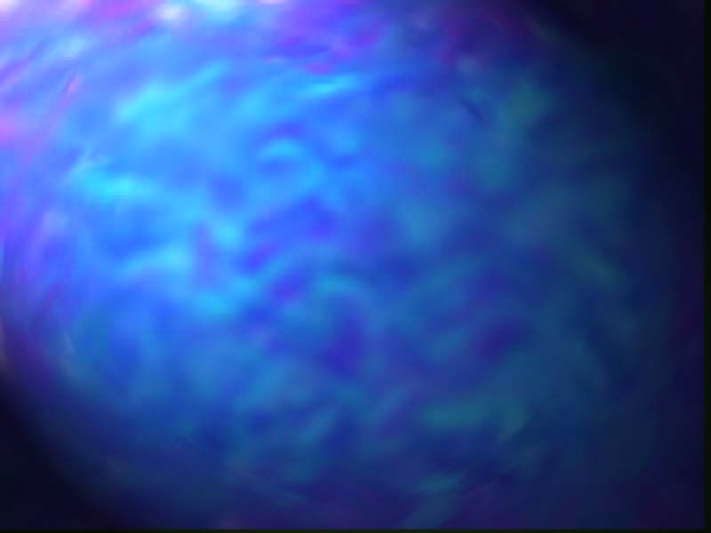
Evolutionary Art
Some slides are imported from
“Getting creative with evolution” from
P. Bentley, University College London
http://evonet.dcs.napier.ac.uk/summerschool2002/tutorials.html

Slide 2
What is Evolutionary Art?
“Imagery produced by a process of simulated evolution inside a computer, guided by an artist's aesthetic fitness selection”
Steven Rooke at http://www.azstarnet.com/~srooke/glossary.html
“… allows the artists to generate complex computer artwork without them needing to delve into the actual programming used”
Andrew Rowbottom at http://www.netlink.co.uk/~snaffle/form/evolutio.html
“… more akin to genetic engineering than to painting”
Jeffrey Ventrella at http://www.ventrella.com/Art/Tweaks/tweaks.html

Slide 3
What is Evolutionary Art?
Technically, it is creating pieces of art
through human-computer interaction, where
compuer: runs evolutionary algorithm
human: applies subjective/aesthetic selection

Slide 4
The Roles in Evolutionary Art
Role of compuer:
offers choices, creates diversity
Role of human:
makes choices, reduces diversity
Selection (aesthetic, subjective) steers generation process towards implicit user preferences
Q: who is creative here?

Slide 5
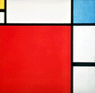
Example: Mondriaan evolver
(Craenen, Eiben, van Hemert)
Application evolving images in the style of Piet Mondriaan
Programming assignment of my univ. course on evolutionary computing
1999 Dutch-Belgium AI Conference paper
On-line “toy” at:
http://www.cs.vu.nl/ci/Mondriaan
or
http://www.xs4all.nl/~bcraenen/EArt/demo.html
Composition with Red,
Blue, and Yellow, 1930

Slide 6
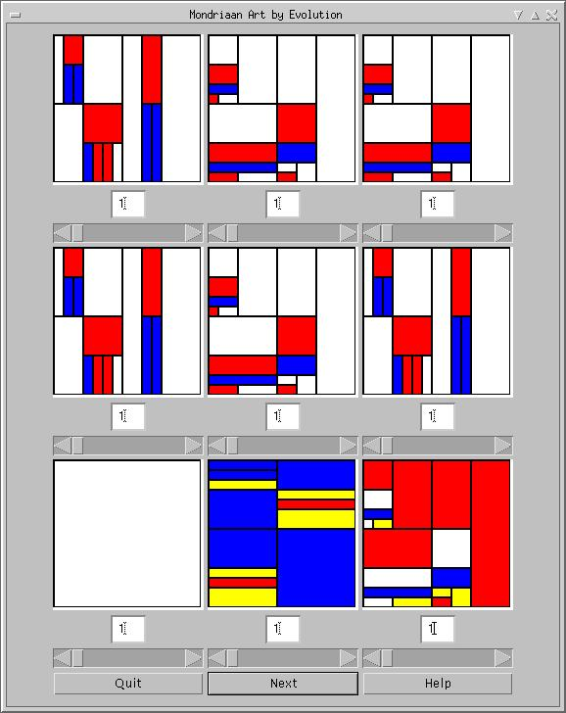
Mondriaan evolver
GUI shows population of 9 pictures
User gives grades
  (thus defines fitness values)
Computer performs one evolutionary cycle, i.e.
  selection, based on this fitness (thus creates mating pool)
  crossover & mutation
  (thus creates new population)
Repeat
See demo here

Slide 7
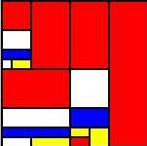
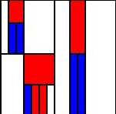
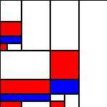
The Evolutionary Art Cycle 1
Population
Parent pool
Parent selection
aesthetic selection
subjective selection
Recombination,
mutation

Slide 8
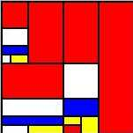
Representation in Evolutionary Art
User selection acts
on this level
Phenotype
level
Decoding
Genotype
level
Genetic operators act on this level
AGCTCTTA

Slide 9
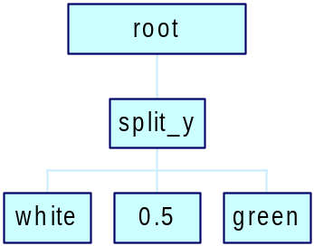
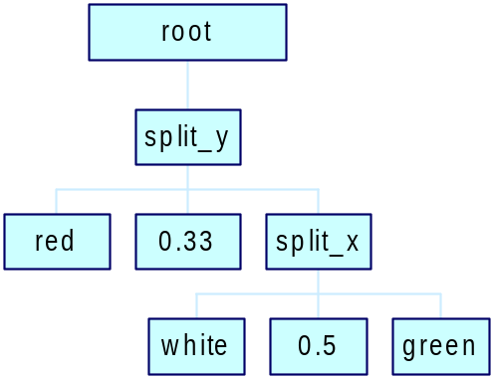
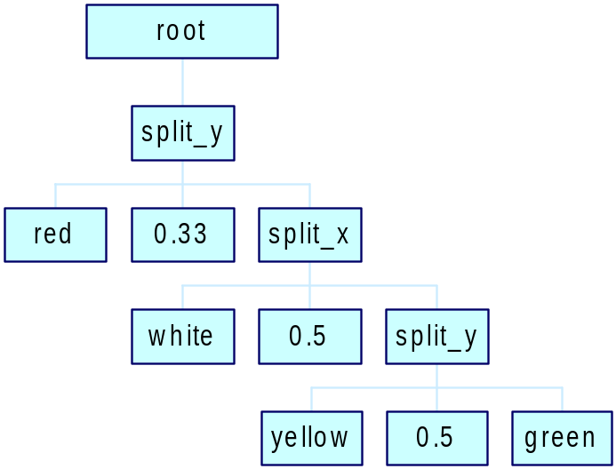
Mondriaan representation

Slide 10
The Evolutionary Art Cycle 2
Parent pool
phenotypes
Population
phenotypes
Parent
selection
Encoding
Decoding
AGCTCTTA
Recomb.
mutation
AGCTCTTA
Population
genotypes
CCTTTGGG
CCTCACAA
Parent pool
genotypes
TGATCGTA
CCTTTGAA
TGATCGTA
AGAGACTA
AGAGACTA
GTGACTCC
AGTACTTA
GTGACTCC

Slide 11
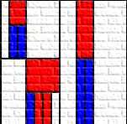
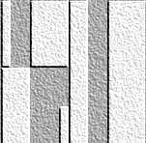
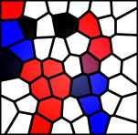
Effects
& hand-made mutations
1. Chromosomes consist of two parts: image + effect
they evolve together
AGCTCT+0000
2. User can try effects with preview and select one (some)
AGCTCT+1000
AGCTCT+0100
AGCTCT+0001
Chosen effects are coded onto the chromosomes (Lamarck)

Slide 12
Points of attention
Representation
  phenotypes shluld be appealing (“fine art”)
  genotypes should be easy to manipulate (operators)
Coding-decoding:
  should be fast
  Lamarckian evolution in case of user-defined effects
Operators
  too disruptive: user sees no link between generations
  too smooth (small changes): evolution is too slow
Selection
  user grades are continuous (fitness values): hard to grade
  user grades are binary (die/multiply): not enough differentiation

Slide 13
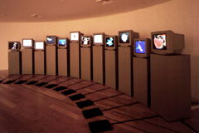
Karl Sims, Galápagos
Galápagos is an interactive media installation that allows visitors to "evolve" 3D animated forms
http://www.genarts.com/galapagos/index.html
Exhibited at the:
  ICC in Tokyo from 1997 to 2000,
  Interactive Computer Art,
  Lincoln, Mass.
  Boston Cyberarts Festival 1999

Slide 14





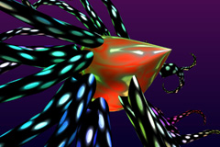
Karl Sims, Galápagos
Box insect
Beaded arms
Multipus-green
Jellyfish
Bfly larva
Multipus-purple

Slide 15
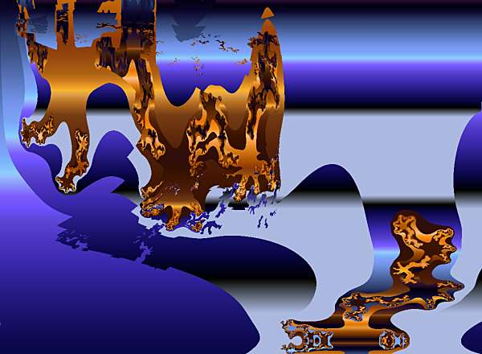
Steven Rooke, Darwin meets Dali

Slide 16
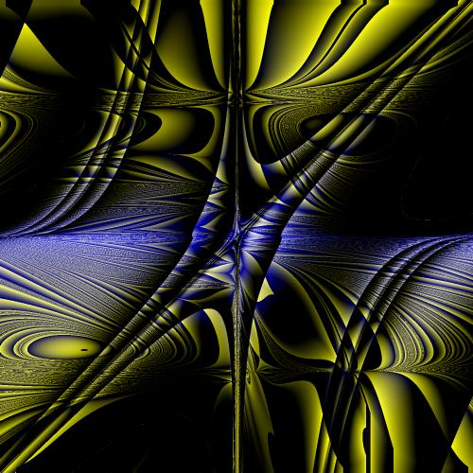
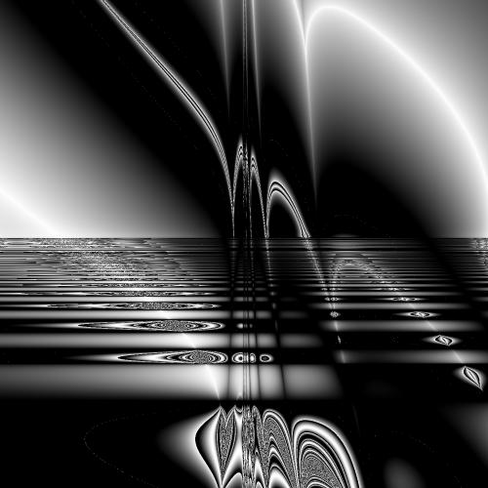
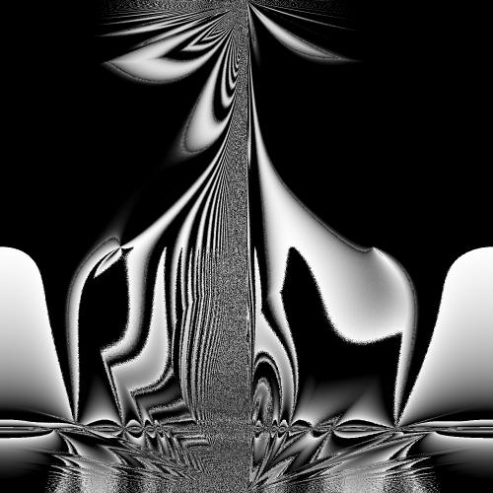
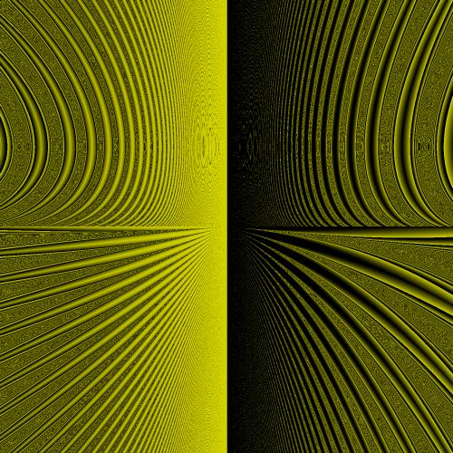
Kleiweg, Evolutionary Art in PostScript
%!PS-Adobe-3.0 EPSF-3.0
%%BoundingBox: 45 170 545 670
/X 0 def
/Y 0 def
/pixcol { } def
/PI 3.14159265358979323846 def
/INDEX {
counttomark 1 sub
exch cvi abs exch
mod
index
} bind def
/ROLL {
exch cvi abs
counttomark 2 sub
mod 1 add exch
cvi
roll
} bind def
/DIV {
dup abs .0001 lt {
0 lt {
-.0001
} {
.0001
} ifelse
} if
div

Slide 17
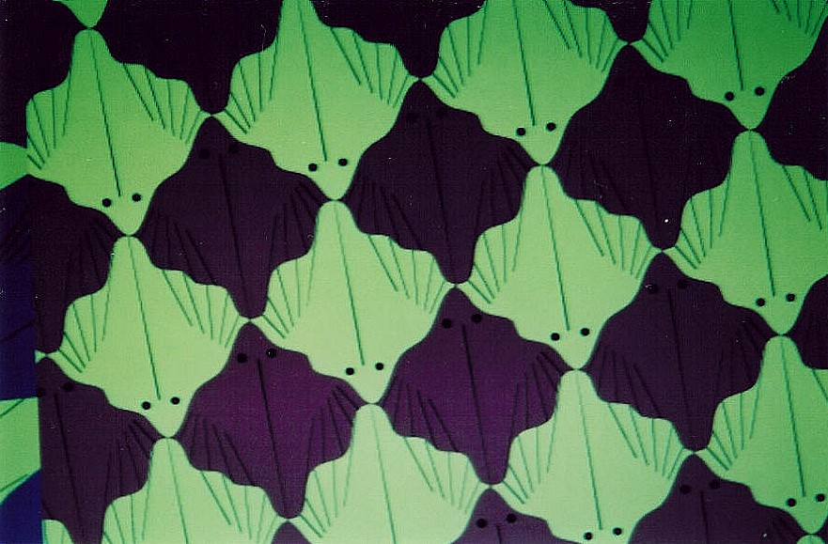
Eiben et al., Escher evolver
Exhibited for 6 months in City Museum The Hague
Flat screens on walls show computer genarted pictures
Visitors vote on separate images (define fitness values)
Computer performs one evolutionary cycle every 30 minutes
Re-design: visitors choose between two images (split screen)
Flatfish

Slide 18
How is this creativity achieved?
When evolution is told to build solutions from components, it becomes creative.
Only those approaches that use component-based representations provide sufficient freedom.
Evolution now explores new ways of putting components together to construct innovative solutions.

Slide 19
Component-based representations
Instead of optimising selected elements of a given solution, we allow evolution to build new solutions from scratch, using component-based representations

Slide 20
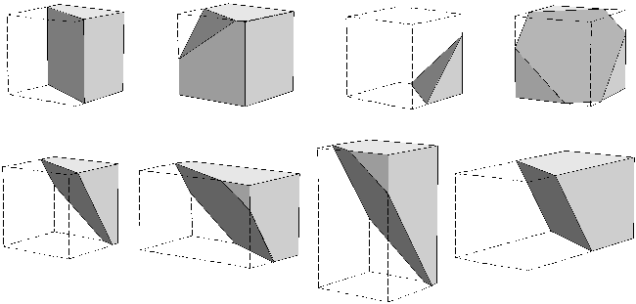
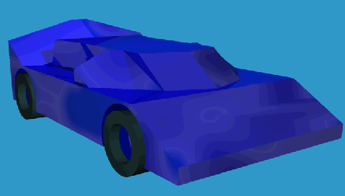
Component-based representations
P. Bentley used primitive shapes to construct novel designs

Slide 21
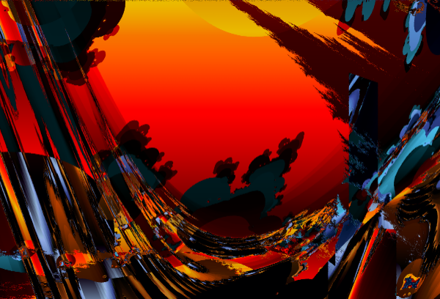
Component-based representations
sin() pdiv() pminus() mandelstalk() pqj4da2013() pln() M_PI 0.022307 x y
Steven Rooke uses GP functions and terminals

Slide 22
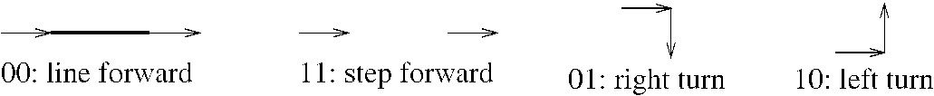
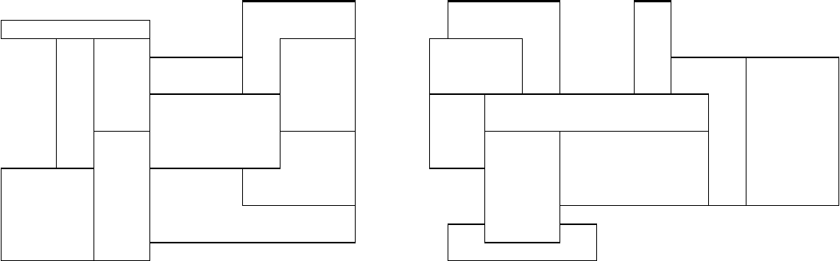
Component-based representations
John Gero used ‘wall fragments’ to generate house floor plans

Slide 23
Creative Computers -
What does this mean?
We are now beginning to understand the benefits and pitfalls of creative evolutionary computation.
Evolution can find solutions that disregard our conventions and theories.
Efficient new designs have been evolved, and unusual art.

Slide 24
Creative Computers -
What does this mean?
Some solutions do perform better, but their functioning is bizarre and difficult to understand (circuits, neural networks, computer programs).
Principle extraction (reverse engineering) is one way of overcoming the fears.
Rather than use directly the wacky evolved designs, we can learn new design techniques and then apply them ourselves.

Slide 25
Creative Computers -
What does this mean?
Legal issues arise when computers are used as composition machines.
For instance, the (British) law only recognises people as capable of music composition.
When using a computer to evolve novel music, someone must be nominated to be the composer…
Listen to sample from P. Bentley

Slide 26
Conclusions
Creative computers allow more innovative ideas to be explored in a shorter time.
Evolution is enabling our technology and arts to develop in surprising and exciting new ways.

Slide 27
Some useful Web links
Andrew Rowbottom, Organic, Genetic, and Evolutionary Art (incl. large software overview) http://snaffle.users.netlink.co.uk/form/evolutio.html
Craig Reynolds, Evolutionary Computation and its application to art and design
http://www.red3d.com/cwr/evolve.html
Matthew Lewis, Visual Aesthetic Evolutionary Design Links http://www.accad.ohio-state.edu/~mlewis/aed.html
Steven Rooke, Evolutionary Art, Glossary of Terms: http://www.azstarnet.com/~srooke/glossary.html
Karl Sims, Homepage at GenArts, Inc.,
http://www.genarts.com/karl/
Linda Moss, Evolutionary Graphics
http://www.marlboro.edu/~lmoss/planhome/index.html

