Slide 2
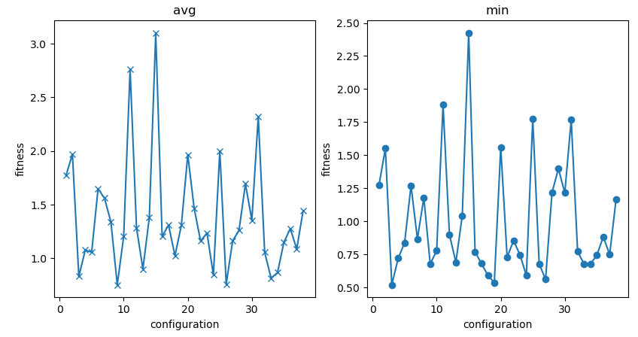
Parameter Tuning Round 2
3
7
2
3
5
6
7
1
2
4
5
6
1
4
1
 | n=200, mate=cxOrdered, cxpb=0.8, tournsize=10, mutpb=0.1, indpb=0.075
 | n=150, mate=cxOrdered, cxpb=1.0, tournsize=15, mutpb=0.1, indpb=0.03
 | n=150, mate=cxOrdered, cxpb=0.85, tournsize=10, mutpb=0.2, indpb=0.09
 | n=175, mate=cxOrdered, cxpb=0.9, tournsize=20, mutpb=0.2, indpb=0.045
 | n=125, mate=cxOrdered, cxpb=0.8, tournsize=15, mutpb=0.2, indpb=0.075
 | n=200, mate=cxOrdered, cxpb=0.95, tournsize=20, mutpb=0.175, indpb=0.06
 | n=175, mate=cxOrdered, cxpb=0.9, tournsize=25, mutpb=0.175, indpb=0.075
2
3
4
5
6
7

Slide 3
Cúal es la mejor configuración?
Friedman’s test:
P-value: 0.00081 < 0.05
Nemenyi´s post-hoc test:
Critical Difference:
N: 25 pruebas; k: 7 configuraciones
CD= 2.949*sqrt(7(7+1)/6*25)
CD=1.802

Slide 4
Nemenyi’s Comparación
 | Conf1 | Conf7 | Conf3 | Conf5 | Conf6 | Conf4 | Conf2
Conf1 | 0 | 0.08 | 0.16 | 0.28 | 1 | 1.88 | 1.92
Conf7 | -0.08 | 0 | 0.08 | 0.2 | 0.92 | 1.8 | 1.84
Conf3 | -0.16 | -0.08 | 0 | 0.12 | 0.84 | 1.72 | 1.76
Conf5 | -0.28 | -0.2 | -0.12 | 0 | 0.72 | 1.6 | 1.64
Conf6 | -1 | -0.92 | -0.84 | -0.72 | 0 | 0.88 | 0.92
Conf4 | -1.88 | -1.8 | -1.72 | -1.6 | -0.88 | 0 | 0.04
Conf2 | -1.92 | -1.84 | -1.76 | -1.64 | -0.92 | -0.04 | 0
 | Conf1 | Conf7 | Conf3 | Conf5 | Conf6 | Conf4 | Conf2
Conf1 | 0 | 0 | 0 | 0 | 0 | 1 | 1
Conf7 | 0 | 0 | 0 | 0 | 0 | 0 | 1
Conf3 | 0 | 0 | 0 | 0 | 0 | 0 | 0
Conf5 | 0 | 0 | 0 | 0 | 0 | 0 | 0
Conf6 | 0 | 0 | 0 | 0 | 0 | 0 | 0
Conf4 | 0 | 0 | 0 | 0 | 0 | 0 | 0
Conf2 | 0 | 0 | 0 | 0 | 0 | 0 | 0
Table 1. Rank Conf j – Rank Conf i
Table 2. (Rank Conf j – Rank Conf i) ≥ CD

