Slide 1

Producing effective figures

Slide 2
Figures can make or break a study.

Slide 3
Simple guidelines can help make great figures.

Slide 4
Identify your message.

Slide 5
Declutter your figures.

Slide 6
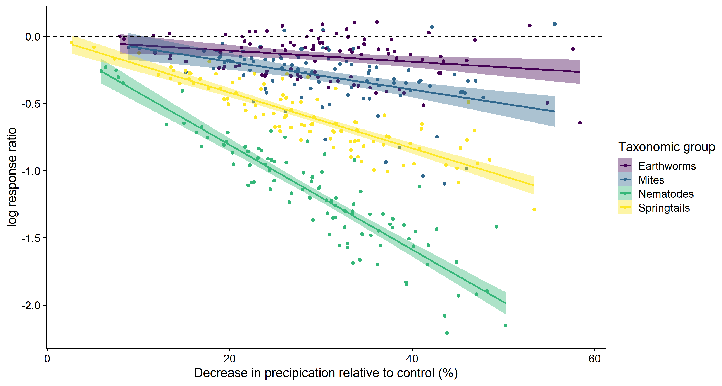
Declutter your figures.

Slide 7
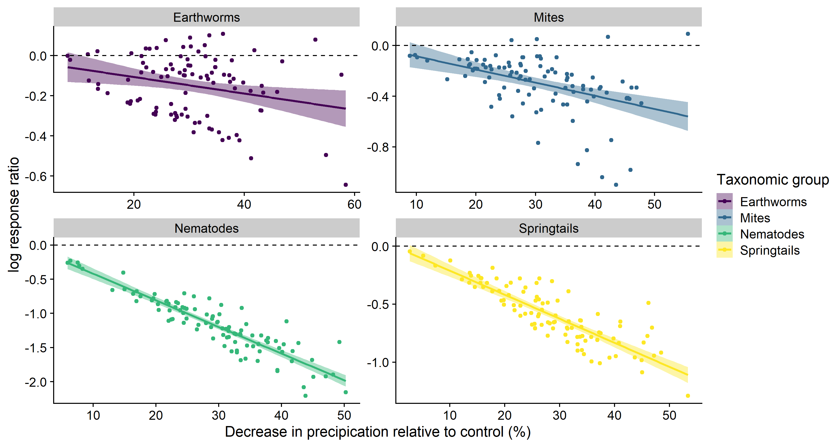
Declutter your figures.

Slide 8
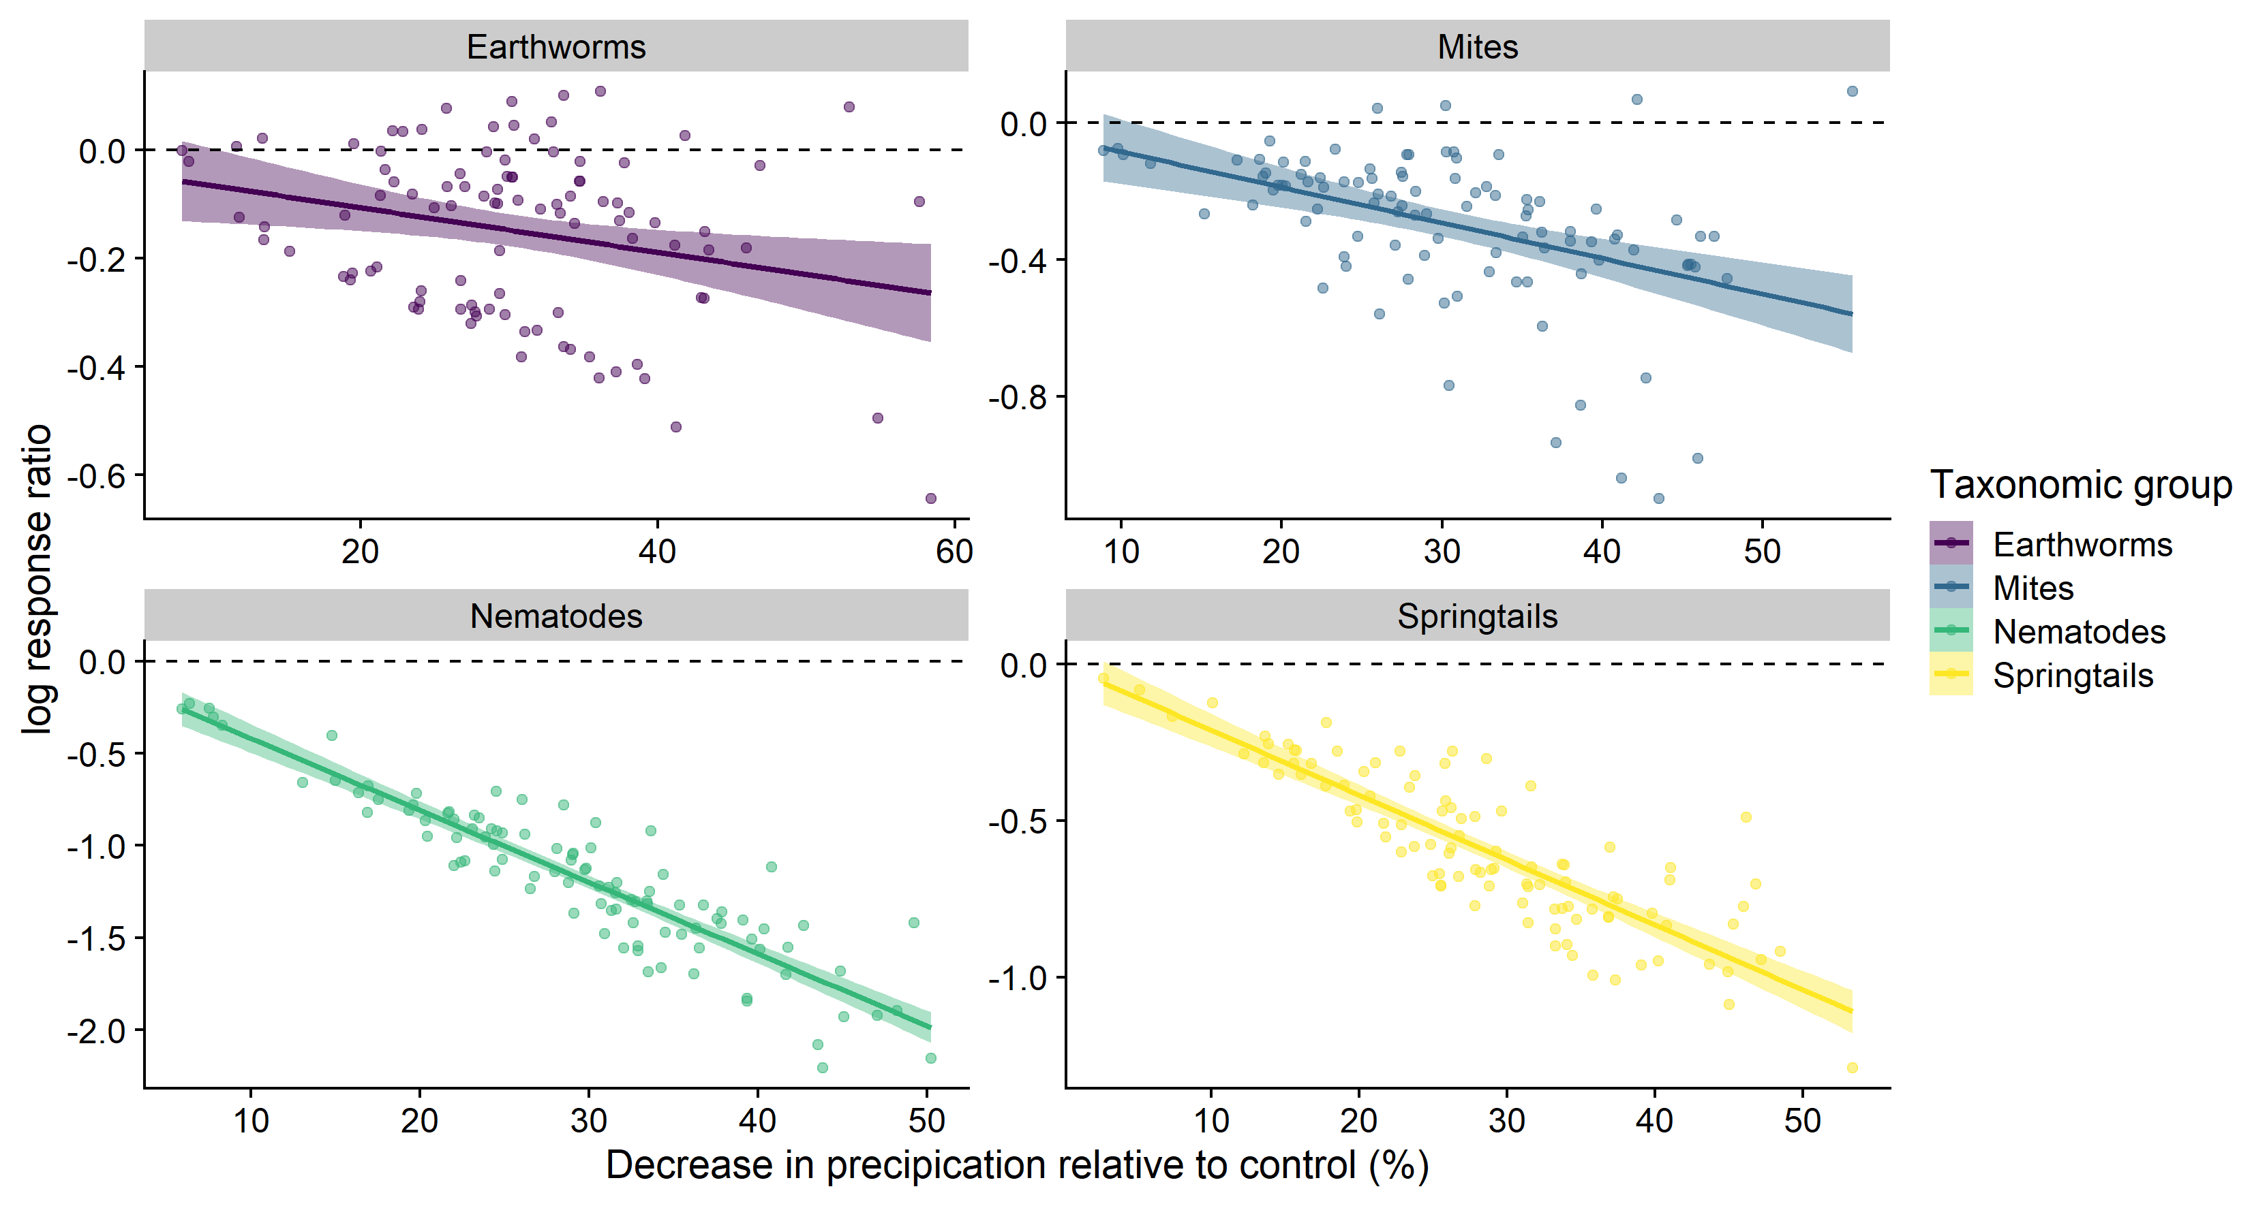
Declutter your figures.

Slide 9
Use colour to your advantage.

Slide 10
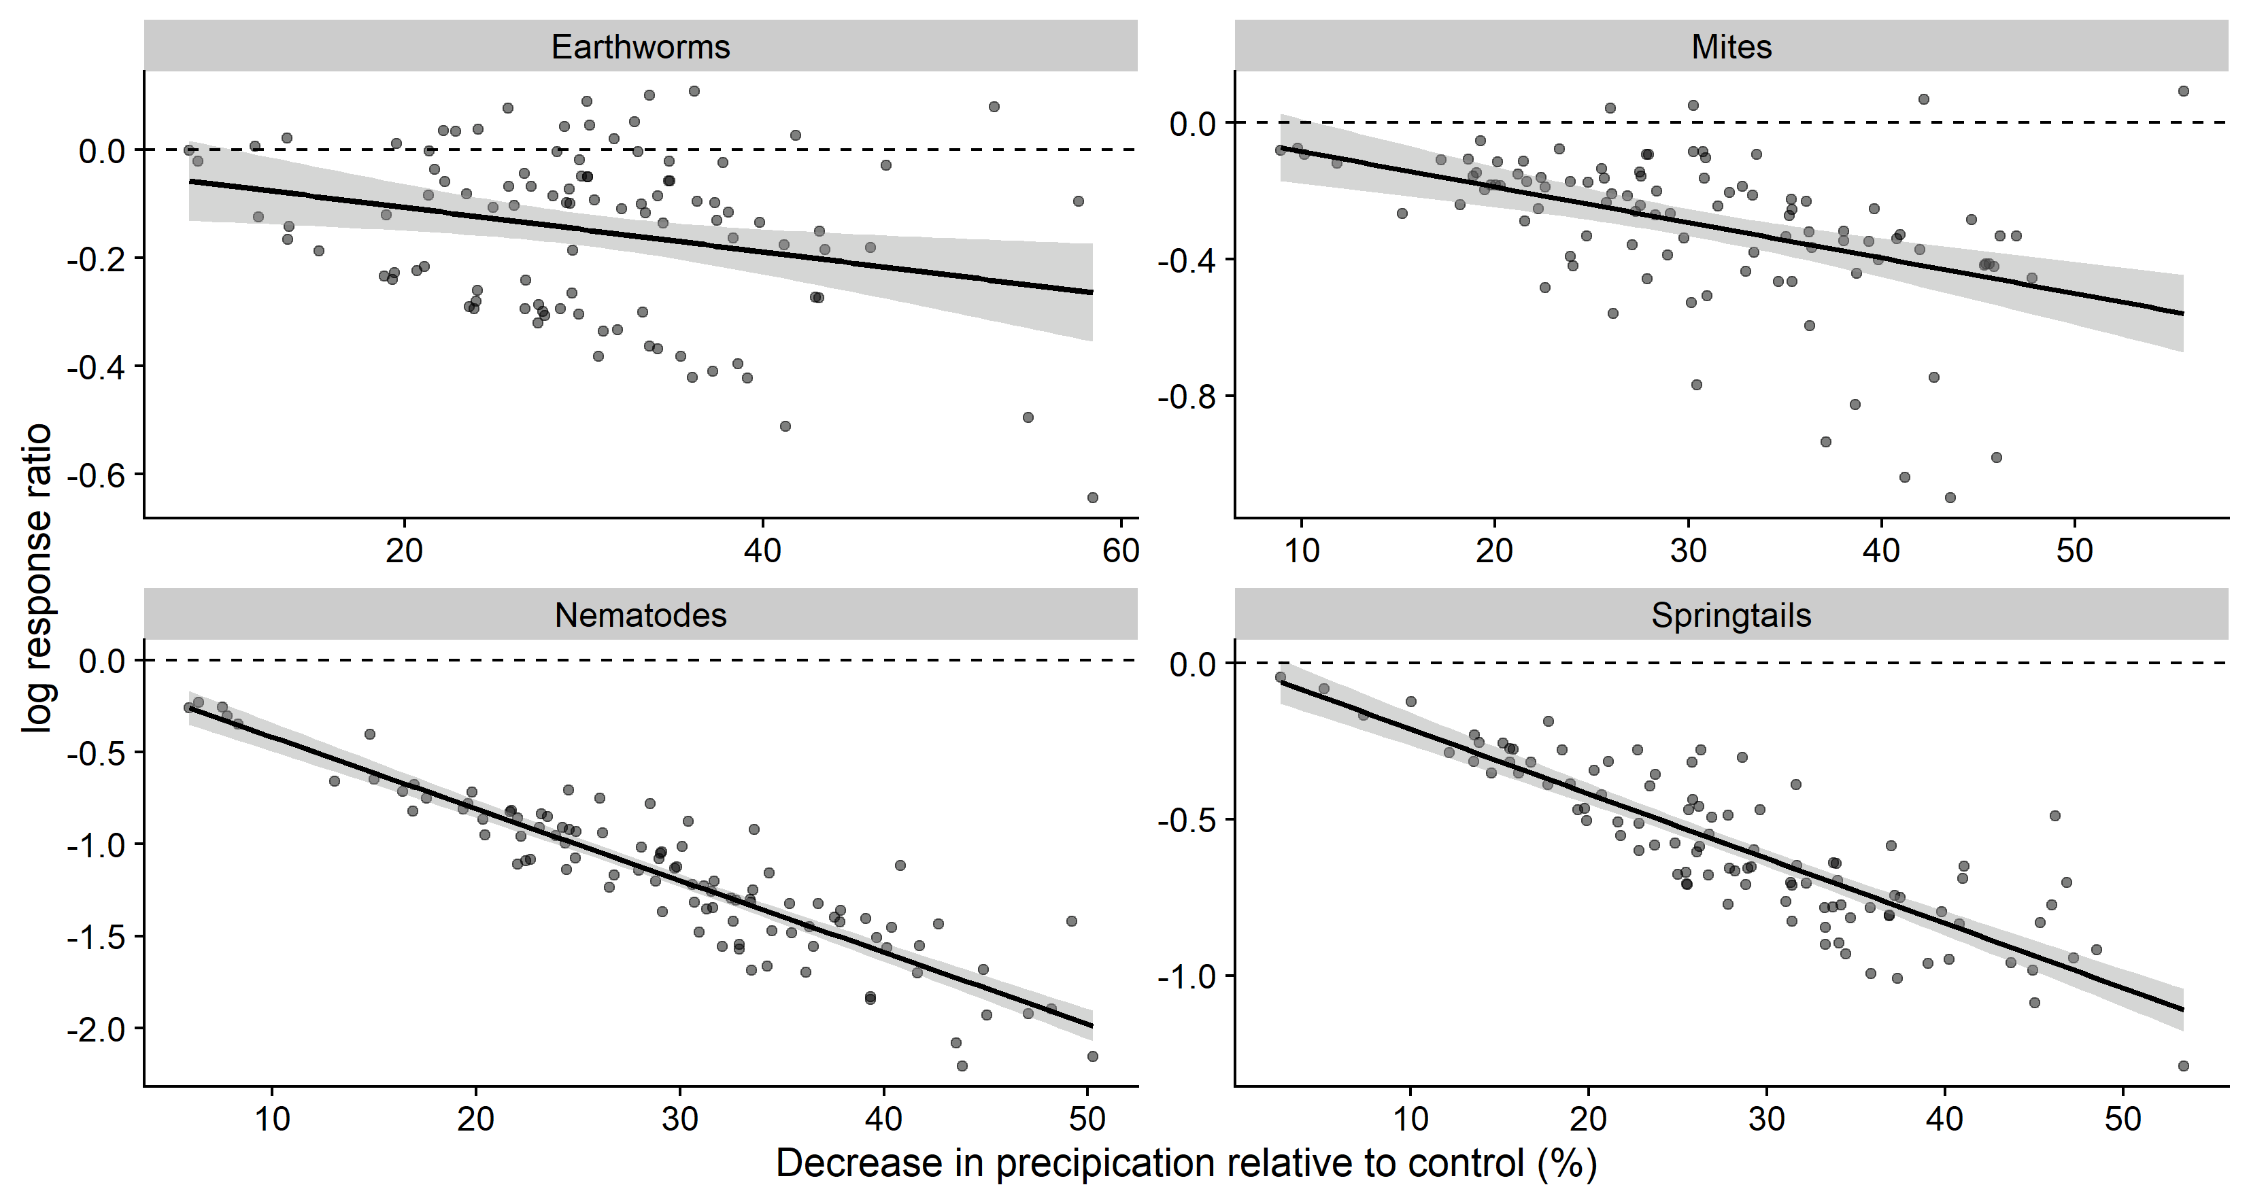
Use colour to your advantage.

Slide 11
Use colour to your advantage.

Slide 12
A brief aside.

Slide 13
Never, ever, use pie charts.

Slide 14
Adapt your figure to the medium.

Slide 15
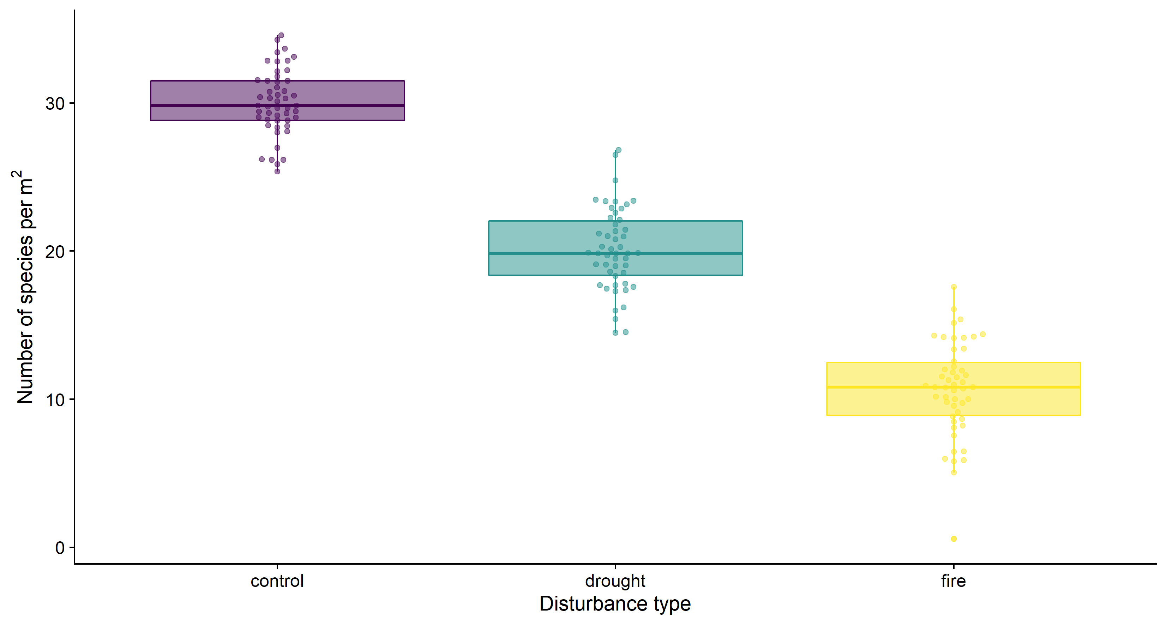
Adapt your figure to the medium.

Slide 16
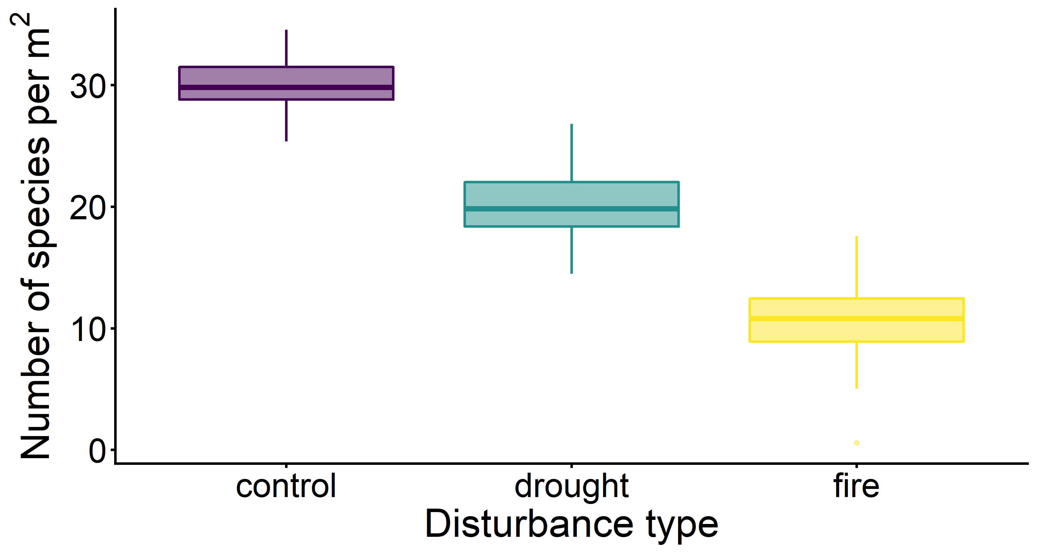
Adapt your figure to the medium.

Slide 17
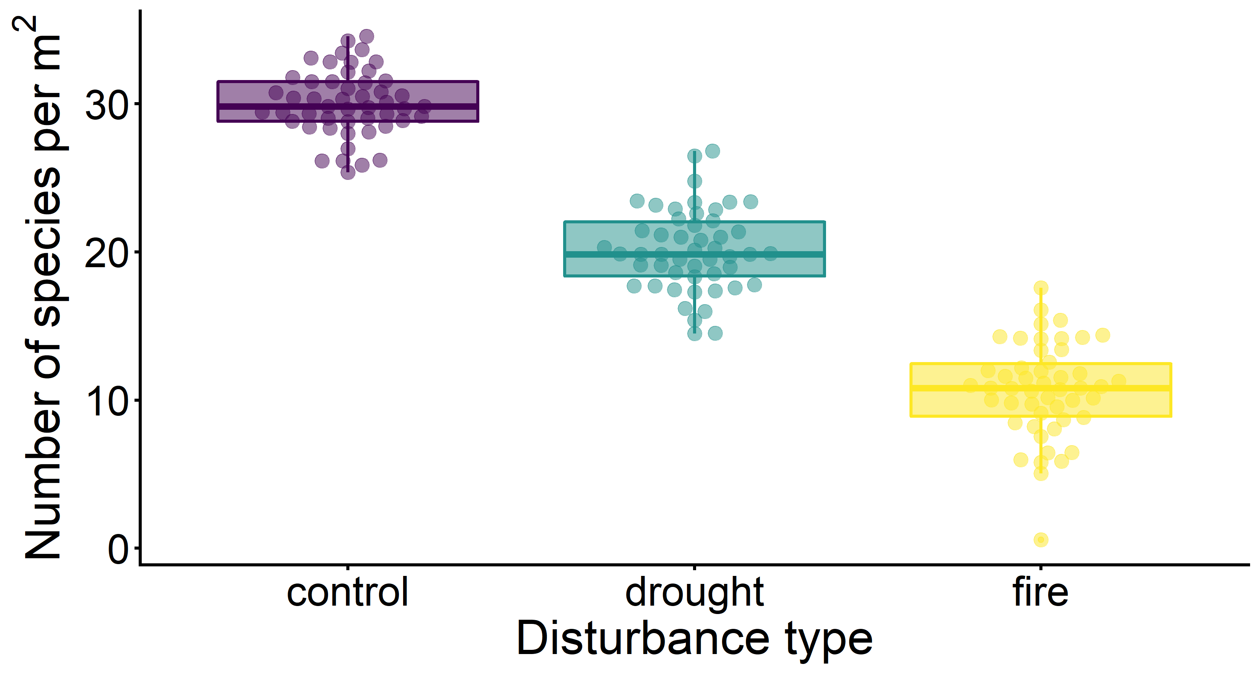
Adapt your figure to the medium.

Slide 18
Captions should make figures understandable in isolation.

Slide 19
Captions should make figures understandable in isolation.

