Slide 1
Determination of α_{s}
from Event Shapes
14th November 2025

Slide 2
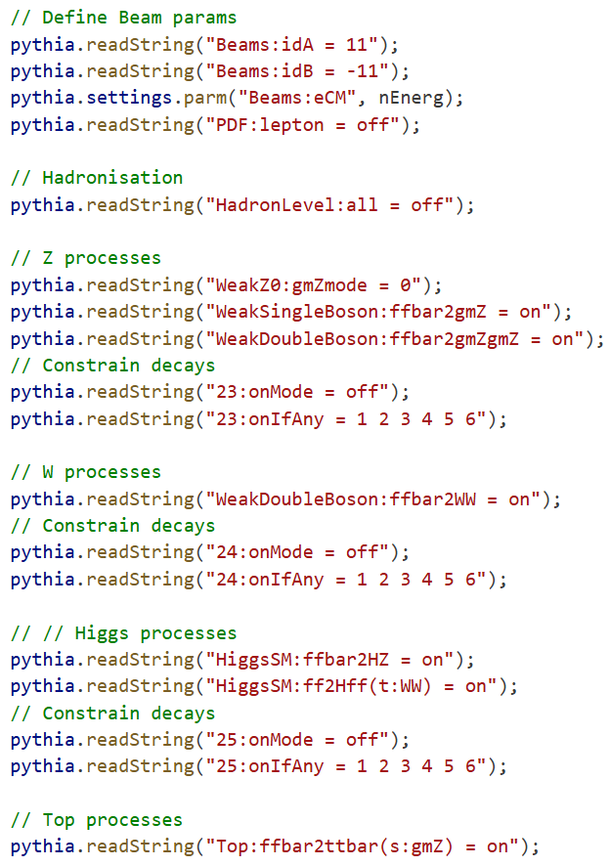
Overview
Objective is to extract α_{s} at FCC-ee energies: 91.2, 160, 240, 365 GeV
For validation with LEP data: Simulated 5 million samples at each energy without ISR with hadronisation
For α_{s} extraction: Simulated 1 million samples at each energy without ISR without hadronisation
Only ee → γZ channel has been selected (code 221) for these studies
Differential distributions of (1-T) and C are compared to perturbative predictions at NNLO using the MINOS fitting routine in ROOT
Values of α_{s} extracted at each energy are averaged for a final value
Results are compared with previous values obtained from ALEPH and L3 along with the 3-loop running prediction
In this presentation, we briefly go through the implemented workflow

Slide 3
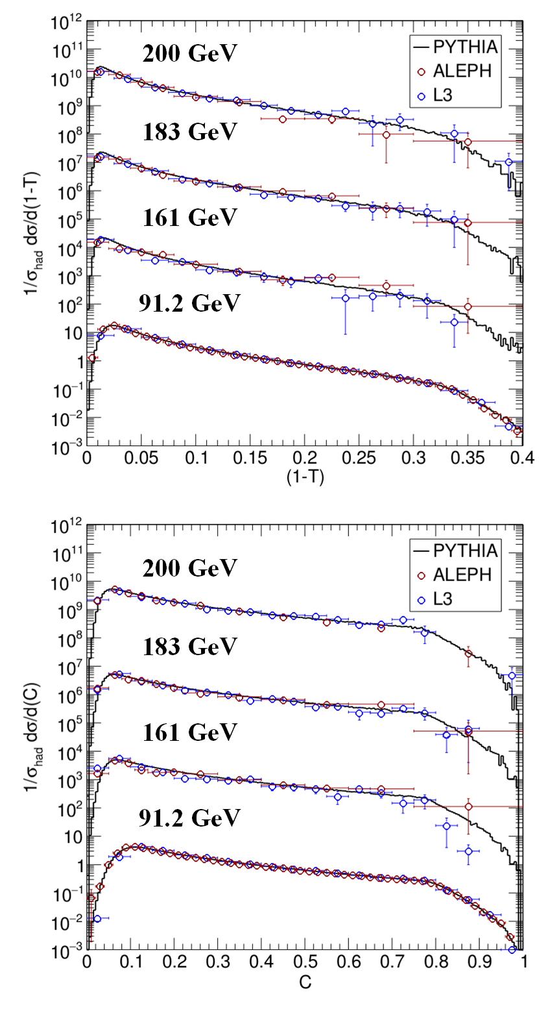
Validation with LEP data (5M samples with hadronisation)

Slide 4
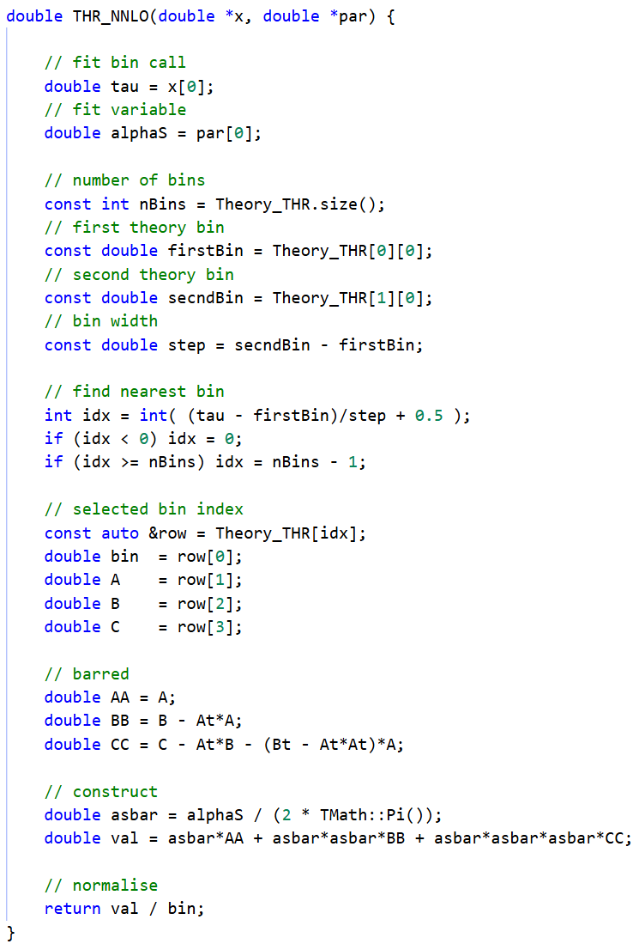
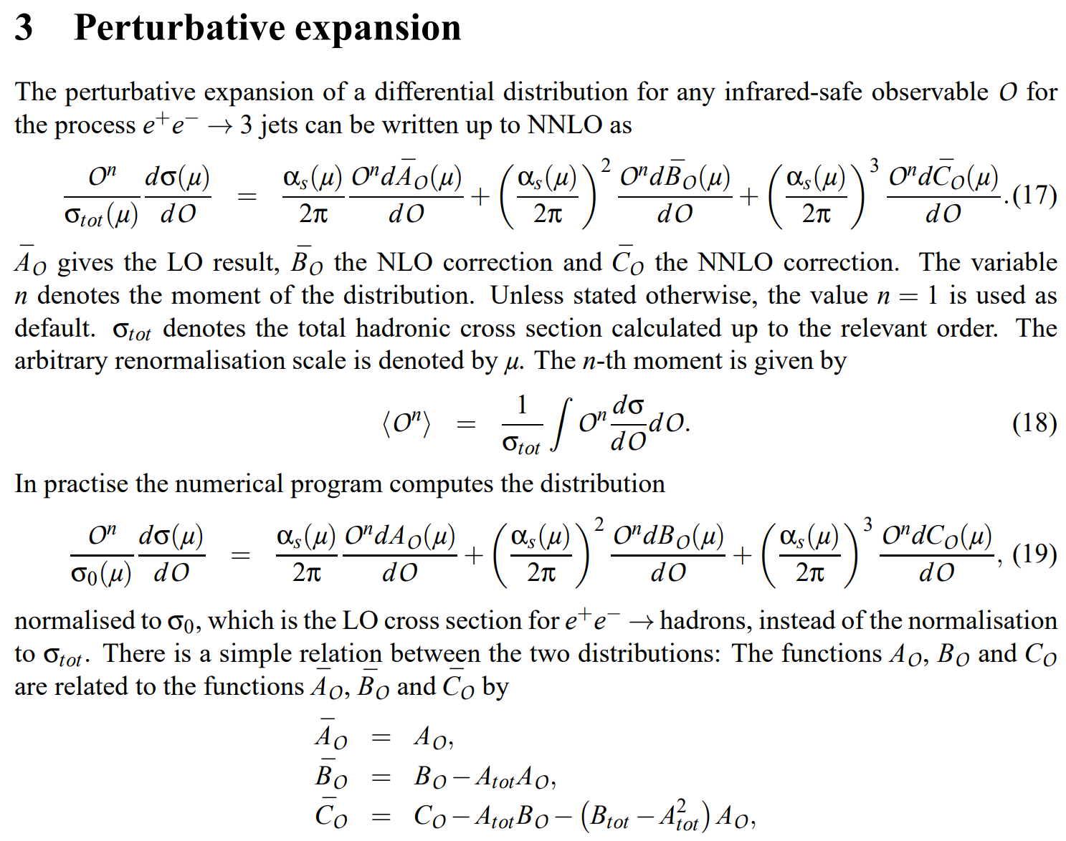
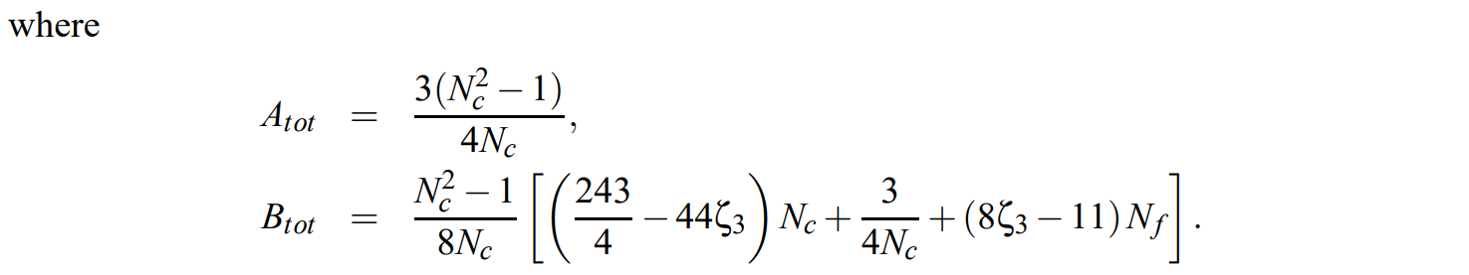
Theory functions
Theory function for (1–T) and C-parameter
Perturbative expression with unbarred coefficients
= divide by bin width

Slide 5
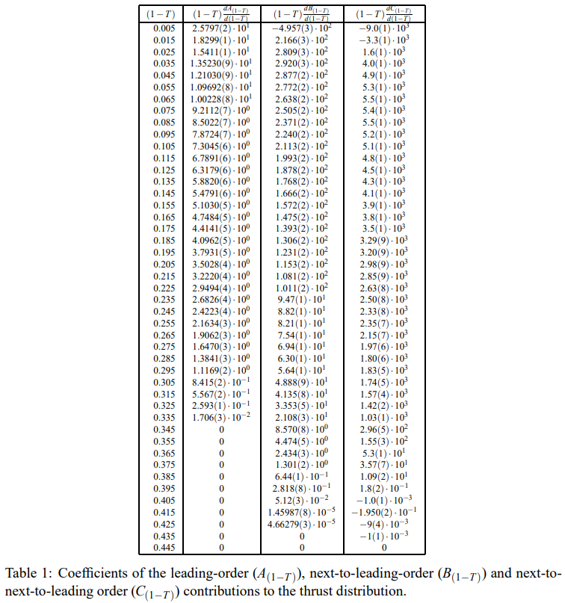
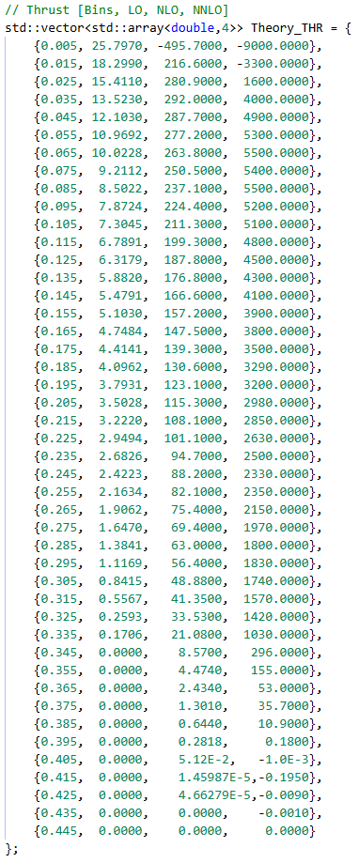
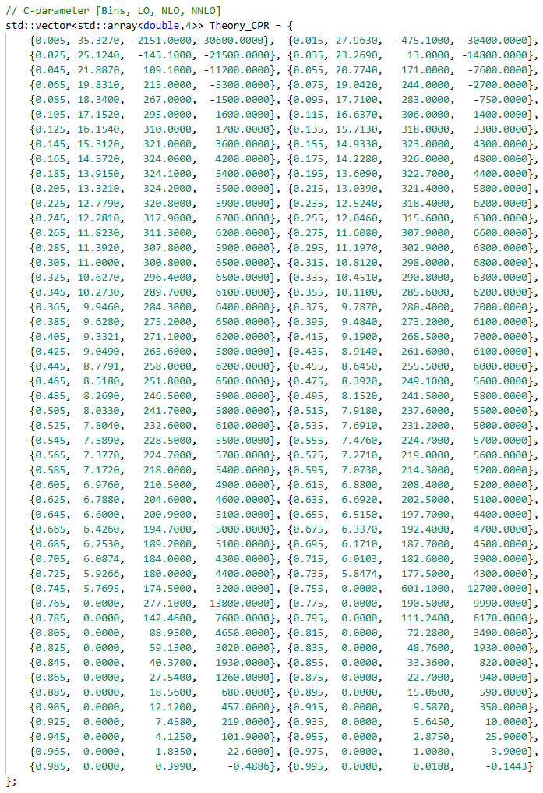
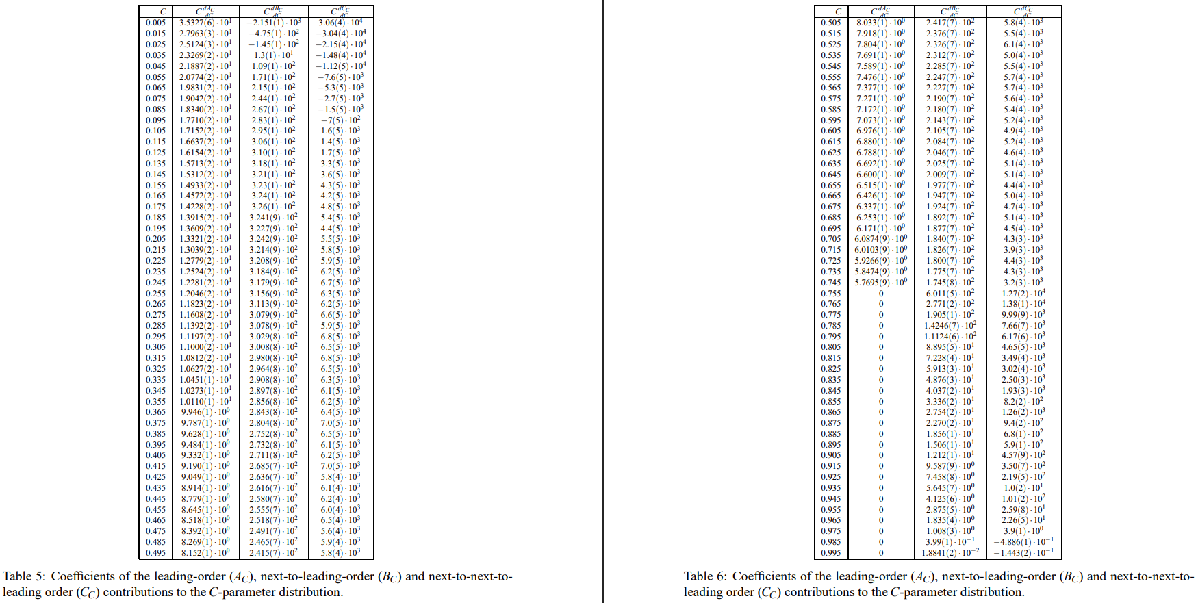
Theory coefficients
C++ structure for coefficients of Thrust and C-parameter
Unbarred coefficients
from Weinzierl*
* S. Weinzierl, Event shapes and jet rates in electron-positron annihilation at NNLO, Journal of High Energy Physics 2009, 041–041 (2009)

Slide 6
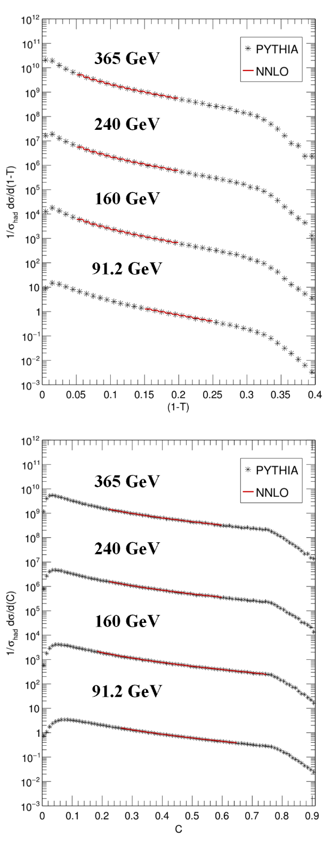
TF1 fits in ROOT
ALEPH fit ranges were used as baseline then tweaked

Slide 7
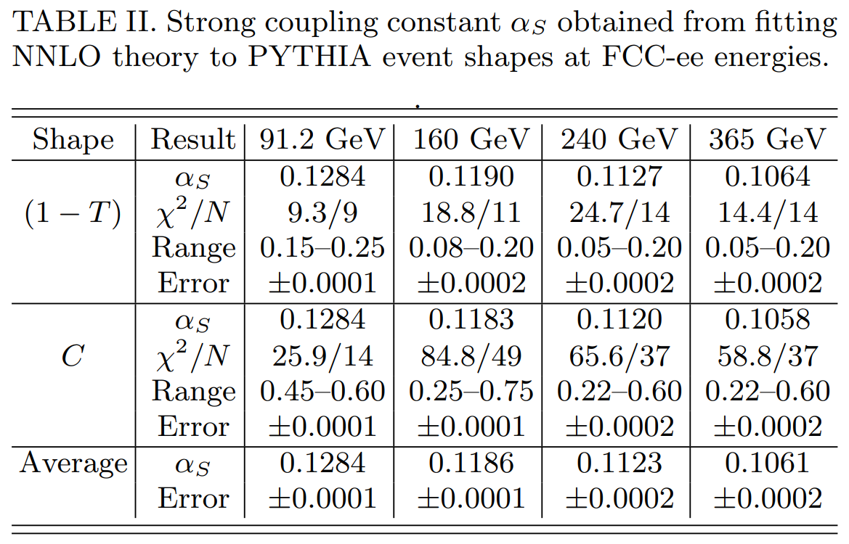
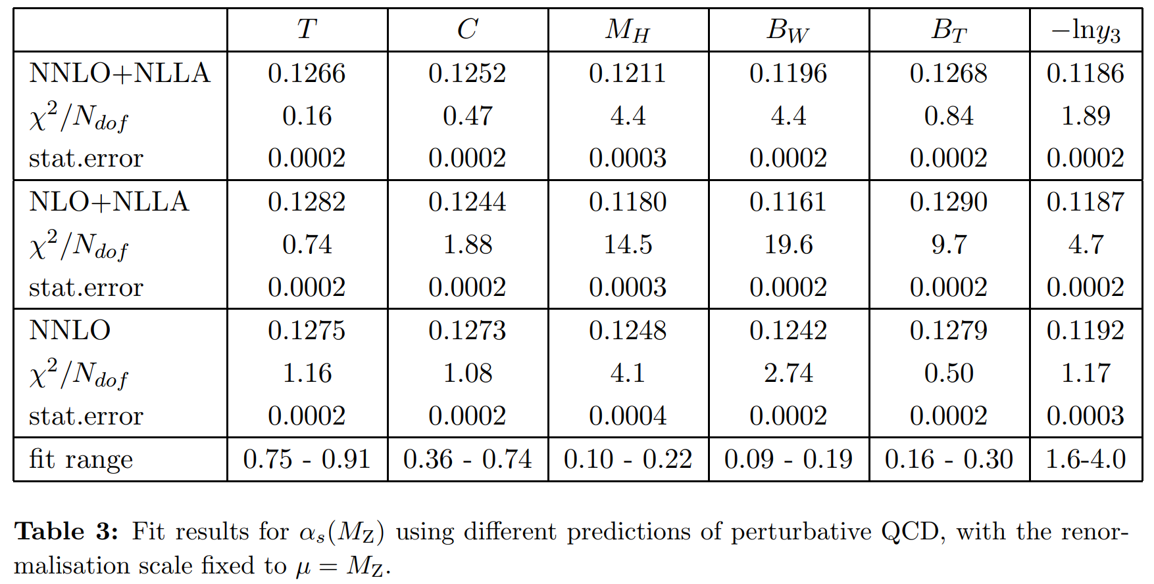
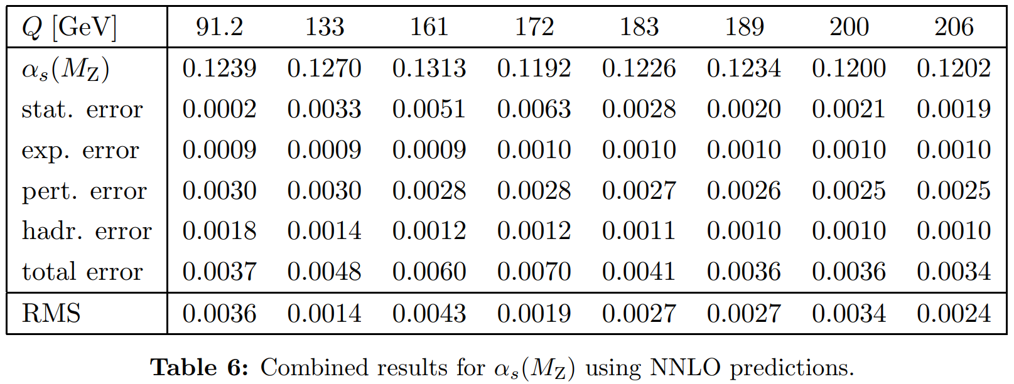
Extracted α_{s} values
(Dissertori*) Contributions of event shapes to NNLO value
(Dissertori*) Extracted NNLO values at LEP-II energies
G. Dissertori, A. G.-D. Ridder, T. Gehrmann, E. Glover, G. Heinrich, G. Luisoni, and H. Stenzel, Determination of the strong coupling constant using matched nnlo+nlla predictions for hadronic event shapes in e+e annihilations, Journal of High Energy Physics 2009,036–036 (2009).

Slide 8
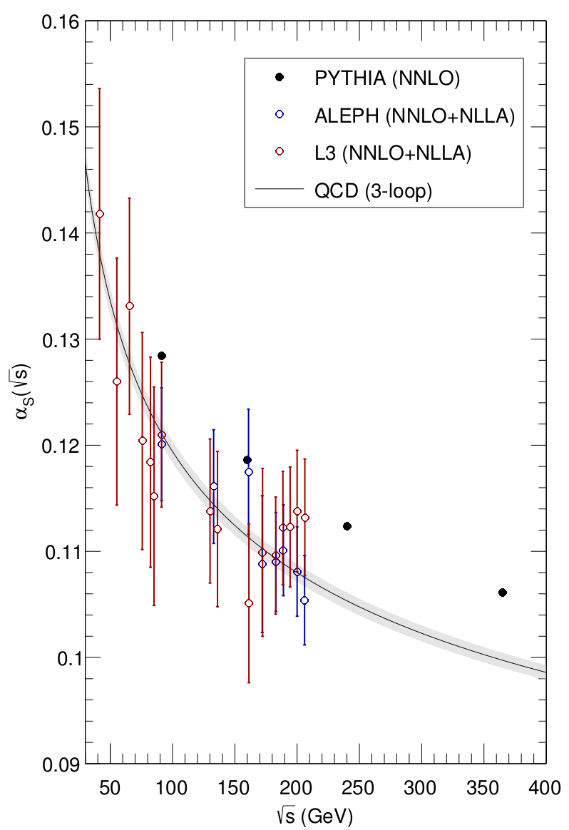
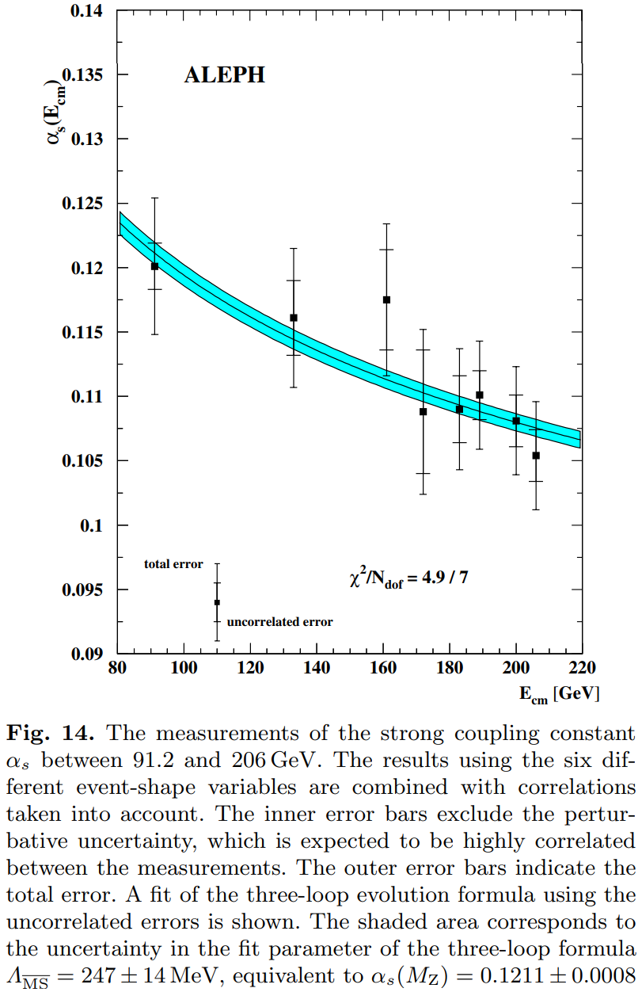
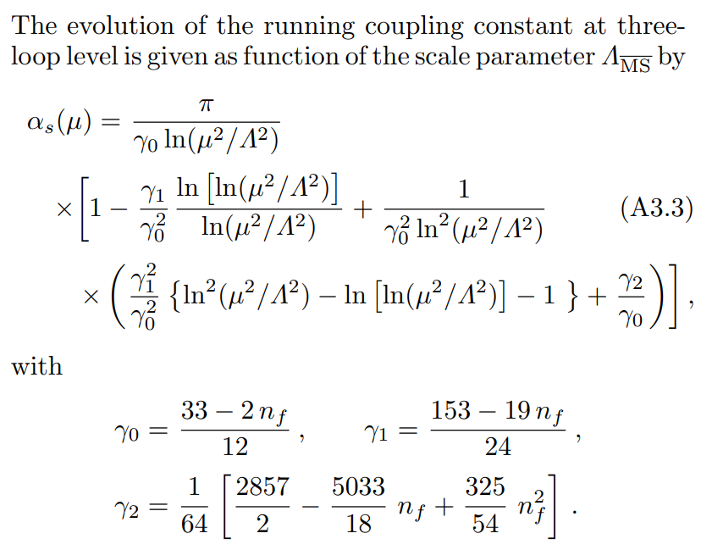
Energy evolution
* ALEPH, Studies of QCD at ee centre-of-mass energies between 91-GeV and 209-GeV, Eur. Phys. J. C 35, 457 (2004).

Slide 9
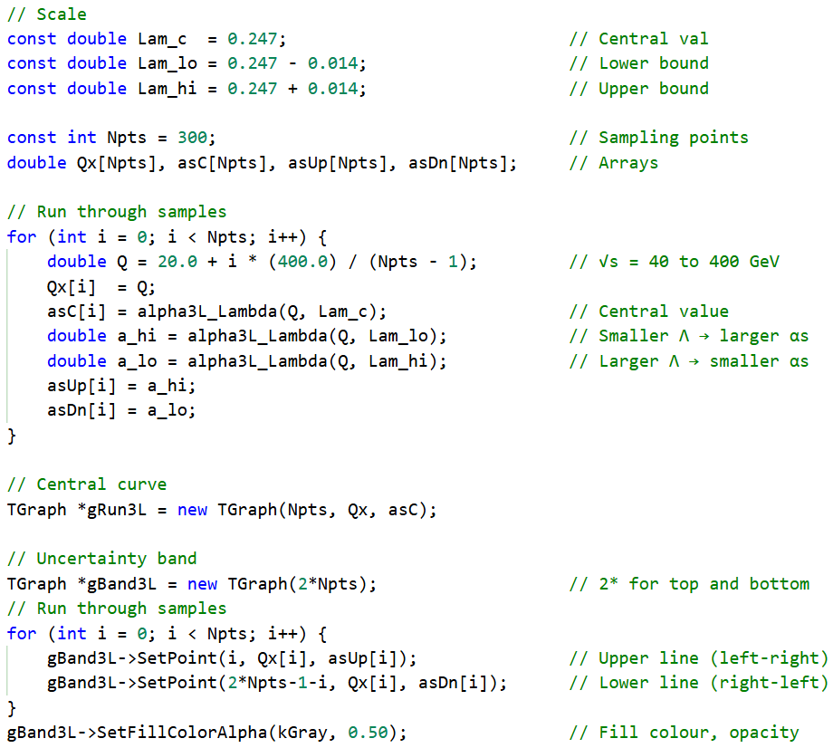
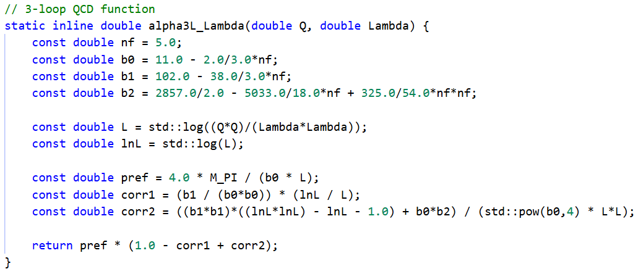
Energy evolution – Code
Constructing 3-loop running with Λ band similar to ALEPH

Slide 10
Summary of results

Slide 11
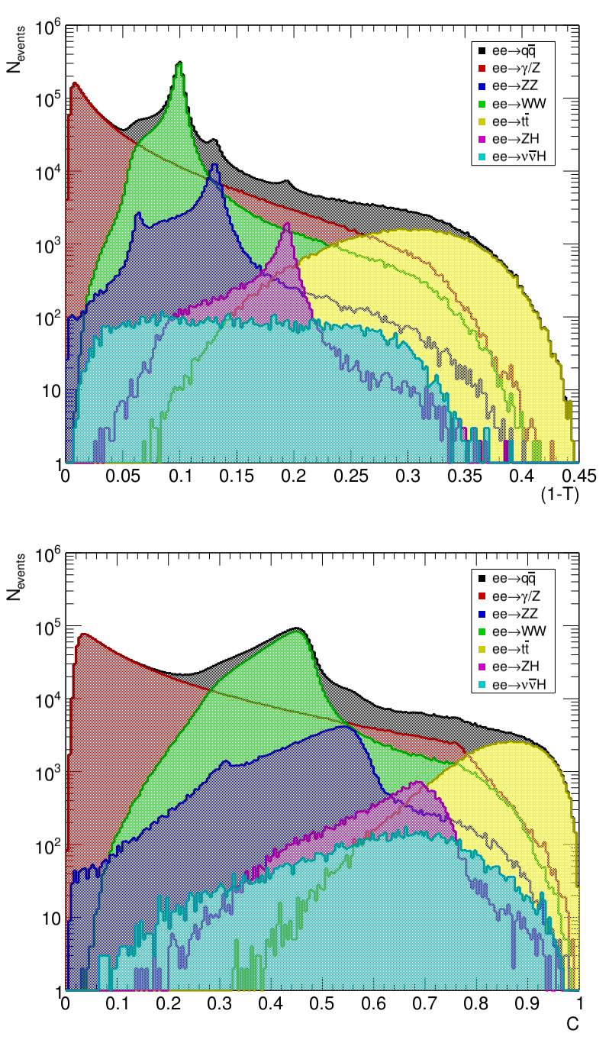
Summary of questions
Are there potential issues with the overall procedure in general?
Is it correct to use the same theory coefficients (A,B,C) for fitting at all energy levels?
Is there a standard procedure for selecting the fit ranges for (1–T) and C?
Are the deviations in our values within expectations considering NNLO?

Slide 12
Backup

Slide 13
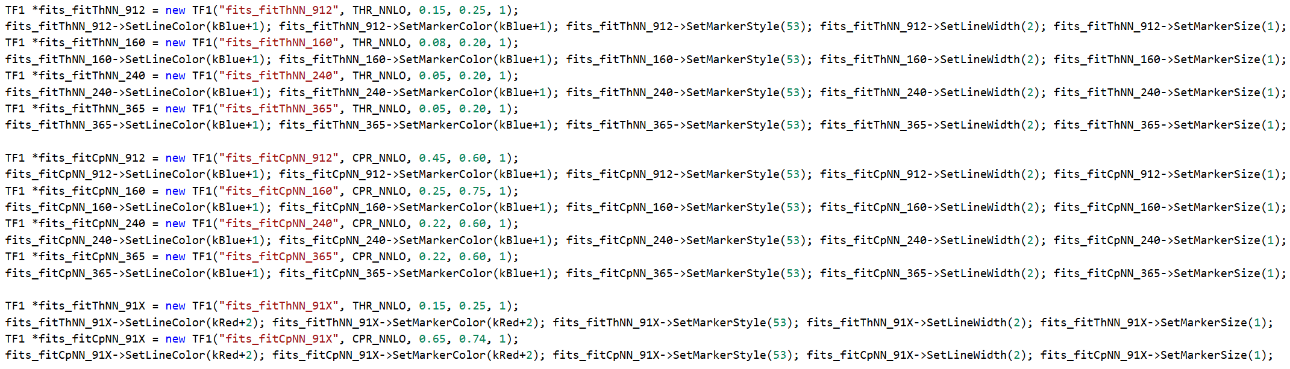
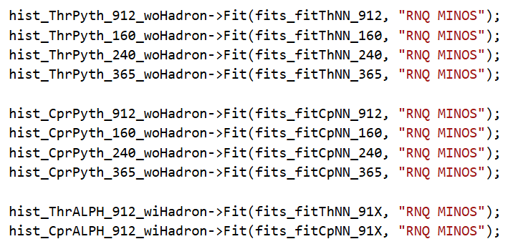
Workflow – TF1 functions

Slide 14
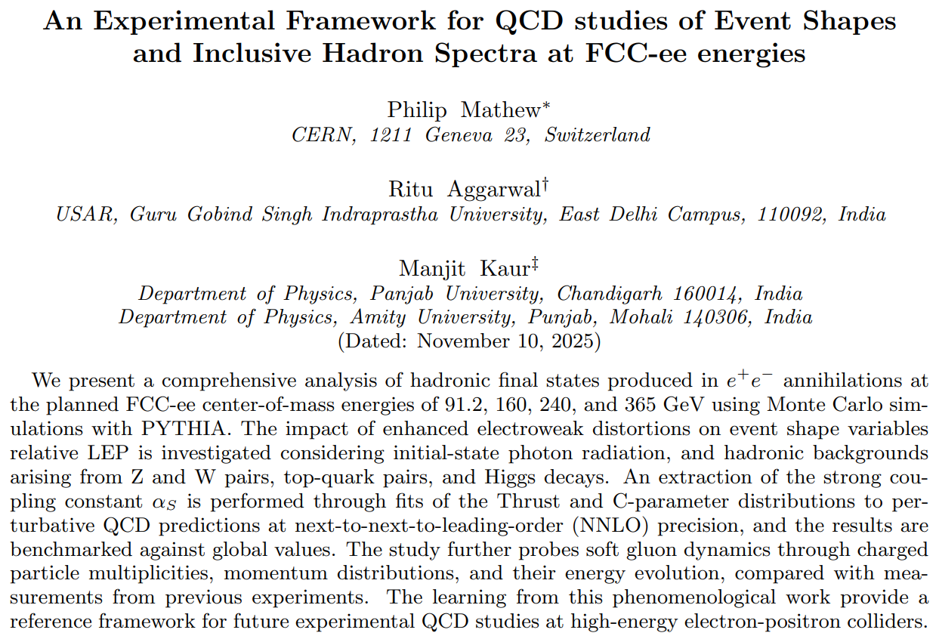
Paper overview
QCD in e⁺e– annihilations
General features
Event shape observables
Event generation
Process selections
PYTHIA calibration
Experimental distortions
QED radiation
Electroweak backgrounds
Determination of α_{s}
Theoretical description
Fitting procedure
Energy evolution
Inclusive Hadron Spectra
Charged hadron multiplicity
Momentum distributions and peaks

