Slide 1
HEP Phenomenology Project

Slide 2
Timeline so far…
16 Aug 2024 – email to Archana Sharma
19 Aug 2024 – email from Manjit Kaur
20 Aug 2024 – Meeting (Philip, Manjit)
xx Sep 2024 – Meeting (Philip, …)
27 Sep 2024 – Meeting (Philip, Manjit, Ritu)
09 Oct 2024 – end of busy phase
21 Oct 2024 – Meeting (Philip, Manjit)
05 Nov 2024 – Meeting (Philip, Manjit)
22 Nov 2024 – Meeting (Philip, Manjit)

Slide 3
Notes

Slide 4
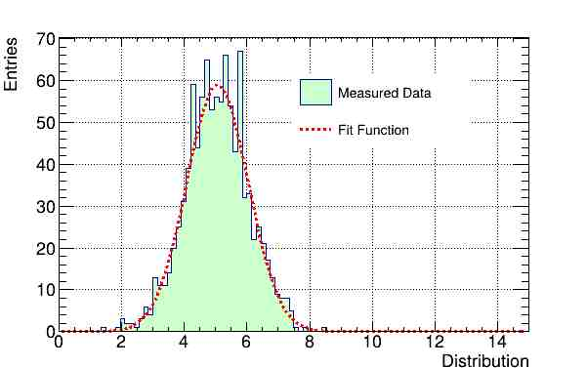
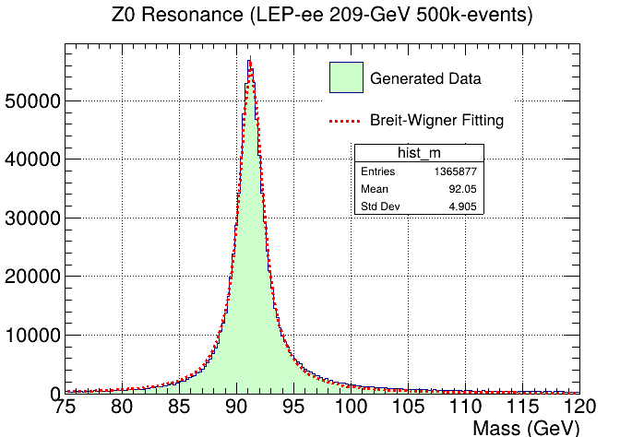
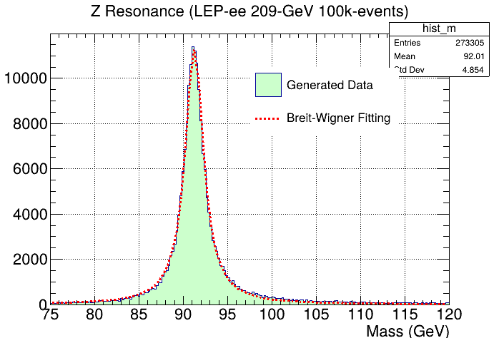
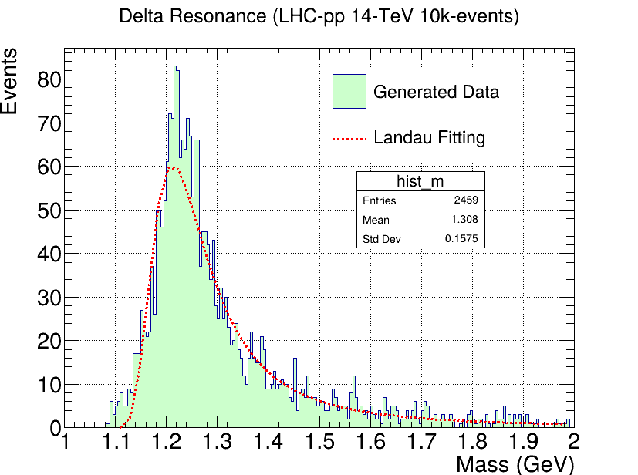
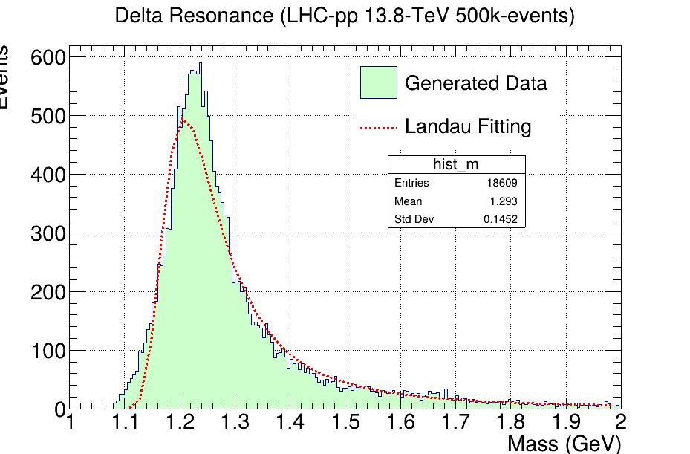
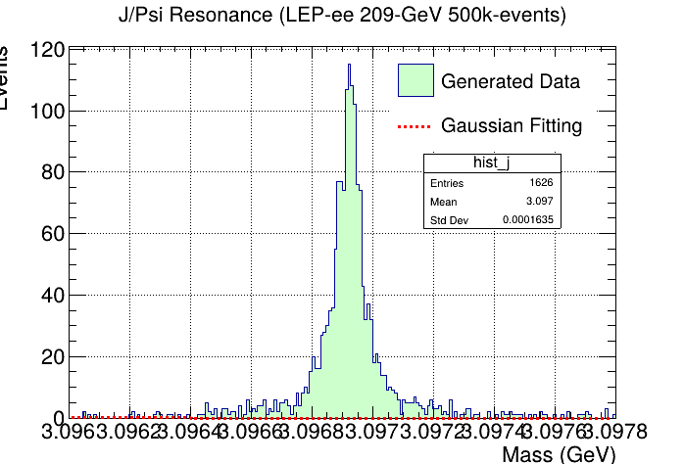
Learning Pythia-ROOT workflows

Slide 5
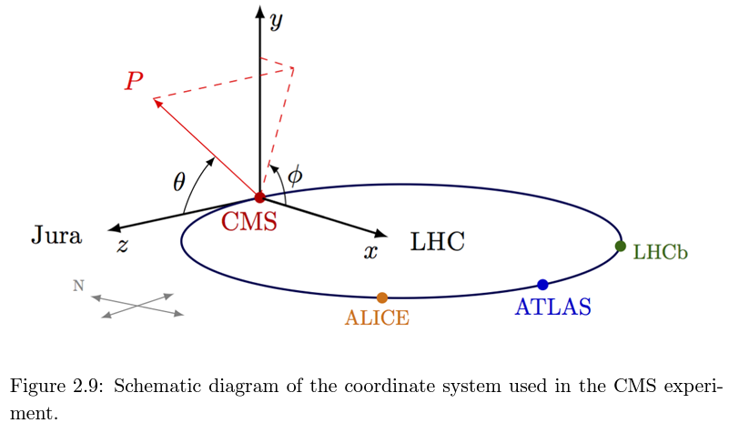
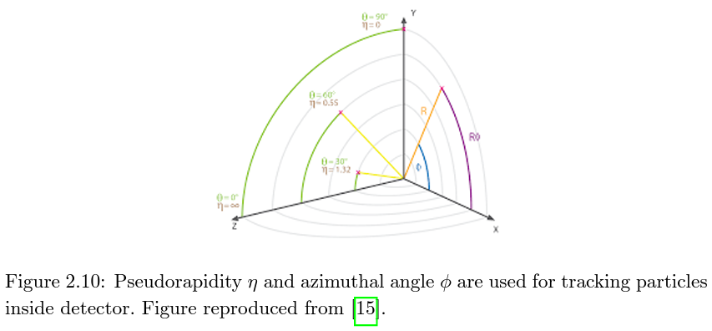
CMS co-ordinate system
Cartesian coordinates:
Origin at the nominal interaction point of the detector.
Z-axis along the direction of counter clockwise beam.
X-axis pointing radially towards centre of LHC ring.
Z-plane is longitudinal and XY-plane is transverse.
Cylindrical coordinates:
Azimuthal angle Φ
Radial distance r
Z coordinate
Spherical coordinates:
Azimuthal angle Φ
Radial distance ρ
Polar angle θ
Particles are typically defined in transverse plane.

Slide 6
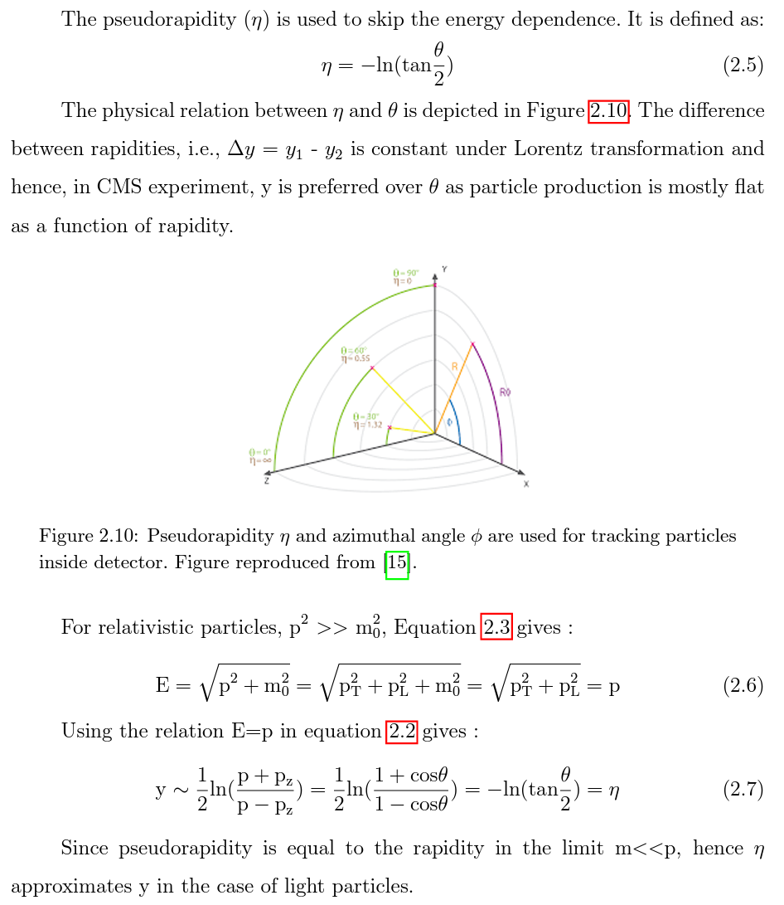
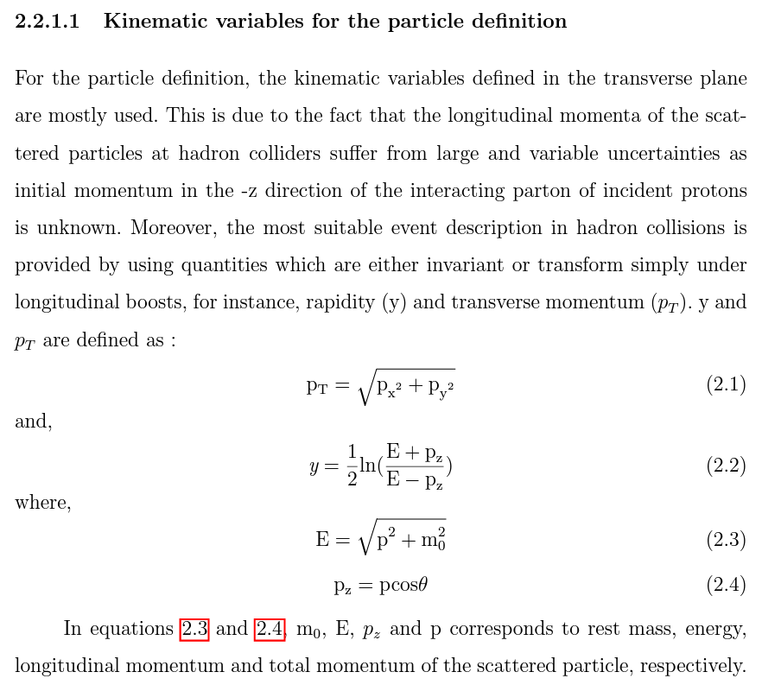
CMS particle definitions

Slide 7
Meeting : 5 November 2024

Slide 8
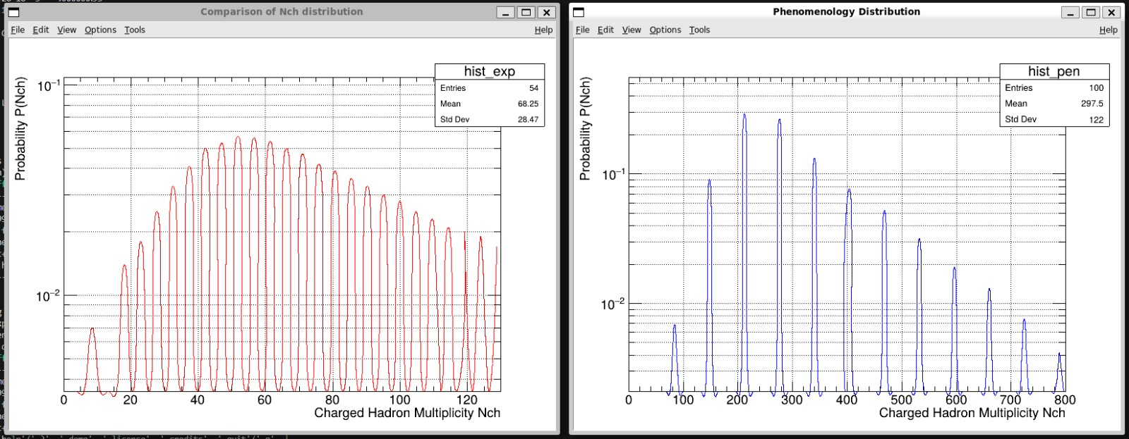
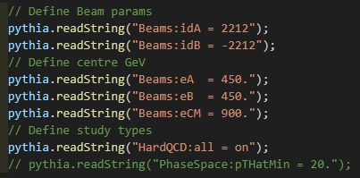
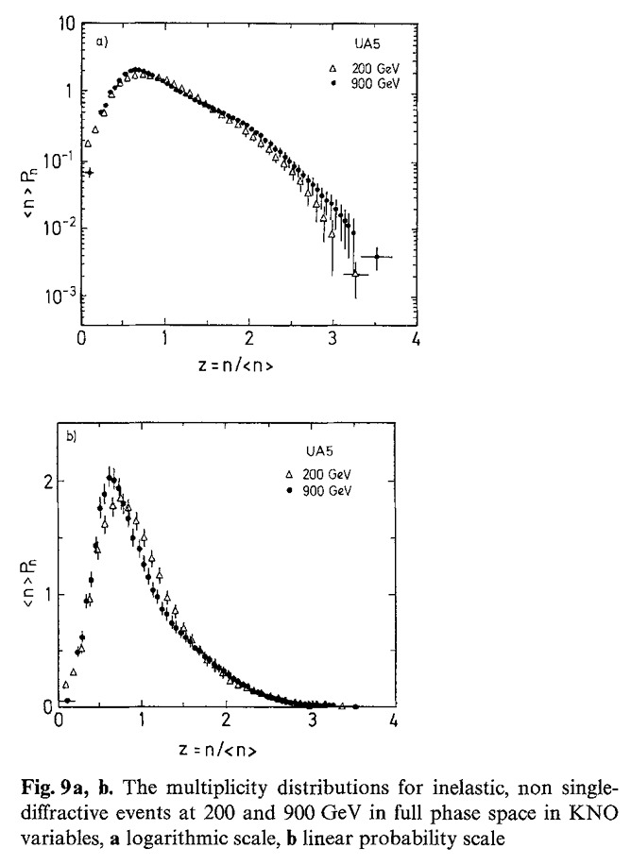
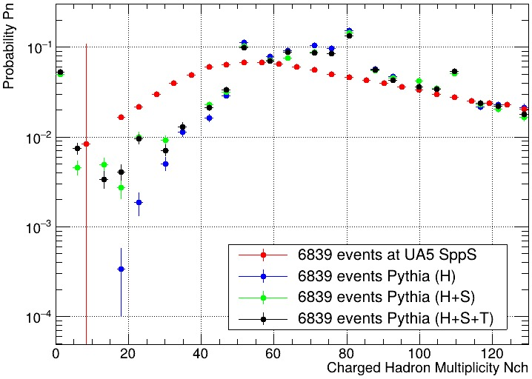
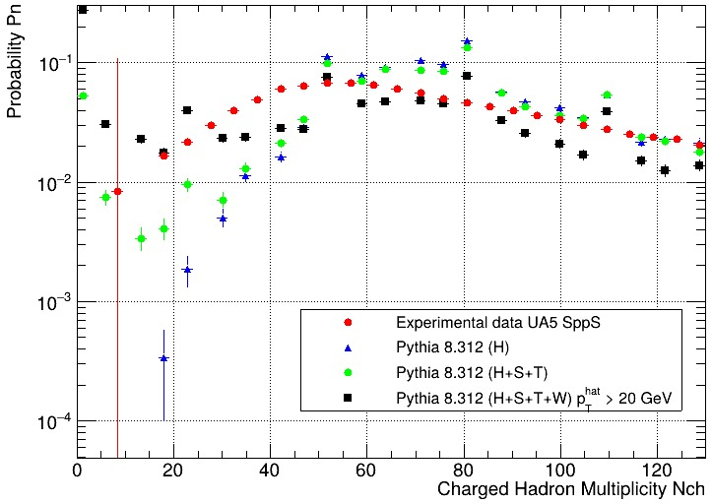
N_{Ch} : UA5 .vs. PYTHIA at 91.2 GeV

Slide 9
Notes

Slide 10
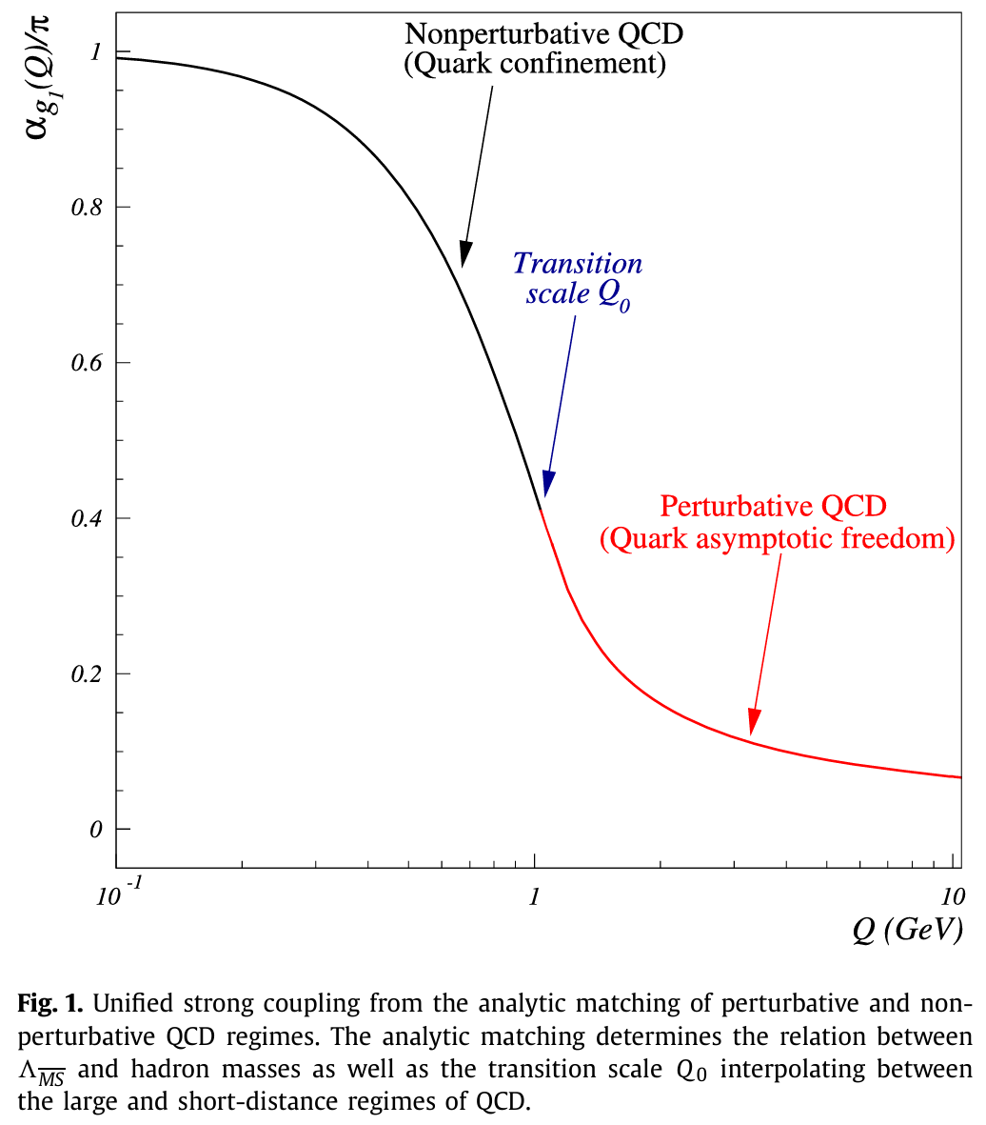
Theoretical ‘eē → hadron’
QCD is the gauge theory for the strong interaction:
Interactions determined by the coupling constant (α_{s}).
Both quarks and gluons carry a ‘colour’ charge.
Colour charge permits gluon-gluon self-interaction.
This results in ‘asymptotic freedom’ i.e. ↓α_{s} at ↑Q
The process ‘eē → qq̅ → hadron’ is split into two regimes:
At (Q₀ ≳ 1 GeV) is pQCD – jet production, parton radiation, deep inelastic scattering.
At (Q₀ ≲ 1 GeV) is npQCD – hadronisation, confinement, meson/baryon bound states.
Perturbation is used to study q-g production with high momentum transfers.

Slide 11
Experimental ‘eē → hadron’
Annihilation of eē (LEP/FCCee) provides a clean environment to study basic QCD processes.
Quark discovered with 2-jet structure in eē collisions at SPEAR at SLAC.
Gluon discovered with 3-jet structure in eē collisions at PETRA at DESY.
Quark spin was confirmed to be ½ from analysing jet angular distributions.
LEP at Z0 resonance (91.2 GeV) offered several advantages:
Large hadronic branching ratio – Z decay produces lepton pairs or hadron jets, but the latter is 70% more probable.
Negligible background – processes without any hadrons were very minimal leading to higher precision analyses.
Suppression of ISR – collider design prevented photon emission from eē resulting in more collision at maximum energy.
Micro-vertex detectors – these special tracking systems near the collision points allowed for flavor-dependent studies.
FCCee will improve over LEP:
Overall – Increased statistical samples of 10¹² partons from Z decays and 10⁷ partons from W decays.
At Z0 – Increased statistical samples by factor of 10⁵ thereby decreasing uncertainties by factor of 300.

Slide 12
Phenomenology ‘eē → hadron’
MC programs split the process into four phases:
Production of qq̅ (electroweak).
Gluon radiation (pQCD).
Matrix element method – calculate Feynman diagrams order by order, only available up to maximum of four partons in the final state.
Parton shower method – approximates full matrix expression as multiple jets, each limited by LLA or MLLA, which then hadronise.
Hadronisation (npQCD).
Independent method – assumes that partons fragment isolated from each other, but it is shown that this does not match experiments.
String method – assumes a colour flux tube connecting qq̅ pairs which creates new hadrons when string is stretched far enough to break.
Cluster method – assumes gluons from pQCD split into qq̅ pairs forming colorless clusters that decay into particles if they have sufficient mass.
Particle decay (electroweak?).
PYTHIA uses LLA parton shower with (m_{branching_parton})² for pQCD and independent/string for npQCD.

Slide 13

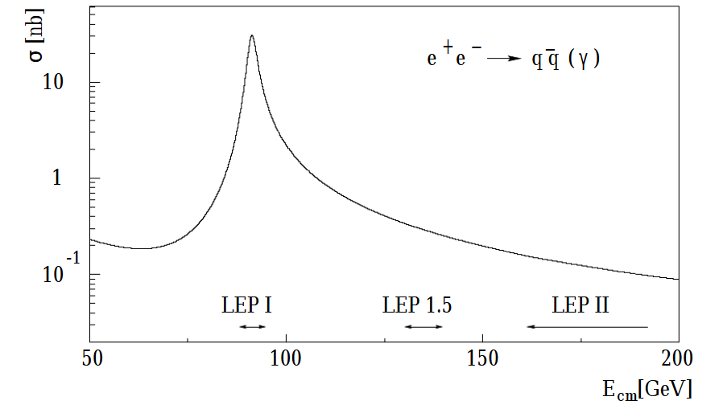
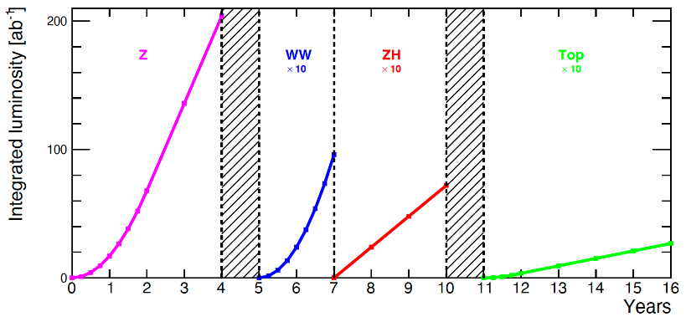
LEP (1989 - 2000)
FCCee (2040-)
Construction:
26.7 km circumference
L3, ALEPH, DELPHI, OPAL
Operation modes:
LEPI √s = 91 GeV for eē → Z0̅ → 2f
LEP1.5 √s = 2 × 80.3 GeV for eē → WW̅ → 4f t¯ t
LEPII √s = 240 GeV for Higgs an SUSY particles
Construction:
26.7 km circumference
L3, ALEPH, DELPHI, OPAL
Operation modes:
Z0 √s = 91 GeV
2W √s = 160 GeV
ZH √s = 240 GeV
TT √s = 365 GeV

Slide 14
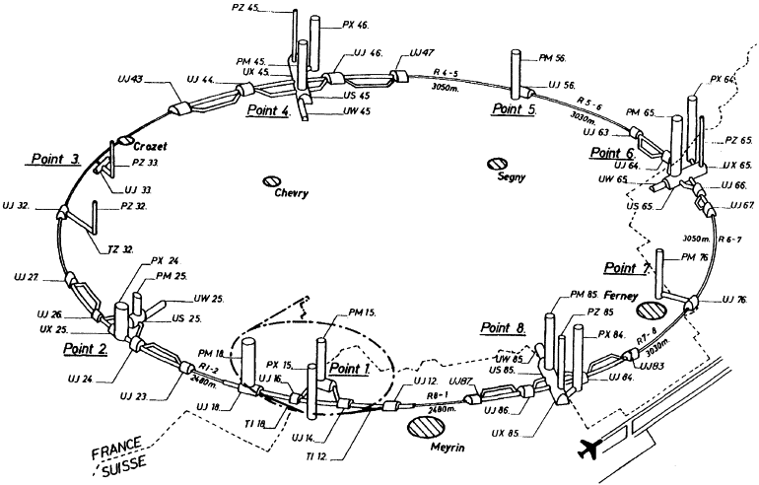
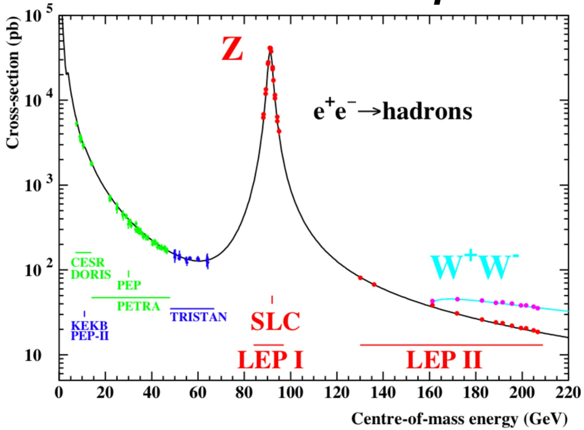
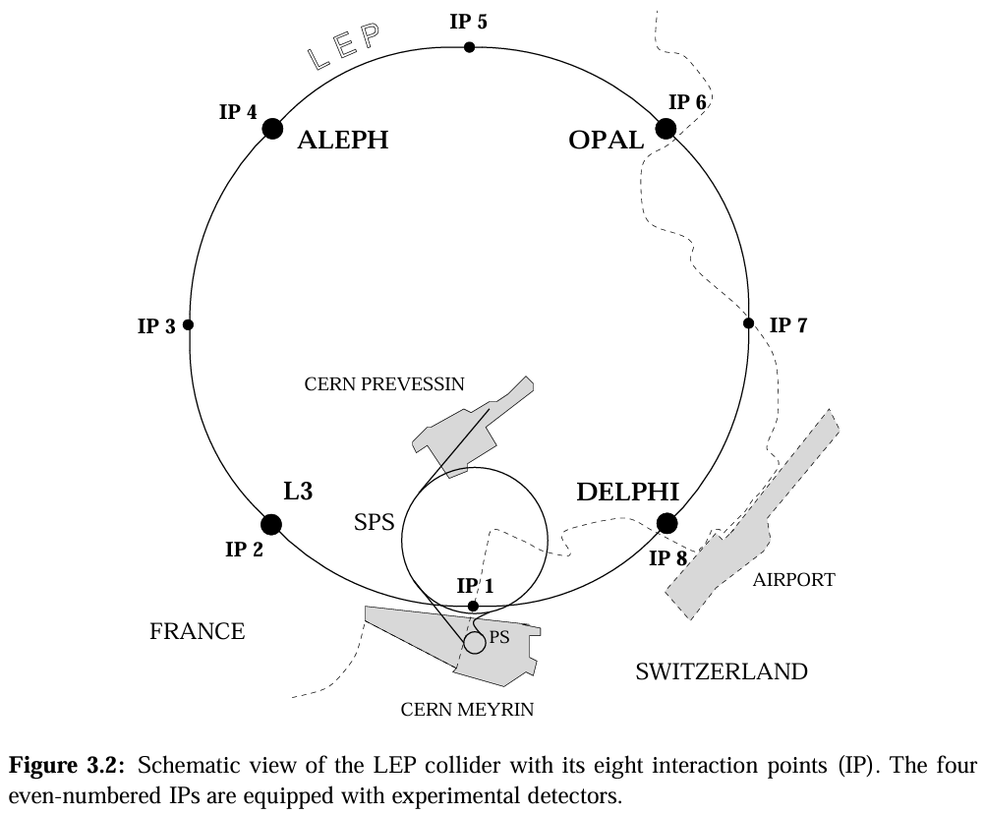
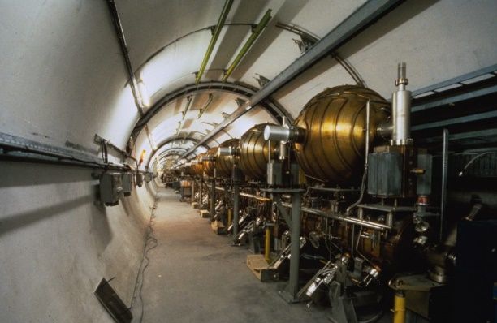
LEP (1989-)
FCCee (2040-)

Slide 15
Meeting : 22 November 2024

Slide 16
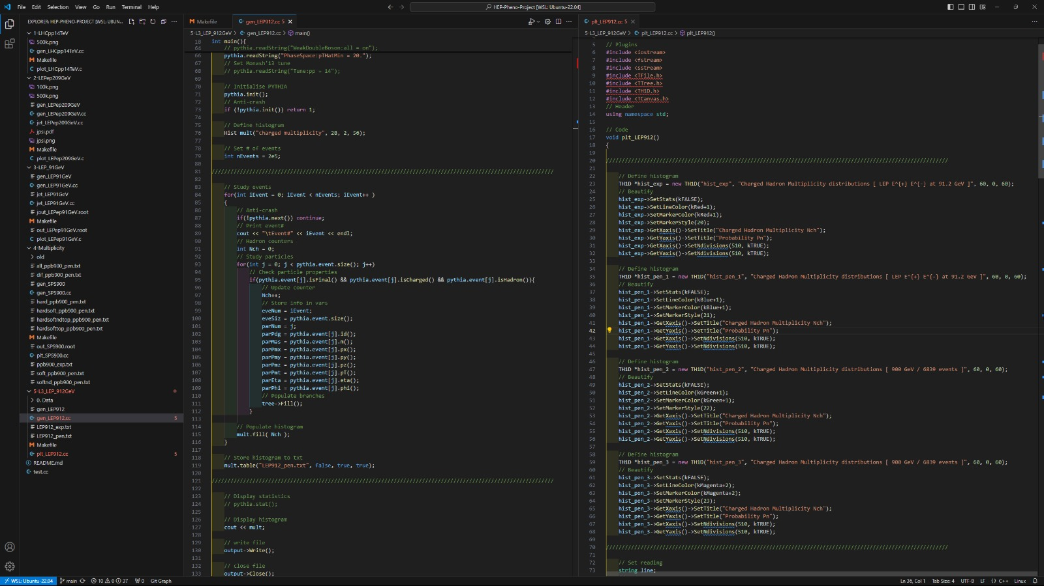
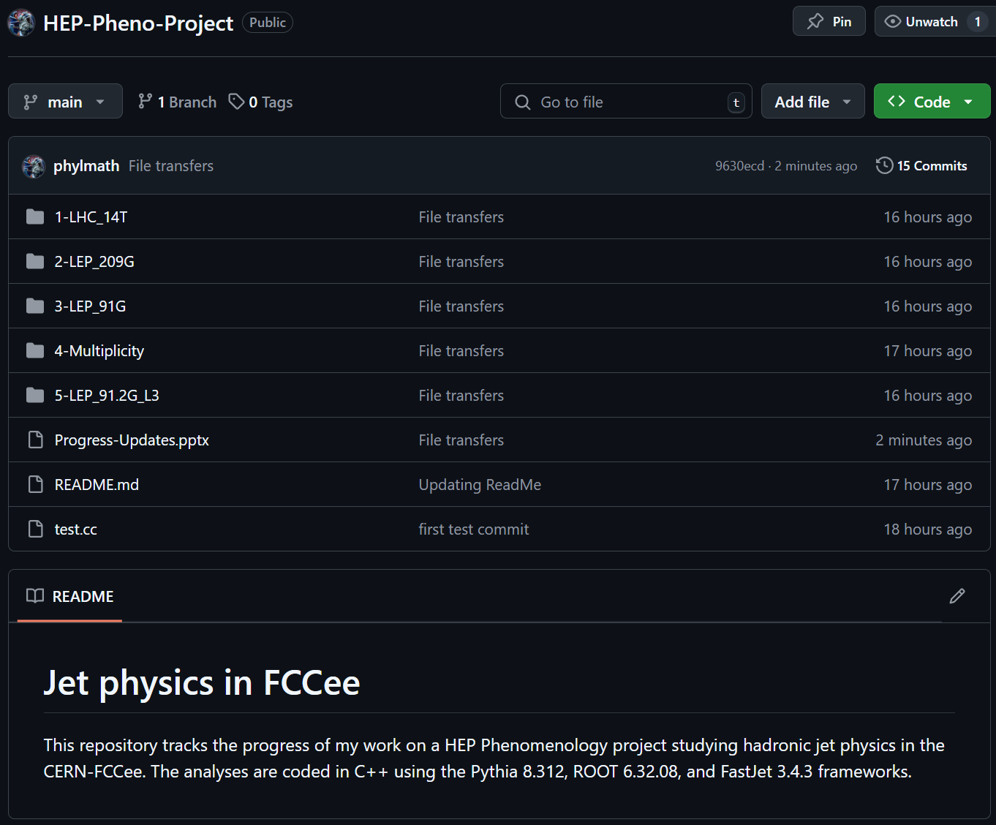
Github Repository (20 November 2024)
Visual Studio Code + Windows Subsystem for Linux
github.com/phylmath/HEP-Pheno-Project

Slide 17
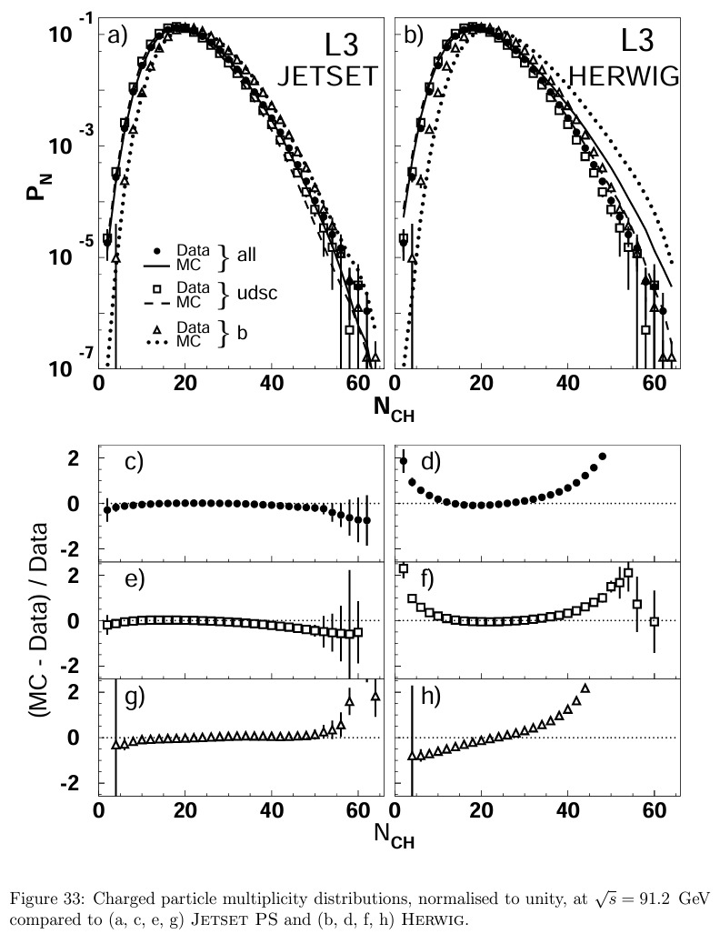
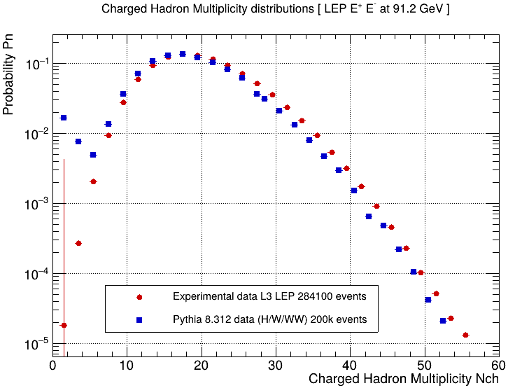
N_{Ch} : L3 .vs. PYTHIA at 91.2 GeV

Slide 18
Notes

