Slide 1
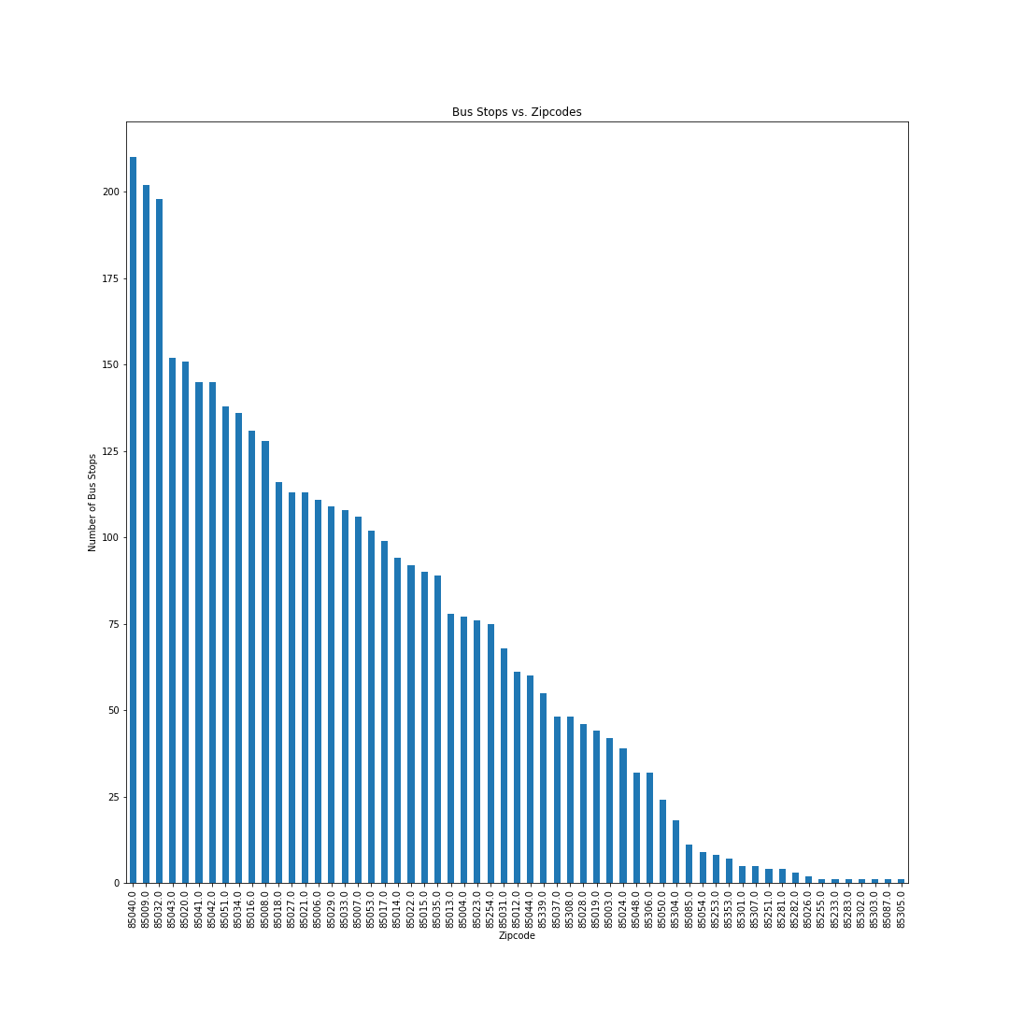
Bus Stops vs. Zip codes
QUESTION
Do low income areas rely more heavily on public transportation?
THE DATA
58 zip codes
Highest number of bus stops from one zip code is 210
Seven zip codes only one bus stop

Slide 2
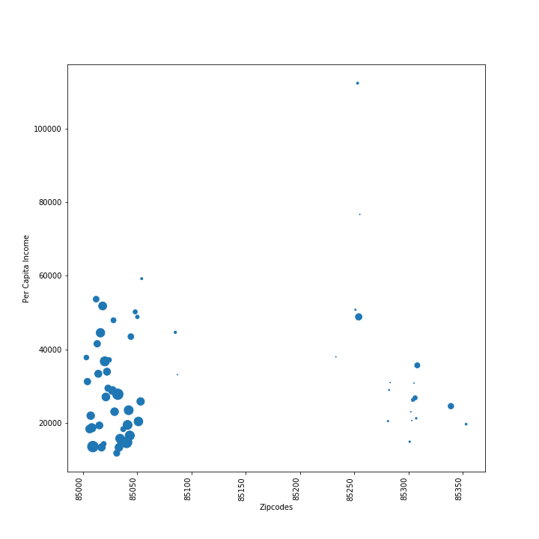
Zip code vs. Income (size = poverty rate)
EXPECTATIONS
Zip codes with higher poverty rate will have a higher number of bus stops
Wealthier zip codes will have fewer bus stops

Slide 3
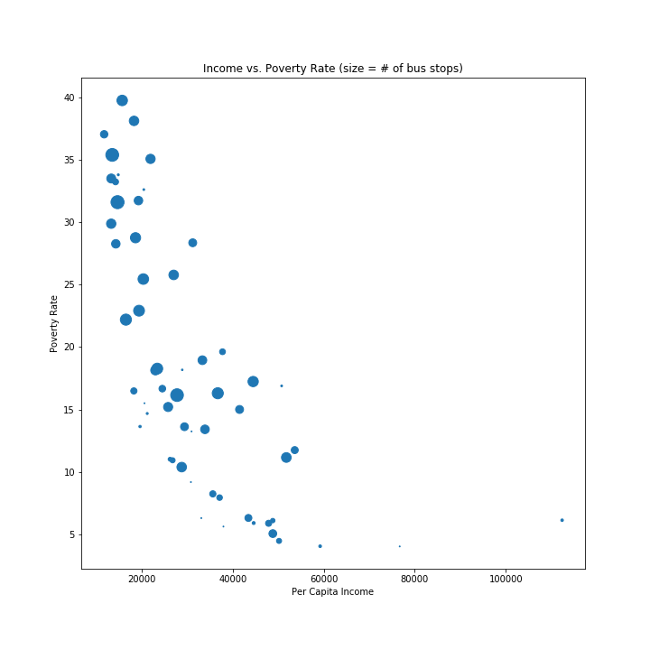
Income vs. Poverty Rate (size=# of bus stops)
ANALYSIS
Lower income zip codes have a higher number of bus stop locations.
Wealthier zip codes lack access to public transportation

