Slide 1
Linear Regression

Slide 2
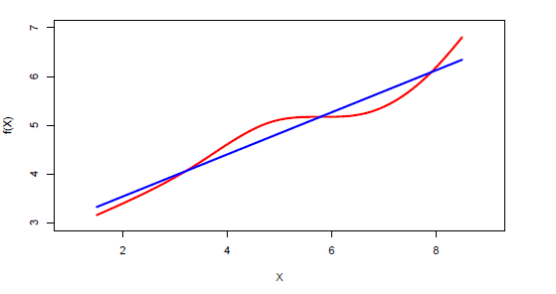
Linear regression
Linear regression is a simple approach to supervised learning. It assumes that the dependence of Y on X1,X2…Xp are linear

Slide 3
Simple linear regression using a single predictor
We assume a model with Y = β0 + β1X .
β0 and β1 are two unknown constants that represent the intercept and slope, also known as coefficients or parameters.
β, Ө , W is widely used to represent the coefficient/ weight of the parameter.

Slide 4
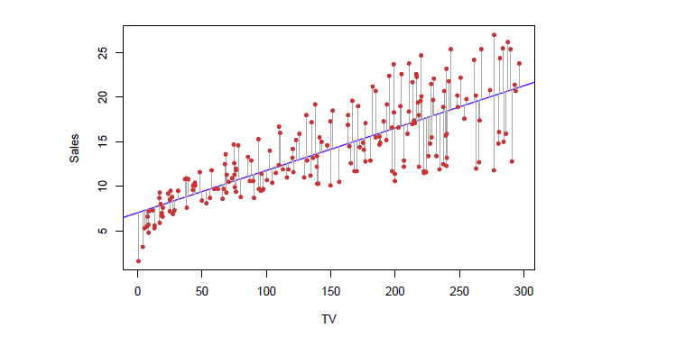
Parameter Estimation / Cost Function
We define the residual sum of squares (RSS) as
Our Goal is find beta such that it will best describe the data (i.e) minimize the error

Slide 5
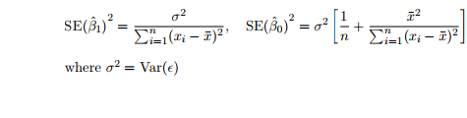
Accuracy of the Coefficient Estimates
The standard error of an estimator reflects how it varies under repeated sampling.
These standard errors can be used to compute confidence intervals.
2 sigma is 95% confidence

Slide 6
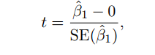
Hypothesis testing
Standard errors forms the basis to perform hypothesis tests on the coefficients. The most common hypothesis test involves testing the null hypothesis of
H0 : There is no relationship between X and Y versus the alternative hypothesis (In other words beta is zero)
HA : There is some relationship between X and Y .
To test the null hypothesis, we compute a t-statistic, given by
Compute the probability of observing any value equal to |t| or larger. We call this probability the p-value.

Slide 7
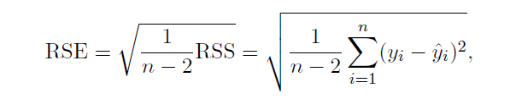


Overall Accuracy of the Model
We compute the Residual Standard Error
R-squared or fraction of variance explained is
TSS – Total sum of error
Value of R^2 depends on the domain (.5 is good in medicine)

Slide 8
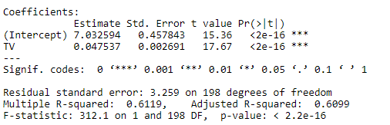
Lab : Advertising Dataset
Results for the advertising data

Slide 9

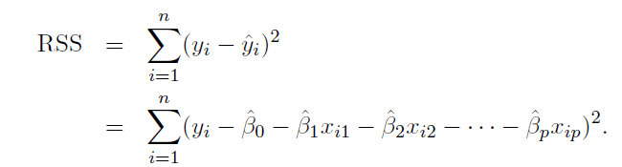
Multiple Linear Regression
Here our model becomes
We estimate β0, β1, . . . , βp as the values that minimize the sum of squared residuals

Slide 10
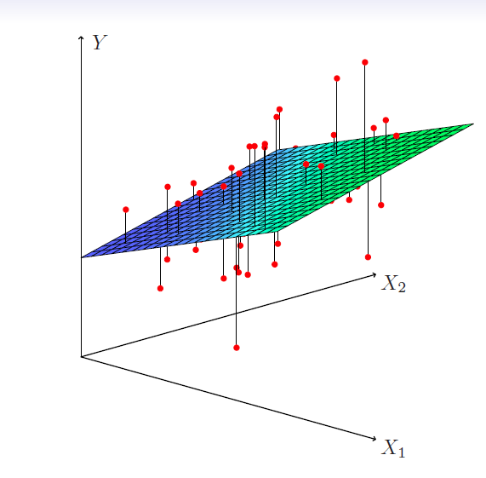
Multiple Linear Regression
Line becomes plane for 2 parameters

Slide 11
Some important Consideration
Do all the predictors help to explain Y , or is only a subset of the predictors useful?
How well does the model fit the data?

Slide 12
Qualitative Predictors
When we encounter a qualitative variable in our data set like male/female , we create a new variable
xi = ( 1 if ith person is female 0 if ith person is male

Slide 13
Qualitative Predictors
With more than two levels, we create additional dummy variables. For example, for the ethnicity variable we create two dummy variables. The first could be
xi1 = ( 1 if ith person is Asian 0 if ith person is not Asian,
and the second could be
xi2 = ( 1 if ith person is Caucasian 0 if ith person is not Caucasian.

Slide 14
Deciding on the important variables
The most direct approach would be all subsets or best subsets regression
However we often can’t examine all possible models, since they are 2p of them; for example when p = 40 there are over a billion models!

Slide 15
Forward selection
Begin with the null model — a model that contains an intercept but no predictors.
Fit p simple linear regressions and add to the null model the variable that results in the lowest RSS.
Add to that model the variable that results in the lowest RSS amongst all two-variable models.

Slide 16
Backward selection
Start with all variables in the model.
Remove the variable with the largest p-value — that is, the variable that is the least statistically significant.
The new (p − 1)-variable model is fit, and the variable with the largest p-value is removed.

Slide 17
Other Criterian to look for
Mallow’s Cp
Akaike information criterion (AIC)
Bayesian information criterion (BIC)
adjusted R2

Slide 18

Interaction and Non Linearity
In our previous analysis of the Advertising data, we assumed that the effect on sales of increasing one advertising medium is independent of the amount spent on the other media.
For example, the linear model
But suppose that spending money on radio advertising actually increases the effectiveness of TV advertising, so that the slope term for TV should increase as radio increases
synergy effect

Slide 19
Interpretation
The results in this table suggests that interactions are important.
The p-value for the interaction term TV×radio is extremely low, indicating that there is strong evidence for HA : β3 <> 0.
The R2 for the interaction model is 96.8%, compared to only 89.7% for the model that predicts sales using TV and radio without an interaction term.

Slide 20
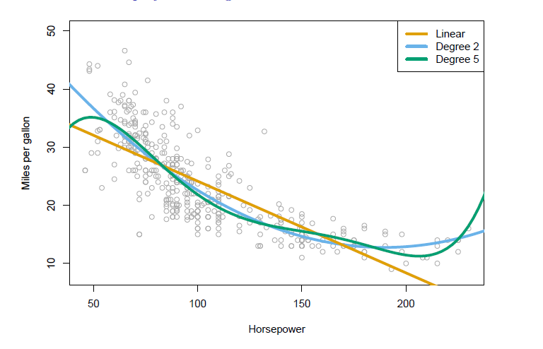

Non Linearity

Slide 21
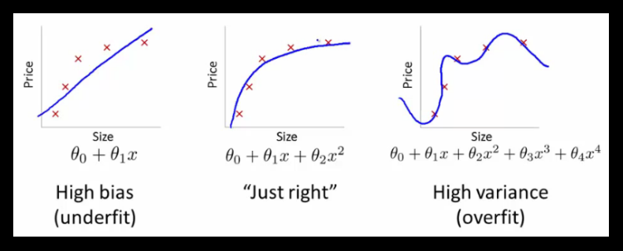
Over Fitting & Under Fitting

Slide 22
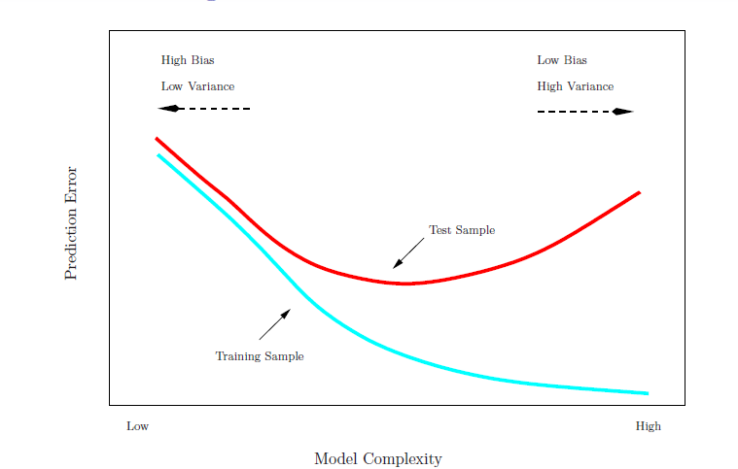
Bias - Variance problem
Training Data
Test Data

Slide 23
Cross Validation
Performance of our model in unknown data is much important than know data
Training sample
Test Sample
Cross Validation

Slide 24
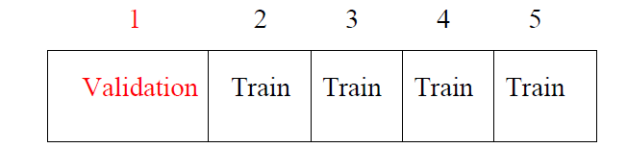
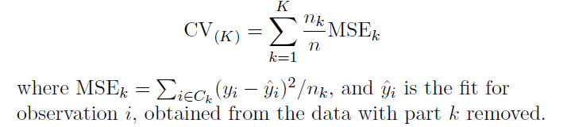
K fold Cross Validation
Divide data into K roughly equal-sized parts (K = 5 here)
Let the K parts be C1, C2, . . . CK, where Ck denotes the indices of the observations in part k
Find MSE for each of the k part and sum the MSE for all 5 part which gives CV error

Slide 25
Regularization
When the number of parameter grows beyond certain range.
Subset selection method would be difficult to apply
As an alternative, fit a model containing all p predictors using a technique that constrains or regularizes the coefficient estimates, and shrinks the coefficient estimates towards zero.

Slide 26
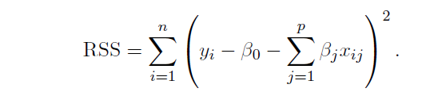
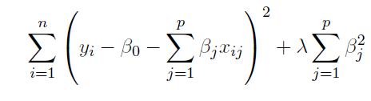
Ridge regression / L2
Recall that the least squares fitting procedure estimates β0, β1, . . . , βp using the values that minimize
Now add a constrain to the cost function
Lamda is the tuning paramter

Slide 27
Ridge regression
The second term penalize the cost function for beta being large
The tuning parameter λ serves to control the relative impact of these two terms on the regression coefficient estimates.
• Selecting a good value for λ is critical; cross-validation is used for this.

Slide 28
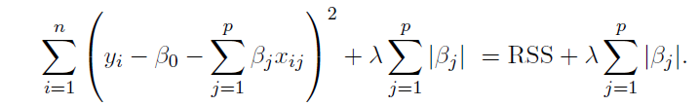
The Lasso / L1
The Lasso is a relatively recent alternative to ridge regression
As with ridge regression, the lasso shrinks the coefficient estimates towards zero.
However, in the case of the lasso, the `1 penalty has the effect of forcing some of the coefficient estimates to be exactly equal to zero when the tuning parameter λ is sufficiently large
As in ridge regression, selecting a good value of λ for the lasso is critical; cross-validation is again the method of choice.
Credit : An Introduction to Statistical Learning

