Slide 1
Coverage
I4SWT

Slide 2
Test coverage
We want a measure of how “good” our test is.
One measure: How much application code is “covered” by tests?
Test coverage measure quality of test (not of the actual product)

Slide 3
Test coverage
The process of determining which areas of a program that are exercised by given set of test cases.
Using that knowledge to systematically expand test cases to test “untouched” parts of the program.
Having a quantitative measure of code coverage
Many different kinds of coverage exist

Slide 4
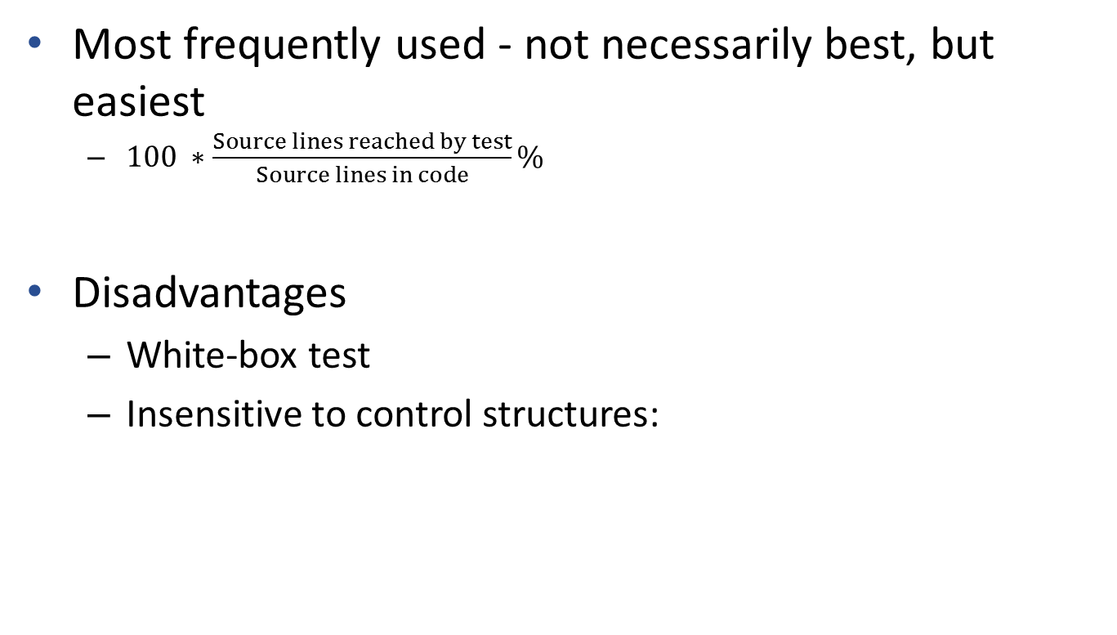
Line coverage (aka. statement coverage)
Most frequently used - not necessarily best, but easiest
$100 ∗\frac{Source lines reached by test}{Source lines in code}\%$
Disadvantages
White-box test
Insensitive to control structures:
Did we test for zero times? Once? Several?
int* p = 0; if (condition) p = &variable; *p = 117;
int array[MAX];
for(int i=0; i<MAX; i++)
{
array[i] = i-1; // ar[i] = i-1 }
Did we test for condition being false?

Slide 5
Branch coverage (aka decision coverage)
Measures to which extent all decision points (if, while, switch etc.) have been fully exercised
Also includes “asynchronous branches” such as exception and interrupt handlers
Fairly simple to calculate, but without the problems of statement coverage.

Slide 6
Branch coverage (aka decision coverage)
Branch coverage also has its deficiencies
In languages with short circuit boolean operators (C, C#, C++, Java, …) we have problems when trying to exercise all code
if (amount > 100 || someCode() == 0) // Was someCode() called?
statement1;
else
statement2;

Slide 7
The 238776 other measures
Attempts to strengthen decision coverage
condition coverage
multiple condition coverage
condition/decision coverage
modified condition/decision coverage
Other measures
relational operator coverage (<=, >=,<,>)
function coverage
call coverage
loop coverage
and so on … and so forth…

Slide 8
Practical experiences
Test coverage works best for new projects where it can be applied from the start
Make the goal 100% coverage, nothing less.
If coverage is 95%, you really know nothing of the remaining 5%
If 95% is ok, then 90% is also fine … so is 85% … naahhh – let’s make it 80%
If something cannot be covered, make an informed decision to exclude it from coverage
Keep the goal at 100%

Slide 9
Ups and downs of coverage
Simple, objective (repeatable) measure for quality of tests
Helps to decide where to spend test effort (adding test cases etc.)
Helps to detect trends (increasing or decreasing coverage in specific parts of the code) and hence take appropriate action

Slide 10
Ups and downs of coverage
100% coverage is no guarantee of zero defects
Very tool dependent (expensive, non-portable)
Test coverage says nothing of omission errors
Test coverage observations takes time

Slide 11
How to automate
We use dotCover to do line coverage calculations
dotCover must run an application
Running coverage calculation takes time because extra code is executed in the UUT
Ideal for Continuous Integration
on each push
nightly
Demo in a minute

Slide 12
Jenkins and dotCover with .Net Core
dotCoverCoverageConfigCore.xml
Reads
Coverage Report.html
Unit Test Report.xml
dotCover
Generates
Generates
dotnet test
Runs
Observes
Runs tests
UUT class
Unit Test class
Runs

Slide 13
node('master'){
stage('Clean Workspace'){
cleanWs()
}
stage('Fetch from Git'){
// Correct branch name, if different from 'main' - it can typically be 'master' instead
git branch: 'master', url:'https://github.com/TeamSWTFrabj/CashRegister.git'
}
stage('Clean Build') {
bat '"C:\\Program Files\\dotnet\\dotnet.exe" clean CashRegister.sln'
}
stage('Build') {
bat '"C:\\Program Files\\dotnet\\dotnet.exe" build CashRegister.sln'
}
try {
stage('Run coverage of unit tests') {
bat '"C:\\Program Files (x86)\\Jetbrains\\dotCover.2020.2.4\\dotCover.exe" analyze
dotCoverCoverageConfigCore.xml'
}
}
finally {
// Always publish test results
stage('Publish Test Results') {
nunit testResultsPattern: 'CashRegister.Test.Unit\\TestResults\\TestResults.xml'
}
}
// Only publish coverage if all tests passed
stage('Publish Coverage Results') {
publishHTML(
[allowMissing: false,
alwaysLinkToLastBuild: true,
keepAll: false,
reportDir: '.',
reportFiles: 'coverage_report.html',
reportName: 'Coverage Report',
reportTitles: '' ])
}
}

