Slide 1
What to test? Let the ZOMBIE guide you
Software Test

Slide 2
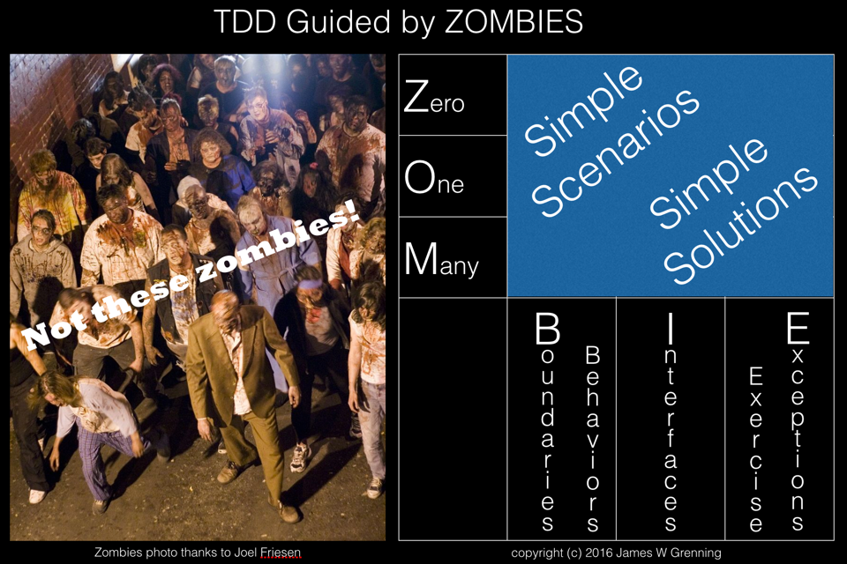
ZOMBIE(S)
Nowadays a guide line for Test Driven Development
http://blog.wingman-sw.com/archives/677
But originally a guide line to select the right test cases

Slide 3
ZOMBIE
Z - Zero
O – One
M – Many
B – Boundaries
I – Interfaces
E – Exceptional Behavior

Slide 4
Z - Zero
Zero input or zero output or zero actions:
Test on the correct state of a newly created object – ZERO calls
Test with the empty input for collection – ZERO elements
Make tests that should return the empty collection – ZERO elements

Slide 5
O - One
One input or One output or One action:
Test on the correct state of a newly created object after one call of each method
Test input with a collection with: – ONE element
Make tests that should return a collection with exactly: – ONE element

Slide 6
M - Many
Many inputs or Many outputs or Many actions:
Test on the correct state of an object after several calls of a each method
Test on the correct state of an object after calls of several mixed methods
Test input with a collection with: – 2 or more elements
Make tests that should return a collection with: – 2 or more elements

Slide 7
B - Boundaries
Use BVA (Boundary Value Analysis) for selecting the correct parameters for tests – both valid and invalid
Use EP (Equivalence Partitions) to keep this to a workable level
Make tests that investigate the specified or implicit boundaries of sizes – as far as practical

Slide 8
I - Interfaces
Test all methods
Test all overloaded versions of methods
Test all thrown exceptions
Use Coverage to be sure
Exercise all called interfaces (Interaction-based testing and Integration testing) to dependencies
Test all events used from dependencies
Test all events UUT provides

Slide 9
E – Exceptional Behavior
This is not just Exceptions as defined in the specifications
This is about robustness
What happens on faulty
Input?
(BVA)
Call sequence?
Dependencies (timeout, unexpected result, exception, …)?

Slide 10

Questions?

