Slide 1
Massive Multiplayer Observer
448.059 Design Patterns UE
by
Philip Loibl, Christian Kopf

Slide 2
Preface: What to expect?
Problem discussion
Revisiting appropriate pattern solution
Implementation for each pattern
Demos
Discussion

Slide 3
Problem:
Imagine designing an open world game where clients are able to move freely.
Consider adding a lot of players.
How to consistently manage rendering-distance and interaction-distance among clients?

Slide 4
Problem:
Changing one object requires changing/informing others, and we don't know how many objects need to be changed.
But we also do not want to couple multiple players tightly.
      Solution → Observer Pattern

Slide 5
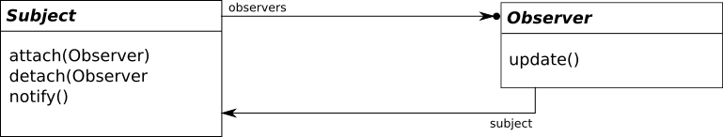
Observer Pattern
Clients (subject) keep track of each other by maintaining an observer-list.

Slide 6
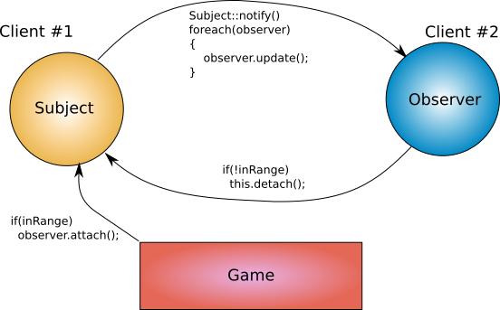
Observer Pattern implementation
But which player is subject and which one is observer?

Slide 7
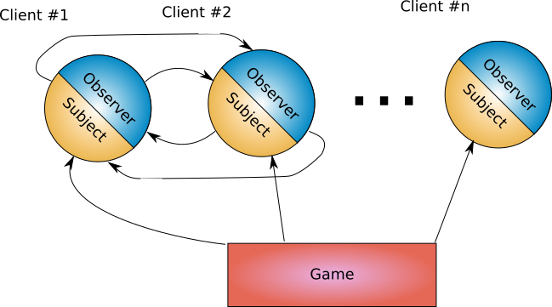
Observer Pattern implementation
Each player has both, an observer- and a subject-interface.

Slide 8
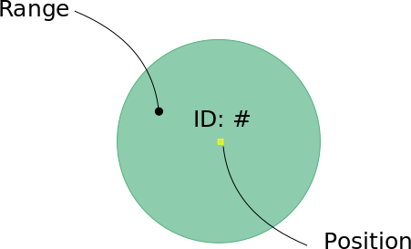
Example implementation:
2D game with movement in x and y
Each player has a position and a range (e.g. for visibility or some sort of interaction).

Slide 9
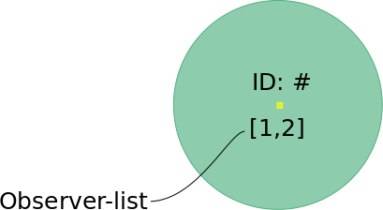
Example implementation (note):
Observer-list entries also displayed in the demo.

Slide 10
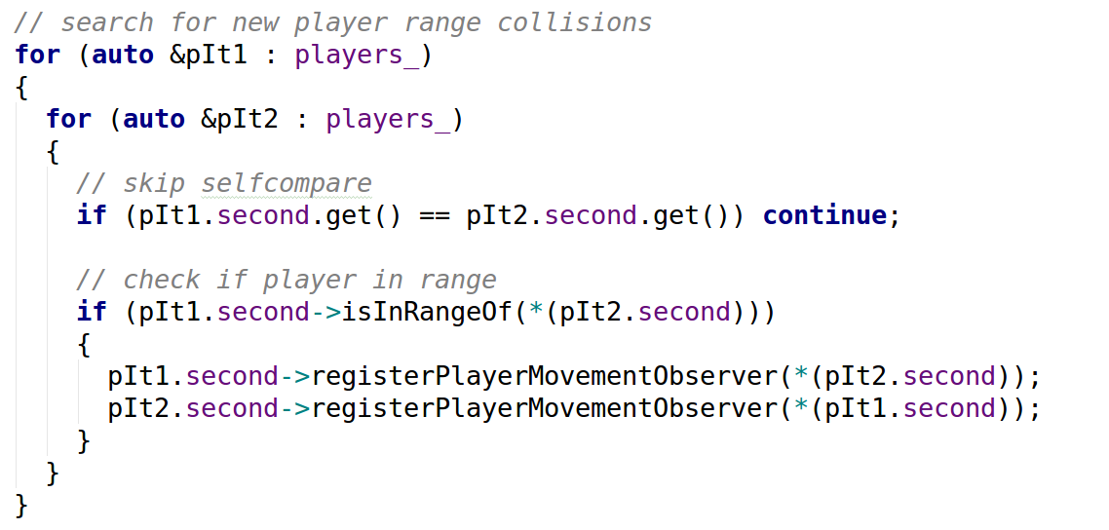
Demo 1 (2 Players moving towards each other)
Game once per update cycle checks if players get in
range
Once in range, the subject interface of both players gets called to attach the opposing participant as an observer.

Slide 11
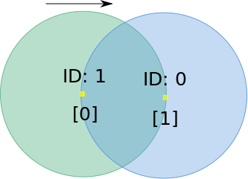
Demo 1 (2 Players moving towards each other)
From now on, both players are updated among another without relying on the game the whole time.
As an example each player would have a list to know which players have to be rendered.

Slide 12
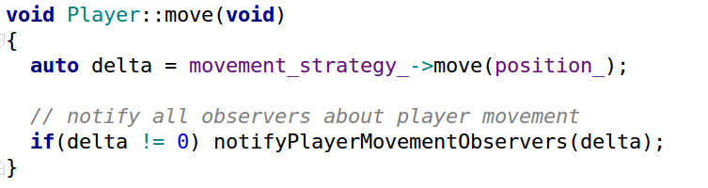
Demo 1 (2 Players moving towards each other)
Both players notify each other (observer-interface) once they updated their position.

Slide 13
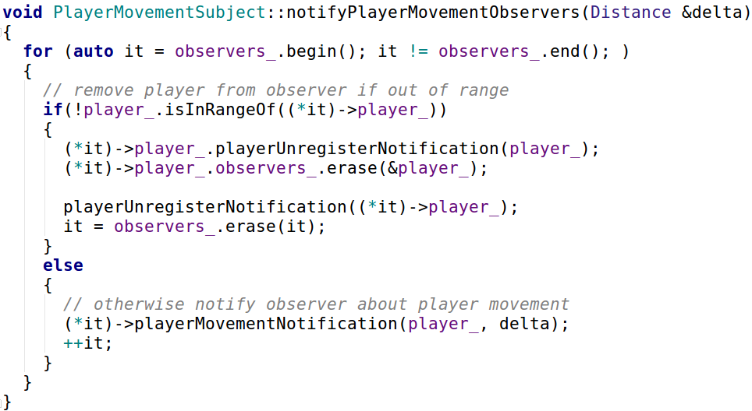
Demo 1 (2 Players moving towards each other)
If they are actually out of range, they notify the opponent party about it and detach the observation.

Slide 14
Demo 2 (Another, slightly more complex example)

Slide 15
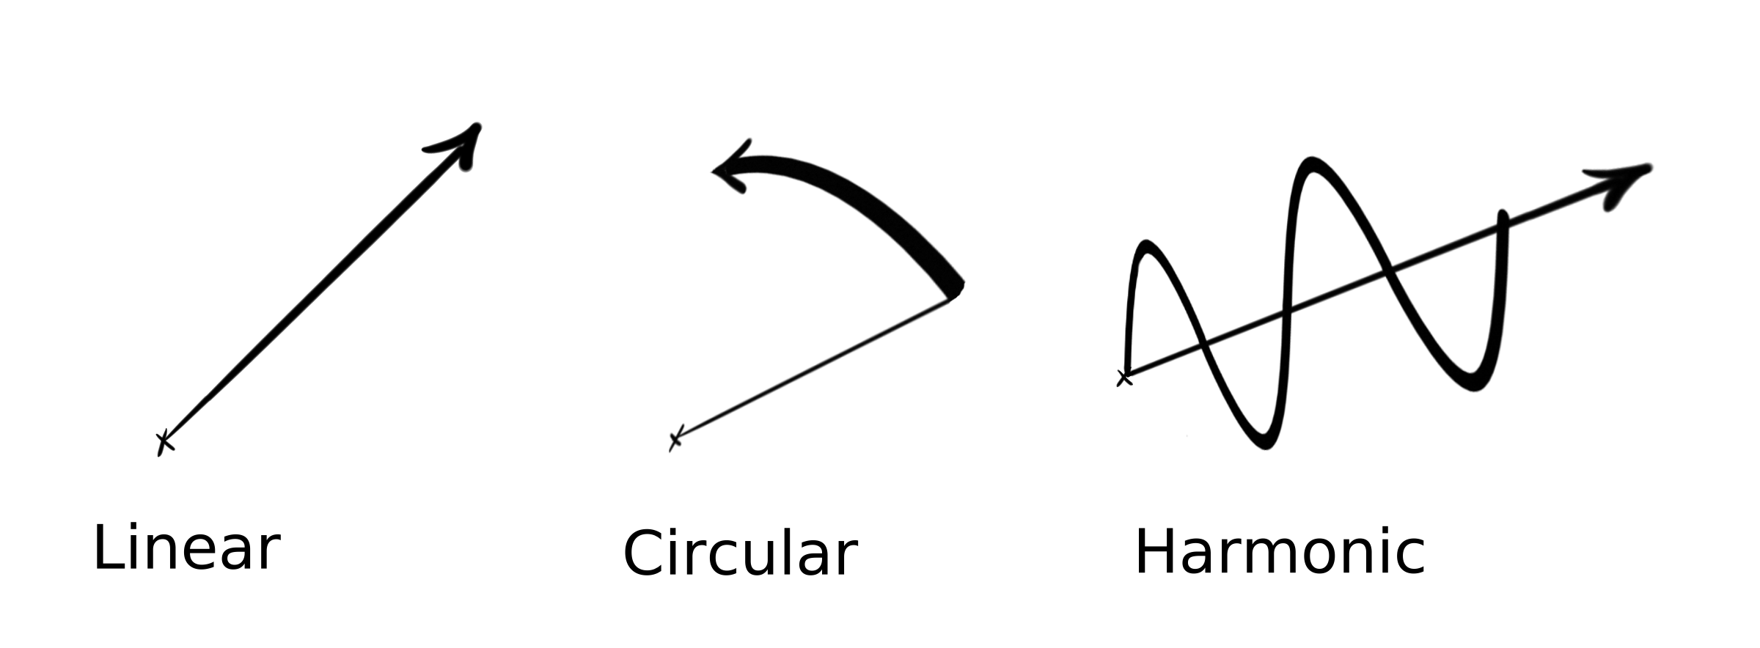
Movement Patterns (not a design-pattern!)
Making things more interesting by deploying different movement patterns for each player.
But how to organize them?

Slide 16
Movement Patterns (still not a design-pattern!)
1 class per movement pattern.
Each class only differs in behavior.
Player doesn´t need to know about it.
      Solution → Strategy Pattern

Slide 17
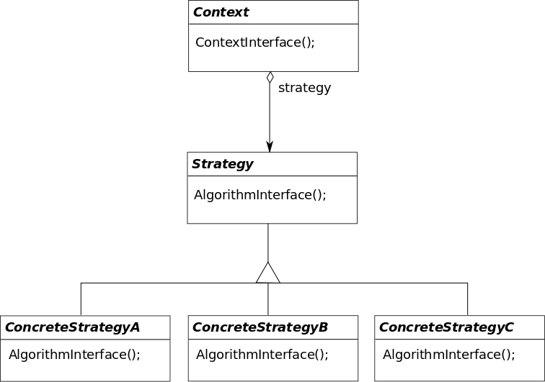
Strategy Pattern

Slide 18
Strategy Pattern Implementation
Each client sets a movement strategy at construction time.
Once every update cycle, the appropriate algorithm is called.

Slide 19
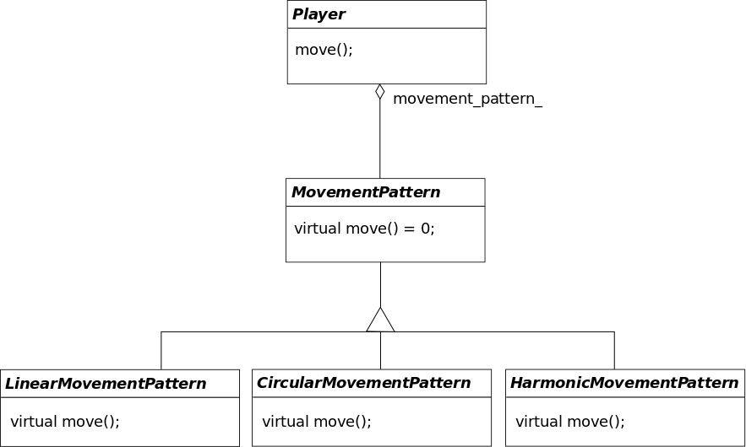
Strategy Pattern Implementation
In our case..

Slide 20
Strategy Pattern Implementation

Slide 21
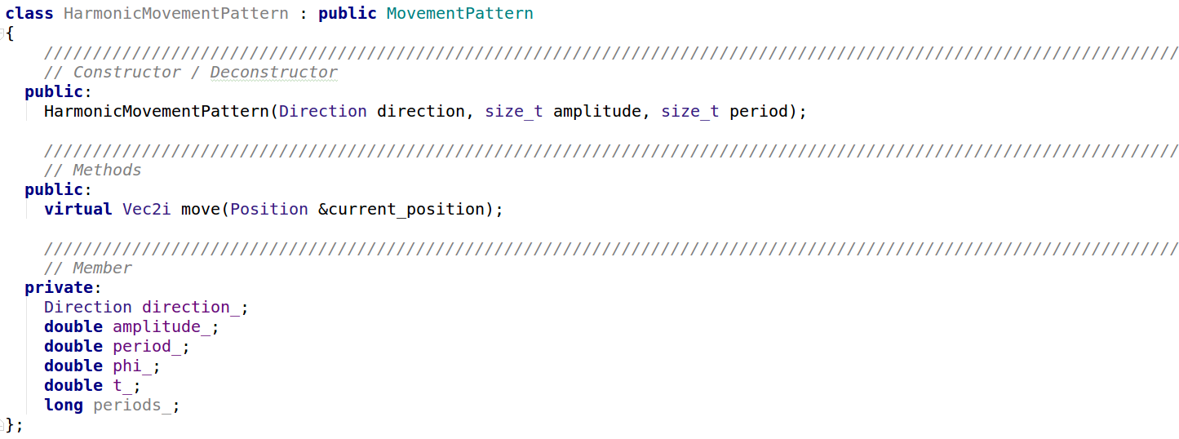
Strategy Pattern Implementation
Each pattern may have additional data members and/or methods

Slide 22
Demos 3 & 4

Slide 23
Questions?

