Slide 1

An Introduction to Sonic Pi by Philip Thompson / Martin Evans

Slide 2
Today’s Lesson :
Discover “Sonic Pi”
Learn to play notes
Learn to use different sounds
Learn to play more than one note
Make loops
Change the Speed (BPM)
Add effects
Play samples
Change parameters of sounds and samples
Use random values
Use “If” statements

Slide 3
[By Sam Aaron]
Notes:
Sonic Pi is a Program made by Sam Aaron. It enables you to make music by coding in Ruby.

Slide 4
Notes:
This is the Sonic Pi interface or GUI (Graphical User Interface)

Slide 5
Sonic Pi version info > (Free to download for Pi / Microsoft / Mac!)
Notes:
Sonic Pi by Sam Aaron info
(Latest version etc)

Slide 6
Coding Area
(Where we type the Ruby Code)
Notes:
Main Coding area.
Run / Stop / Record / Save / Load buttons.
Buffer 0 – 9 (windows you can make new files in)

Slide 7
Help / Examples (you can copy / paste from here into
The coding area above)
Notes:
Help & Examples. A fantastic resource of working examples you can cut N paste from
Or, use the help files which list the different aspects of Sonic Pi or Alphabetical Glossary of keywords / programming tools

Slide 8
Settings / >
Preferences
Notes:
Preferences / Settings
Access to Audio / Input & Output / Editor (interface) / Visuals / Updates

Slide 9
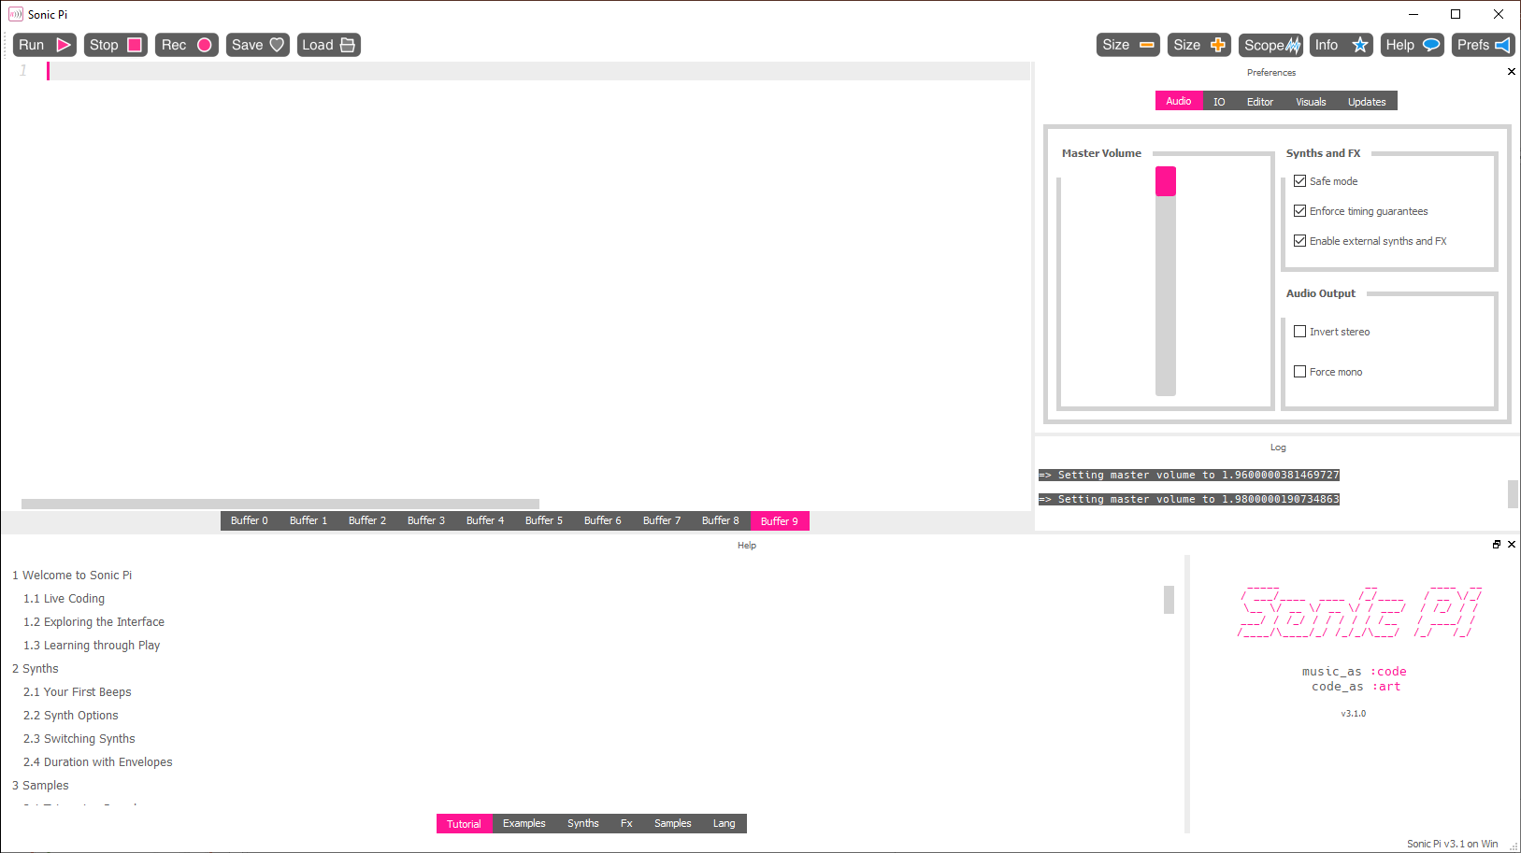
Select “Audio”
And put the Volume to maximum
Notes:
Because our headphones are quite quiet, we’ll crank the volume up.
Click on the “Audio” part of the settings menu & select the Master Volume slider & drag it up to maximum.

Slide 10
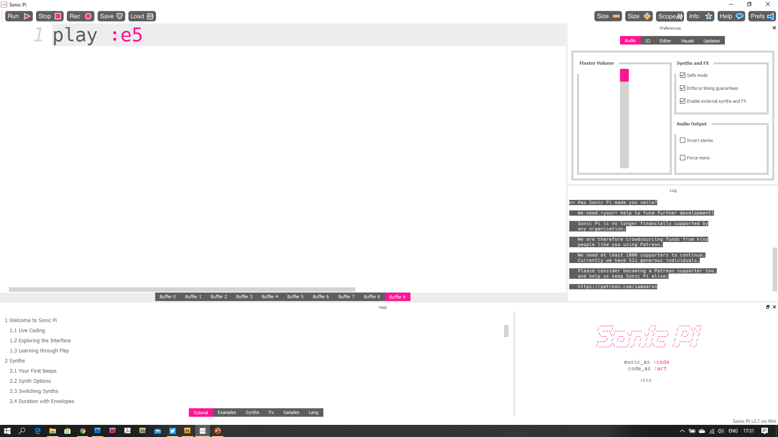
Type “play :e5”
(musical letter (a – g) + number (scale))
For sharp & flat notes add “f” or “s” after the letter
e.g. :Gs4 (G Sharp 4)
Notes:
Type Play :e5
(you can type numbers here, but I’ve found that kids use daft numbers (100000) etc. Best to keep it as musical notes too, as they have less chance of being “discordant” & more likely to “sound musical” (so it won’t put the kids off because it “sounds horrible”).

Slide 11
Press “Run”
Notes:
Press Run.
A sound should play (a middle E beep)

Slide 12
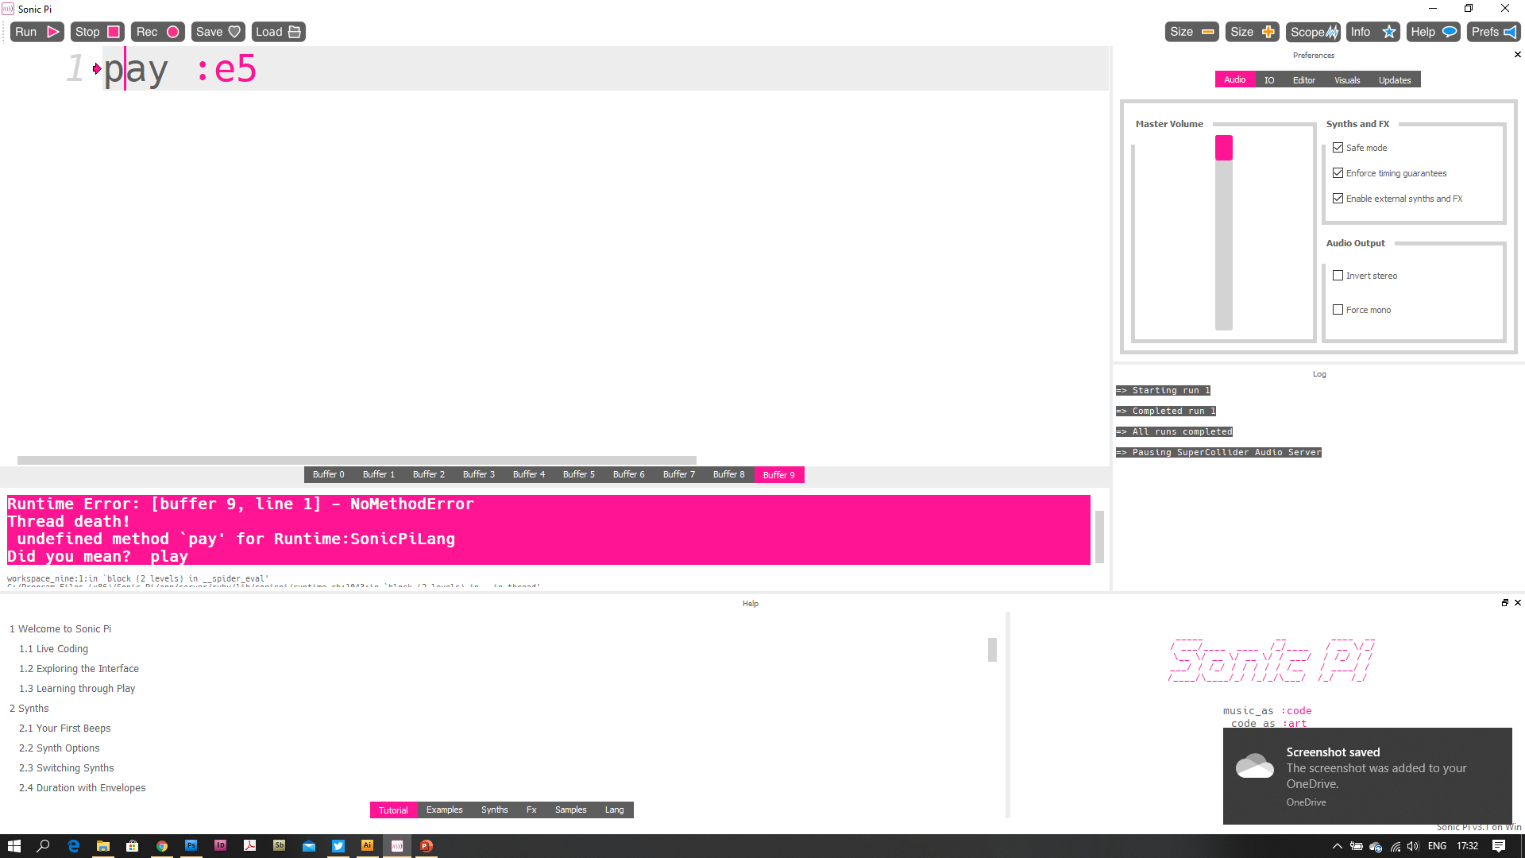
I accidentally typed in “pay” instead of play and press “Run”
I then get info on the mistake
Notes:
I purposefully mis-type something, and Sonic Pi shows us where the error is (pink Arrow + Pink background text, plus a hint at what Sam thinks you actually meant!)
“Did you mean Play?” fantastic.

Slide 13
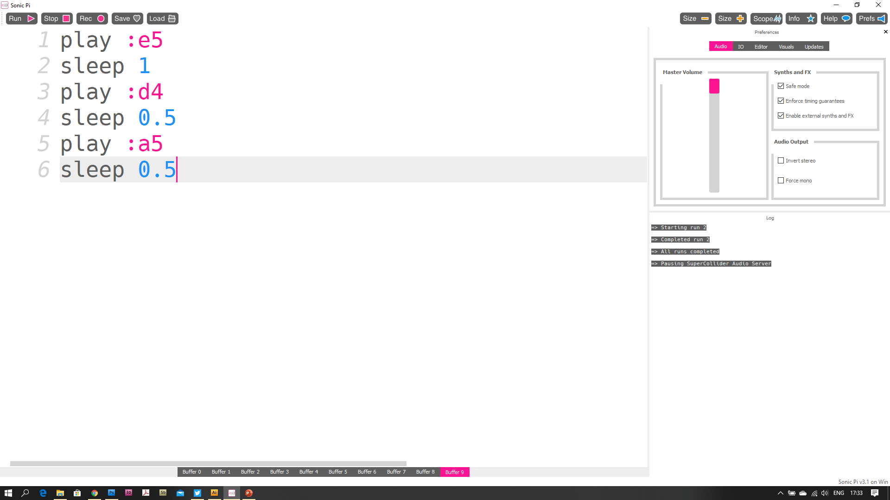
Add a “sleep 1”
The number is how many beats Sonic Pi waits
(add more plays (with different notes)
AND sleeps in-between each “play”)
Notes:
We’ll add more notes, to start making a tune! All we need is a “sleep” and a duration (in beats, not seconds).
If you want to keep to a 4/4 tune, make sure your beat “sleeps” add up to 4 or 8 or 16’s
But, if we have odd numbers of sleeps, that’s fine, you’ll be creating cool new time signatures!

Slide 14
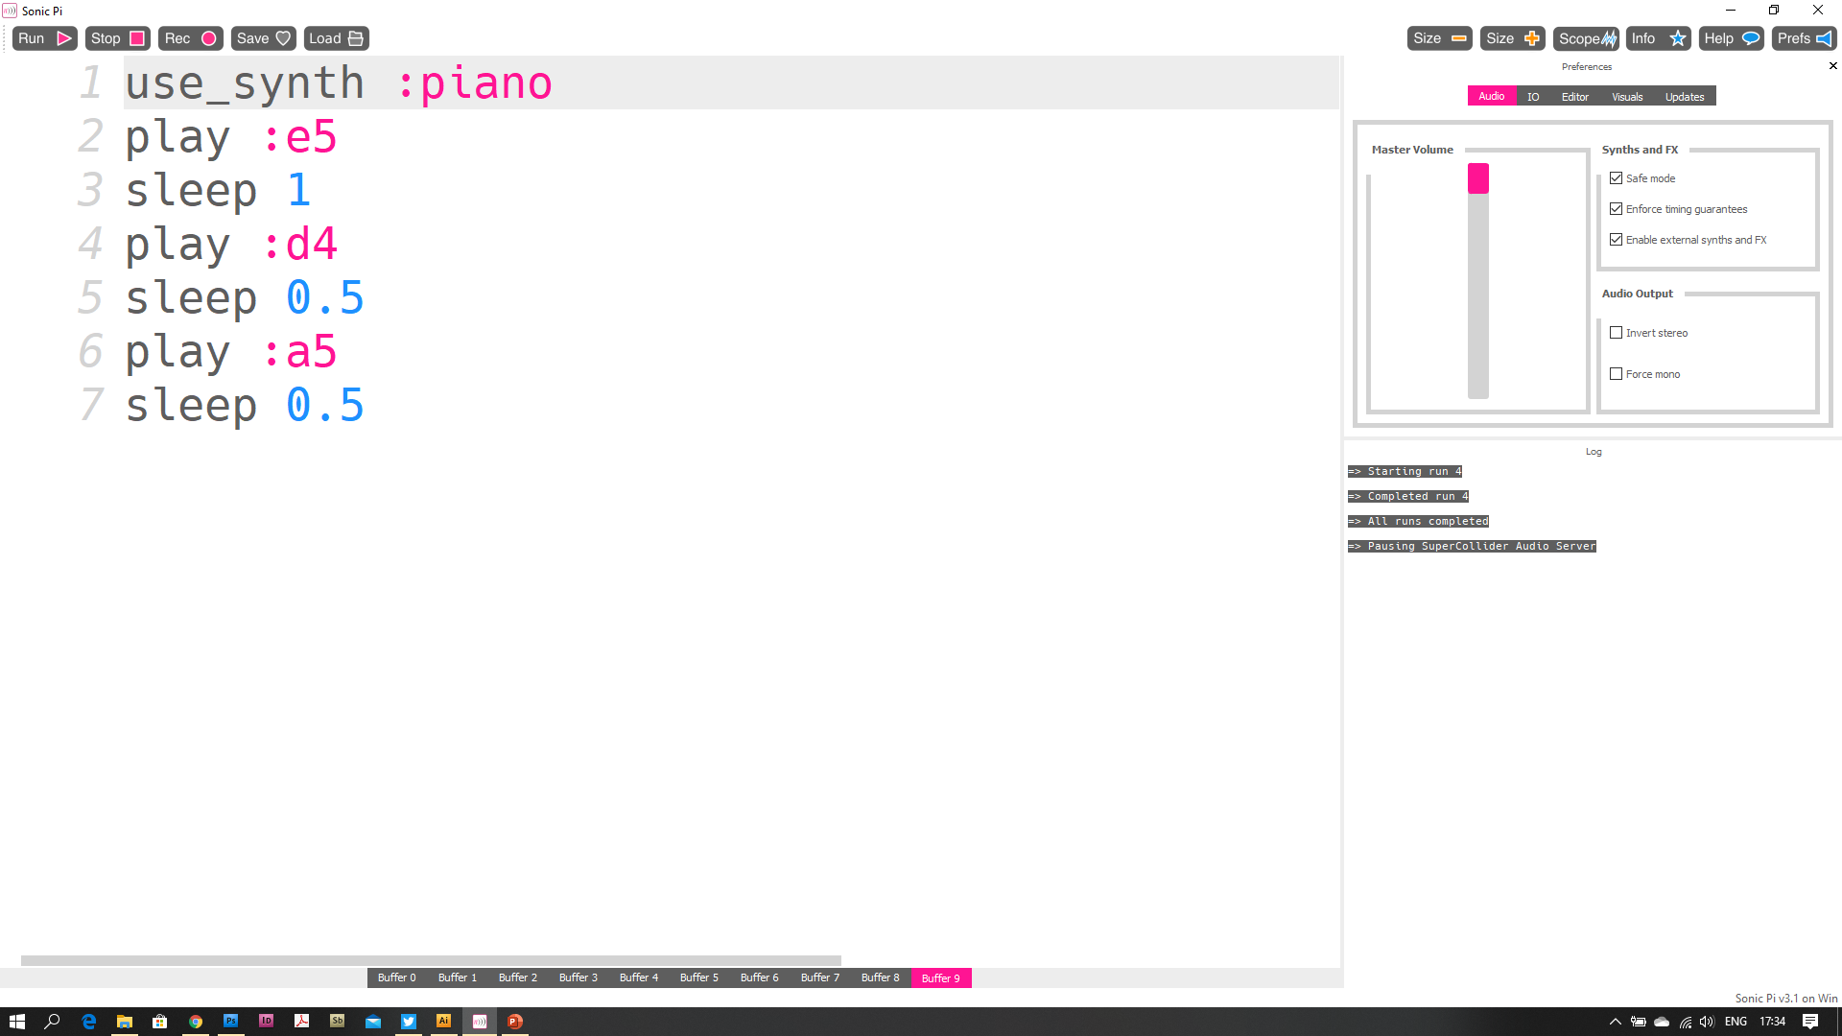
Above your “tune” Write “use_synth” (and pick a synth)
(the “underscore” is SHIFT & “-”) Sonic pi should give you a list of possible keywords that help you write code quicker.
Notes:
Bored with a beep? We’ll change the “synth” (Synthesiser) there are loads of different “instruments” (or sounds), so try your own here, as the hints will tell you all the possible synths to choose from.

Slide 15
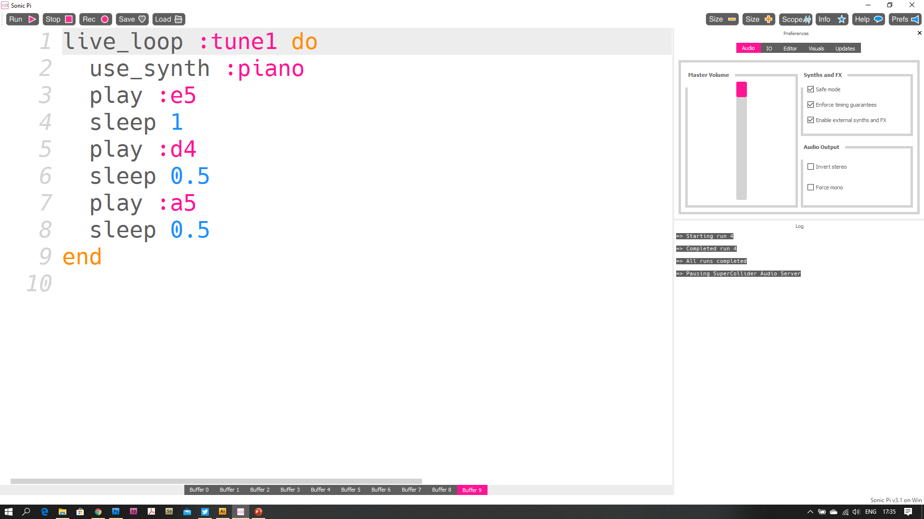
Type “live_loop” Then give your loop a name :someName & add “do”
Notes:
Bored of pressing play all the time?
We’ll put the “tune” into a “live_loop”, when you press play, if there are no errors, the live loop will keep playing.
If you change the synth or notes, you don’t have to press Stop & then Run, just press “Run” and the loop will change when the previous cycle has finished.
You can make changes “live” so you can keep the music going & perform live. If there is a mistake in a loop, it won’t play, but, if you have several loops going, anything without an error will keep playing.

Slide 16
Add a final sleep (if you didn’t have one)
And type “end” (at the end!) Press Run!
Notes:
“close” your live_loop with an “end” – you’ll notice that your code “indents” so you can see where the loop starts & ends.

Slide 17
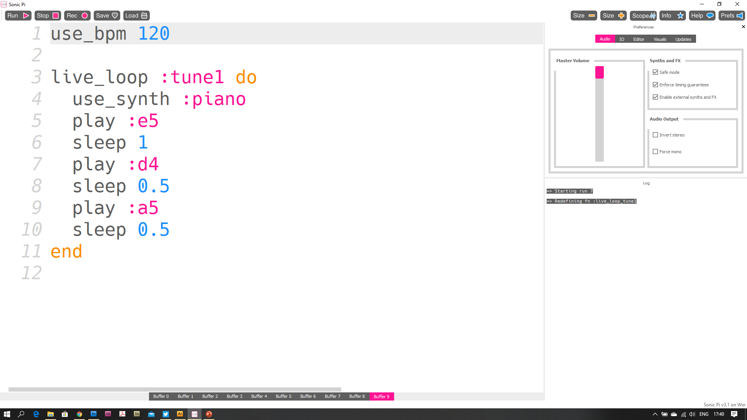
A bit slow?
Change the BPM (beats per minute)
use_bpm 120 makes the loop faster
Notes:
You can affect the speed of the tune by adding in a “use_bpm” (beats per minute). If this is at the start (outside) of any live loops, if you change this, you do have to press “stop” then “Run” to make it change the tune’s speed.

Slide 18
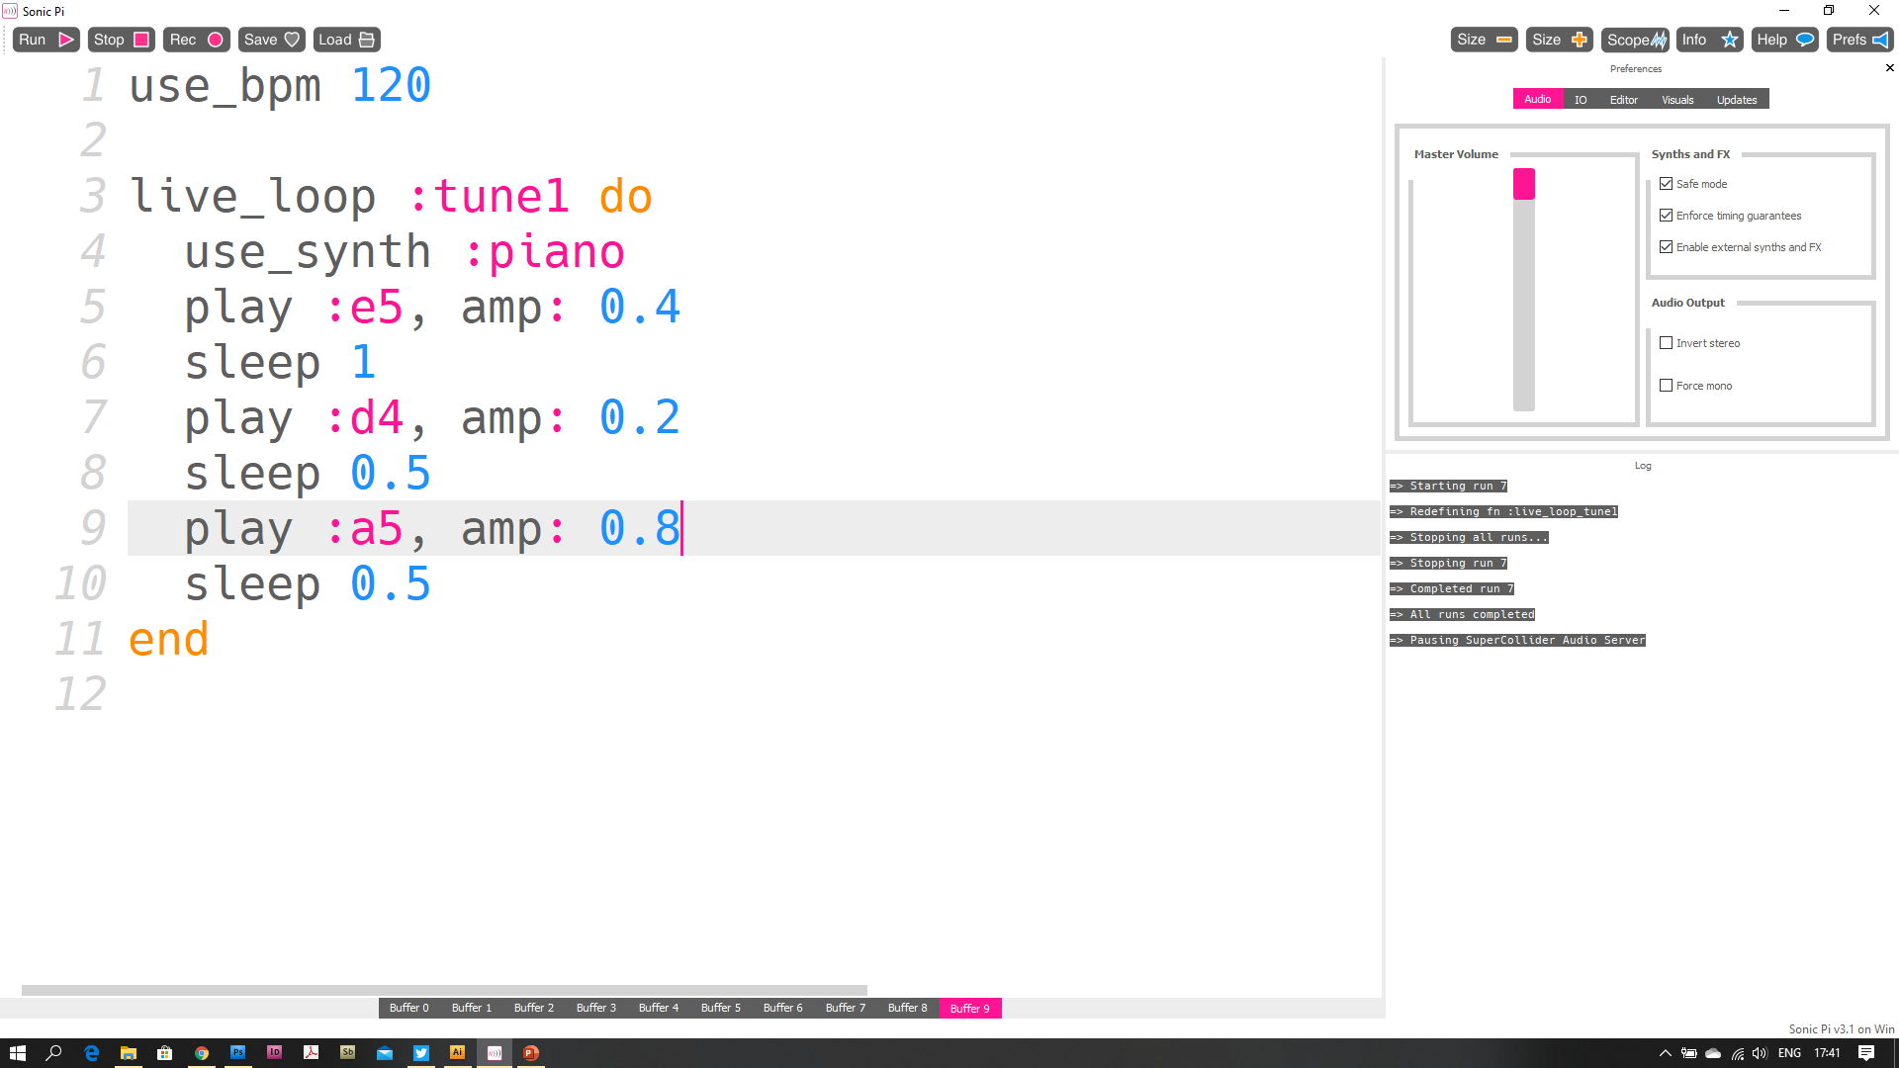
We can control the volume
Of each note.
After the note type “,”
And select “amp:” put in something between 0 & 1
0.4 etc.
Notes:
We can also affect the single note’s “parameters” (various aspects of the note’s sound). Here, we will change the amp: (amplitude) or Volume. This number can be anything from 0 to a positive number. Anything louder than 5 is usually not going to change the sound’s volume, but have a play & find out.
The syntax is important. After the “play :e5” we need a “,” (comma) and then a space, then “amp:” (colon after amp). Then a space & then the number.

Slide 19
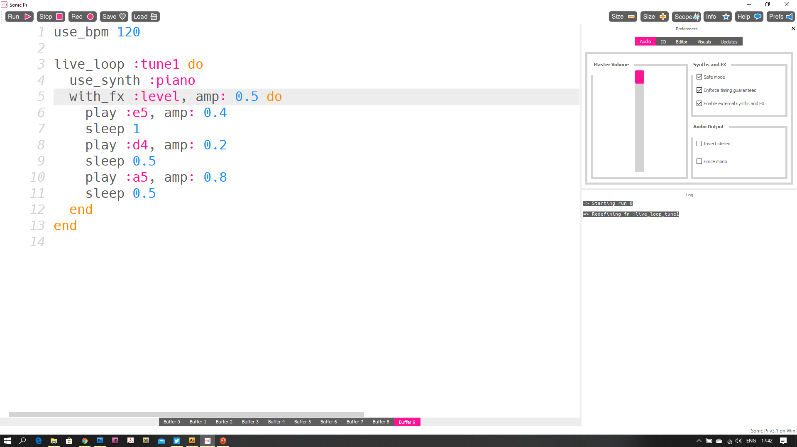
We can also control the volume of all the notes by using “with_fx”
with_fx :level, amp: 0.4
This will affect the whole block it surrounds. End the FX with an “end” too.
Notes:
We can also use an “effect” (use_fx) to change a whole range of notes. There are many “fx”, but, we’ll use “:level” to change the whole array’s volume too.
Wherever you want to start the effect, type: with_fx :level, amp: 0.5 do
The syntax is important again, a space after “with_fx”, then “:level” (colon then ‘level’ (or what ever fx you choose). Then “,” (a comma) then “amp:” then a space, then the number.

Slide 20
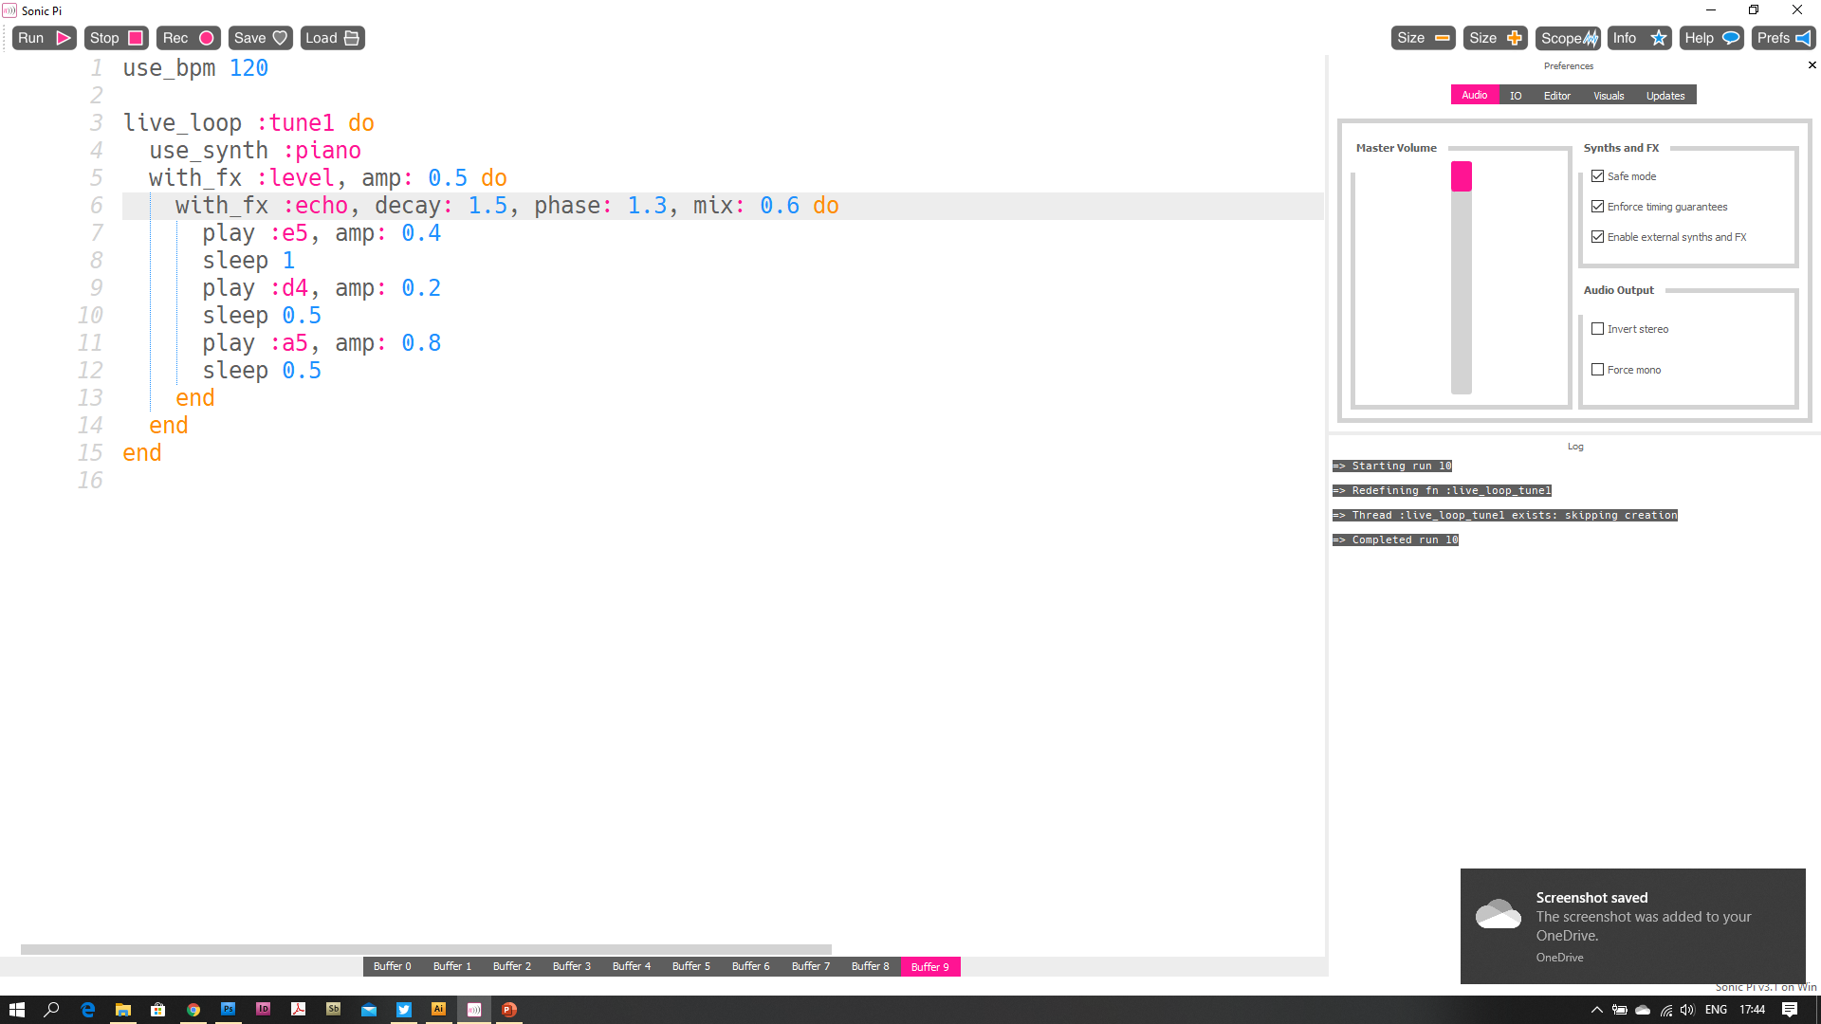
You can add a few “with_fx”
The FX affects up to where the “end” wraps. Try changing the position of the “:echo” end
Notes:
We’ll add another FX, this time “echo”. It has different “parameters” (they come up as hints when you put a comma after :echo .
Again, if you are adding a new fx, you’ll need an “end” where you want the fx to stop affecting notes / samples.

Slide 21
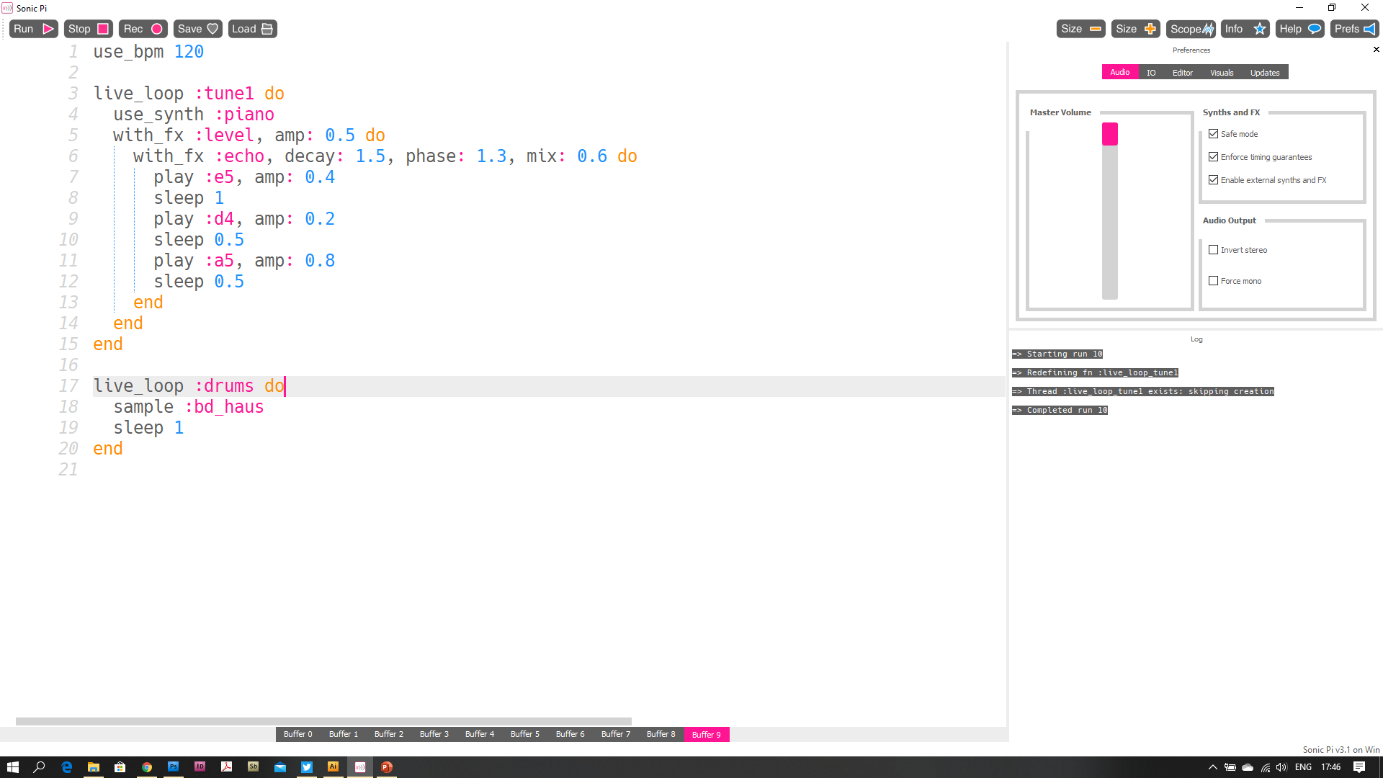
We’ll add another “live_loop”. We’ll call it “:drums”
We’ll add a “sample” now Select “:bd_haus” Add a sleep (1 beat) and an end
Press Run
Notes:
We’ll add another “live_loop”, this time, we’ll use it to control Drum SAMPLES. (not notes).
Your loop will need a “sleep” otherwise it will create an error. If you don’t add the sleep, you’re basically telling the computer to play a drum sample as quickly as the computer can loop.
Again, the “sleep” values are in beats. (not seconds).

Slide 22
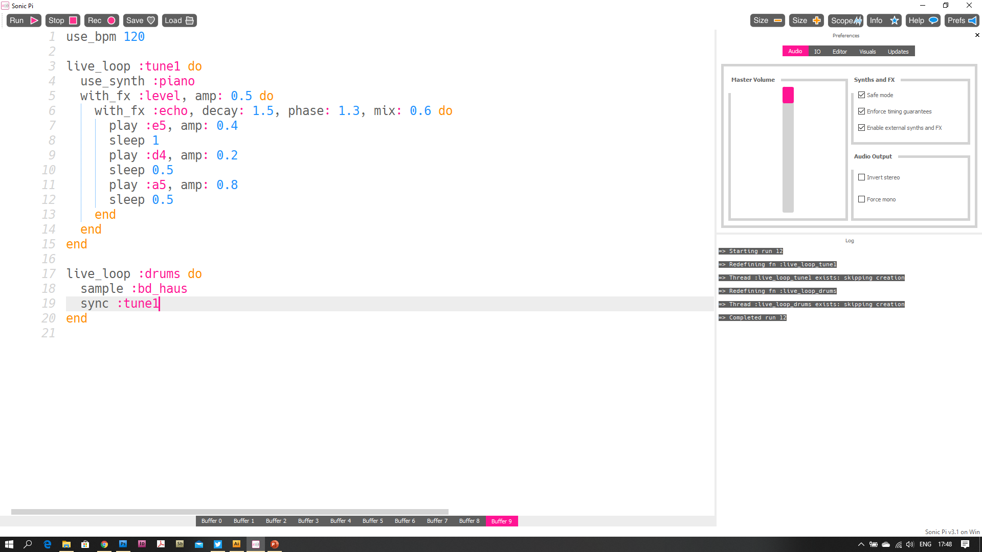
We can also
“sync” (syncopate)
The loop to the tune
Instead of a “sleep 1”
We’ll replace it with “sync :tune1”
Notes:
You can “syncopate” (sync) the loop to another loop…

Slide 23
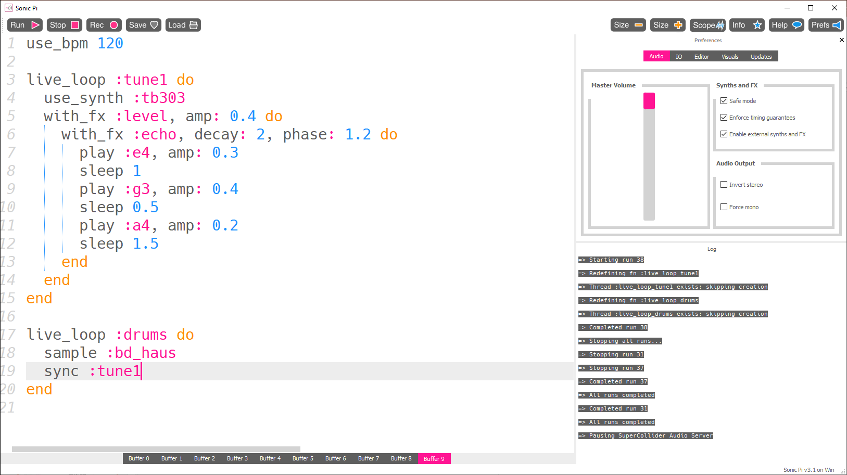
What?! The Beat just plays slowly now
Because it is “Sync’d” to the tune, the tune is 3 beats long, so the drums wait for :tune1 to finish before playing again.
Add some new drum samples and sleeps (that add up to 3 beats) add a snare?
Notes:
…meaning that the loop only starts when the loop it is is sync’d to starts. If your “tune” is 8 beats long and your drum loop is only 4 beats. You will hear the 4 beats, then it waits until the “tune” finishes to start again.

Slide 24
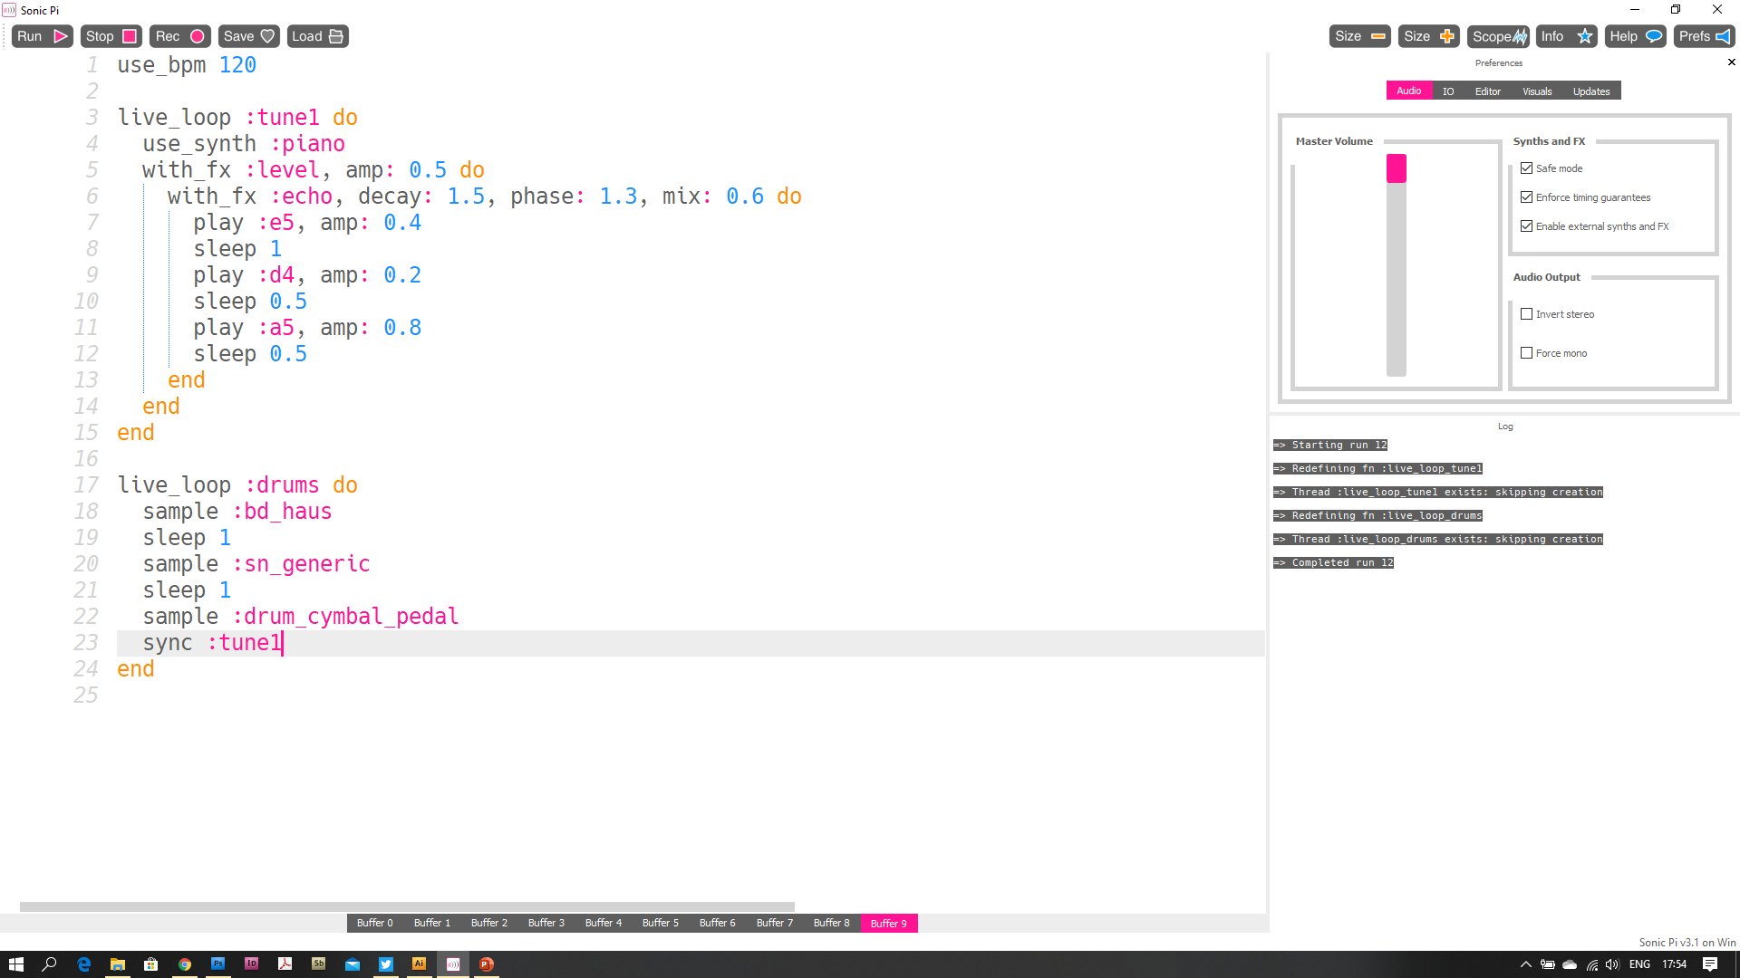
I’ve added some sleeps and new drum samples. Play with the samples / sleeps see what happens.
Notes:
We’ve added more drum samples (snare drum & cymbal). Still Sync’d to “:tune1”

Slide 25
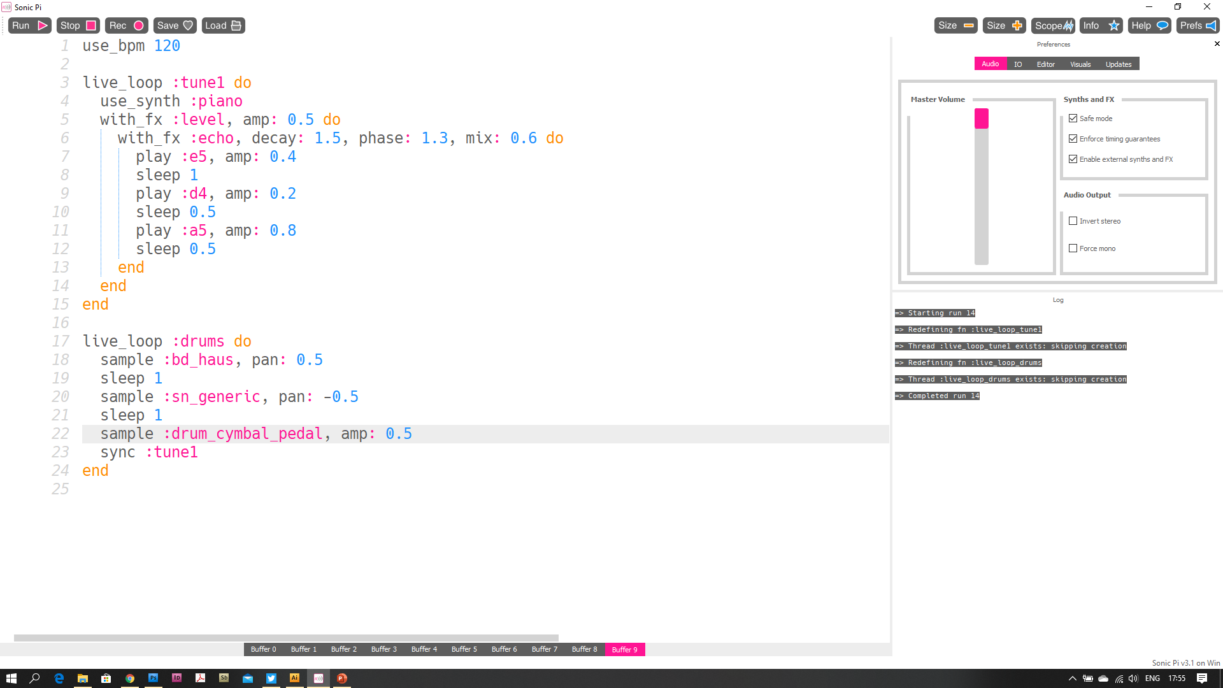
Like the “amp:”, we can affect the “pan:” (left to right) position of a sound. The values can only be between -1 & 1
Notes:
We can also affect the parameters of a sample, just like that of “play” (notes). We will change the pan (lef to right “position” of a stereo sound).
These parameters range from -1 to 1

Slide 26
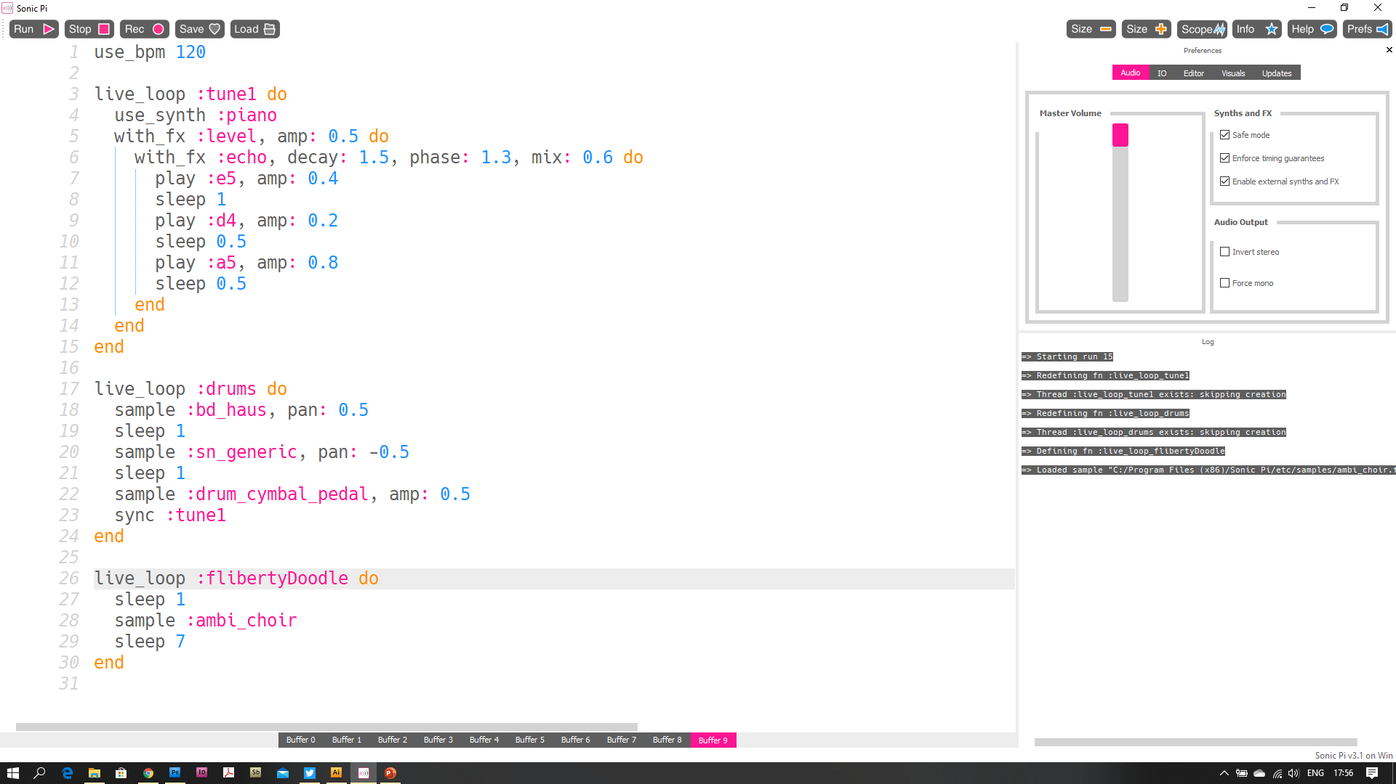
Add more “live_loops” Sync them to other loops or just add different sleeps see what happens! (psst, you’re making music!)
Notes:
We’ll add another live_loop. You can call your loops ANYTHING… here’s proof that :flibertyDoodle works.
Putting a sleep BEFORE the sample means there’s a short pause before the sample plays.

Slide 27
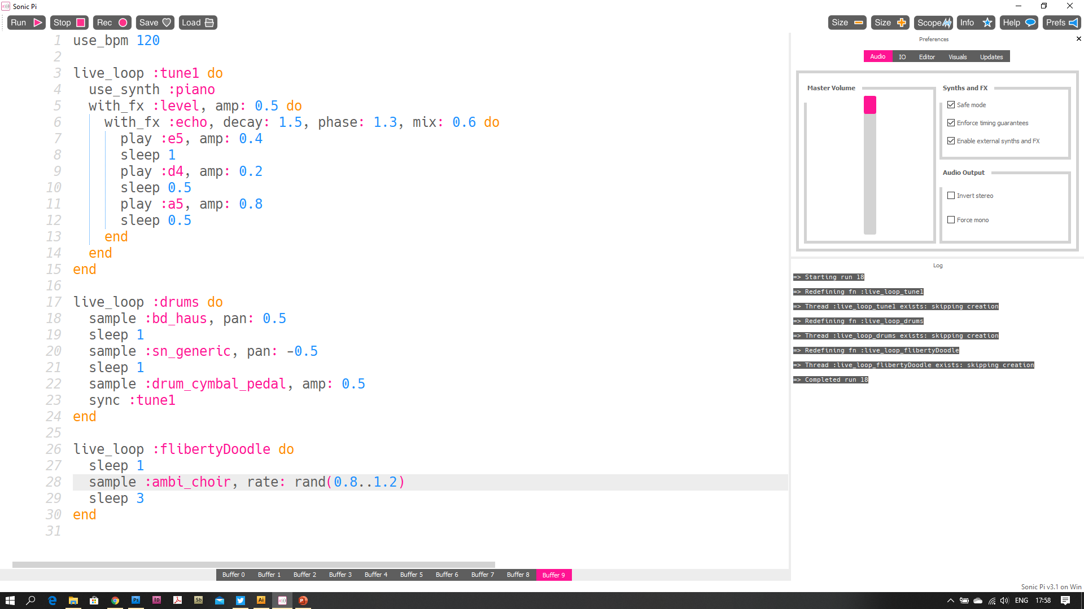
There are loads of “parameters” we can affect. We can also add random values.
Lets change the “rate:” of the choir sample to be a random number between 0.8 & 1.2
Type “, rate: rand(0.8..1.2)”
Notes:
We will use a ruby “random” value for the rate of the sample. This speeds up / slows down the sample (therefore changing its pitch / frequency).
We use “rand(a, b)” (where a is an integer and b is an integer greater than a). In this example we use 0.8 to 1.2 . The syntax is rand(0.8..1.2)

Slide 28
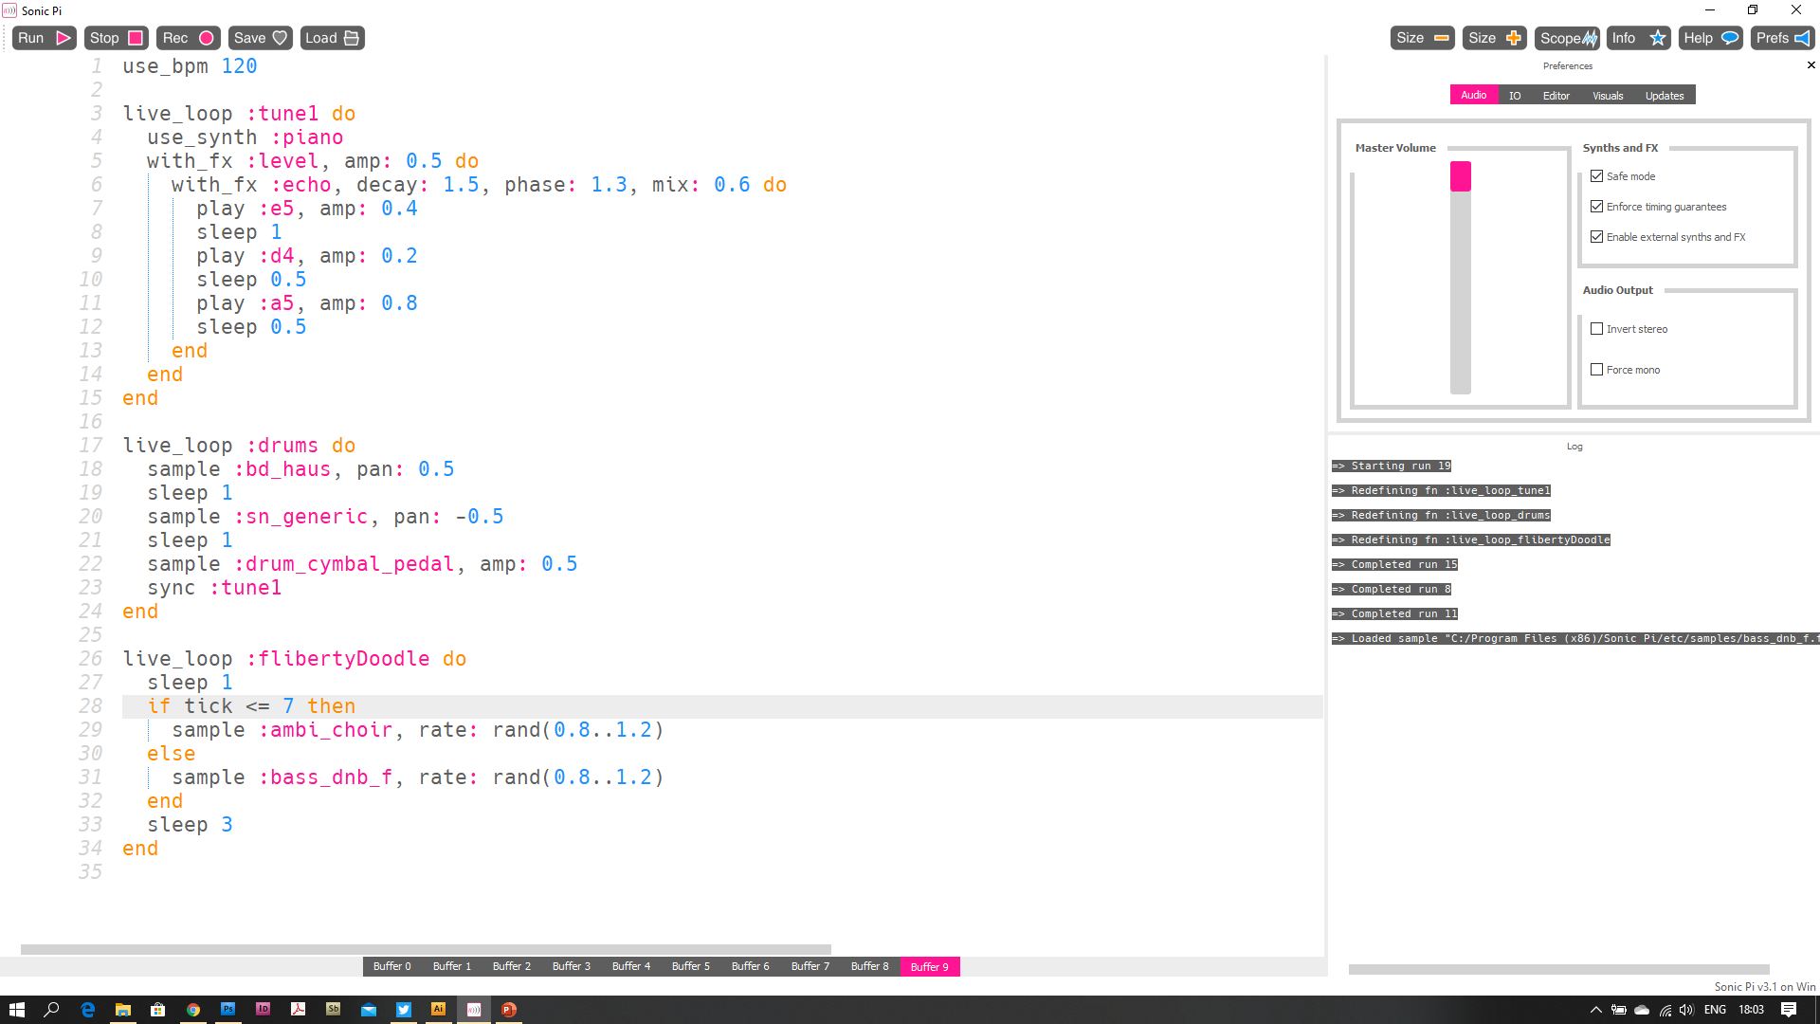
“tick” is a way Sonic Pi can keep track of how many times a loop has played for. You can also use it to change when things happen. We’ll use an “if” statement (I’ll zoom in)…
Notes:
Sonic Pi can also count how long a loop has been running for.
Tick is the keyword you can use.
We will check IF the loop is greater than or equal to 7 in order to play a different sample to the loops 0 – 6
*note* you can only refer to the tick once… checking against the “tick” more than once seems to make the tick count up quicker.

Slide 29
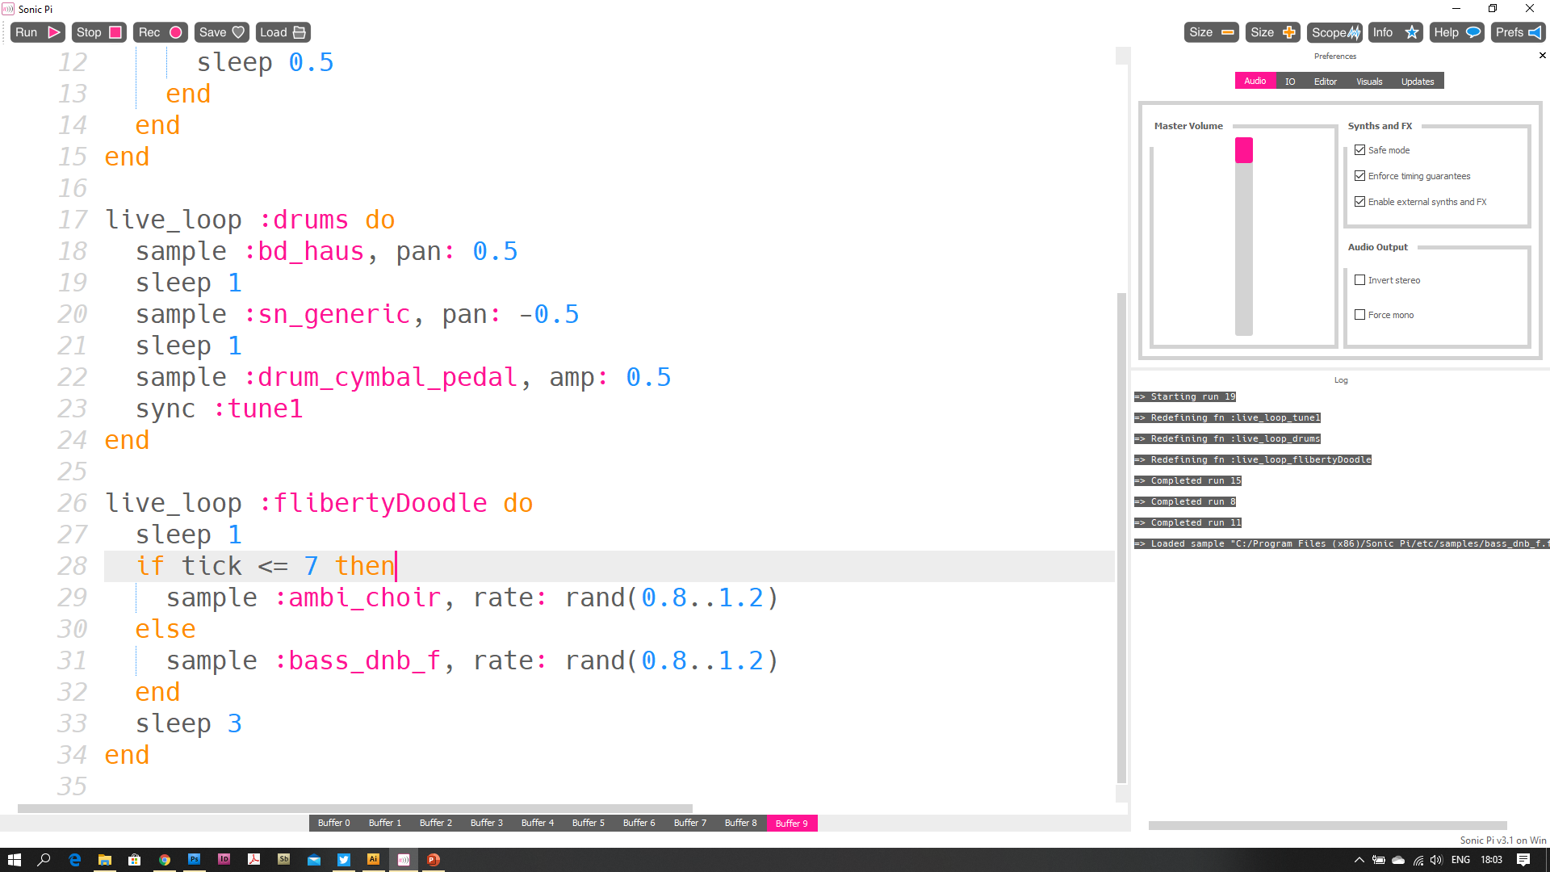
Copy the code below, then press Stop (if it is already playing). Press “Run” and wait a while. What happens?
Notes:
Zoomed in for ease of reading.

Slide 30
NOW MAKE SOME MUSIC!
Play…
Try…
Make Mistakes…
Fix the mistakes!
Enjoy!
Notes:
Now go play! Make some music!
This is just the beginning!
Enjoy sonic Pi, making music, learning ruby and having fun.
Big thanks to Sam Aaron too for making an amazing tool to teach coding while making music. Or is that teaching music while using Ruby?

Slide 31
Sonic Pi
Free to download!
www.sonic-pi.net
Notes:
This lesson was made by Philip Thompson of Digital Maker CIC.

