Slide 1

DPS2 Software Architecture
May 2011 Onwards

Slide 2
Scope
DPS2 Modernisation Development post May 2011
Sales
Sales Costing
Finance
Ref Data Maintenance
Vaadin
Google Guice
GWT Event Bus
Model View Presenter
Hibernate
Security
Development Environment
Notes:
Only focusing on post May 2011. Pre May 2011 is Seam code which is already understood by support.
Overview first.
Then deeper look at each area.
Assumed audience. Designers, developers going forward.
Areas covered. As listed.
I have 3 working apps to play with.
The final one combines all of the new technologies and techniques.
Small piece on security.
Does this meet everyones expectations?

Slide 3
Vaadin
Vaadin as in Saab
Not Vadin as in Darth Vader
Web application framework for RIA (Rich Internet Application)
Finnish Company (Vaadin is Finnish for female reindeer)
Commercial product; IT Mill Toolkit started in 2000
Opensourced in 2007
Renamed to Vaadin in 2009
Fremantle development with Vaadin started in May 2011
Built on top of Google Web Toolkit
Programming is in Java in the same style as Java Swing
Notes:
The UI part of the new tech.
Chosen to replace Seam due to :
Productivity.
Testability.
etc.
Original Paper available
Slide shows some of the history.
In terms of maturity, it is in a sweet spot.
Good pedigree but still actively developed.
Stress importance of java type safety for increasing productivity.
Fast bug finding
Fast navigation
Merge issues found quickly

Slide 4
Google Guice
Popular Dependancy Injection (DI)Framework
Used to ‘wire’ code together
With DI :
Code is loosely coupled.
Code is more reusable.
Code is more readable.
Unit testing is easier.
Notes:
Why have DI.
Structure code.
Go some way towards a component based design
Testing and mocking.

Slide 5
GWT Event Bus
Component of the Google Web Toolkit.
Implements a publish – subscribe pattern
The event mechanism in a Vanilla Vaadin application (or Swing App) binds the consumer of events to the producer.
The event bus is used to decouple event producers and event consumers.
Creates loose coupling of components.
Allows greater flexibility in design and reuse.
Notes:
Loosely couple app.

Slide 6
Model View Presenter
Without patterns a UI application very quickly gets out of control.
MVP introduced to enforce standard patterns :
Application structure
UI construction
Update and Read-Only UI
Event handling
Combined with a typical service tier and data access layer, means everyone knows where ‘things’ should happen.

Slide 7
Hibernate and Security
Hibernate
Usage carried on from Seam/JSF DPS2 code.
Existing Entity model reused.
Entity Manager reused and injected using Guice.
Vaadin Add-on : JPA Container used to bind entities to UI components.
Security
Re-using Seam security model.

Slide 8
Development Environment
Intellij
Not mandated
Used for its productivity gains
Helps new java developers learn, suggests better ways to code.
JRebel
Hot deployment tool
Allows code changes to be tested without a deploy to the server.
Continuous Integration
The code is compiled and tested everytime code checked in.
Reports issues to the team early.

Slide 9

Vaadin

Slide 10
What is Vaadin ?
Vaadin is a Java web application framework.
Designed for creating rich and interactive applications that run in the browser.
For creating Applications not Websites.
The programming model is much the same as in traditional desktop programming, with events and listeners rather than requests and responses.
No HTML, XML or JavaScript necessary.
Notes:
Compare the programming model of Seam vs Vaadin.

Slide 11
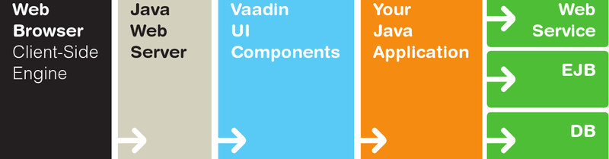
Vaadin Architecture Part 1
We don’t really need to know.
It makes no difference to the developers day job.
Built on top of GWT.
Lots of AJAX built in.
Uses JSON for client server comms.
Magic
Project
Notes:
JSON Javascript object notation.
We don’t see the magic happen.

Slide 12
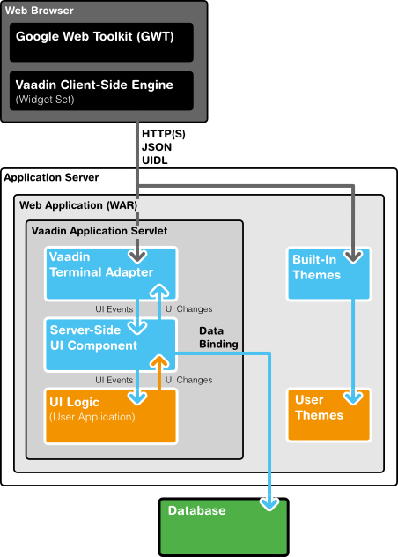
Vaadin Architecture Part 2 (If you really need to know)
Vaadin runs as a servlet in a Java webserver, serving HTTP requests.
The terminal adapter receives client requests through the web server's Java Servlet API, and inteprets them to user events for a particular session.
Sessions are tracked using cookies.
Events are associated with UI components and delivered to the application, which handles them with listeners.
If the application logic makes changes to the server-side UI components, the terminal adapter renders them in the web browser by generating a response.
The client-side engine running in the browser receives the responses and uses them to make any necessary changes to the page in the browser.

Slide 13
Things to consider
Stateful architecture
Held in server memory per user session
Need to profile regularly
Rich components
No faffing with javascript or AJAX
Extendable to create project component set
Type safe
Pure Java
Easy to test compared to traditional web app

Slide 14
What does Vaadin look like ?
Vaadin
import com.vaadin.ui.*; public class HelloWorld extends com.vaadin.Application { public void init() { Window main = new Window("Hello window"); setMainWindow(main); main.addComponent(new Label("Hello World!")); }
}
Swing
import javax.swing.JFrame; import javax.swing.JLabel; public class HelloWorldSwing { public static void main(String[] args) { JFrame frame = new JFrame("HelloWorldSwing"); final JLabel label = new JLabel("Hello World"); frame.getContentPane().add(label); } }
Notes:
Quick look at the swing app.

Slide 15
Simple Vaadin Demo
Maven Archetype
In Intellij
New project from archetype
Jetty:run
Note :
Click Listener
Servlet Config
groupId
com.vaadin
artifactId
vaadin-archetype-clean
version
1.6.1
Notes:
Use intellij community edition. Install maven.
Devs need to understand maven.
Simple app uses jetty server. Our real app uses Jboss.
web.xml
Describes servlet to run
Vaadin ApplicationServlet starts up and looks for
MyVaadinApplication and runs the init method of that class.
MyVaadinApplication
extends Vaadin Application
runs init method once only.
(In our full blown app runs when log in).
Need to be aware of that when dowing real dev.
(UI construction code only run at login)
Build and run
Run in debug
Place breakpoint
Modify code
Build and run.

Slide 16
Components - Quick demos.
http://demo.vaadin.com/sampler
Forms
(Bound to Item – db row)
TextFields
(Bound to Property – db column)
Tables
(Bound to Container – db table)
Combos
(Bound to Container – db table)
Tabbed panels
Etc
Add-Ons – Components and Containers.
Notes:
Another good reason for using Vaadin is the quality of documentation.
Add-ons
We use
- JPAContainer
- Paged Table
- We extend CustomField.
Project philosophy is to keep look and feel like seam.
And not to use complex components.

Slide 17
Reusable Fremantle Custom Components (Examples)
FmTextFields for Numeric Types (with validation masks)
FmButton (disables double click)
Address selector
Entity specific combos (e.g. CurrencyCombo)
Dual Text Search – Like or equals
Validations
Fremantle specific date
Decimal Format
Required validation
The DPS2 project has its own theme.
Themes are CSS.
Extended from an existing theme.

Slide 18
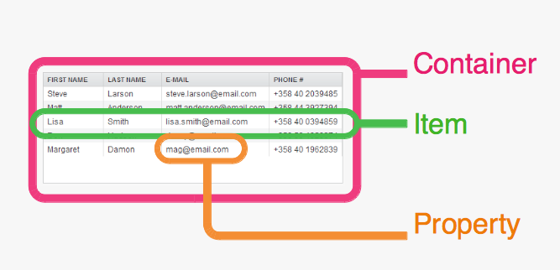
Binding Data to Components
Data model represented as Containers, Items and Properties
Defined as java interfaces, additional interfaces for sorting and filtering etc.
Value change listeners directly update UI from data changes (Configurable)
UI changes propogated to data model either by commit/discard or auto. (Configurable )

Slide 19
Container Implementations
BeanContainer
Wrap POJO’s
In memory
JPA Container (Add-On)
Wrap entities
Table = Container
Row = Item
Column = Property
LazyQueryContainer (Add-On)
Wrapper for custom data source

Slide 20

Guice
Notes:
Break

Slide 21
Guice is a Dependency Injection Framework
Dependency Injection is a pattern providing Inversion of Control
IOC removes the need for a dependency to be hard wired.
Examples of IOC are :
JNDI
Factory Pattern
Good Example of IOC is a database connection via JNDI.
// Look up the JNDI data source only once at init time Context envCtx = (Context) new InitialContext().lookup("java:comp/env"); datasource = (DataSource) envCtx.lookup("jdbc/MyDataSource");

Slide 22
Guice DI
Demo
Shows app with no DI
Vs Guice
Notes:
In Intellij
https://github.com/philbarton/fremantleGuice.git
In No Guice
Examine Customer – see Notifier is hard coded.
What do we do if we want to mock or stub out the notifier.?
Build and run noGuice
Modify customer to use SMS.
In Guice
Examine Customer – see Notifier is hard coded.
Not Inject.
Examine Notifier ImplementedBy.
Examine GuiceNoModule
Will use defaults
CustomerModule defines Notifier as SMS
Build and run
GuiceWithProviderModule
Alternative way of injecting. Especcially used for external classes.
Its how we access the Identity and EntityManager from Seam.

Slide 23
Guice @ Fremantle
Module binds based on user roles
Update code injected if role has update
Otherwise, default is read-only.
Care needed not to include processing in @Inject methods
Has slipped in in some areas (under going refactoring)
Slows down the application start up.
Re-use of Seam components using Guice Providers
E.g. Entity Manager
Notes:
No building or computation in Inject methods.

Slide 24

GWT Event Bus

Slide 25
Why have an Event Bus
Decouple components
Consumers of events know nothing about the producers
And vica versa
Consumers don’t have to have an association with the producers
Greater flexibility for change
Components can be moved and reused without changing the event handling
Assist with unit testing
Possible to generate events without the UI components
Possible to verfy events are produced by having test listeners
Without an event bus you have long chains of method calls, making the code brittle

Slide 26
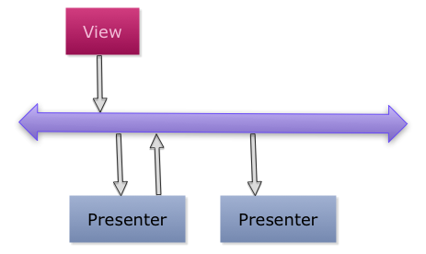
How it works
Publish from Views or Presenters
Subscribe in Presenters
Event Bus stored in a ThreadLocal variable
Accessed by static method : getEventBus()
Synchronous
Notes:
Only presenters should run business logic.
Views are for UI viewing and event generation.
Some views store state changes e,g, the item selected in a table, rather than sending it in the event.
Early code passed id’s or items around. Worked but slightly more fragile then storing in context.

Slide 27
Code Samples
Publish
CashReceiptsSearchControlsView.java
Subscribe
CashReceiptsSearchResultsPresenter.java
Note:
No guarantee of order.
Assume we fire, Event #1 from publisher A
If we have consumers B and C with a registered interest in Event #1.
We have no guarantee which consumer will get the message first.

Slide 28
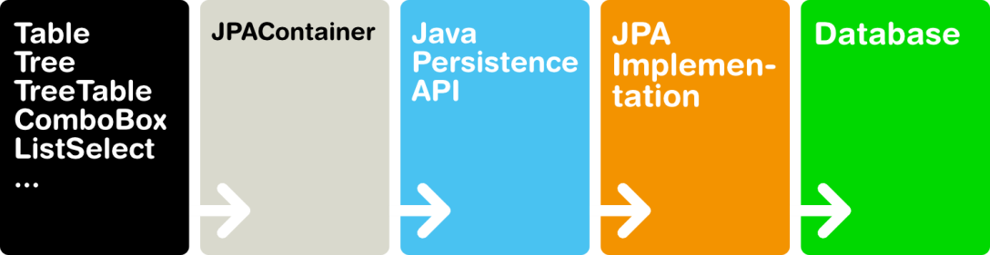

Repository

Slide 29
Two modes of database access
Java Persistence API JPA Container
Vaadin Add-On
Backs all UI tables
Form editing operates on items (db row) taken from the container (db table)
Hibernate Entity Manager
Used for ad hoc queries and updates.
Wrapped in Data Access Objects DAO’s
Also used for stored procedure calling

Slide 30
Entity managers are shared
Both forms of access reuse the Seam Entity Managers
Accessed through Entity Provider
Two entity managers used.
Normal and Temporary
Temporary used for database views.
Temporary has clear method to force read from DB

Slide 31
Hibernate Part One
Object relational mapping (ORM)
Hibernate is an implementation of JPA
Top link / Eclipse Link is another variant
Mapping to tables and rows done with annotations.
ClientCashReceipt.java
Uses standard optimistic locking
OPT_VER column.
Happens automagically
VersionedEntity.java

Slide 32
Hibernate Part Two
Transactions started manually, apart from in JPA Container.
Named Queries used to access database.
Called from DAO’s
ClientInvoiceAllocation.java
ClientInvoiceAllocationDAO.java
DB Views gotcha
Hibernate maintains a cache, so we need to clear the persistence context so that data is refreshed from the database.
Standard mechanism to call stored procedures
Managed transaction
All have a return code and message.
Rollback gotcha
A rollback detaches all entities, session needs to be restarted.
I.e. go back to a searcher

Slide 33
JPA Container
Code example
Created using factory
Container has a one to one mapping with a table or view
Nested properties create joins
Removing properties stops a join. (Improves performance)
ClientCashReceiptAuditContainerFactory.java
Filtering provides way of doing queries
ContainerFilterExample.java

Slide 34

Fremantle Software Architecture
Notes:
Now that we have a knowledge of the under lying technologies. We can pull them all together.

Slide 35
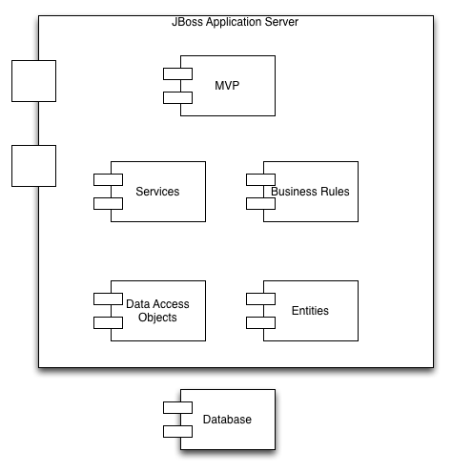
Layered design

Slide 36
Model View Presenter Part One

Slide 37
Model View Presenter Part Two
Model
In most cases the model is a JPAContainer or EntityItem
Typically built by the presenter and passed to the view.
The view interacts with the model to display and edit data.
View
The view is constructed at the request of a presenter
The view only contains UI code,
The view generates events
Presenter
The presenter constructs' the view
Listens for events
Applies business processing, calling services and rules

Slide 38
Read and Update
Design decision taken early to create a read and an update version for each area of the UI.
Reduces complexity of the authorization model.
Defaults to read, unless user has a specific role.

Slide 39
Demo
We have a demo that contains all the technologies.
But lets run through the development tools that we use.

Slide 40
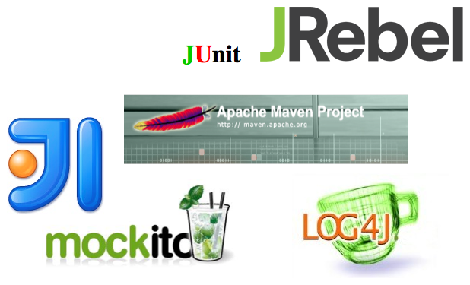
Development Environment

Slide 41
Maven
Tool to manage and build java based projects
Provides a uniform build process
Configured by pom.xml files (project object model)
Extended using plugins (e.g. test coverage report tool)
Manages dependencies
e.g. versions of supporting libraries
Vaadin
Seam etc
Typical use
clean
install
Runs test suite

Slide 42
Intellij
Integrated Development Environment
Project created by importing maven build files.
Edit, compile and run code from with IDE.
Runs a full copy of JBoss
Runs selected tests from the test suite
Full debugger support.
Inline warnings help to improve code quality

Slide 43
JRebel
The DPS2 project build can take sometime.
A clean deploy and server restart can take 15mins or more.
Prior to using JRebel changes had to made in batches and some hacks were used to deploy xhtml.
Now, JRebel hot deploys code.
This means we can make a change, hit the make button in the IDE, and the change is deployed immediately so we can test straight away.
Doesn’t work for everything.
New hibernate entities don’t work
New events don’t work
Changing a class hierarchy is hit and miss.

Slide 44
Testing
Junit is used to run tests
When run within Intellij shows test coverage.
Use mock objects to assist testing
Allows us to program the behavior of objects, so that our code under test can be exercised.
e.g. Mock out a DAO, so that service can be exercised.
Mock object framework we use is Mockitio
Used in conjunction with Guice, allows us to use Test Modules to inject mocked objects as dependencies.

Slide 45
Logging
We use log4j
Very simple to use
Makes debugging easier
With hibernate settings, the SQL generated is logged
Log files stored in JBoss directory structure
<jbosshome>\jboss-as\server\production\log
Logging levels controlled by config file :
<jbosshome>\jboss-as\server\production\conf\jboss-log4j.xml

Slide 46
QA Policies
We do informal code reviews ad hoc.
Things we try to watch out for.
No warnings in code
(If can’t be avoided then use suppression annotations) Demo
No commented out code
No To-Do’s
Keep the code DRY (Don’t repeat yourself)
Try to remove/reduce duplication, but don’t make it too complex.

Slide 47
Continuous Integration (CI)
CI is a mechanism whereby, when code changes in subversion. The code is checked out, complied and tested.
This means we have a very quick feedback cycle.
If anyone breaks tests we know about it.
We run unit and integration tests.
Unit very quick, with mocking
Integration access's the database
Encouraged to check in often.
We use a tool called Jenkins.
Web based

Slide 48
Demo
Covers
Vaadin
Guice
Event Bus
MVP
https://github.com/philbarton/vaadinMVPGuiceJumpStart.git
We’ll get it up and running now.
Then, make some enhancements after the next section:
Add a create popup.
Modify the edit form field factory so that edit can’t change the description.

Slide 49
Application Design

Slide 50
Hosting Vaadin with Seam/JSF
Application Servlets
Web.xml
iFrame
financeApplication.xhtml
Menu options - init application.
FinanceApplication.java

Slide 51
Module Structure
Sales
Sales Costing
Finance
Security
Code snippet
Word Merge
Docx4j
Gotchas

