Slide 1

NHS Capacity Analysis
Phil Best

Slide 2
Agenda
Context
2. Patterns, insights, and business recommendations
3. Analytic recommendations
4. Conclusion

Slide 3
1. Context

Slide 4
Context Problem Statement
Analysis into whether the NHS has enough capacity to meet demand, and how resources are currently being utilized. Failing to understand this could lead to poor investment decisions and poorer provision of healthcare amongst the UK population.

Slide 5
2. Patterns, insights, and business recommendations

Slide 6
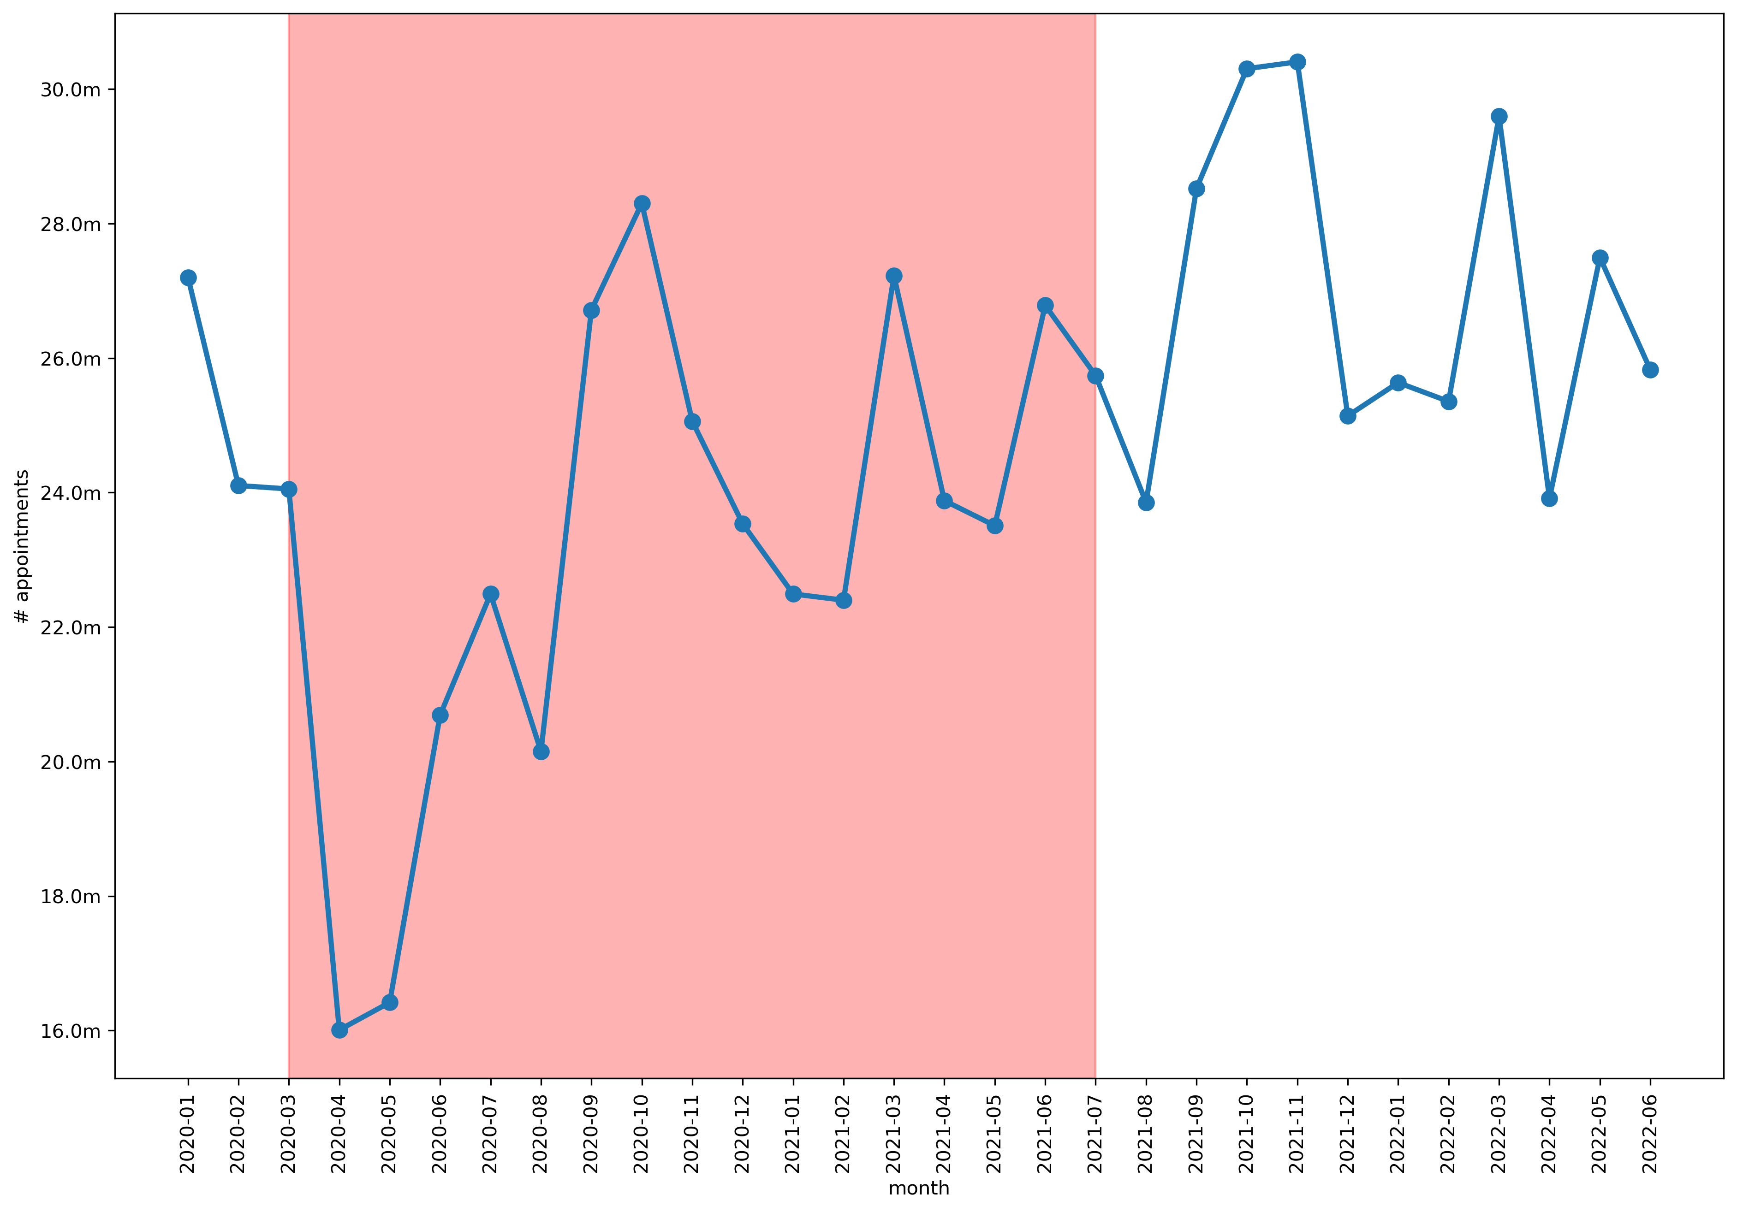
Patterns and Insights Covid impacted available data. Analysis focused on August 2021 to June 2022

Slide 7
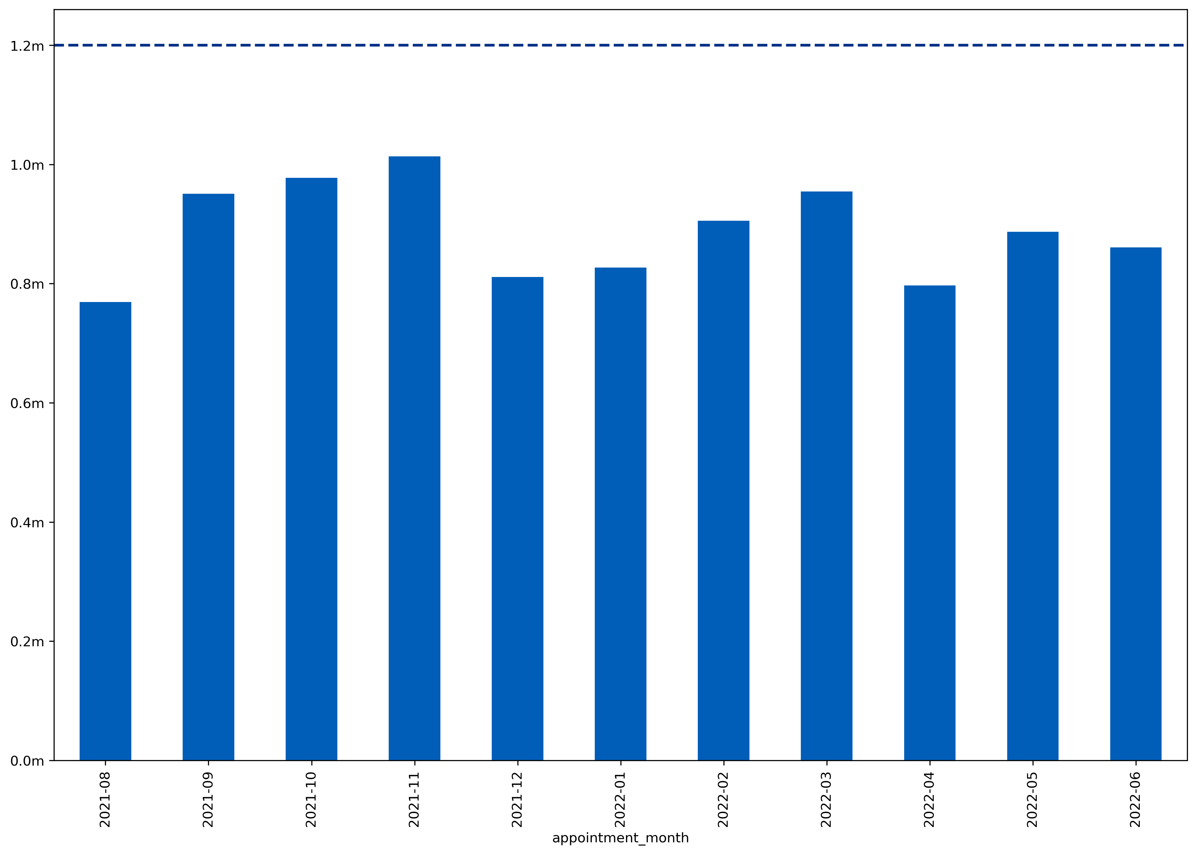
Patterns and Insights Overall, average daily usage is under the 1,200,000 capacity
Average daily # appointments
month

Slide 8
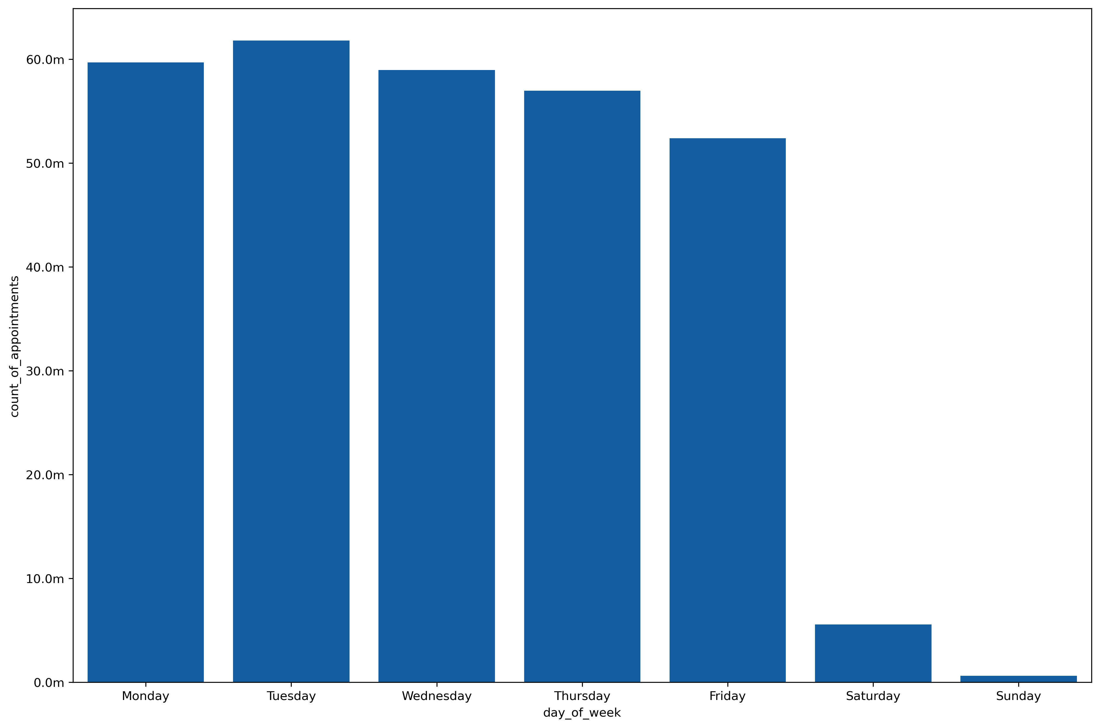
Patterns and Insights However, weekends are significantly skewing the data
Total # appointments

Slide 9
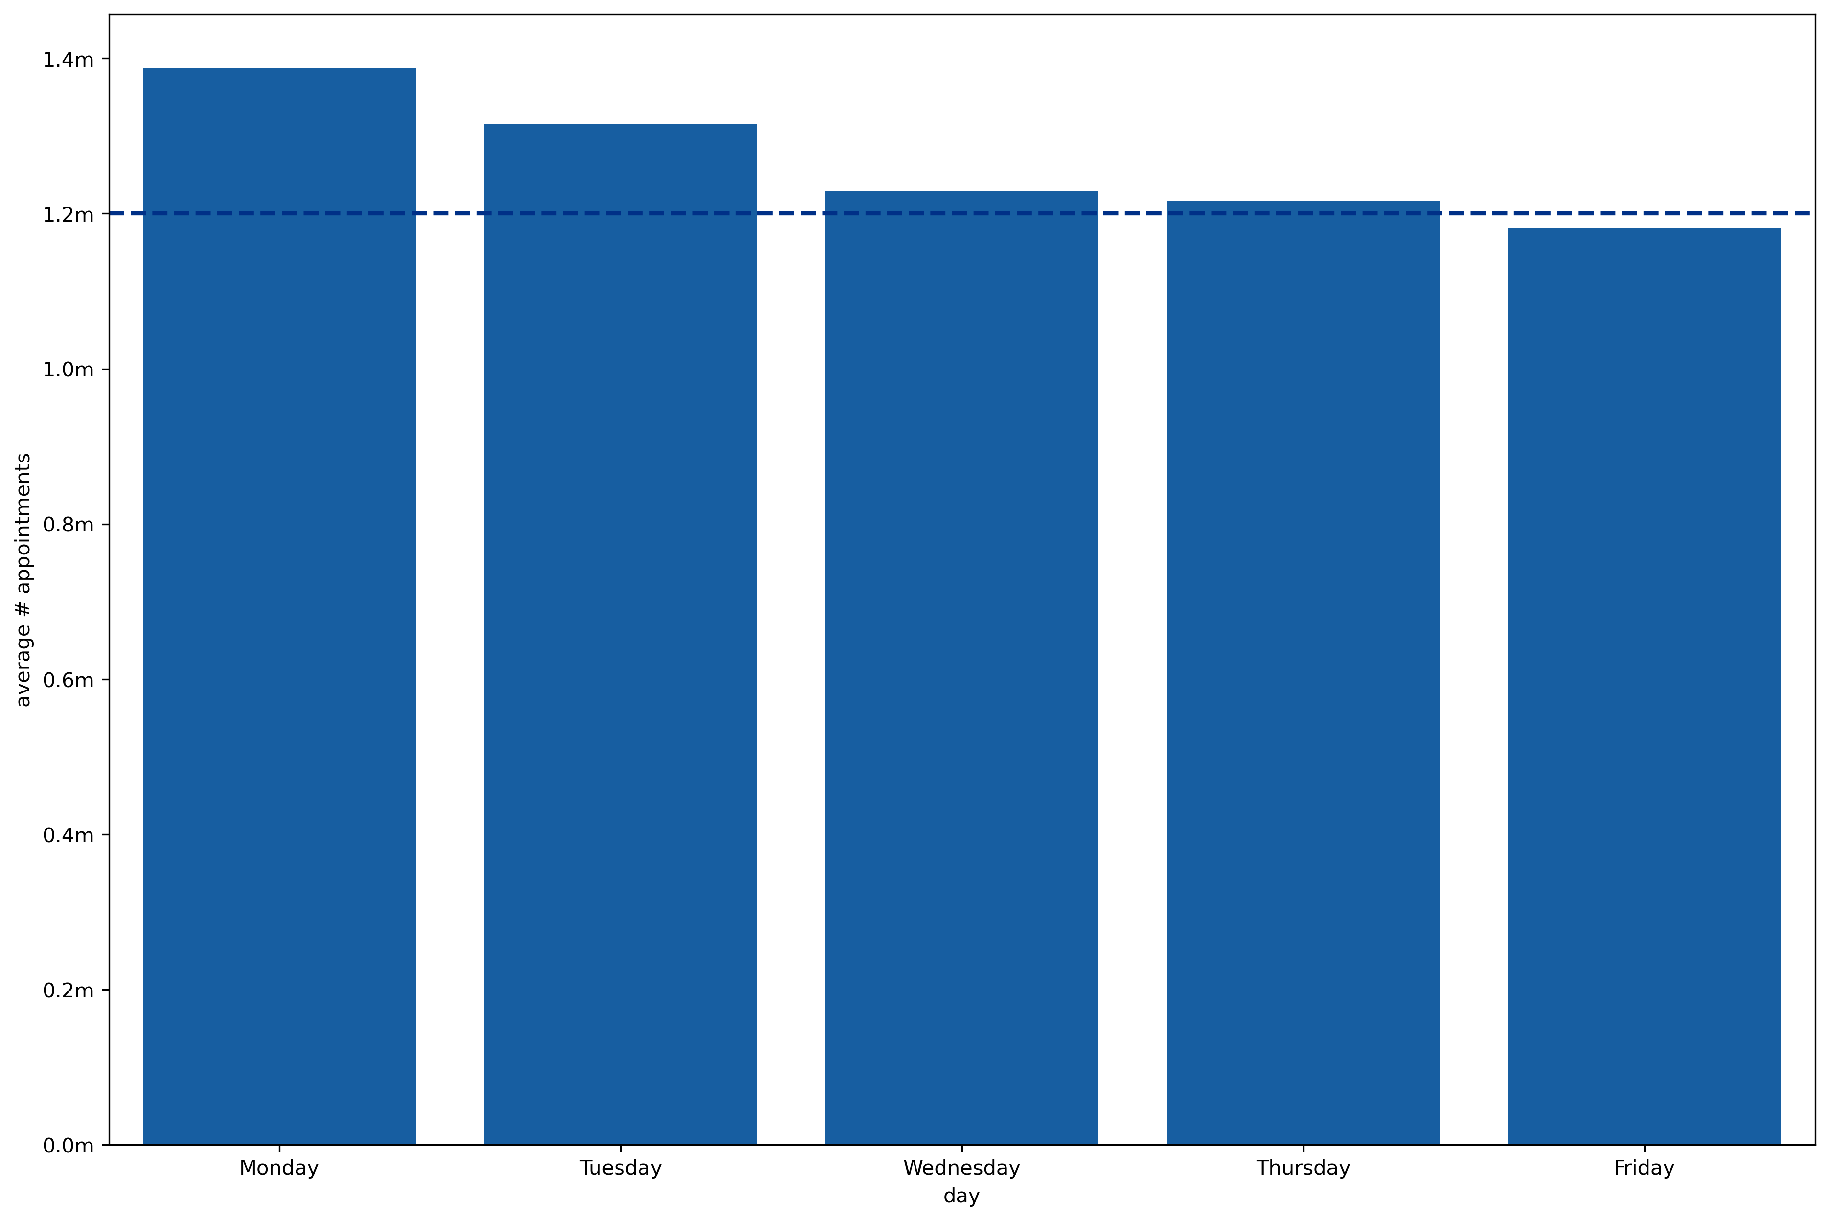
Patterns and Insights On average, the NHS is operating c.330k appointments over capacity on weekdays

Slide 10
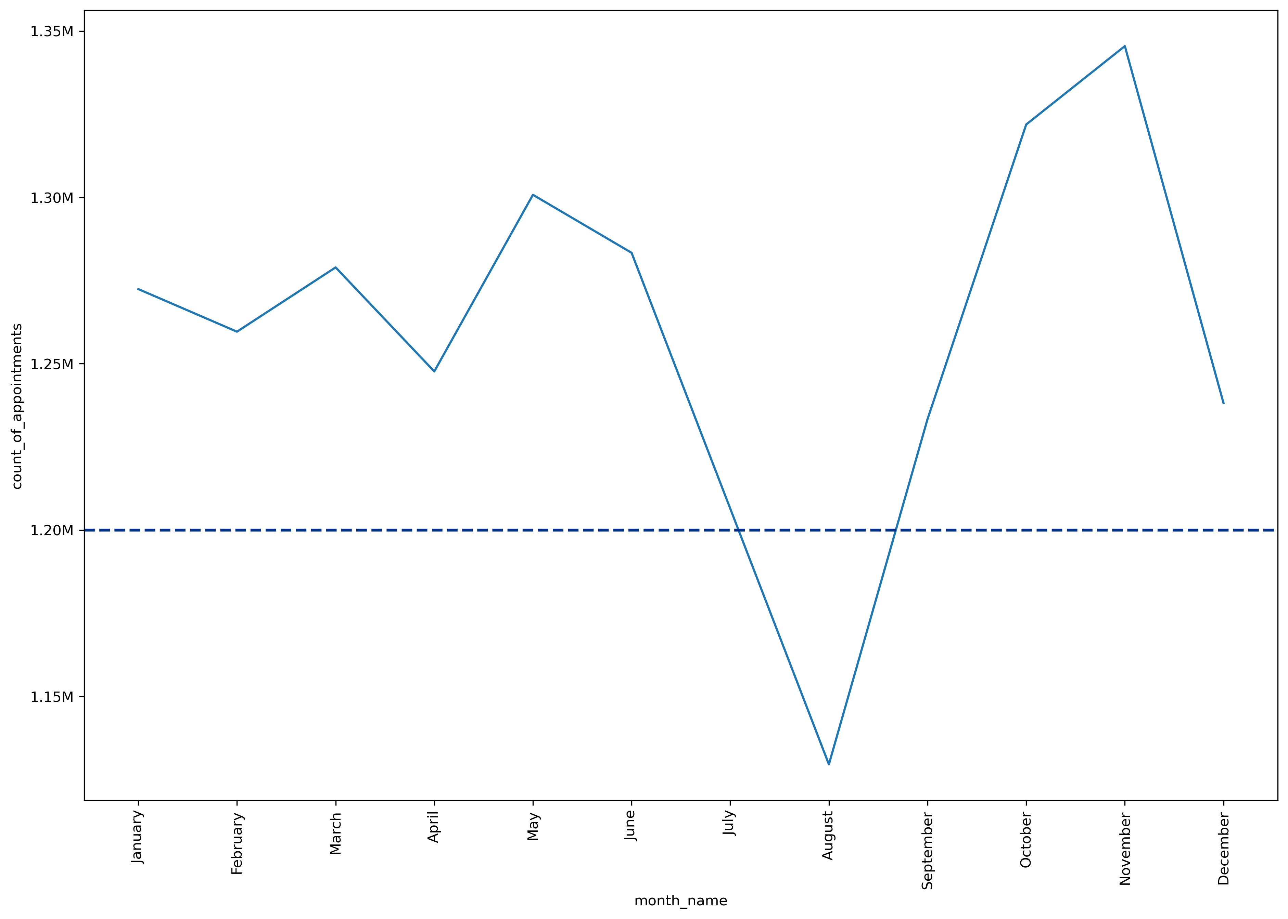
Patterns and Insights The average weekday is over capacity in every month other than August*
Average weekday # appointments
month

Slide 11
Business Recommendations
Capacity needs to be increased by an estimated 2,640 FTEs* to meet average weekday demand.
* The European Union of General Practitioners and BMA have recommended a safe level of patient contacts per day in order for a GP to deliver safe care at not more than 25 contacts per day. Which means an FTE = >125 appointments per week

Slide 12
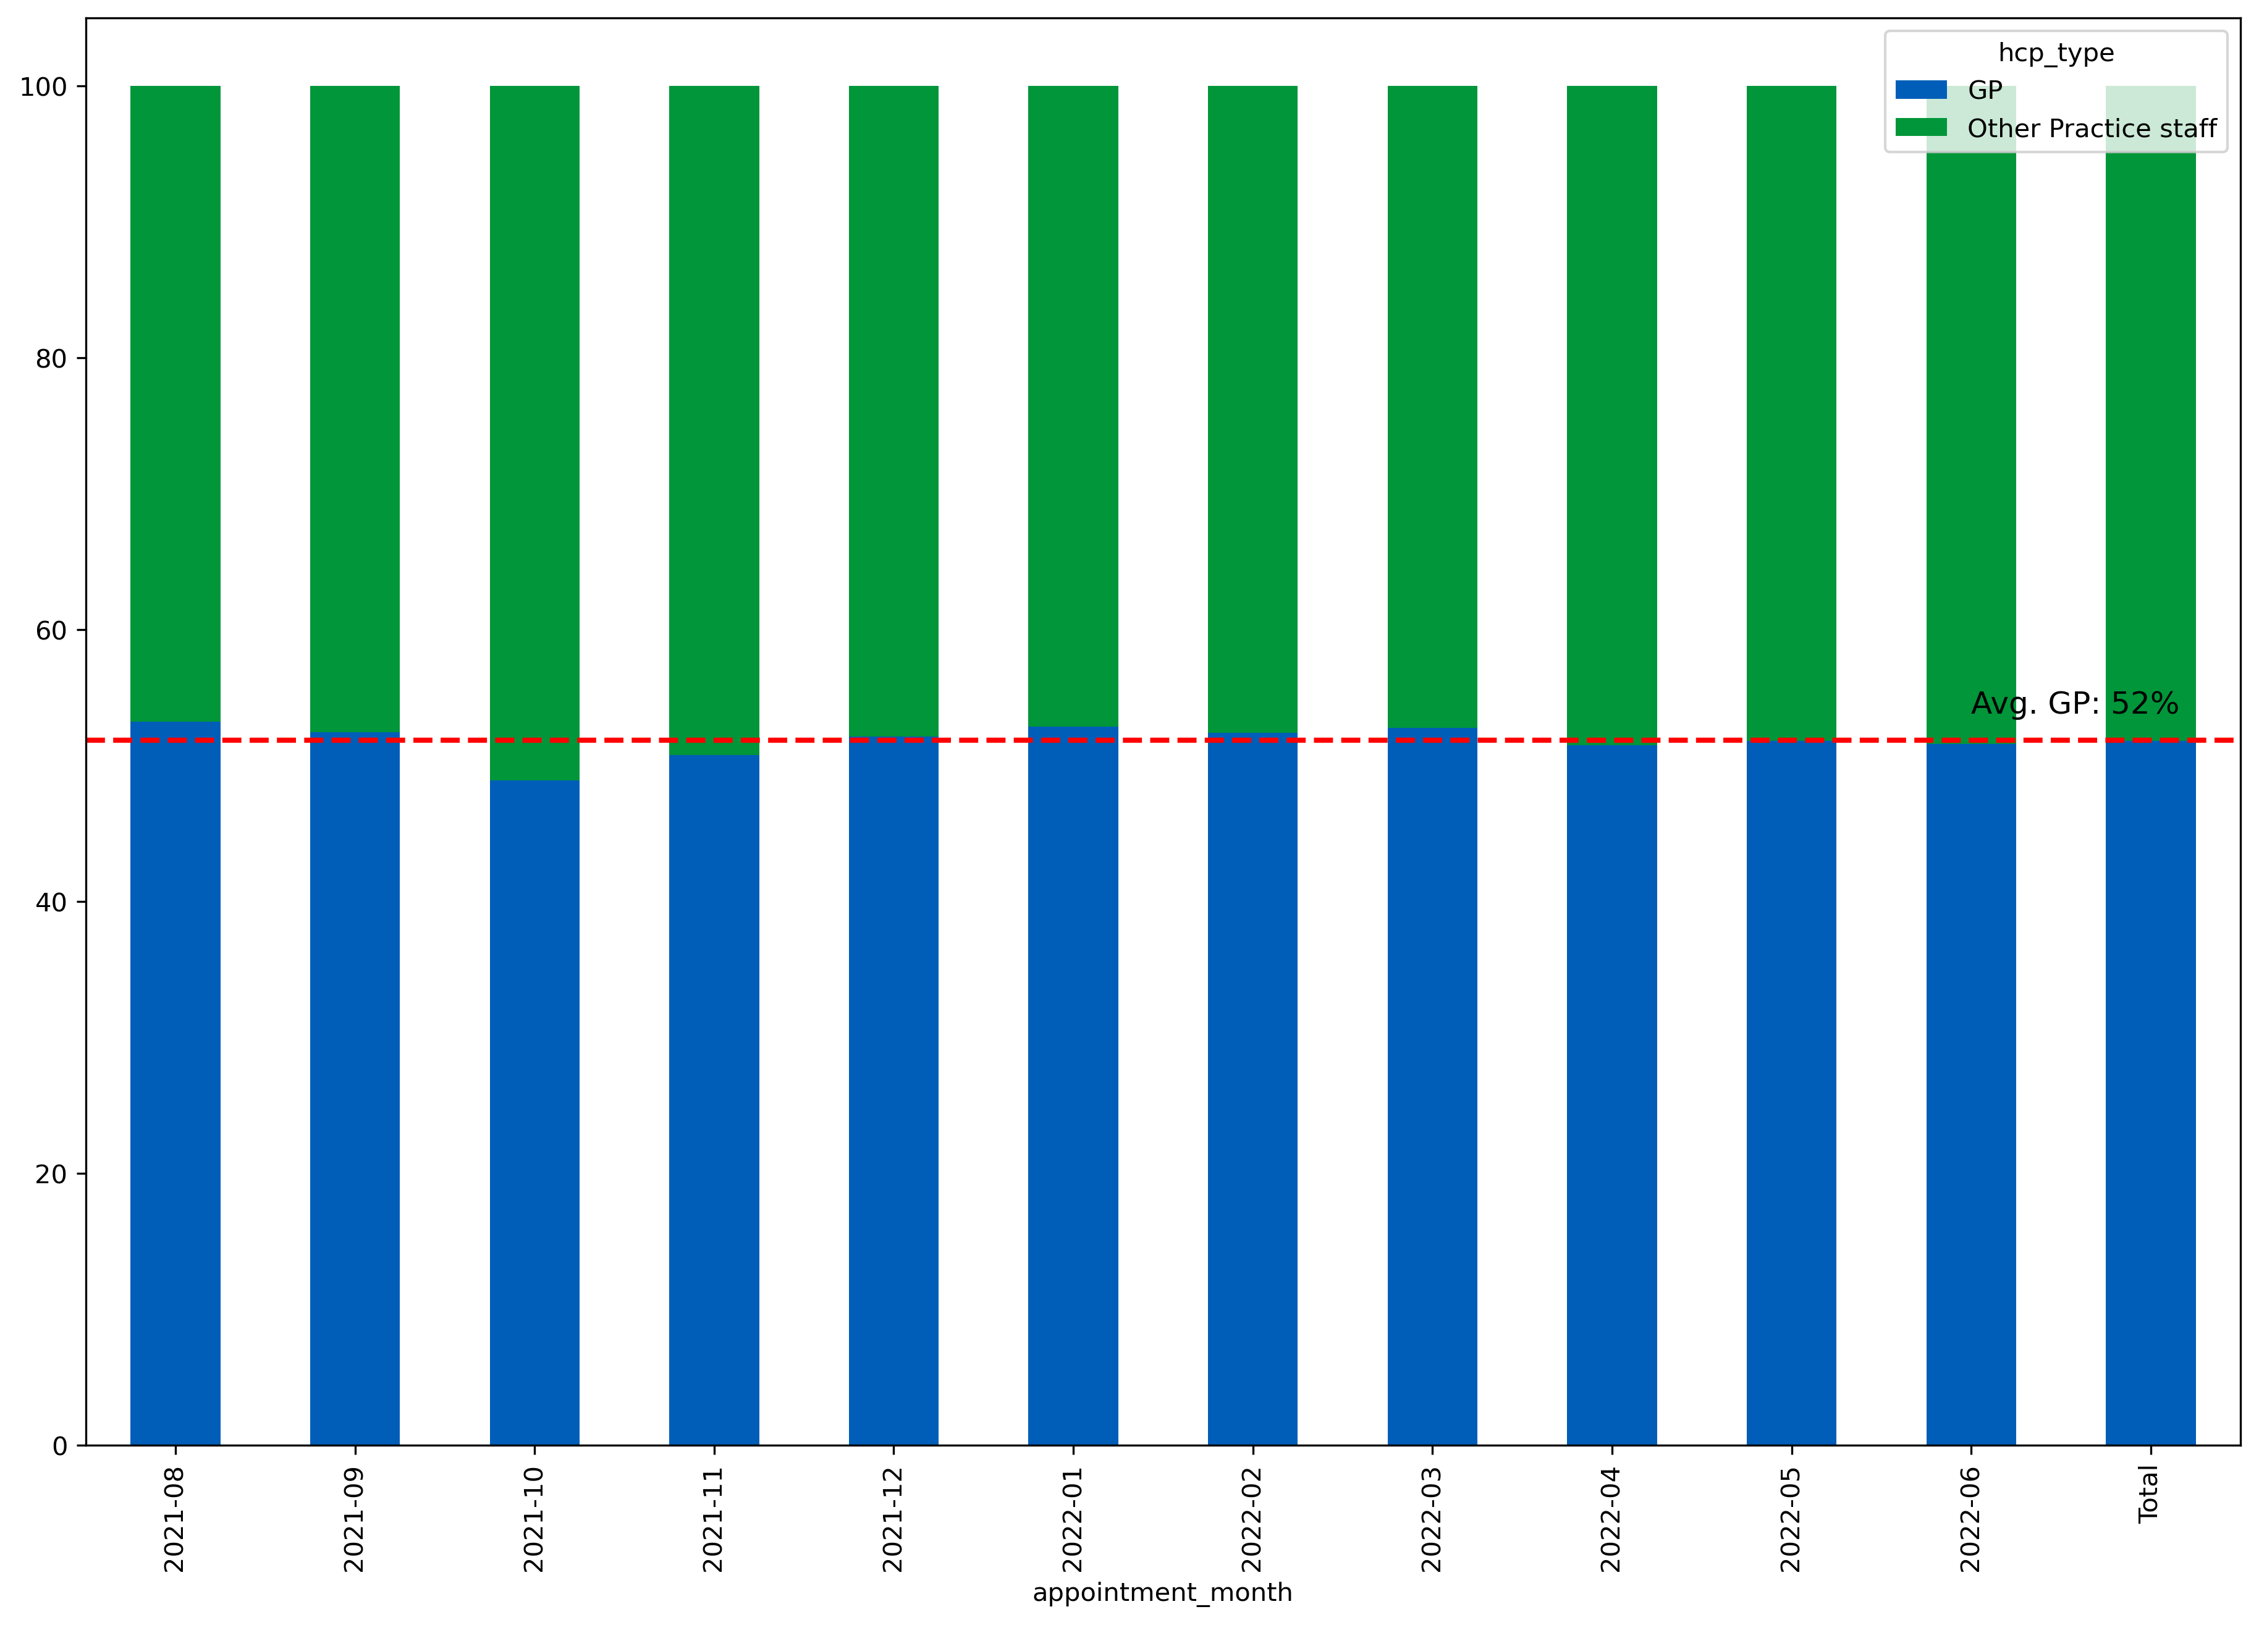
Patterns and Insights 90% of appointments take place in General Practice with c.50% conducted by a GP.
%

Slide 13
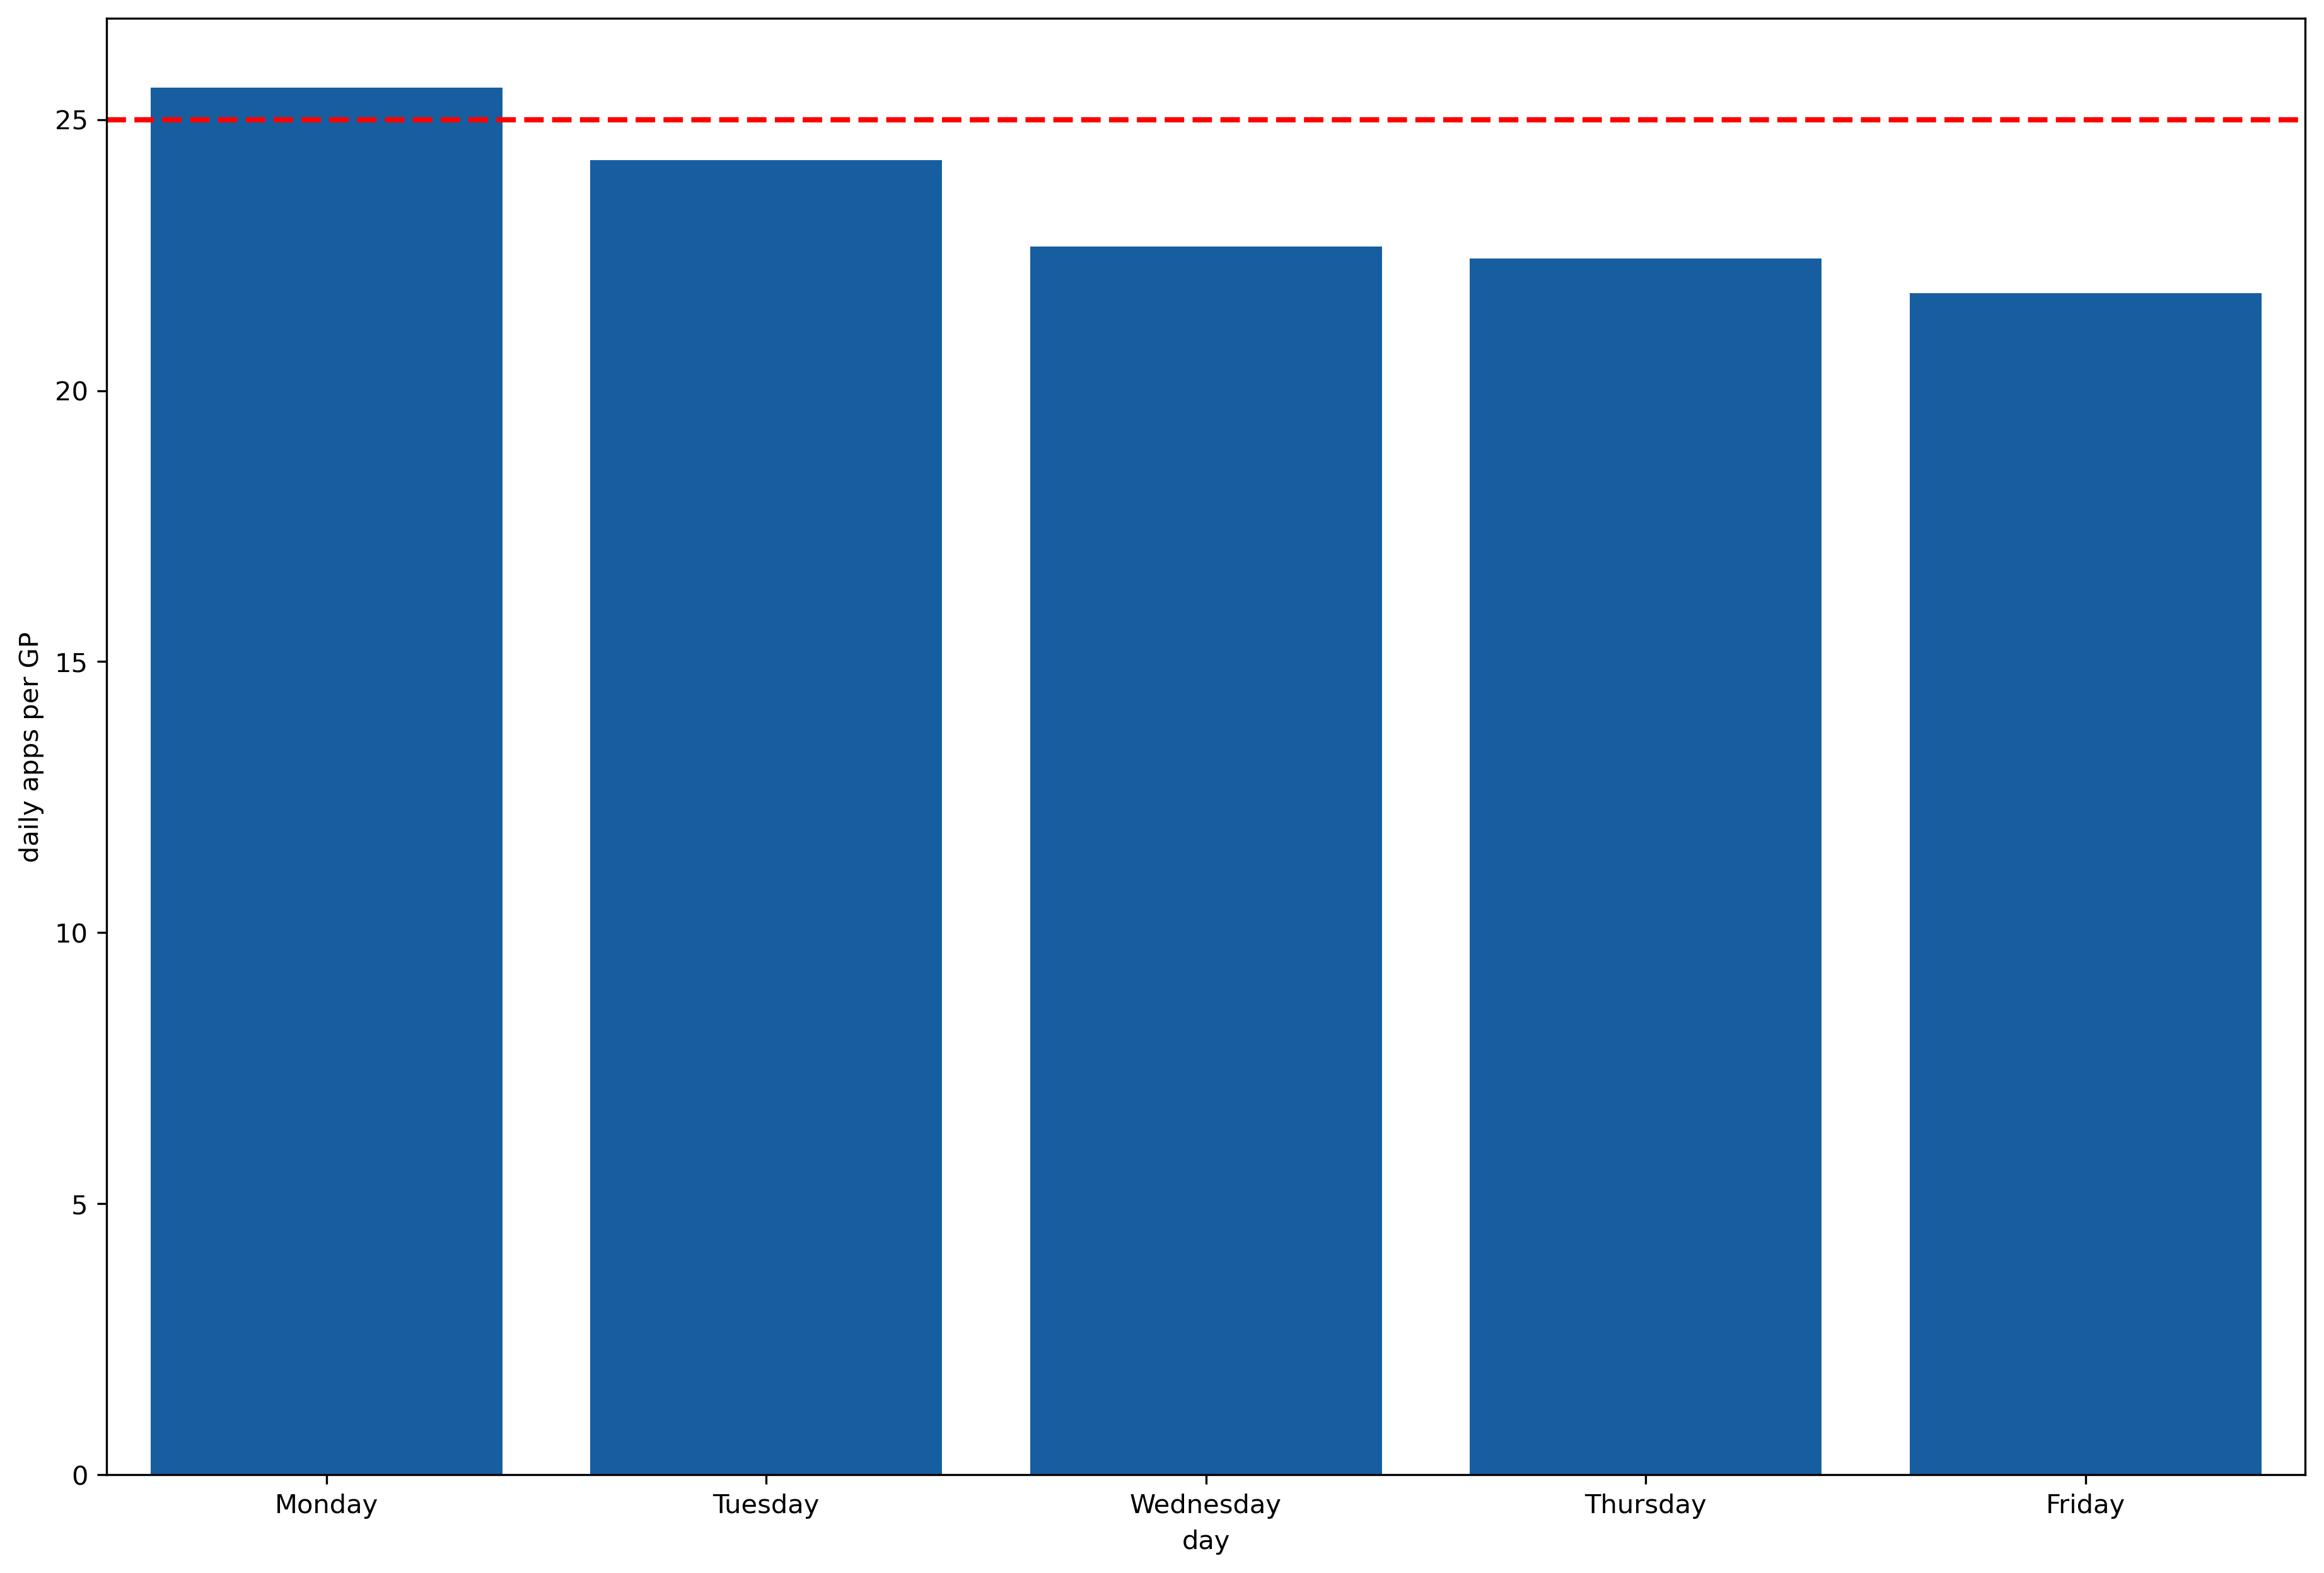
Patterns and Insights This is leading to GPs conducting over the safe level of daily appointments on Mondays
Based on currently 28,197
GP FTEs*
*source https://www.bma.org.uk/advice-and-support/nhs-delivery-and-workforce/pressures/pressures-in-general-practice-data-analysis

Slide 14
Business Recommendations
Capacity needs to be increased by an estimated 2,640 FTEs* to meet average weekday demand.
Incentivize GPs to open over weekends to reduce pent-up demand which is amplifying capacity issues

Slide 15
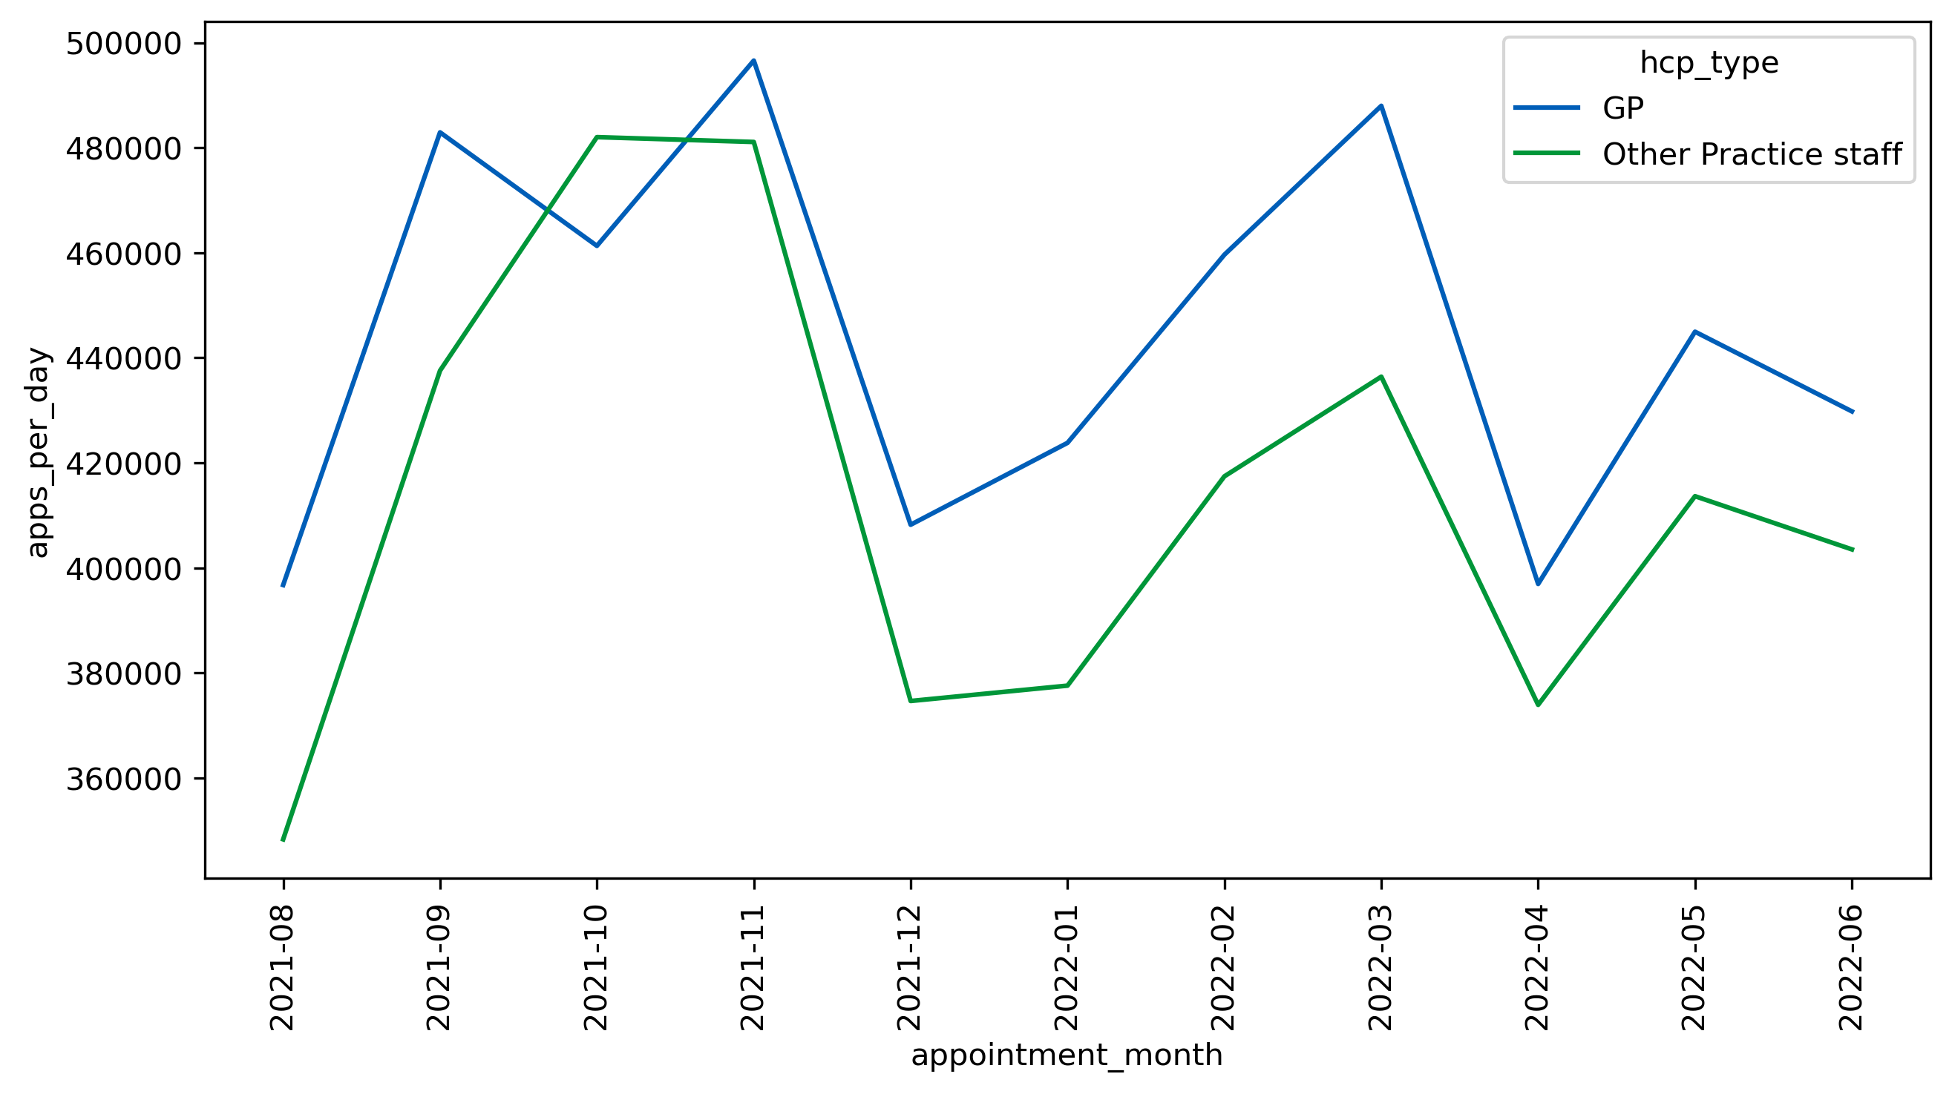
Patterns and Insights There is a sharp rise in appointment count done by Other Practice Staff in October
Average daily # appointments
month

Slide 16
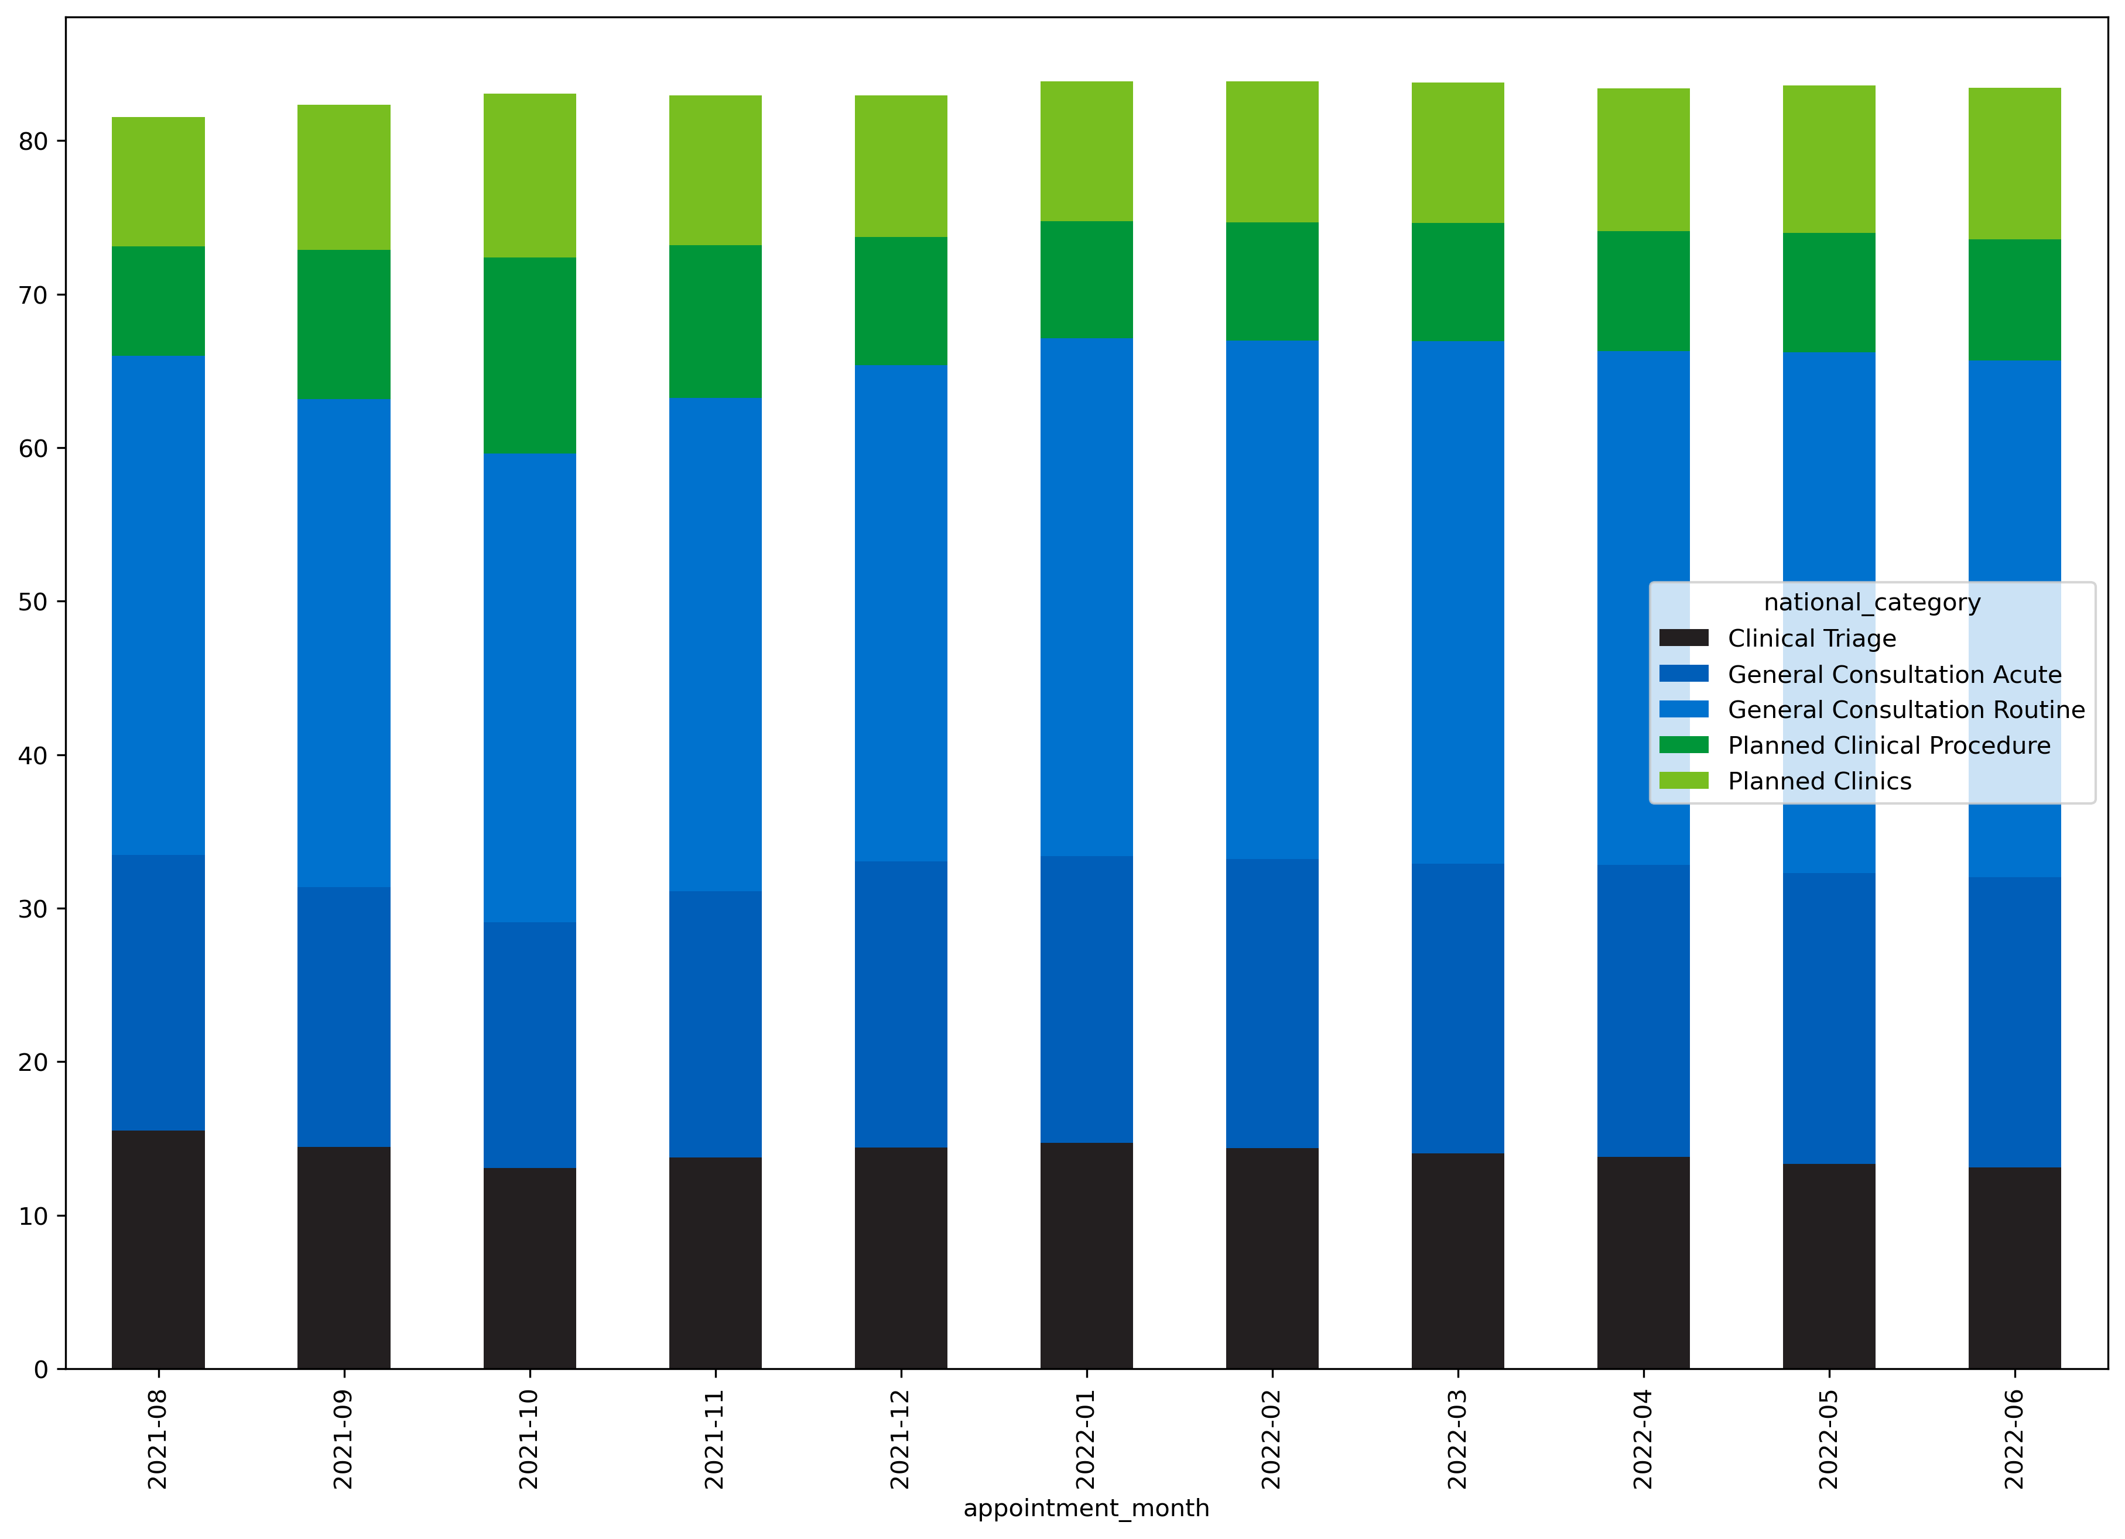
Patterns and Insights This appears to be driven by Planned Clinical Procedures such as vaccines*
%
* source
https://www.england.nhs.uk/wp-content/uploads/2021/03/B0486-network-contract-des-standardised-gp-appointment-categories-21-22.pdf
month

Slide 17
Business Recommendations
Capacity needs to be increased by an estimated 2,640 FTEs* to meet average weekday demand.
Incentivize GPs to open over weekends to reduce pent-up demand which is amplifying capacity issues
Start annual flu vaccine program as early as possible to reduce appointments at busiest time of year (currently 3rd October*)
*https://www.england.nhs.uk/statistics/statistical-work-areas/flu-vaccinations/

Slide 18
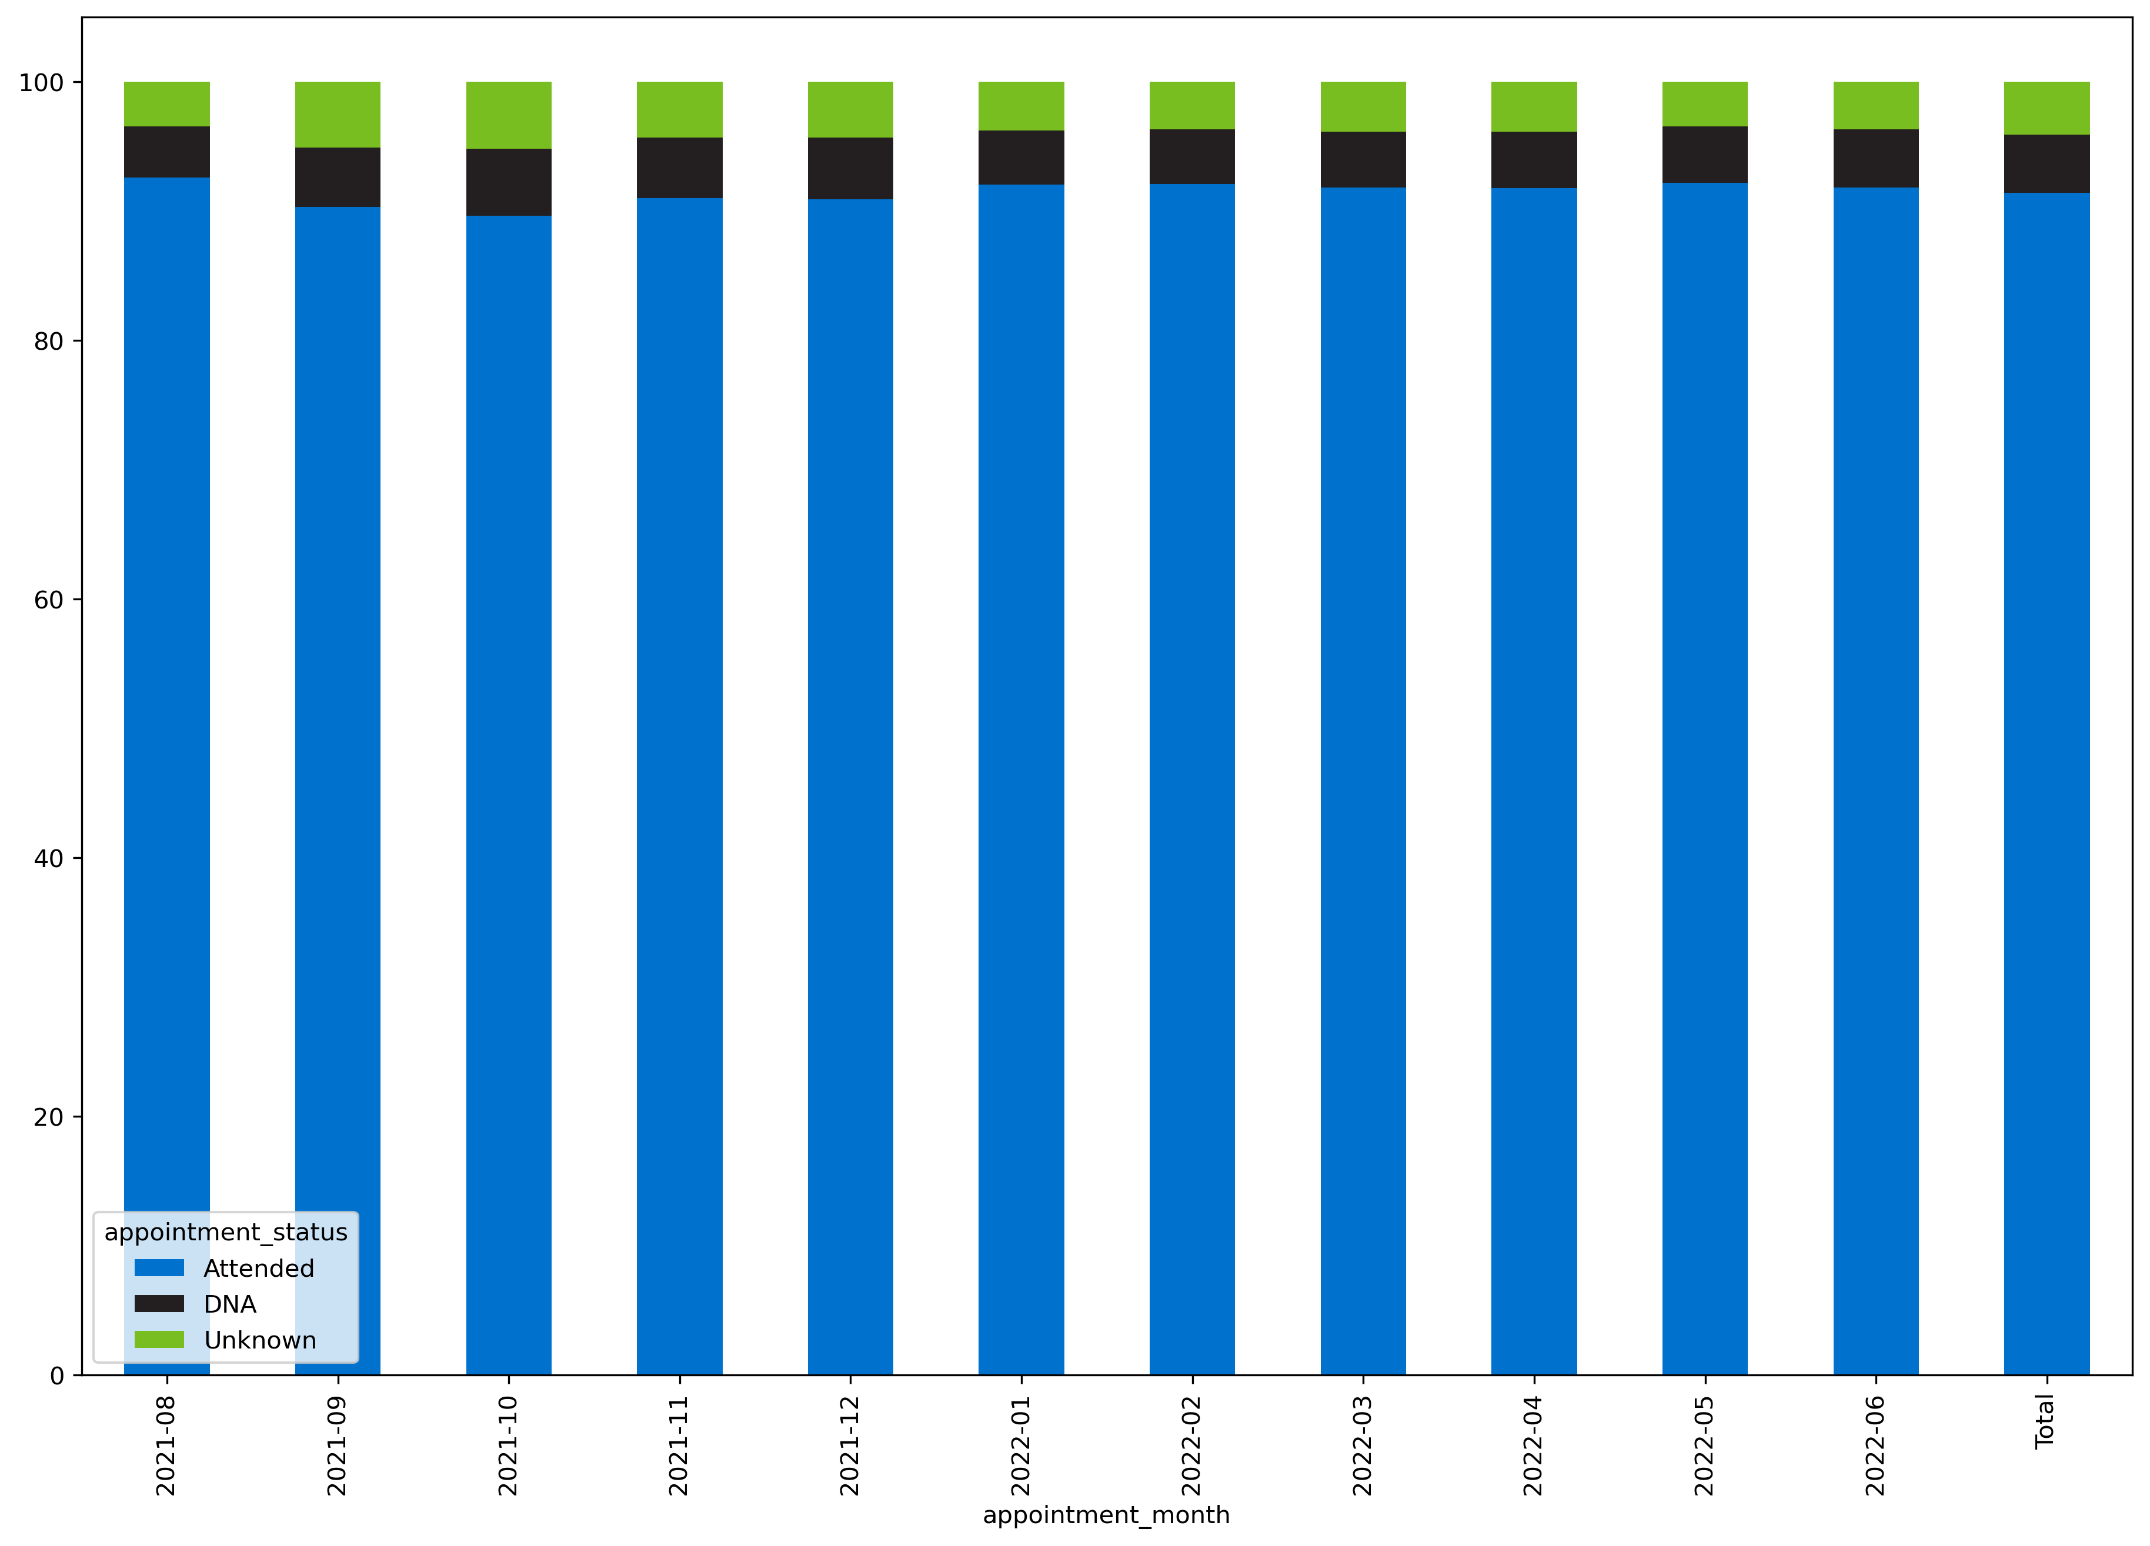
Patterns and Insights 4-5% not attended (average 250k-310k appointments per working week lost)
%
month

Slide 19
Business Recommendations
Capacity needs to be increased by an estimated 2,640 FTEs* to meet average weekday demand.
Incentivize GPs to open over weekends to reduce pent-up demand which is amplifying capacity issues
Start annual vaccine programs as early as possible to reduce appointments at busiest time of year
Explore measures to reduce unattended appointments such as financial penalties or incentives

Slide 20
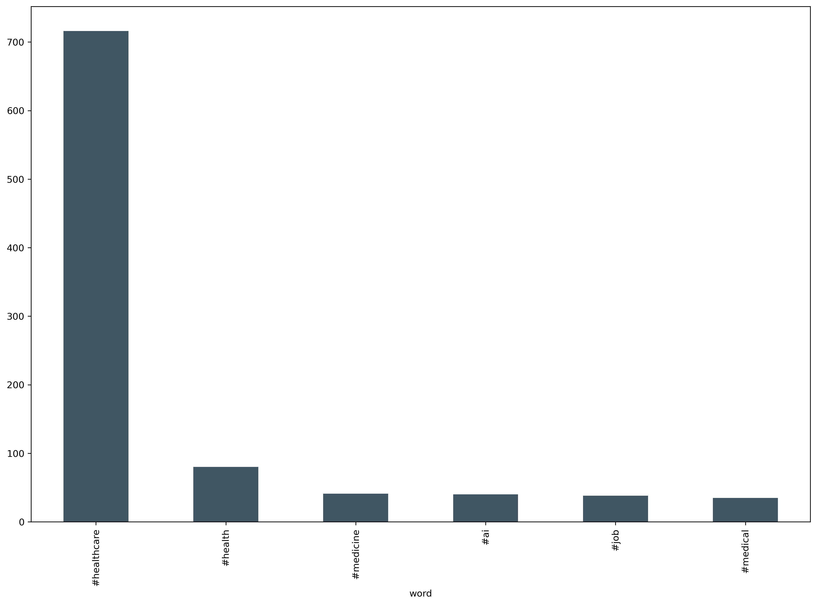
Patterns and Insights Twitter (X) data provided limited insights as it was unstructured and inconsistent
Example #Healthcare
As Arkansas’ first Comprehensive Stroke Certified Center, UAMS provides Arkansans with access to the most advanced stoke care…
#Healthcare
Most retweeted
RT @UltimaLionsDen: Temitope is looking to boost efficiency in the Health industry with his app- \nWe-Care Africa…

Slide 21
Business Recommendations
Capacity needs to be increased by an estimated 2,640 FTEs* to meet average weekday demand.
Incentivize GPs to open over weekends to reduce pent-up demand which is amplifying capacity issues
Start annual vaccine programs as early as possible to reduce appointments at busiest time of year
Explore measures to reduce unattended appointments such as financial penalties or incentives for attending
Before investment in further Twitter data, use NHS account for customer service, promoting own hashtags to aid analysis

Slide 22
3. Analytical Recommendations

Slide 23
Analytical Recommendations
Create clear standardization of data entry to improve data quality
Further analysis of recent data to see YonY comparison
Further exploration on retention of GPs required (September 2015 -July 2022, a decrease of 6.3% of the GP workforce*)
Further exploration into regions and geographies, with direction on capacity for each area
* Fit for the future. Retaining the GP workforce https://www.rcgp.org.uk/getmedia/155e72a9-47b9-4fdd-a322-efc7d2c1deb4/retaining-gp-workforce-report.pdf

Slide 24
4. Conclusion

Slide 25
Thank you

