Slide 1

Turtle Games
Customer Analysis
Phil Best
11.04.2025

Slide 2
Agenda
Context
1. Loyalty Scheme Insights
2. Customer Segmentation
3. Review and Product Sentiment
4. Predictive Models from Loyalty Data
Summary

Slide 3
Context
Turtle Games would like to understand trends in its loyalty point and customer review data, and whether predictive models can help make improvements to its strategy. These insights will allow Turtle Games to better serve their customers, which ultimately will lead to increased sales and profit for the business.

Slide 4
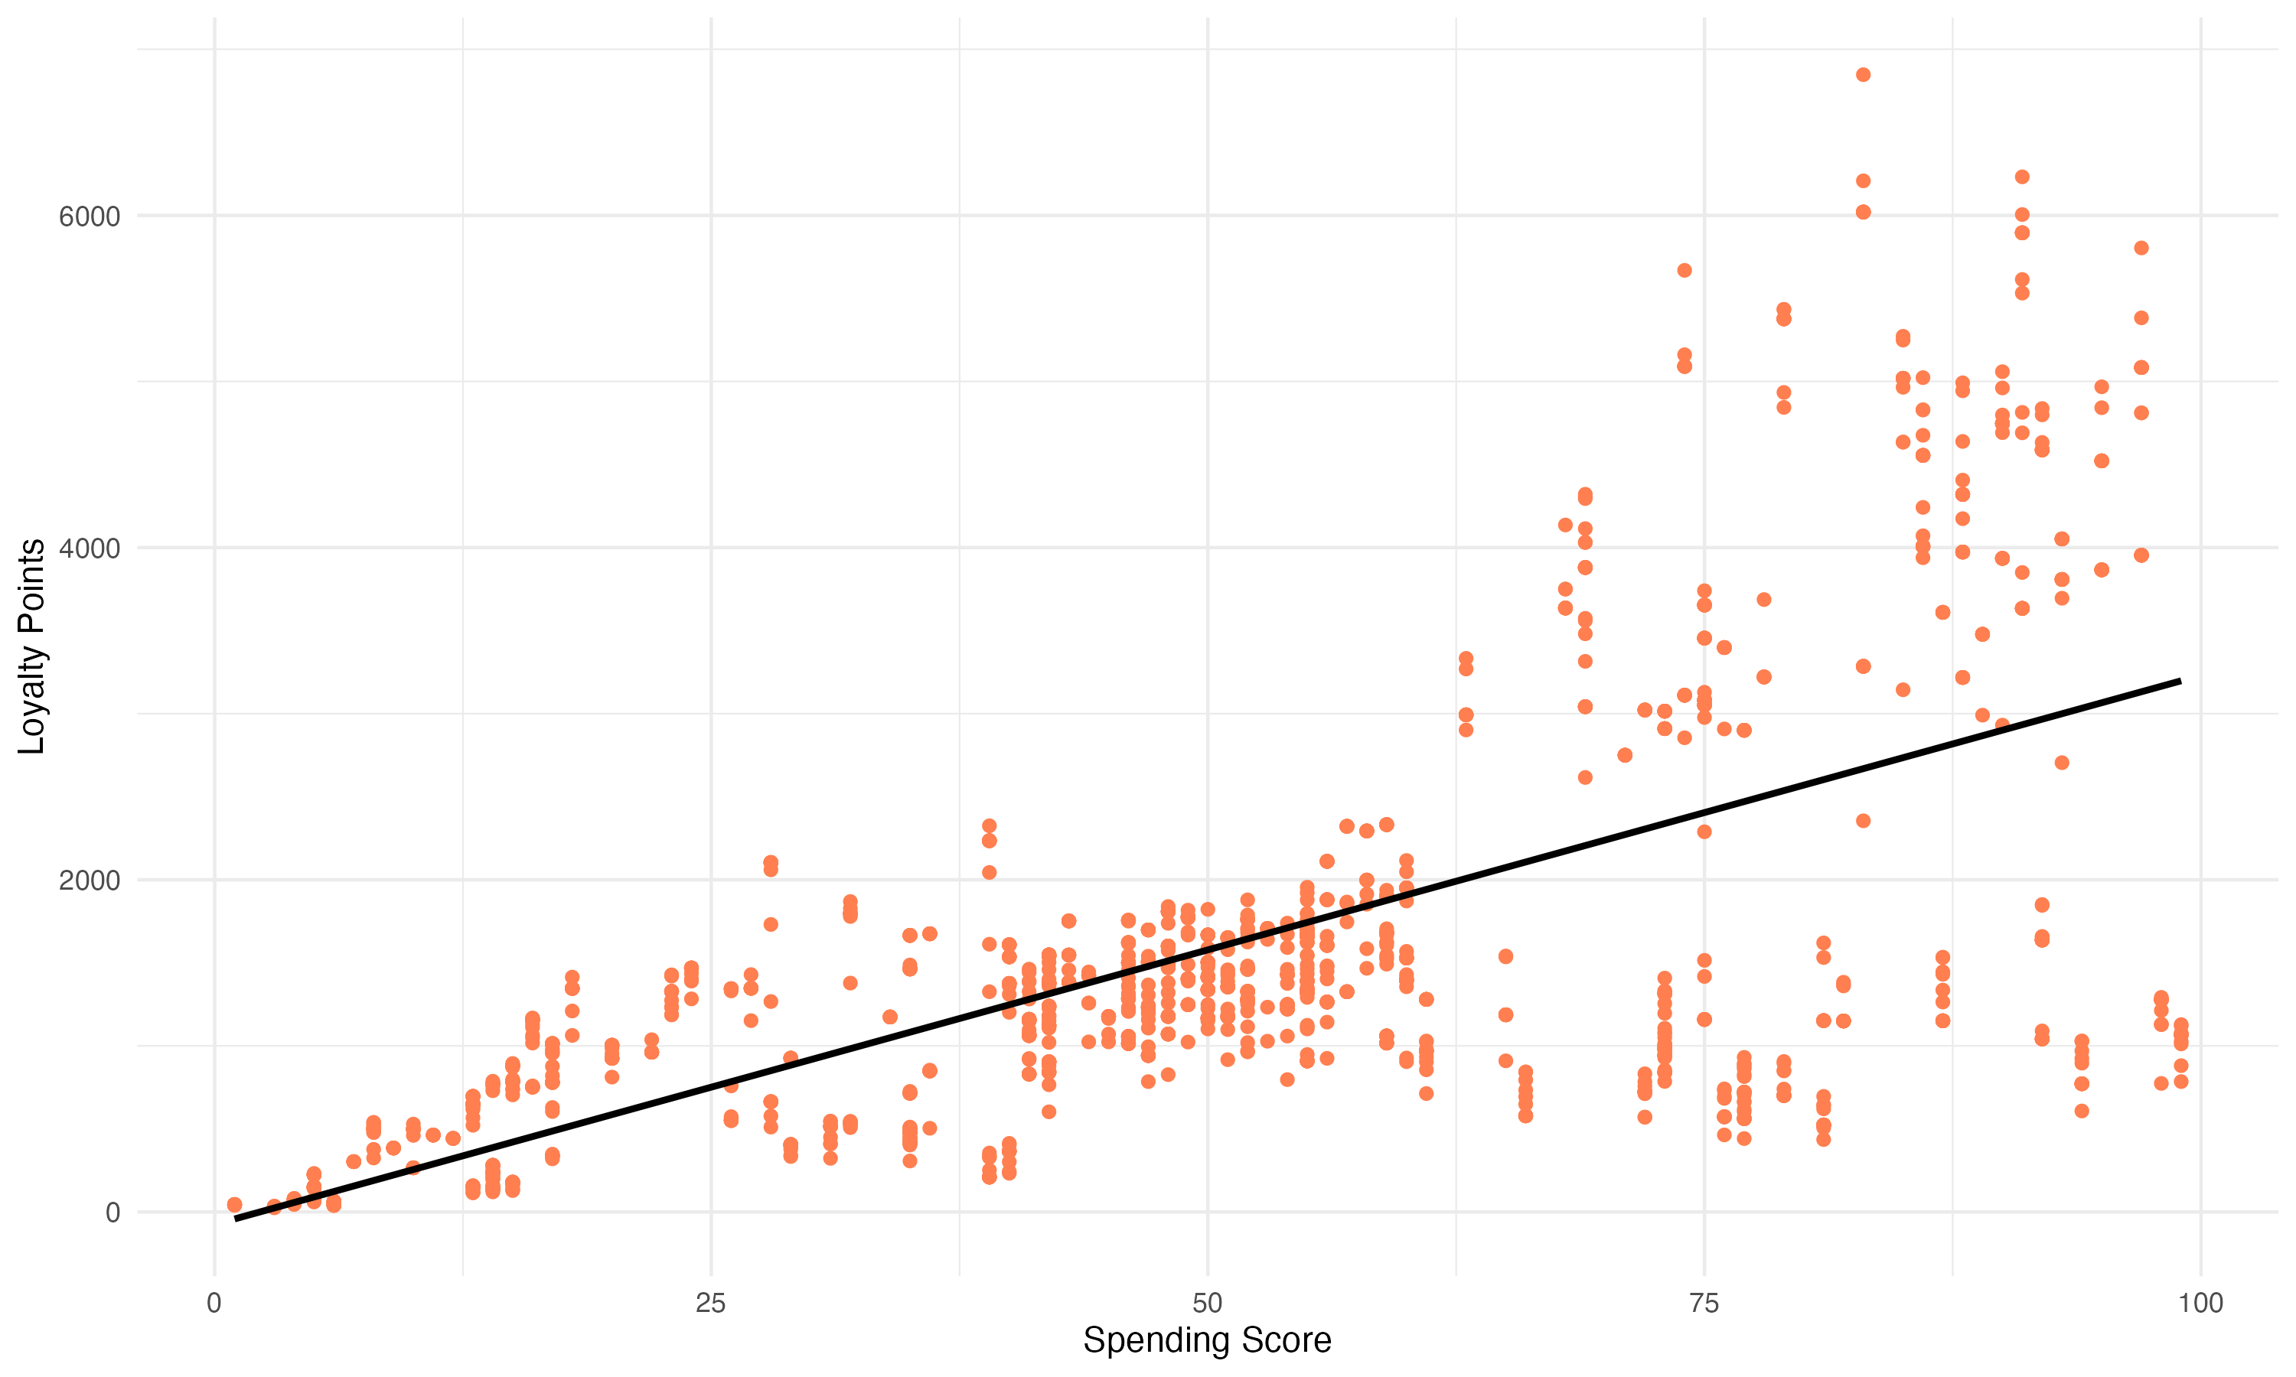
1. Loyalty Scheme Insights Spending Score explains 45% of variation in Loyalty Points
1 unit Spending Score
=
33 units Loyalty Points
Notes:
Mentioned decision tree and adding age to the mix improving model
Is Pay intentional? Is the loyalty scheme profiling users and applying different loyalty points?
How are loyalty points actually accrued?
What can people do with thes loyalty points

Slide 5
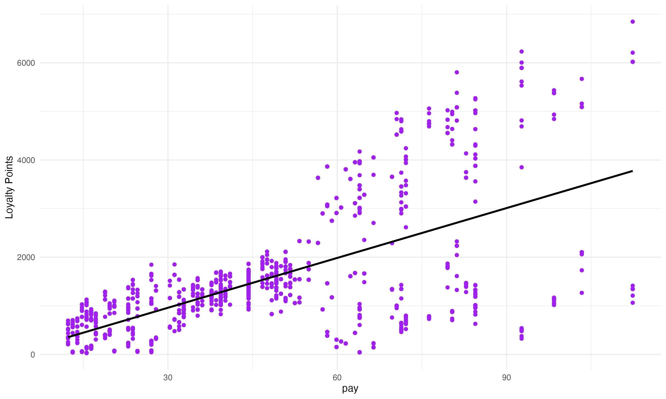
1. Loyalty Scheme Insights Pay explains 38% of variation in Loyalty Points
1 unit Pay
=
34 units Loyalty Points
Notes:
Mentioned decision tree and adding age to the mix improving model
Is Pay intentional? Is the loyalty scheme profiling users and applying different loyalty points?
How are loyalty points actually accrued?
What can people do with thes loyalty points

Slide 6
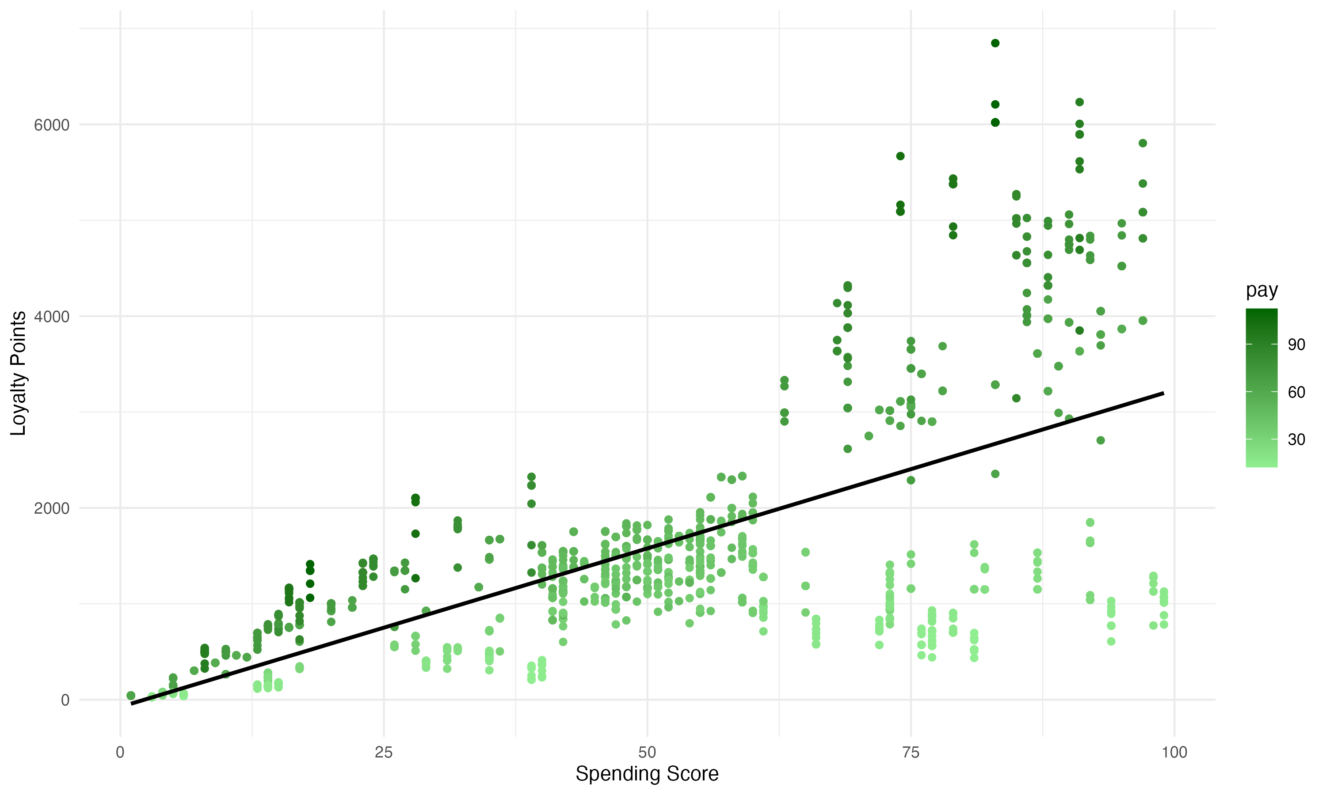
1. Loyalty Scheme Insights Pay and Spending Score combined explain over 83% of variation in Loyalty Points
Notes:
Mentioned decision tree and adding age to the mix improving model
Is Pay intentional? Is the loyalty scheme profiling users and applying different loyalty points?
How are loyalty points actually accrued?
What can people do with thes loyalty points

Slide 7
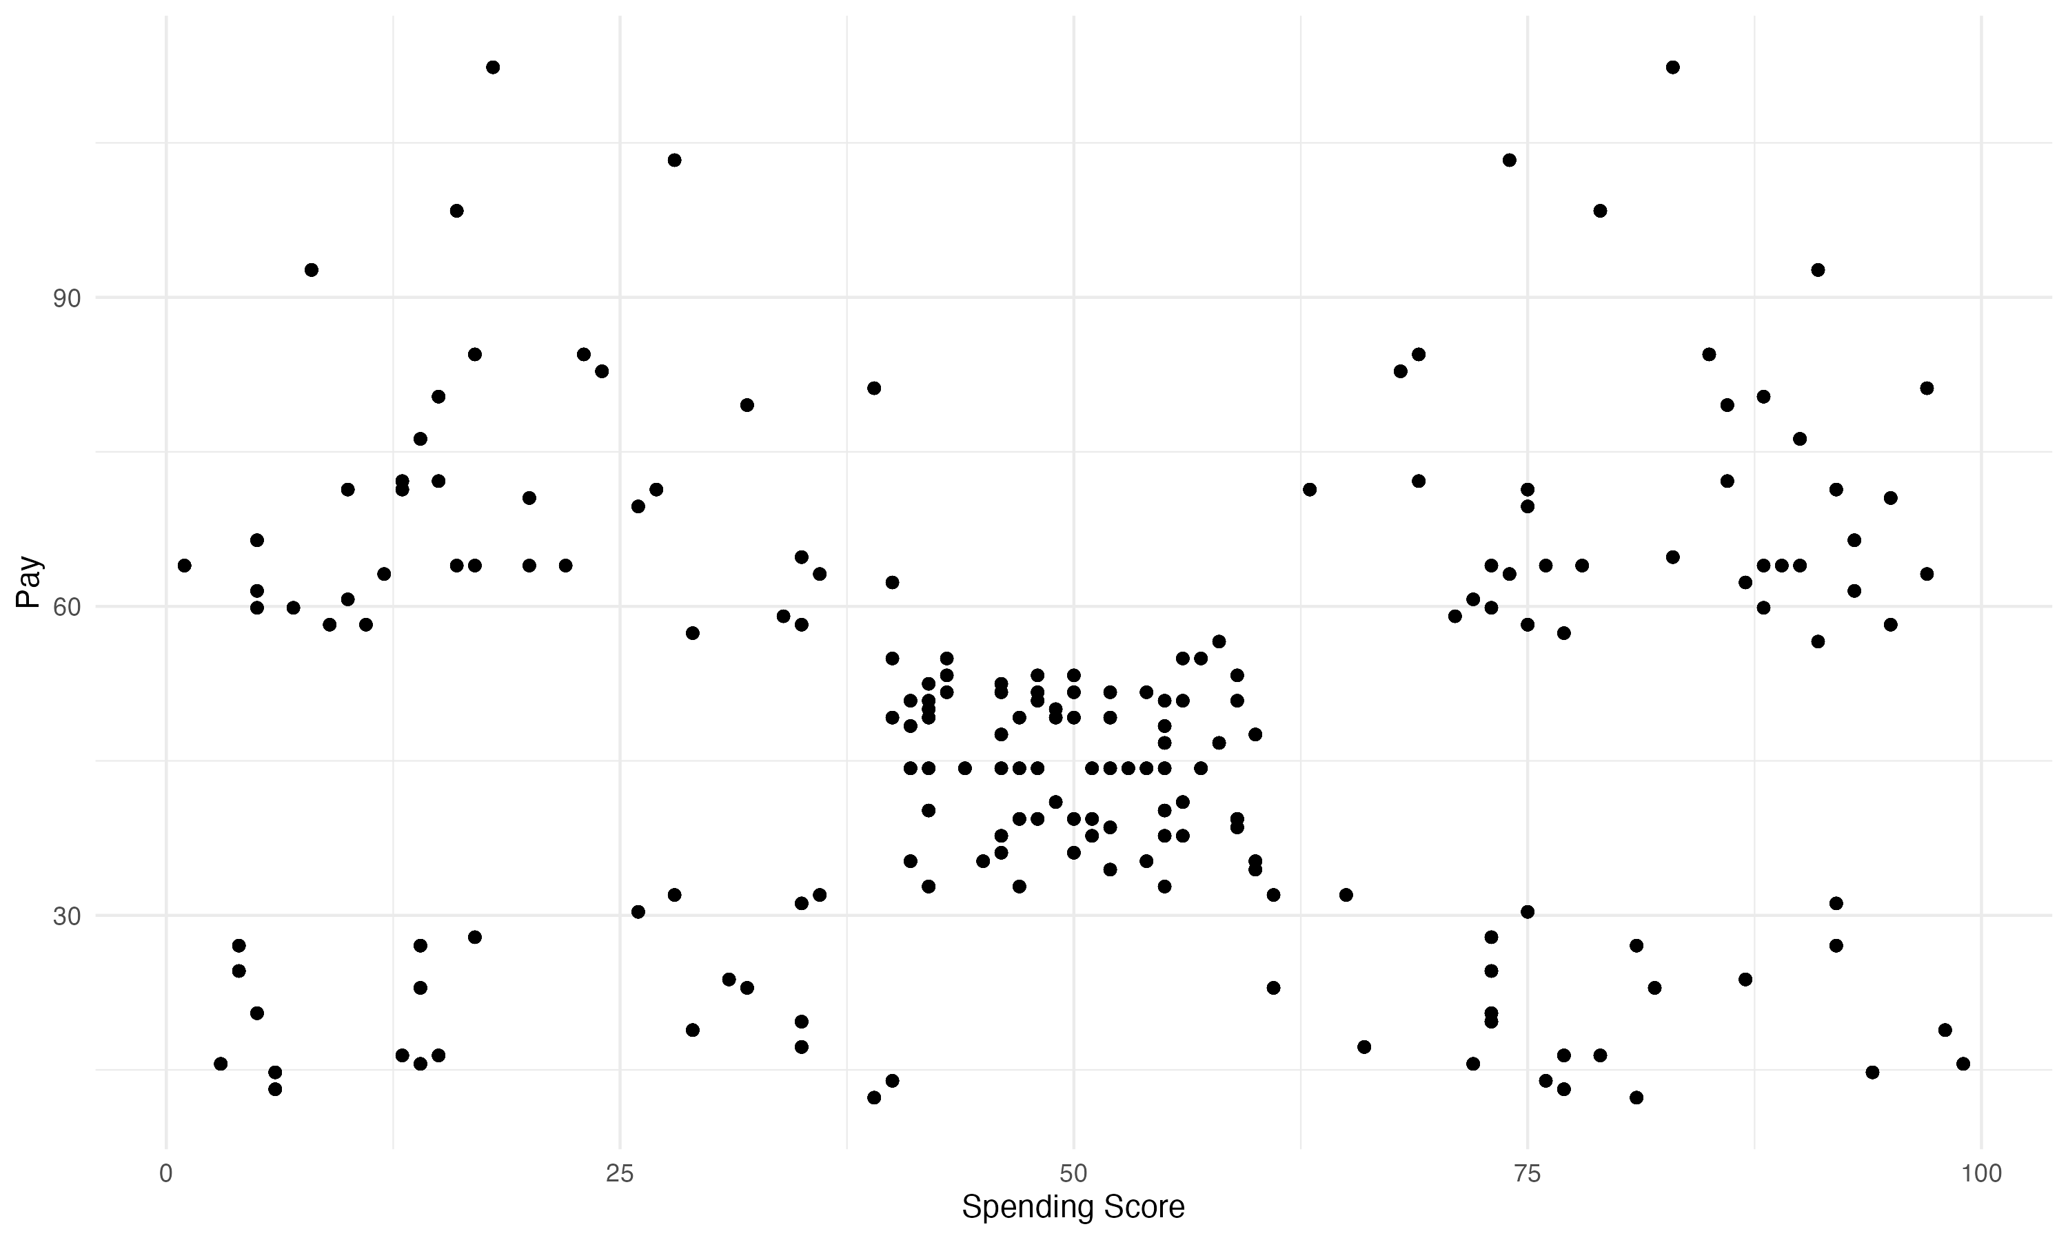
2. Customer Segmentation Relationship between Spending Score + Pay used to identify segments
Notes:
Mentioned decision tree and adding age to the mix improving model
Is Pay intentional? Is the loyalty scheme profiling users and applying different loyalty points?

Slide 8
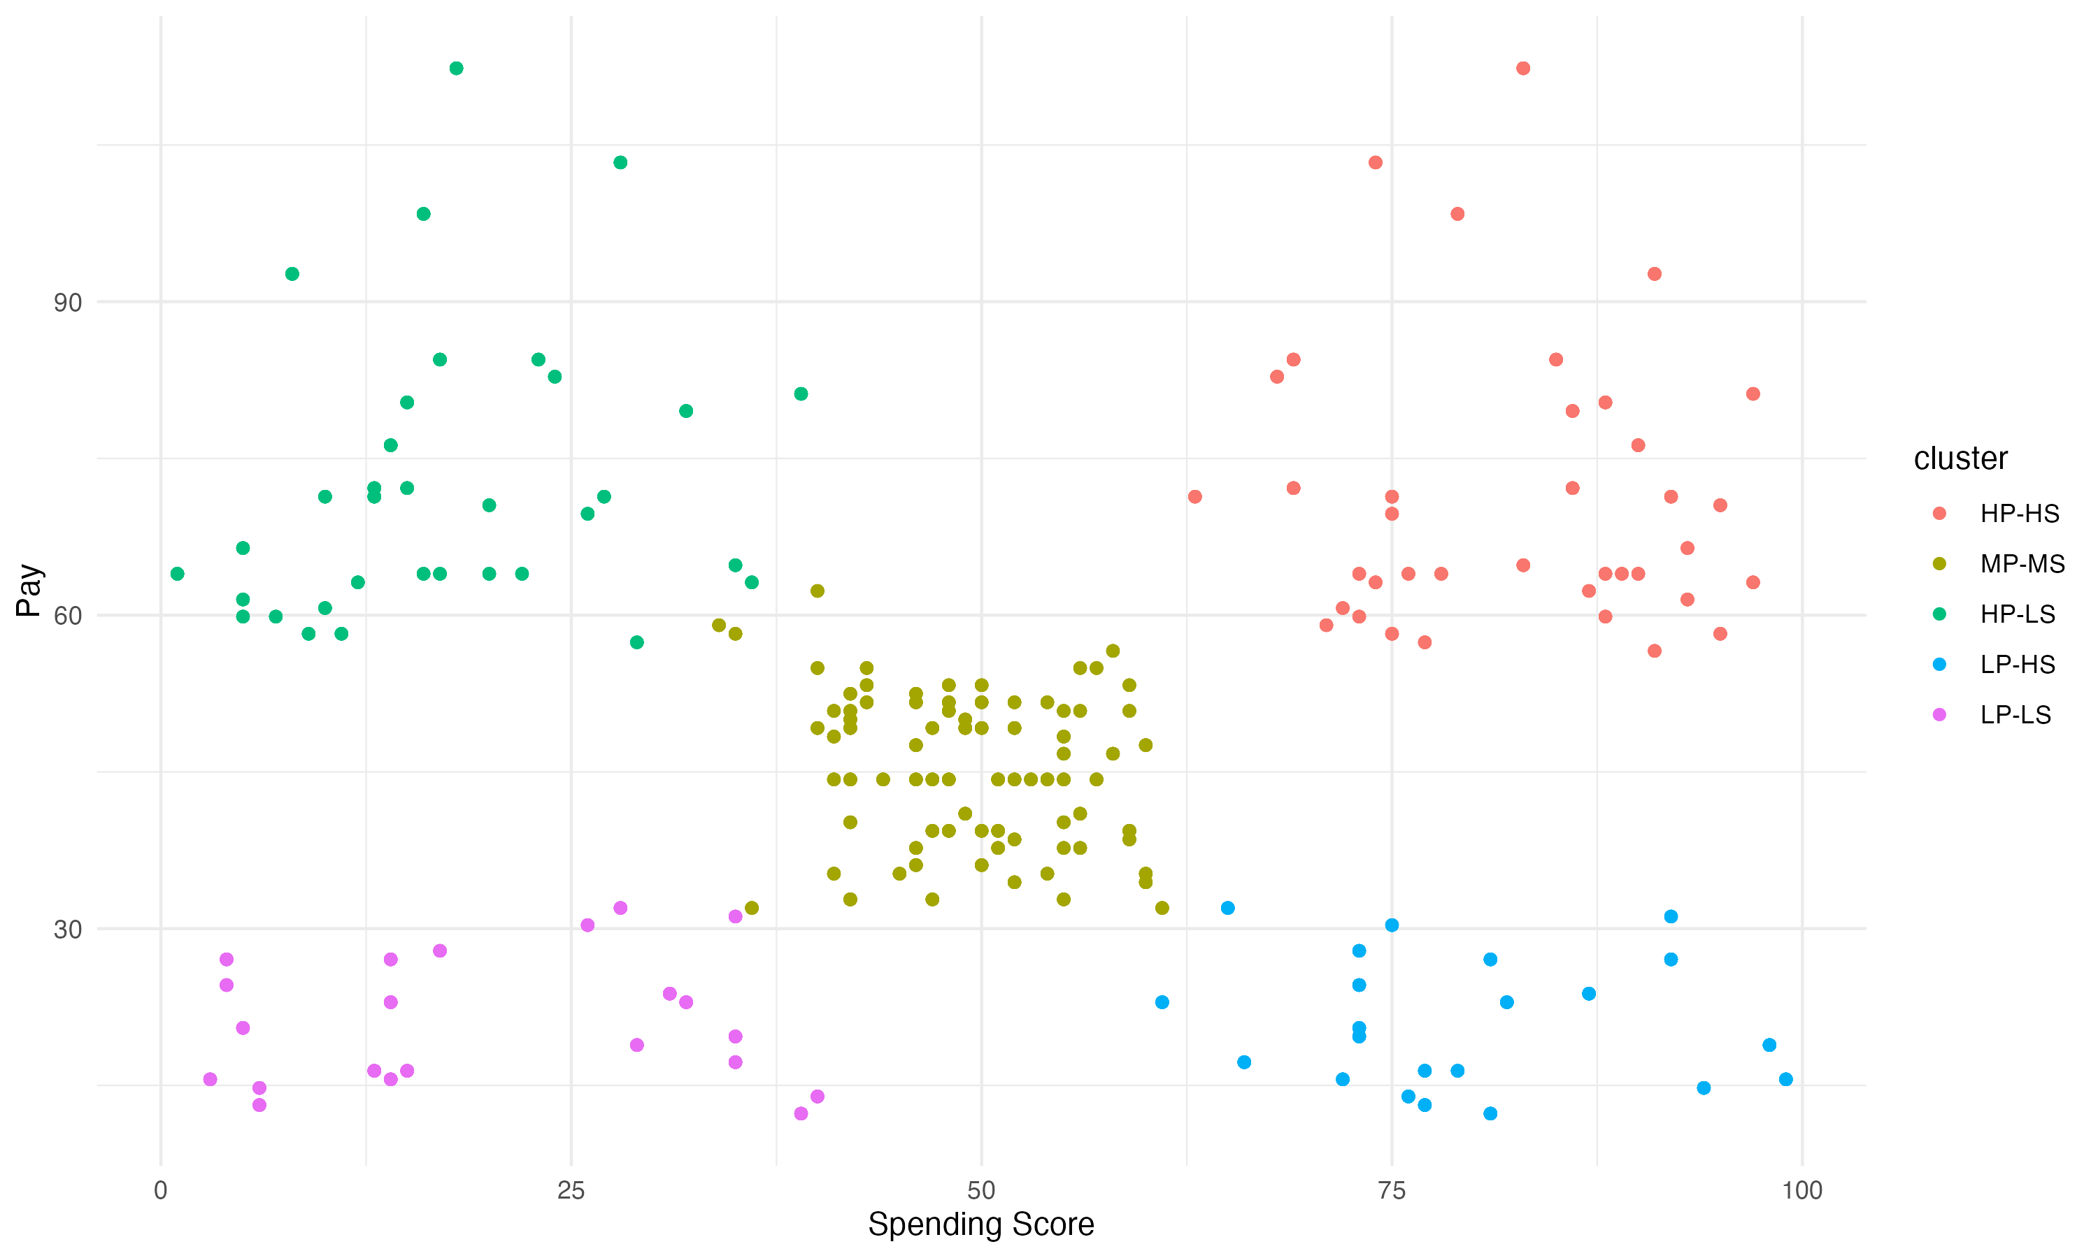
2. Customer Segmentation There are 5 distinct clusters of customers using Pay + Spending Score
Notes:
Mentioned decision tree and adding age to the mix improving model
Is Pay intentional? Is the loyalty scheme profiling users and applying different loyalty points?

Slide 9
2. Customer Segmentation There are 5 distinct clusters of customers using Pay + Spending Score
High Pay/Low SS
High Pay/ High SS
Mid Pay/ Mid SS
Low Pay / High SS
Low Pay/ Low SS
Notes:
Mentioned decision tree and adding age to the mix improving model
Is Pay intentional? Is the loyalty scheme profiling users and applying different loyalty points?

Slide 10
2. Customer Segmentation There are 5 distinct clusters of customers using Pay + Spending Score
High Pay/Low SS
High Pay/ High SS
Customers: 330
Avg Loyalty Points: 912
Customers: 356
Avg Loyalty Points: 3,988
Mid Pay/ Mid SS
Customers: 774
Avg Loyalty Points: 1,420
Low Pay / High SS
Low Pay/ Low SS
Customers: 271
Avg Loyalty Points: 275
Customers: 269
Avg Loyalty Points: 972
Notes:
Mentioned decision tree and adding age to the mix improving model
Is Pay intentional? Is the loyalty scheme profiling users and applying different loyalty points?

Slide 11

2. Customer Segmentation Marketing strategy should focus on maintaining ‘V.I.P’s and upselling High Pay/Low Spend Segment
High Pay/Low SS
High Pay/ High SS
Customers: 330
Avg Loyalty Points: 912
Customers: 356
Avg Loyalty Points: 3,988
Upsell
V.I.P.
Notes:
Mentioned decision tree and adding age to the mix improving model
Is Pay intentional? Is the loyalty scheme profiling users and applying different loyalty points?

Slide 12
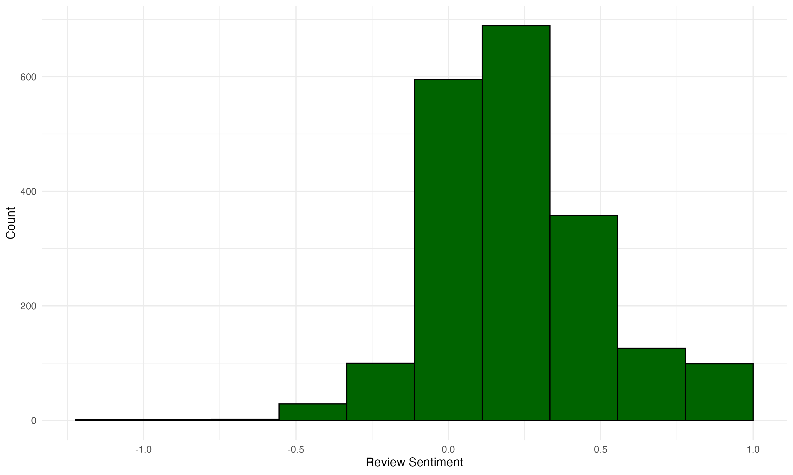
3. Review and Product Sentiment Review sentiment skews positive, with an average rating of +0.23

Slide 13
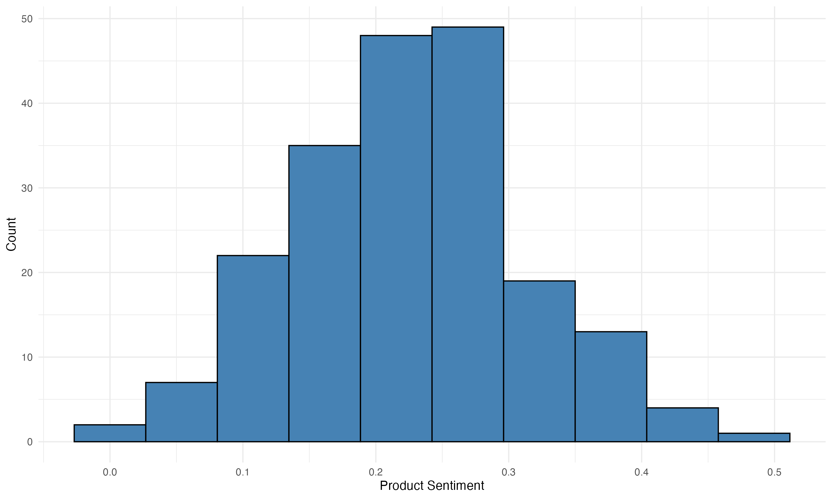
3. Review and Product Sentiment No products have a negative average sentiment score
Bottom 3 products
6431
3436
9597
Top 3 products
9119
9080
11004

Slide 14
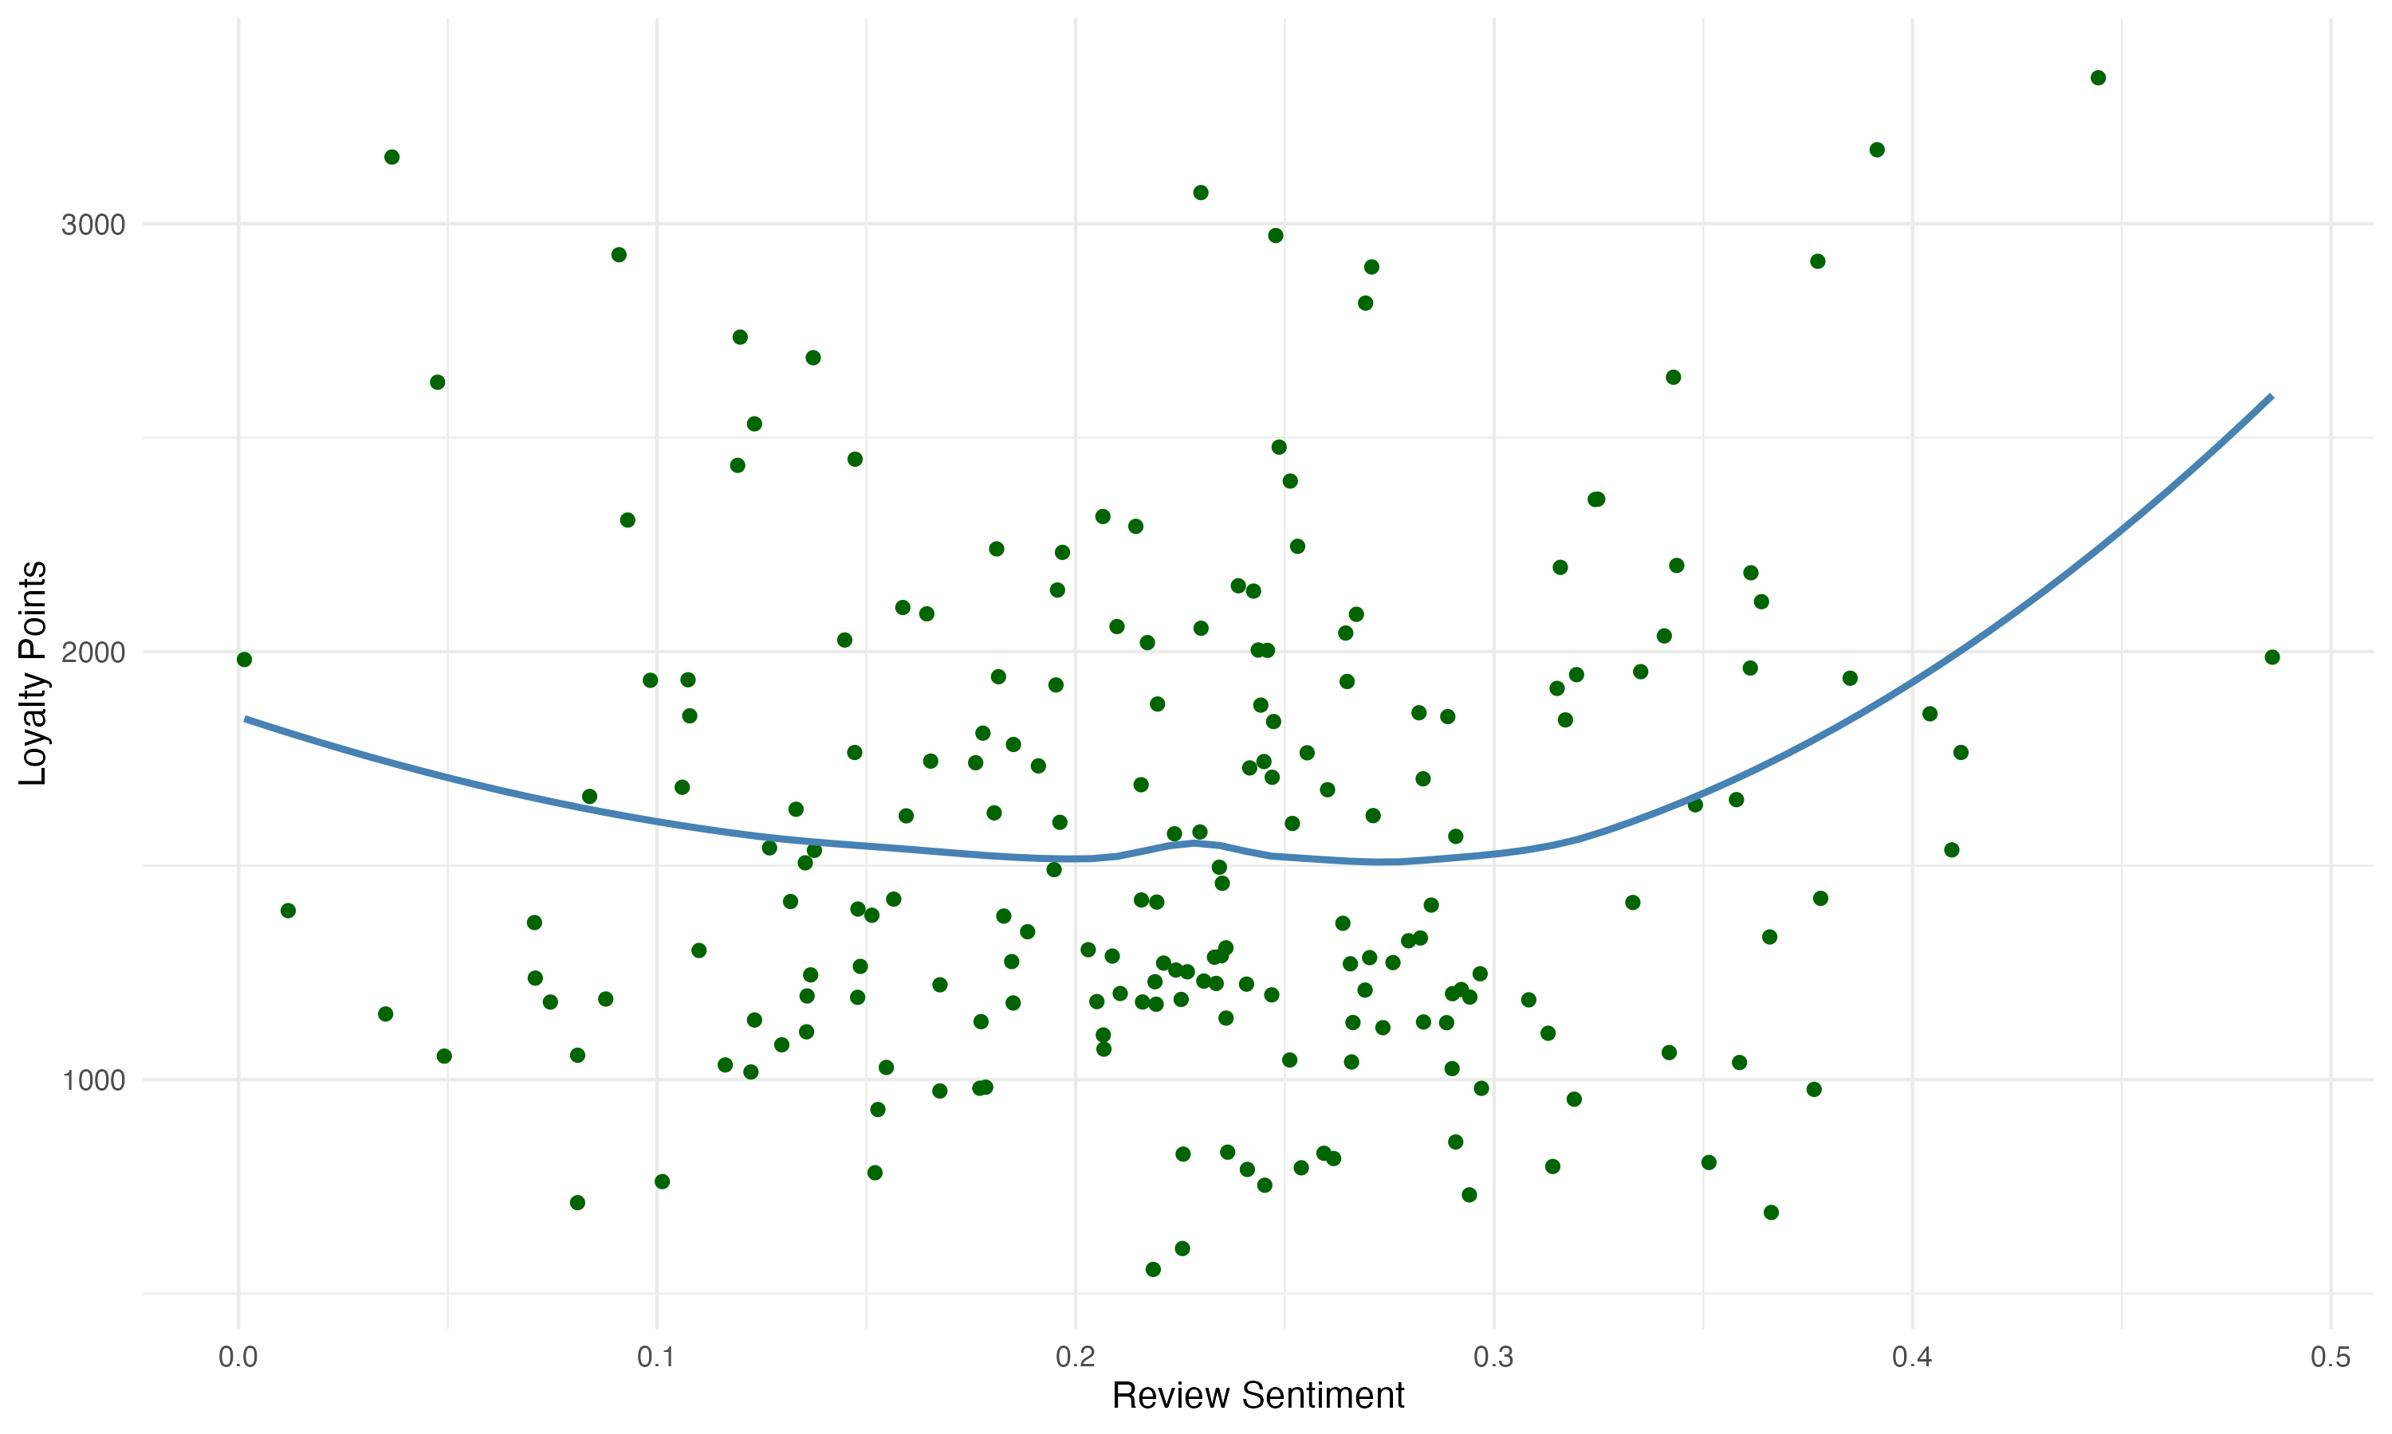
3. Review and Product Sentiment There is an opportunity to better link Loyalty Points to Product Sentiment
Notes:
Mentioned decision tree and adding age to the mix improving model
Is Pay intentional? Is the loyalty scheme profiling users and applying different loyalty points?

Slide 15
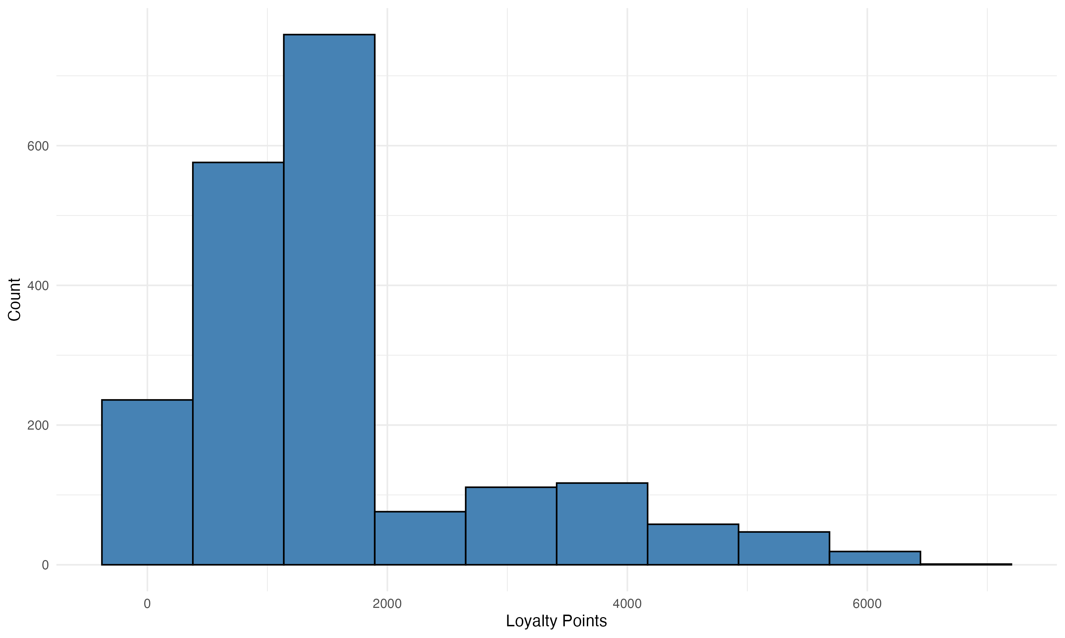
4. Predictive Models from Loyalty Data Loyalty points are heavily skewed which may impact multiple regression model performance
Notes:
Mentioned decision tree and adding age to the mix improving model
Is Pay intentional? Is the loyalty scheme profiling users and applying different loyalty points?

Slide 16
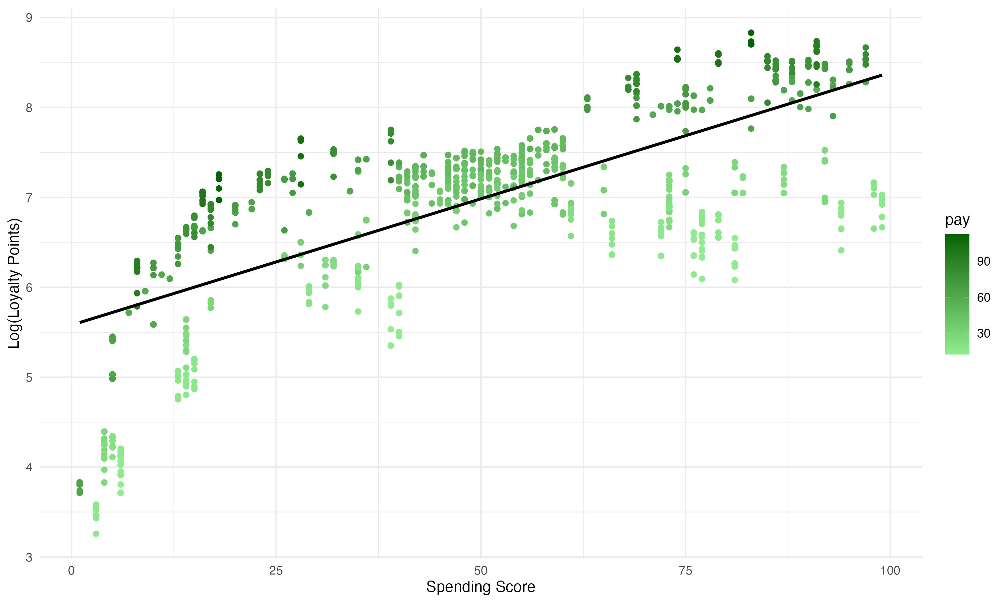
4. Predictive Models from Loyalty Data Transforming the data reduces the impact of outliers in multiple regression model
Pre-transformation
Post-transformation
Notes:
Mentioned decision tree and adding age to the mix improving model
Is Pay intentional? Is the loyalty scheme profiling users and applying different loyalty points?

Slide 17
4. Predictive Models from Loyalty Data Use Pay, Spending Score, Age & Education as features
Multiple Linear Regression Model features | Adj. R-Squared
Pay, Spending Score, Age + Education | 82%
Pay | Spending Score | Age | Education | Predicted LP
90,000 | 80 | 30 | Graduate | 2112
90,000 | 80 | 30 | PostGraduate | 2112
90,000 | 80 | 80 | PostGraduate | 2112
20,000 | 80 | 80 | PostGraduate | 475
Notes:
Mentioned decision tree and adding age to the mix improving model
Is Pay intentional? Is the loyalty scheme profiling users and applying different loyalty points?

Slide 18
4. Predictive Models from Loyalty Data Use Pay, Spending Score, Age & Education as features
Multiple Linear Regression Model features | Adj. R-Squared
Pay, Spending Score, Age + Education | 82%
Pay | Spending Score | Age | Education | Predicted LP
90,000 | 80 | 30 | Graduate | 2112
90,000 | 80 | 30 | PostGraduate | 2112
90,000 | 80 | 80 | PostGraduate | 2112
20,000 | 80 | 80 | PostGraduate | 475
Questions
How is spending score assigned, and when is it assigned to a customer?
Do loyalty points translate to customer spend?
What is the overall aim of the loyalty scheme?
How are loyalty points spent?
Notes:
Mentioned decision tree and adding age to the mix improving model
Is Pay intentional? Is the loyalty scheme profiling users and applying different loyalty points?

Slide 19
Summary
Loyalty Points are mainly defined by Pay and Spending Score
Focus marketing strategy on:
increased spend from the High Pay, Low Spending Score segment
Maintaining loyalty of the High Pay, High Spending Score segment
Overall, Positive sentiment towards products based on reviews
Potential to better link product sentiment to loyalty points
Predictive models can be used to predict loyalty however business needs to be aware of skewed data

