Slide 1
Adverse Events Report

Slide 2
An R Markdown Document (Main Report)
This is an R Markdown document. Markdown is a simple formatting syntax for writing on the web. R Markdown takes this a step further by combining Markdown prose and R code into reproducible documents that can be output as HTML, PDF, Word, and many more output formats. For more details on using R Markdown, have a look through its documentation site.
Let’s get our data

Slide 3
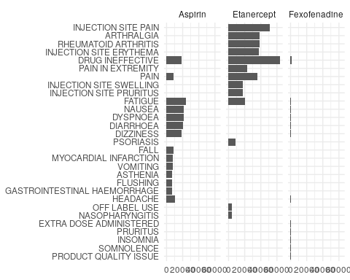
plot

Slide 4
data
## term count drug gender
## 1 DRUG INEFFECTIVE 49820 Etanercept female
## 2 INJECTION SITE PAIN 41796 Etanercept female
## 3 INJECTION SITE ERYTHEMA 32546 Etanercept female
## 4 RHEUMATOID ARTHRITIS 32466 Etanercept female

