Slide 1
Bowsher Rx
2018-11-02

Slide 2
Bowsher Rx

Slide 3
Tylenol Summary
There were 20 adverse events for Tylenol.

Slide 4
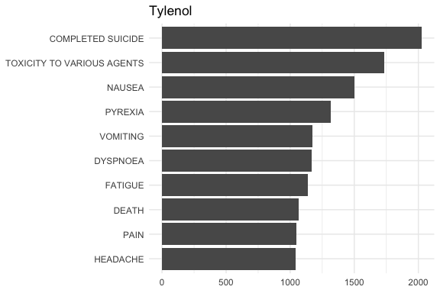
All Events
Year to Date

Slide 5
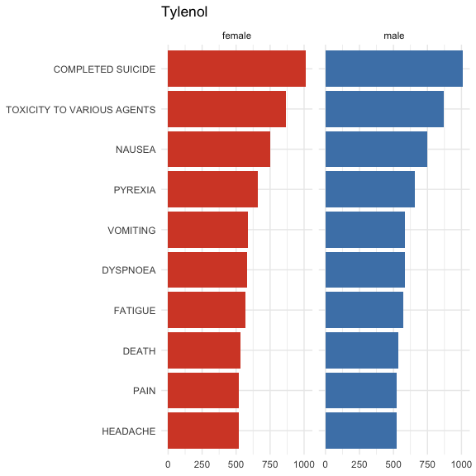
Events by Gender

