Slide 1
Bowsher Rx
2018-11-04

Slide 2
Bowsher Rx

Slide 3
Parlodel Summary
There were 20 adverse events for Parlodel.

Slide 4
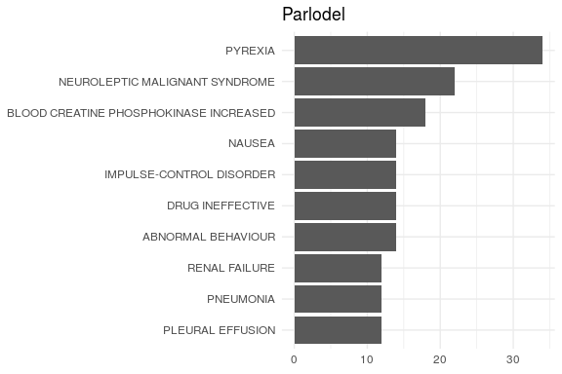
All Events
Year to Date

Slide 5
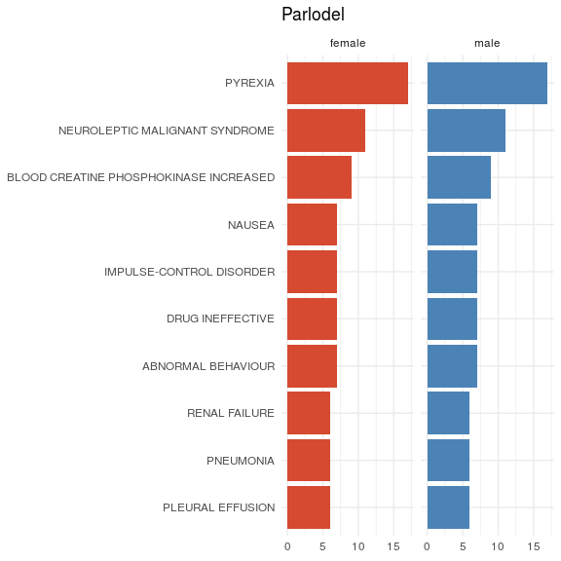
Events by Gender

