Slide 1
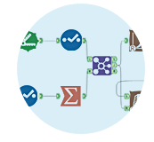

Deeper Insights with Alteryx
An overview of Alteryx Self-Service Data Analytics Platform

Slide 2

"About Me"
I am the Operations Analyst at Vista Retail Support, an EPOS Maintenance and Support-Service provider.
I lead a small team responsible for developing practical and actionable solutions to challenges facing the
business through the analysis of operational trends
I started using Alteryx over a year ago after looking for a new product to replace Excel as our primary analysis tool.
During the free-trial period I was amazed at how easy the product was to use and was quickly able to automate
many of our recurring MI reports, saving considerable resource hours as a result.
Since then Alteryx has become a crucial BI tool with many departments relying on it for ongoing operations.
Alteryx has helped us save resources, increase productivity, reduce costs and reclaim lost revenue.
You can read more about how we're using Alteryx at Vista Retail Support in the DataIQ case study at
http://bit.ly/2cCq2oe
|

Slide 3
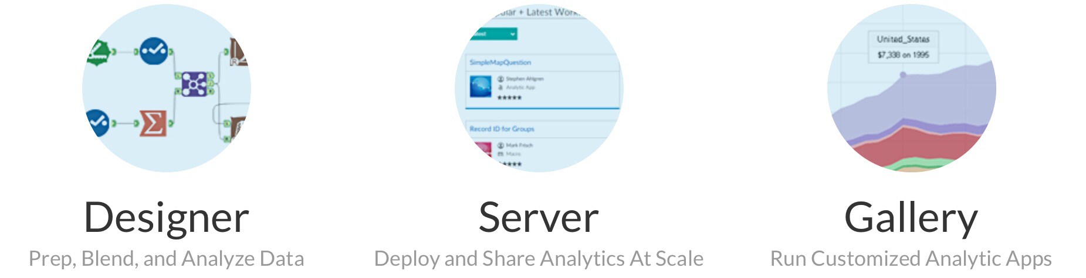
What is Alteryx?
Alteryx is a self-service data analytics platform which combines data preparation and blending
with predictive, statistical and spatial analytics, all in one intuitive user interface
Alteryx comprises three core products:
|

Slide 4
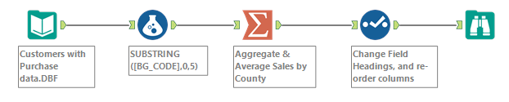
What is Alteryx?
With Alteryx Designer you can connect to and cleanse data from a variety of sources with specially designed tools.
Alteryx works by creating a 'pipeline' connecting your data from an input to an output. Along the way you can drop
tools in the path of your data to manipulate it
The use of the tool palette means no coding experience is required whilst retaining reproducibility
Alteryx empowers data analysts and subject-matter experts alike to find deeper insights in just hours!
|

Slide 5
Who uses Alteryx and why?
Data Analysts
Analysts need to prep and blend data from databases, warehouses, spreadsheets, the cloud and many other sources. The
mix of data blending, preparation, investigation and predictive modelling tools all under one hat make Alteryx the perfect
companion for any analyst
BI Developers
Again the ability to easily prepare and blend data, coupled with tools for integrating into more traditional front-end
visualisation packages such as Tableau, Qlik and Power BI make Alteryx an ideal Business Intelligence package.
DBA's
The ability to integrate with multiple data sources and a range of in-database tools makes creating ETL processes
a breeze. On a Stack Overflow post several users stated they've never gone back to SSIS since acquiring Alteryx
http://bit.ly/2cPCHHg
You!
Who knows their data better than the data-owners? Alteryx simple and intuitive interface means you can gain insights
whatever your background.
|

Slide 6
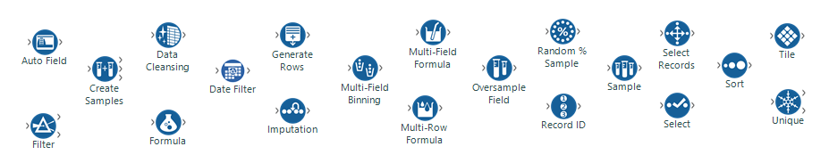
Data Preparation
It is often said Analysts spend 80% of their time prepping and cleaning data
According to users of Alteryx, Designer cuts data prep by 30% leaving more time for testing hypothesis
and evaluating models
The Data Preparation palette offers 20 standard tools with a range of capabilities
|

Slide 7
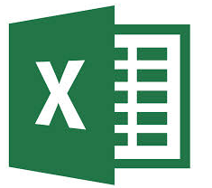



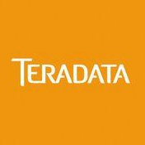
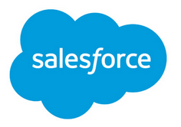


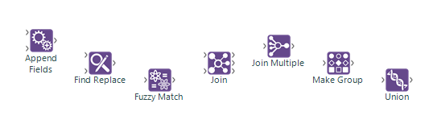
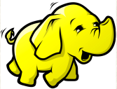
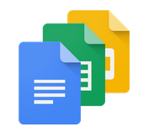




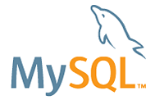
Data Blending
Many of us face the reality that our data is not stored in just one system. Accessing and blending that data is just
one step in the analytic workflow
With Alteryx Designer, blending data from multiple sources is easily accomplished, regardless of data structure and
format
Just some of the formats supported by Alteryx:
There are seven principle blending tools
|

Slide 8
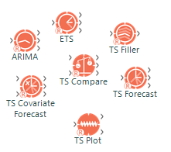
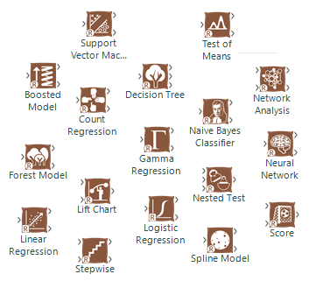
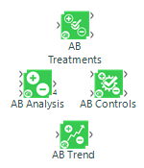
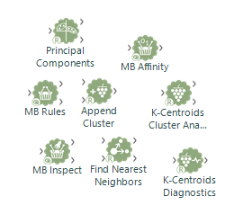
Predictive Analysis
Predictive analysis is about forecasting events using a range of statistical and machine learning
techniques
By highlighting and extracting certain traits from our data we can identify trends and use these to predict
behaviours which may occur / have occurred in the past, present or future
Alteryx Designer offers over 30 predictive tools based on the R statistical programming language. Each tool
is highly customisable to meet your specific needs
|

Slide 9
Statistical Analysis
Before you can analyse your data you need to understand it
Statistical Analysis is about scrutinising and summarising your data to understand its nature and make
inferences from your sample about the larger population
Identifying trends in your dataset is the best and easiest way to gain insights about your business and is the
first step in building predictive models
Alteryx offers an array of statistical tools for carrying out data investigations
|

Slide 10
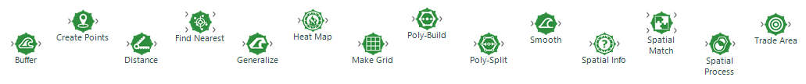
Spatial Analysis
On its own, it can be difficult to derive value from geospatial data, yet it can offer a wealth of information
when properly analysed
Designer helps you take advantage of spatial data through techniques such as drive-time, trade area,
spatial-matching and point creation
|

Slide 11
Demonstration
You work at Twitter HQ in San Francisco. On your way home you plan to go Pokémon hunting.
You live North West or your office and only plan to search within a 2-mile radius. You're hoping to find a good
all-rounder with a fair attack and defence. You're also hoping for a Pokémon that none of your friends have so it
can't be a creature that spawns frequently. In order to maximise your chances you've decided to use Data and Alteryx.
This demonstration will show some of the Data Prep, Blending, Statistical & Spatial Analysis and Reporting tools
available with Alteryx Designer.
These datasets are available in CSV format from Kaggle at:
http://bit.ly/2d9IXLS
http://bit.ly/2c2ZJt2
They are also available, along with the demonstration workflow, from GitHub at http://bit.ly/2cWoGI2
|

Slide 12
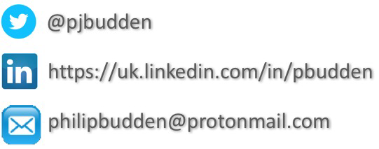
Contact Me
Why not try Alteryx free for 14-days?
Just visit http://bit.ly/2dancf8
|

