Slide 1
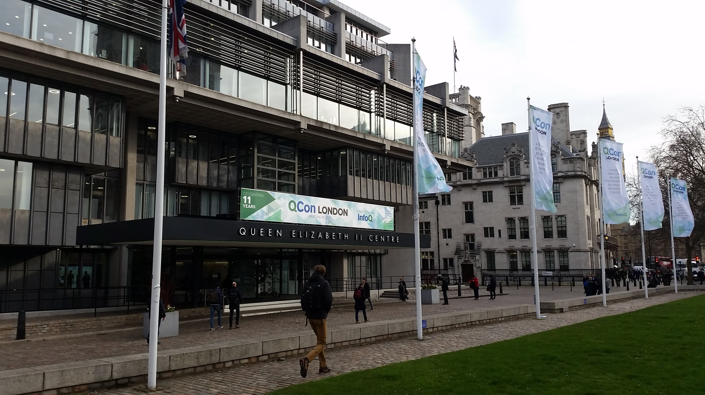
QCon London 2017

Slide 2
QCon is…
A conference for “Software Development Professionals”
“Engineers over Evangelists, Practitioners over Trainers/Coaches, Team Leads over Consultants”
Java and JVM focussed
Busy – around 1400 attendees
Exhausting – 129 talks over three days
Very well organised
Notes:
Central London
Voting feedback next day on best talks
Badge features
Chef formerly head chef at Dorchester hotel
Lunch for 1400 people in one hour
Lots of options

Slide 3



All in the view from the top floor

Slide 4

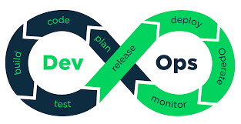
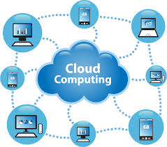

Covered at QCon
Notes:
Serverless – third party hosted functions to replace traditional backend server
Dev/ops CI/CD
Cloud computing
Micro services

Slide 5
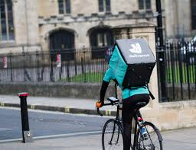


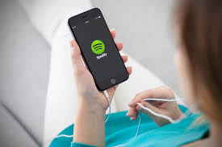
Sent engineers to give talks at QCon
Notes:
Deliveroo – described how they moved from monolith to micro service based approach, but only when massive scaling was required
Microservices – scalable, responsive, resilient. Hard to do, Stateful is harder,
Spotify – ad-serving architecture. Slide of add companies involved
Instagram, Facebook – I didn’t attend these

Slide 6
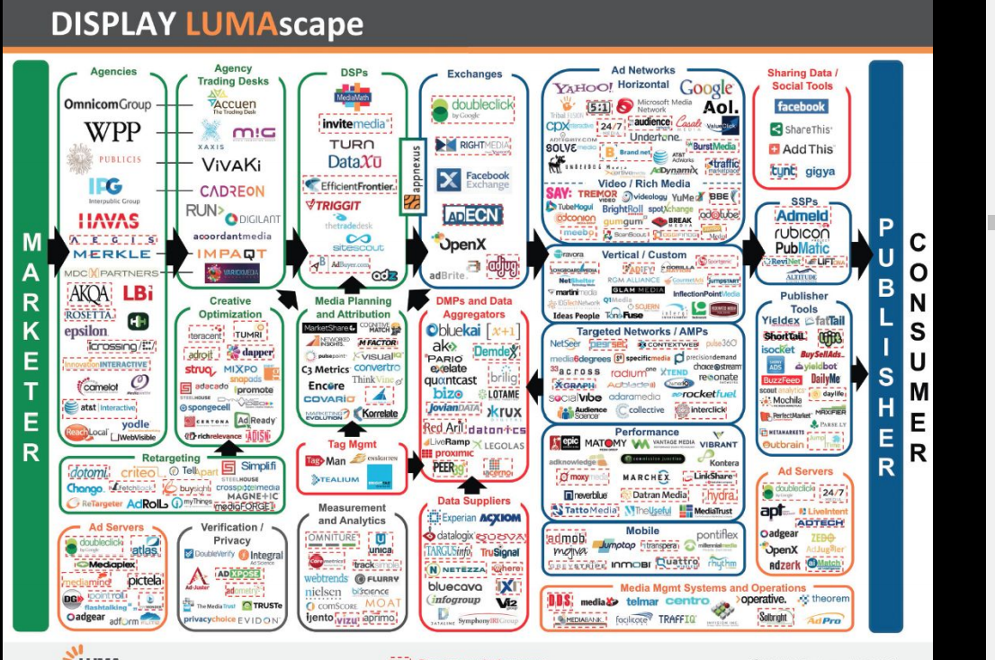
Notes:
Spotify
Reduce state management
Break up monolith

Slide 7
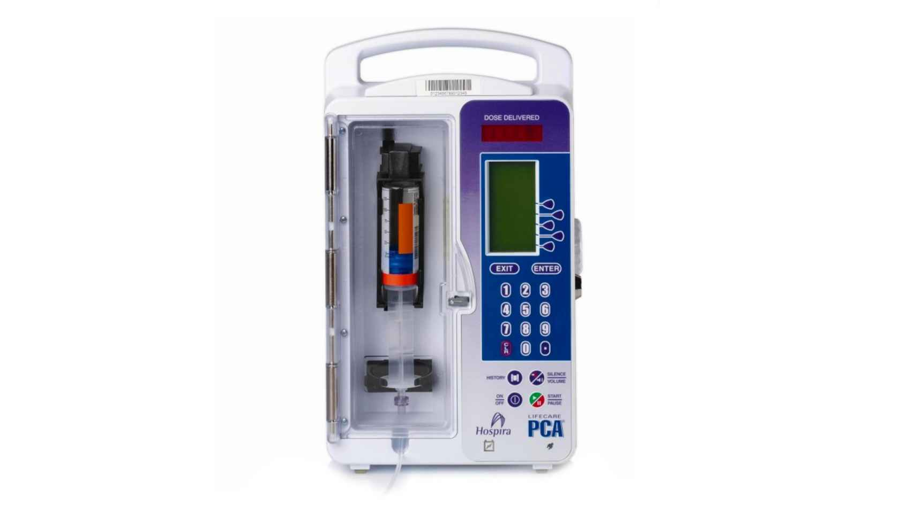

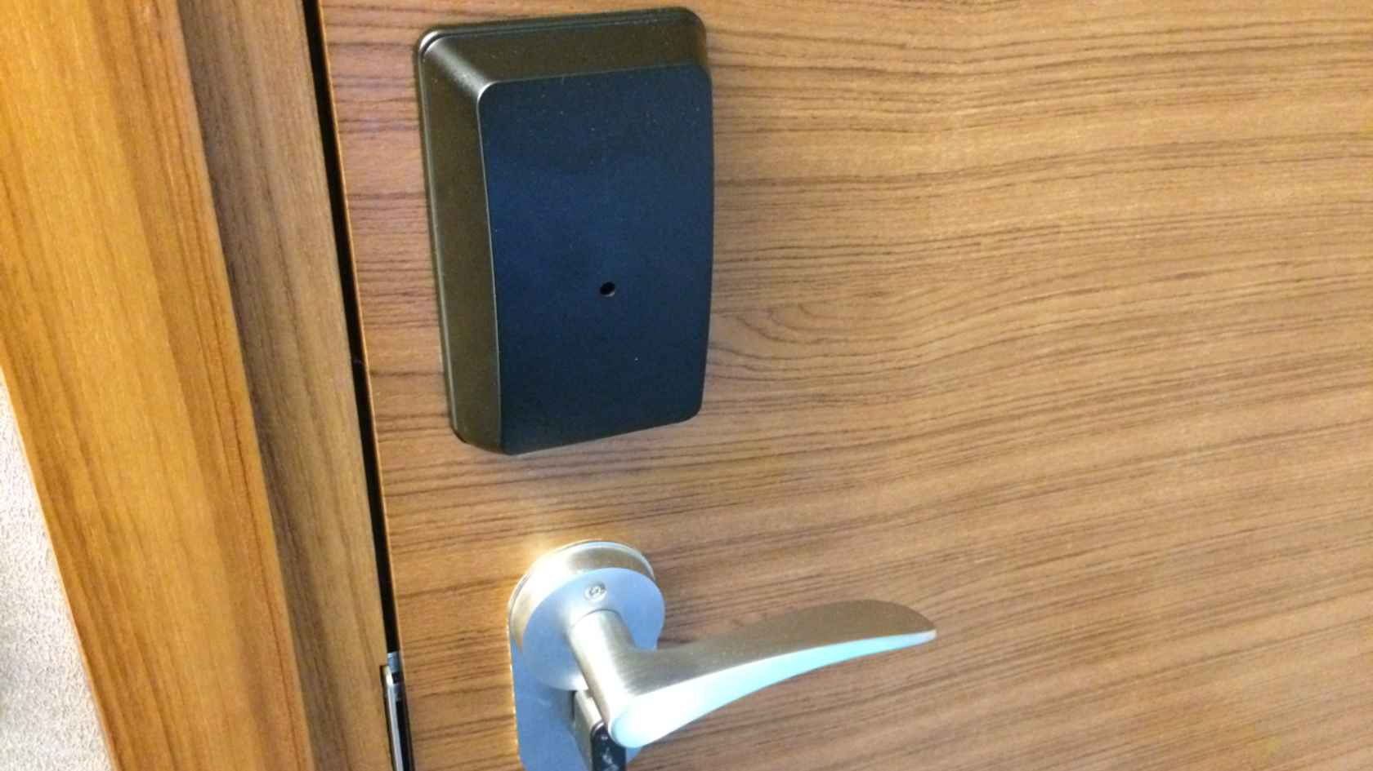
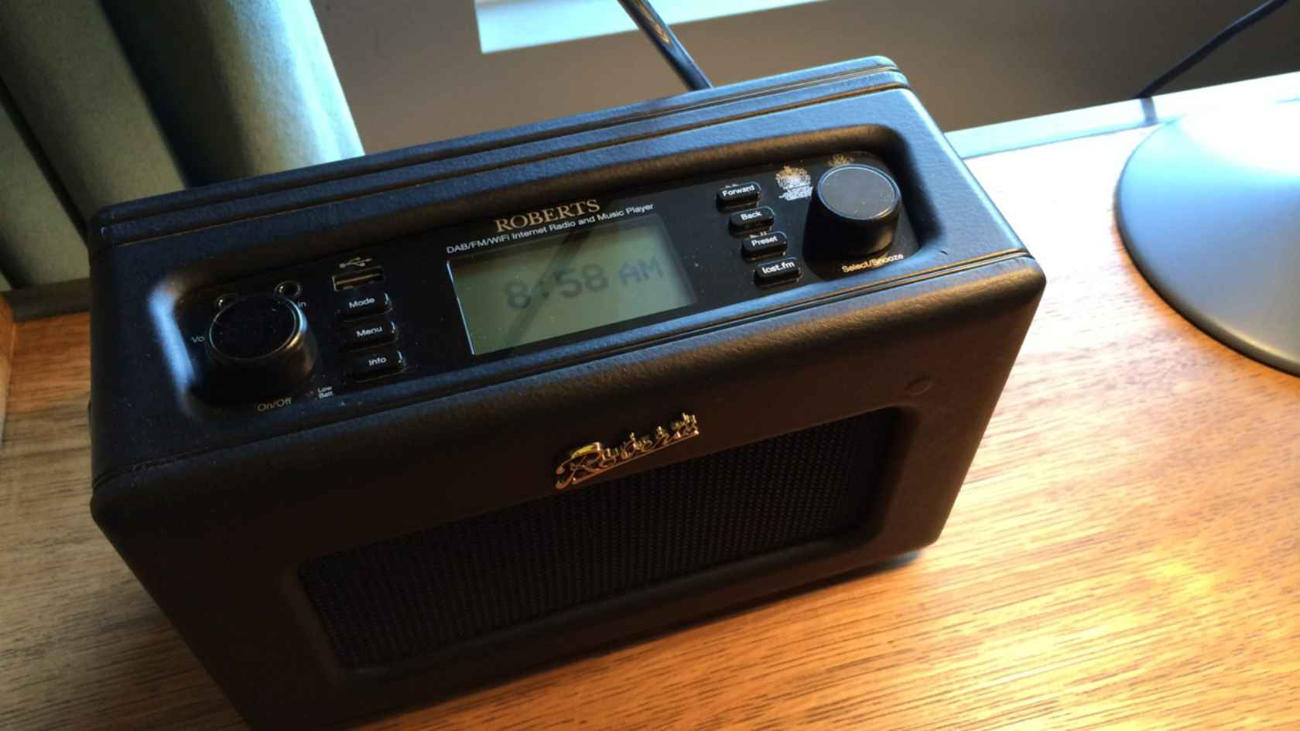
Insecure IoT Devices
Notes:
Petnet Smart Feeder – 12 hr server outage
Drug pump – telnet to root access with no password required
Hotel door with NFC – opened up to contain all door entries. “Smart” Hotel rooms with IP address numberered by room
Hotel smart radio. App was able to access other radios in other rooms

Slide 8

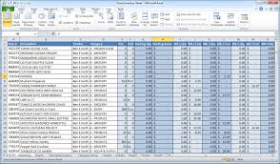
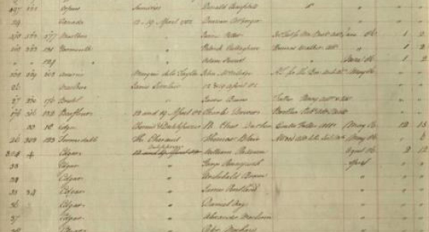
Transaction logs
Notes:
Bitcoin – built on Blockchain
Shipping ledger – list of goods bought and sold
Excel spreadsheet
Also Event sourcing

Slide 9

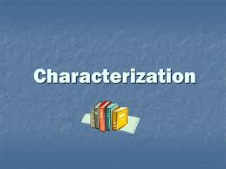

Types of Testing

Slide 10
Property-Based Testing
1) Describe the input
2) Describe the properties of the output
3) Have the computer try lots of random examples – check they don’t fail
Good for eg round trip
Quickcheck (haskell) Hypothesis (Python), several for Java

Slide 11
Programmable Infrastructure Testing
Intended for working on cloud deployments - Chef Puppet Ansible
What level of testing appropriate?
Used Cucumber and Serverspec with Selenium to test web service
Notes:
Could/should we be doing something similar (eg query gss-skim)

Slide 12
Characterization Testing
Tests you write to describe the current behaviour of your system
Start with a single test which executes a method
See what outputs produced by different inputs and name tests accordingly

Slide 13
Strategic Code Deletion
Types of useless code:
Unreachable
Dead
Low value
How to detect? Code coverage tools, mutation testing, feature probes

Slide 14



References in the “Soft Skills” talks
Notes:
Thoughtworks
Devops
Adaptive
Consistent theme - enable teams to work like startups, feedback, small steps, short sprints

Slide 15




Java versions

Slide 16
Java 9 - Jigsaw
Modularization of Java
No longer rely on classpath
Explicit module-info.java file to define dependencies
Still awaiting full support in IDEs and build tools
Notes:
Jigsaw – Modularised – module-info.java, forces you to think about dependencies
Early access, IDEs and build tools not working with Jigsaw yet
Live coding demo

Slide 17
Java 9 – Reactive Programming
Flow API for Reactive Streams
Not Java 8 streams
Implemented by third party libraries (eg RxJava)
allows working with multiple streams, handles backpressure
Notes:
Reactive programming – programming model for asynchronous data streams, pub/sub model
Reactive Streams - Flow API – API to allow use of Reactive Java Java RX
Live coding demo

Slide 18
Java 9 – The Rest
Convenience Collections Methods
List<String> fruits = List.of("apple", "orange", "banana");
Map<String, String> capCities = Map.ofEntries(entry("Manitoba", "Winnipeg"), entry("Alberta", "Edmonton"));
Removing some deprecated code
Private methods on Interfaces
New methods on Streams (takeWhile(), dropWhile())
REPL – console to run Java commands
Plus lots more
Notes:
List.of(), Set.of(), Map.ofENtries(Map.entry…
Private methods on interfaces
New methods on streams (takeWhile)
Removing deprecations
REPL

Slide 19

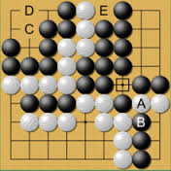

New computer languages
Notes:
Go – how to build a bank in Go
Elm – Compiles to javascript
Julia – scientifc programming

Slide 20
Some Other Stuff
Machine Learning
Performance Java vs C# vs C++
How to parallelize Java Streams

Slide 21
Interested in any of These?
https://qconlondon.com and click on the 2017 Schedule
Let me know if there’s any specific talks you’d like to access

