Slide 1
SQL Developer Interview Presentation

Slide 2
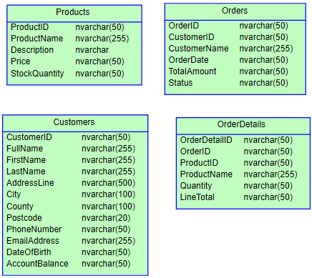
Original Database Schema

Slide 3
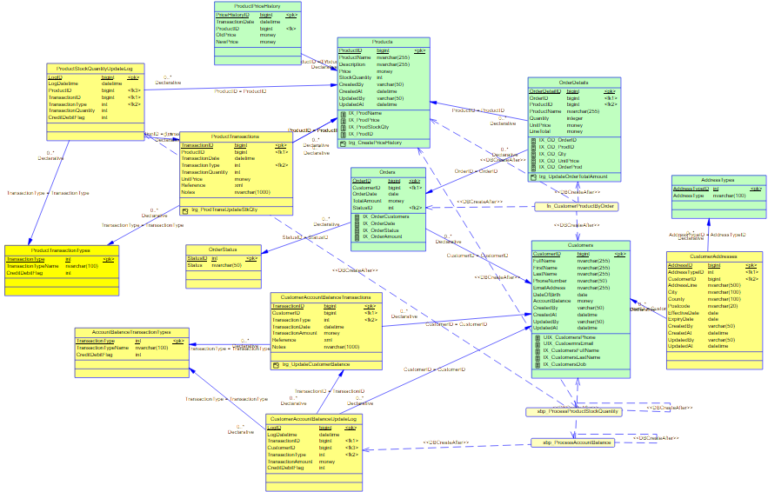

Slide 4
ID fields used integer type
In modern programming, bigint are better for programming integration
Scalable range, bigint (or int) and easy to manage
Unique ID will make it easy to spot the record
Customers.CustomerID
Products.ProductID
Orders.OrderID
OrdersDetails.OrderDetailsID

Slide 5
Date fields used `date` type
Customers.DateOfBirth
Orders.OrderDate

Slide 6
Quantity used `integer` type
Products.StockQuantity
OrderDetails.Quantity

Slide 7
Money (amount/cost) fields used `money` type
Customers.AccountBalance
Products.Price
Order.TotalAmount
OrderDetails.UnitPrice
OrderDetails.LineTotal

Slide 8
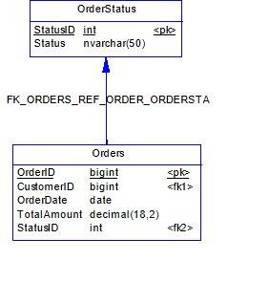
Split OrderStatus into master table and keep the StatusID in Orders table
Data Integrity
Referential Consistency
Centralised Control of Status Definitions, and change of Status description will not affect the orders data.
Smaller and faster `Orders` Table
Support Localisation and Multi-language UIs
Better control for reporting and filtering

Slide 9
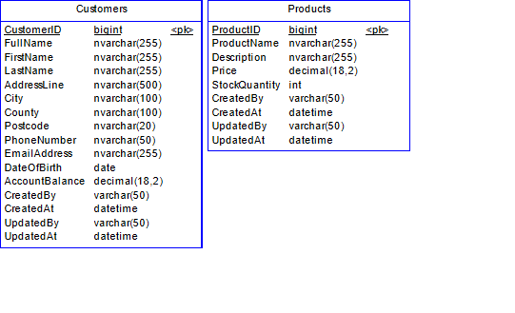
Master tables added creation and modification fields for audit trail purpose
Customers, Products added `CreatedBy, CeatedAt, UpdatedBy and UpdatedAt` fields
audit trail purpose

Slide 10
Split the transaction fields such as AccountBalance, StockQuantity into transaction tables
Separate the master table which stores stable, descriptive data
The transaction table captures dynamic, time-sensitive events and typically operates via record inserts rather than updates.

Slide 11
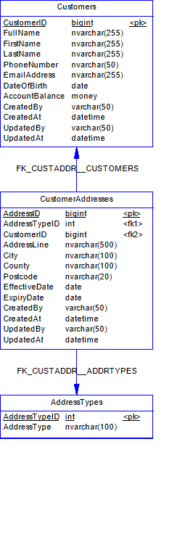
Split Address Fields into CustomerAddresses
Enabled multiple addresses for a customer, such as billing/shipping
Added EffectiveDate and ExpiryDate

Slide 12
Enabled service broker
For async trigger update
Customers.AccountBalance
Products.StockQuantity

Slide 13
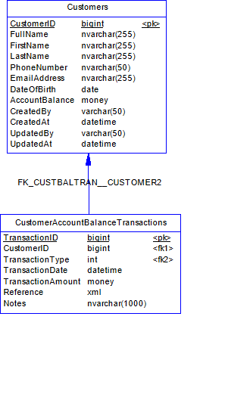
Split the transaction fields such as AccountBalance, StockQuantity into transaction tables
Frequent updated AccountBalance field moved to Transaction table
All update on the AccountBalance be stored in the transaction table for audit purpose
Using trigger to update AccountAmount via Service Broker

Slide 14
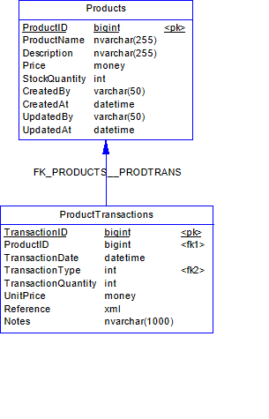
Split the transaction fields such as AccountBalance, StockQuantity into transaction tables
Same for product quantity
Quantity fields moved to transaction table
Using trigger to update AccountAmount via Service Broker

Slide 15
Add default values and checking to columns
Quantity default 0
OrderDate default getdate()
Products.Price default 0
Products.StockQuantity >=0
Customers.AccountBalance >=0

Slide 16
PK for identity, FK for integrity, Indexes for speed added
Created targeted indexes on frequently queried fields
Applied predictive indexing for fields commonly used in WHERE, JOIN, or ORDER BY clauses.
Used SQL Server Tuning Advisor with sample data to identify and address missing or underused indexes.
PK: Primary Keys - Ensures each row is uniquely identifiable
FK: Foreign Keys - Links tables together, enforcing valid references
IX: Indexes - Accelerate query performance
UIX: Unique Indexes – Email, PhoneNumber

Slide 17
Primary Keys
TableName | IndexName | IndexType
CustomerAccountBalanceTransactions | PK_CUSTOMERACCOUNTBALANCETRANS | NONCLUSTERED
Customers | PK_CUSTOMERS | CLUSTERED
OrderDetails | PK_ORDERDETAILS | CLUSTERED
Orders | PK_ORDERS | CLUSTERED
OrderStatus | PK_ORDERSTATUS | CLUSTERED
ProductPriceHistory | PK_PRODUCTPRICEHISTORY | CLUSTERED
Products | PK_PRODUCTS | CLUSTERED
ProductTransactions | PK_PRODUCTTRANSACTIONS | CLUSTERED
TransactionTypes | PK_TRANSACTIONTYPES | CLUSTERED

Slide 18
Indexes
TableName | IndexName | IndexType
Customers | UIX_CUSTOEMRSEMAIL | NONCLUSTERED
Customers | UIX_CUSTOMERSPHONE | NONCLUSTERED
OrderDetails | IX_OD_ORDERID | NONCLUSTERED
OrderDetails | IX_OD_ORDERPROD | NONCLUSTERED
OrderDetails | IX_OD_PRODID | NONCLUSTERED
OrderDetails | IX_OD_QTY | NONCLUSTERED
OrderDetails | IX_OD_UNITPRICE | NONCLUSTERED
Orders | IX_ORDERAMOUNT | NONCLUSTERED
Orders | IX_ORDERCUSTOMERS | NONCLUSTERED
Orders | IX_ORDERDATE | NONCLUSTERED
Orders | IX_ORDERSTATUS | NONCLUSTERED
Products | IX_PRODID | NONCLUSTERED
Products | IX_PRODNAME | NONCLUSTERED
Products | IX_PRODPRICE | NONCLUSTERED
Products | IX_PRODSTOCKQTY | NONCLUSTERED

Slide 19
Foreign Keys
ForeignKeyName | ParentTable | ParentColumn | ReferencedTable | ReferencedColumn
FK_CUSTOMER_REF_CUSTO_CUSTOMER | CustomerAccountBalanceTransactions | CustomerID | Customers | CustomerID
FK_ORDERDET_REF_ORDER_ORDERS | OrderDetails | OrderID | Orders | OrderID
FK_ORDERDET_REF_PRODU_PRODUCTS | OrderDetails | ProductID | Products | ProductID
FK_ORDERS_REF_CUSTO_CUSTOMER | Orders | CustomerID | Customers | CustomerID
FK_ORDERS_REF_ORDER_ORDERSTA | Orders | StatusID | OrderStatus | StatusID
FK_PRODUCTP_REF_PRODU_PRODUCTS | ProductPriceHistory | ProductID | Products | ProductID
FK_PRODUCTT_REF_PRODU_PRODUCTS | ProductTransactions | ProductID | Products | ProductID
FK_PRODUCTT_REF_TRANS_TRANSACT | ProductTransactions | TransType | TransactionTypes | TransType

Slide 20
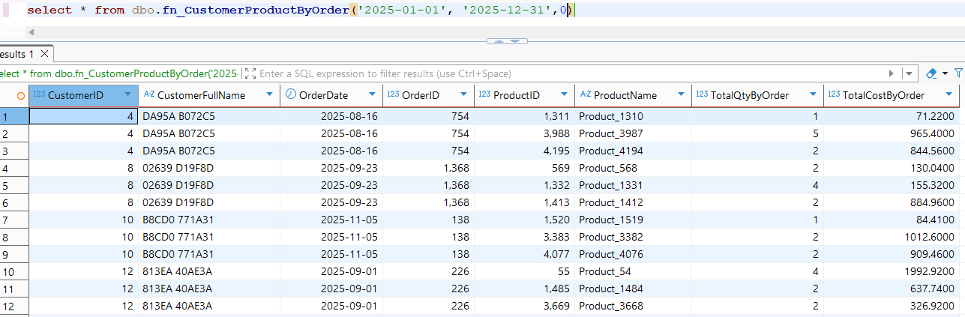
Reporting Table Function

Slide 21
Added Process Log
CustomerAccountBalanceUpdateLog
ProductStockQuantityUpdateLog

