Slide 1


Using Fedora Commons to create a persistent archive for digital objects
Phil Cryer
Open Source Development Lead

Slide 2
<abstract />
With the increasing amount of digital data and demand for open access to view and reuse such data continually increasing, the adoption of open source digital repository software is critical for long term storage and management of digital objects. By utilizing the open source Fedora Commons software, the Missouri Botanical Garden has created a stable, persistent archive for Tropicos digital objects, including specimen images, plant photos, and other digital media. Metadata, organized in standard Dublin Core extracted from Tropicos, are stored alongside the digital objects providing search and sharing of data via open standards such as REST and OAI, opening the door for mash-ups and alternative uses. The presentation will cover initial discovery, required hardware and software, and an overview of our experience implementing Fedora Commons. Lessons learned, pros and cons, and other options will also be covered.

Slide 3
<abstract />
With the increasing amount of digital data and demand for open access to view and reuse such data continually increasing, the adoption of open source digital repository software is critical for long term storage and management of digital objects. By utilizing the open source Fedora Commons software, the Missouri Botanical Garden has created a stable, persistent archive for Tropicos digital objects, including specimen images, plant photos, and other digital media. Metadata, organized in standard Dublin Core extracted from Tropicos, are stored alongside the digital objects providing search and sharing of data via open standards such as REST and OAI, opening the door for mash-ups and alternative uses. The presentation will cover initial discovery, required hardware and software, and an overview of our experience implementing Fedora Commons. Lessons learned, pros and cons, and other options will also be covered.
In other words, implement Fedora Commons so that it...
  Creates and maintains a persistent, stable, digital archive
  Stores the data in a neutral manner using open standards
  Promotes content sharing and reuse using open standards

Slide 4

<software />
What is it, and what does it provide?
Note: it is NOT related to Fedora Linux at all!

Slide 5
<software />
What is it, and what does it provide?
it is an integrated digital repository-centered platform

Slide 6
<software />
What is it, and what does it provide?
it is an integrated digital repository-centered platform
it enables storage, access and management of virtually any kind of digital content

Slide 7
<software />
What is it, and what does it provide?
it is an integrated digital repository-centered platform
it enables storage, access and management of virtually any kind of digital content
it provides a base for software developers to build tools and front ends on for sharing, reuse and displaying data online

Slide 8
<software />
What is it, and what does it provide?
it is an integrated digital repository-centered platform
it enables storage, access and management of virtually any kind of digital content
it provides a base for software developers to build tools and front ends on for sharing, reuse and displaying data online
it is free, community supported, open source software

Slide 9
<goals />
To update the Tropicos image collection to a modern repository model

Slide 10
<goals />
To update the Tropicos image collection to a modern repository model
Create and maintain a persistent, stable, digital archive
    provide backup, redundancy and disaster recovery for current system
    complement existing architecture by incorporating open source software
    provide full-text search across all metadata

Slide 11
<goals />
To update the Tropicos image collection to a modern repository model
Create and maintain a persistent, stable, digital archive
    provide backup, redundancy and disaster recovery for current system
    complement existing architecture by incorporating open source software
    provide full-text search across all metadata
Store the data in a neutral manner, using open standards
    organize Tropicos image metadata using standard Dublin Core
    store digital objects along with the descriptive XML files on the filesystem

Slide 12
<goals />
To update the Tropicos image collection to a modern repository model
Create and maintain a persistent, stable, digital archive
    provide backup, redundancy and disaster recovery for current system
    complement existing architecture by incorporating open source software
    provide full-text search across all metadata
Store the data in a neutral manner, using open standards
    organize Tropicos image metadata using standard Dublin Core
    store digital objects along with the descriptive XML files on the filesystem
Promote content sharing and reuse via open standards
    repository accessible via the REST protocol
    Allow data sharing available via OAI-PMH protocol (Open Archive Initiative)‏ for incremental harvesting

Slide 13
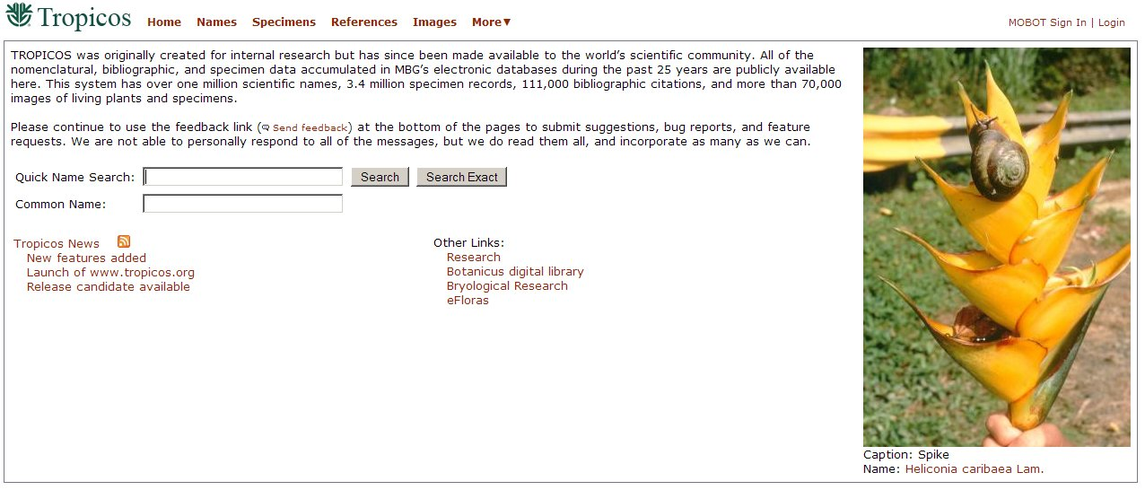
<baseline />
Tropicos Images (www.tropicos.org)‏
  over 85,000 images of herbarium specimens and live plants with metadata
  data stored in a MSSQL relational database
  the web front end is presented in Microsoft .NET (recently redesigned)‏

Slide 14
<steps />
To ingest our current data into Fedora Commons

Slide 15




<step_1 />
To ingest our current data into Fedora Commons
  build a suitable server to run Fedora Commons and house the digital collection
    standard x86 server running Debian GNU/Linux (stable branch)
      Note: Since this runs under Tomcat, it can be installed in Mac and Windows too.
    install and configure Tomcat application server and MySQL database server
    install Fedora Commons 3.0

Slide 16
<step_2 />
To ingest our current data into Fedora Commons
  build a suitable server to run Fedora Commons and house the digital collection
    standard x86 server running Debian GNU/Linux (stable branch)
      Note: Since this runs under Tomcat, it can be installed in Mac and Windows too.
    install and configure Tomcat application server and MySQL database server
    install Fedora Commons 3.0
  convert the data from the MSSQL server into an XML format for import into Fedora Commons
    get a raw XML file extract from the current MSSQL database store of the images metadata
    Convert raw XML into FOXML (Fedora Commons default XML schema, which includes the industry standard Dublin Core descriptions) using scripts and xsltproc

Slide 17
<step_2 />
Raw Tropicos data
ImageFileID=1111
ImageSubdirectory=024
ImageFilename=TAN000058.sid
Photographer=Fano Rajaonary, Madagascar
Copyright=Herbier du Parc Botanique et Zoologique de Tsimbazaza, Antananarivo, Madagascar
PhotoDate=12 April 2005
ShortCaption=Isotype
LongCaption=Isotype: TAN000058 Herbier du Parc Botanique et Zoologique de Tsimbazaza, Antananarivo, Madagascar
Note=One part of two (Inflorescence)
ImageKind=Type Specimen
ImageFormat=SID
NameID=50059127
ScientificName=Dypsis fanadianae
SpecimenID=1054721
SeniorCollector=Beentje, Henk Jaap
CollectionNumber=4729
LocationCountry=Madagascar
LocationUpperPolitical=Fianarantsoa
Coordinates=21º22'S 047º47'E
[...]

Slide 18
<step_2 />
Raw Tropicos data
ImageFileID=1111
ImageSubdirectory=024
ImageFilename=TAN000058.sid
Photographer=Fano Rajaonary, Madagascar
Copyright=Herbier du Parc Botanique et Zoologique de Tsimbazaza, Antananarivo, Madagascar
PhotoDate=12 April 2005
ShortCaption=Isotype
LongCaption=Isotype: TAN000058 Herbier du Parc Botanique et Zoologique de Tsimbazaza, Antananarivo, Madagascar
Note=One part of two (Inflorescence)
ImageKind=Type Specimen
ImageFormat=SID
NameID=50059127
ScientificName=Dypsis fanadianae
SpecimenID=1054721
SeniorCollector=Beentje, Henk Jaap
CollectionNumber=4729
LocationCountry=Madagascar
LocationUpperPolitical=Fianarantsoa
Coordinates=21º22'S 047º47'E
[...]
Converted metadata in FOXML
<oai_dc:dc> <dc:title>Beentje, Henk Jaap - 4729</dc:title><dc:creator>Missouri Botanical Garden</dc:creator>
<dc:subject>Type Specimen</dc:subject>
<dc:subject>Ifanadiana MAD</dc:subject>
<dc:description>Isotype: TAN000058 Herbier du Parc Botanique et Zoologique de Tsimbazaza, Antananarivo, Madagascar</dc:description>
<dc:description>50059127 Dypsis ifanadianae</dc:description>
<dc:description>Beentje, Henk Jaap</dc:description>
<dc:description>Isotype</dc:description>
<dc:publisher>Missouri Botanical Garden</dc:publisher>
<dc:contributor>Fano Rajaonary, Madagascar</dc:contributor>
<dc:date>26 July 1992</dc:date>
<dc:date>12 April 2005</dc:date>
<dc:type>image</dc:type>
<dc:format>image/sid</dc:format>
<dc:identifier>http://tropicos.org/image/1111</dc:identifier>
[...]

Slide 19
<step_3 />
To ingest our current data into Fedora Commons
  build a suitable server to run Fedora Commons and house the digital collection
    standard x86 server running Debian GNU/Linux (stable branch)
      Note: Since this runs under Tomcat, it can be installed in Mac and Windows too.
    install and configure Tomcat application server and MySQL database server
    install Fedora Commons 3.0
  convert the data from the MSSQL server into an XML format for import into Fedora Commons
    get a raw XML file extract from the current MSSQL database store of the images metadata
    Convert raw XML into FOXML (Fedora Commons default XML schema, which includes the industry standard Dublin Core descriptions) using scripts and xsltproc
  ingest (import) the converted FOXML files into Fedora Commons server using the provided scripts

Slide 20
<step_4 />
To ingest our current data into Fedora Commons
  build a suitable server to run Fedora Commons and house the digital collection
    standard x86 server running Debian GNU/Linux (stable branch)
      Note: Since this runs under Tomcat, it can be installed in Mac and Windows too.
    install and configure Tomcat application server and MySQL database server
    install Fedora Commons 3.0
  convert the data from the MSSQL server into an XML format for import into Fedora Commons
    get a raw XML file extract from the current MSSQL database store of the images metadata
    Convert raw XML into FOXML (Fedora Commons default XML schema, which includes the industry standard Dublin Core descriptions) using scripts and xsltproc
  ingest (import) the converted FOXML files into Fedora Commons server using the provided scripts
  configure cron jobs on the Linux server to sync the Fedora Commons datastore with the MSSQL Tropicos database on additions and edits

Slide 21
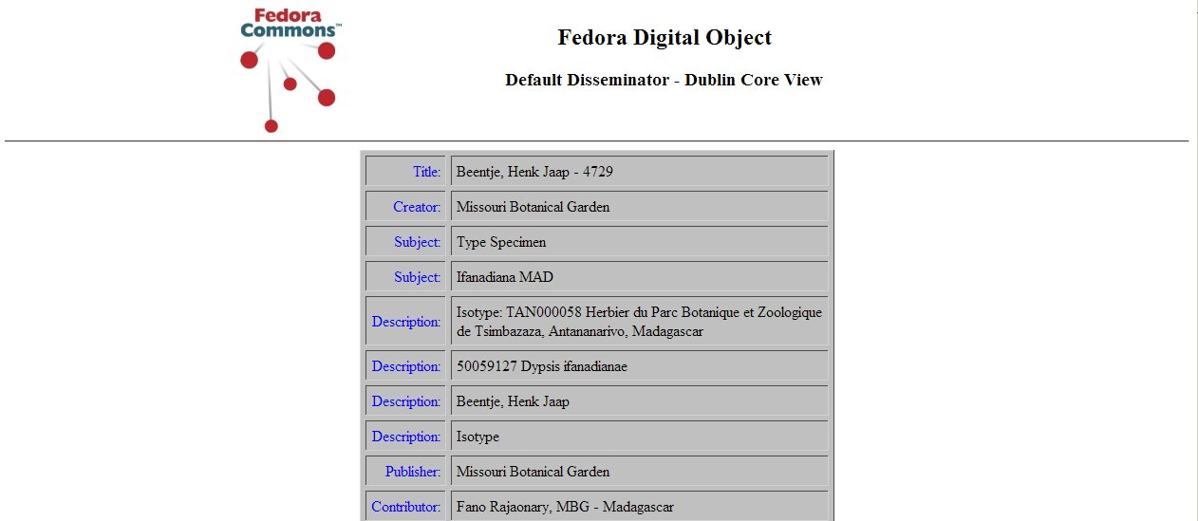
<results />
Results
  Fedora Commons has Tropicos metadata synced with Tropicos database
  accessible via the current sharing and harvesting protocols REST and OAI-PMH

Slide 22
<benefits />
Benefits to the Tropicos image collection
After migrating data into Fedora Commons, all main goals have been accomplished
    created an organized, persistent, maintainable, digital archive
    data is stored in a neutral manner using open standards
    data is now available for content sharing and reuse using open standards

Slide 23
<benefits />
Benefits to the Tropicos image collection
After migrating data into Fedora Commons, all main goals have been accomplished
    created an organized, persistent, maintainable, digital archive
    data is stored in a neutral manner using open standards
    data is now available for content sharing and reuse using open standards
But wait, there's more!
    digital objects and metadata are redundantly stored in a 'rebuildable' state
      files stored on filesystem alongside descriptive XML (simple to backup)‏
      objects and data can 'live on' if database is ever lost (disaster recovery)‏
      data can be migrated to a different system, without issue (futureproof)‏
      All versioning and auditing is logged to the XML file (sustainable)‏
    provides a new, integrated work-flow for adding or modifying objects
      this workflow now serves as an auditing and quality control tool for current system, flagging records with missing or broken links to images
    open source allows us to add new initiatives to add functionality

Slide 24
<pros />
Pros
  allows anyone to publish their collections online
  provides a sustainable architecture for digital objects to reside
  standards compliance ensures 'best practices' in terms of storage and sharing
  It doesn't force you to adopt any new methodologies
  active development and support community (wiki, forums, mailing lists, irc)‏
  open source software (free to use, modify, redistribute)

Slide 25
<cons />
Pros
  allows anyone to publish their collections online
  provides a sustainable architecture for digital objects to reside
  standards compliance ensures 'best practices' in terms of storage and sharing
  It doesn't force you to adopt any new methodologies
  active development and support community (wiki, forums, mailing lists, irc)‏
  open source software (free to use, modify, redistribute)
Cons
  steep learning curve
  importing existing data can be difficult
  no simple web front end to get a test site up quickly (having one would increase adoption)‏
  development overtook documentation for a time (fixed)‏

Slide 26
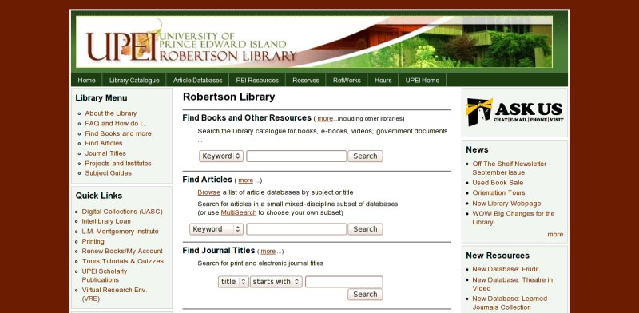
<others />
University of Prince Edward Island Library (Canada)‏
they have developed Drupal module to manage and display data (to be released)‏
many different groups at the university share their digital collections this way

Slide 27
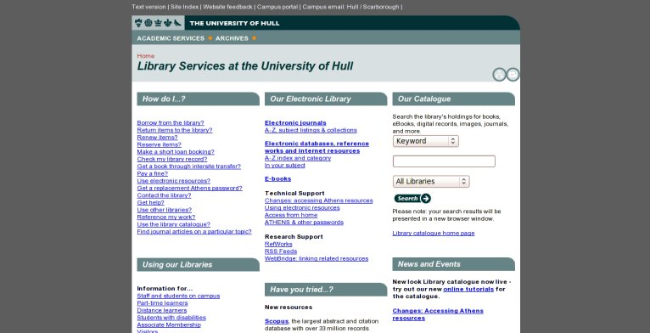
<others_2 />
The University of Hull (England)‏
uses Muradora, project using PHP and MySQL, for the web UI (open source)‏
used extensively throughout the university, and has been online for over a year

Slide 28
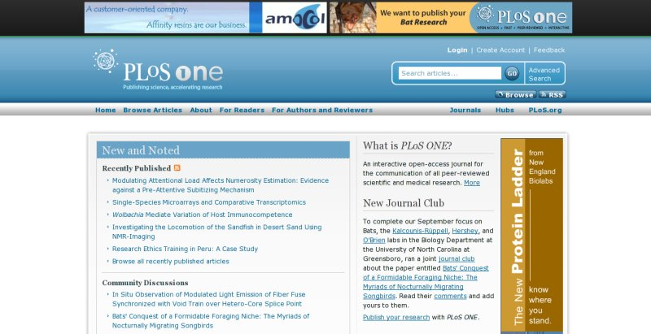
<others_3 />
Public Library of Science's PloS ONE (America)‏
developed an in-house front end called Topaz for the web UI (open source)‏
also developed Ambra for the publishing system (open source)‏

Slide 29
<future_echos />
Web front ends
investigate the latest PHP front ends from projects like Fez and Muradora
implement University of Prince Edward Island's Drupal module
implement The Fascinator, a simple front end with Solr search integrated
investigate integration with GBIF's new IPT project

Slide 30
<future_echos />
Web front ends
investigate the latest PHP front ends from projects like Fez and Muradora
implement University of Prince Edward Island's Drupal module
implement The Fascinator, a simple front end with Solr search integrated
investigate integration with GBIF's new IPT project
Will it scale?
discover how Fedora Commons can scale to handle today and tomorrow's enormous data handling needs
understand how such data can be shared in an effective method

Slide 31
<future_echos />
Web front ends
investigate the latest PHP front ends from projects like Fez and Muradora
implement University of Prince Edward Island's Drupal module
implement The Fascinator, a simple front end with Solr search integrated
investigate integration with GBIF's new IPT project
Will it scale?
discover how Fedora Commons can scale to handle today and tomorrow's enormous data handling needs
understand how such data can be shared in an effective method
Distributed architecture
look at options for storing huge amounts of data, and how Fedora Commons can control this type of distribution
examples of this are P2P networking protocols like Bittorrent, and distributed filesystems like hadoop (Yahoo's open source distributed filesystem project)‏

Slide 32
<future_echos />
Web front ends
investigate the latest PHP front ends from projects like Fez and Muradora
implement University of Prince Edward Island's Drupal module
implement The Fascinator, a simple front end with Solr search integrated
investigate integration with GBIF's new IPT project
Will it scale?
discover how Fedora Commons can scale to handle today and tomorrow's enormous data handling needs
understand how such data can be shared in an effective method
Distributed architecture
look at options for storing huge amounts of data, and how Fedora Commons can control this type of distribution
examples of this are P2P networking protocols like Bittorrent, and distributed filesystems like hadoop (Yahoo's open source distributed filesystem project)‏
Development
contributed to an auto-installer script for The Fascinator (now available)‏
creating a 'deb' package installer to simplify native installation on Debian and Ubuntu Linux (available Nov 2008)‏
export ATOM files and notify via RSS
BHL Articles Repository (end of 2009)‏

Slide 33


<done />
More information
Fedora Commons
  www.fedora-commons.org
  www.fedora-commons.org/wiki
Feedback (please)‏
  phil.cryer@mobot.org
Acknowledgment
Thanks to the TWDG community at large, but specifically Chris, Chuck, Dave, Tim, Markus, Nicky, Kevin, Patrick, Dimitri, Denato and Stan for their education and guidance.
Thought‏‏
“Those who have much are often greedy, those who have little always share.”
Oscar Wilde

