Slide 1
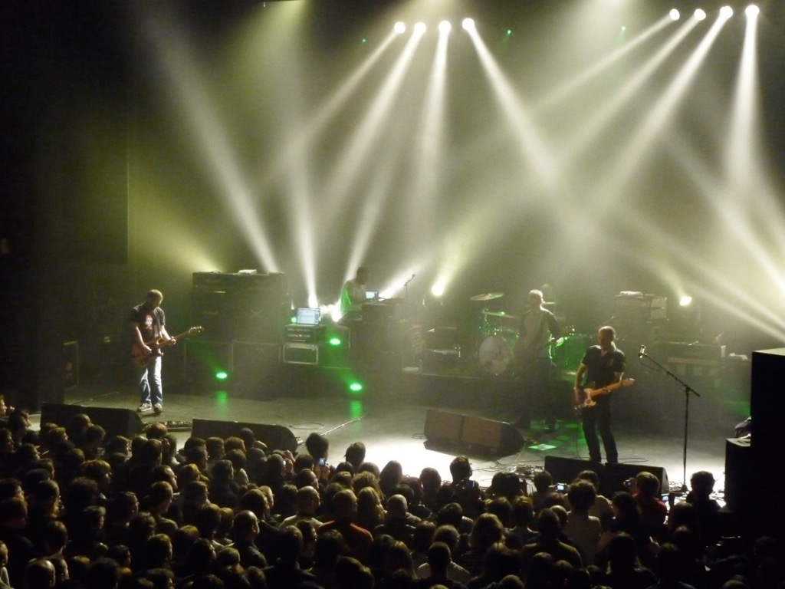

storing and distributing data
Phil Cryer
open source systems architect
and accidental tourist
BHL/Mobot, Saint Louis, MO

Slide 2

data problem?
Notes:
First, what is the problem with data? Why do we *need* to architect a solution for our data?

Slide 3

data problem!
Notes:
We have lots of data, we to be able to store it, serve it, and ultimately safeguard it.

Slide 4
data storage
    more data is constantly being created and saved
    storage has not kept up with Moore’s Law
    expanding SANs is expensive (not sustainable)
    backups are for disaster recovery, not redundancy or failover
Notes:
So data storage, we have lots of data, and the amount increases constantly. The size of storage has failed to live up to Moore’s law, other options such as SANs are prohibitory expensive, and not sustainable for most institutions we deal with. And while backups are always important to have, they’re for disaster recovery, not redundancy or failover.

Slide 5
bhl data storage
    approximately 24 TB of data, cannot host locally
    currently stored at Internet Archive (IA)
    lack of control for editing and updating
    single point of failure
Notes:
BHL has about 24 Terabytes of data, and while we add titles, this total continues to rise. (chris’ projection?) Right now the data is stored at Internet Archive (IA), which does provide for a long term storage, but with all of our data in one place, we have a single point of failure. With IA being in San Francisco, we constantly worry about, what if?

Slide 6
bhl data delivery
    approximately 24 TiB of data, cannot host locally
    currently stored at Internet Archive (IA)
    lack of control for editing and updating
    single point of failure
    save metadata locally at Mobot to remix and serve
    the rest is sourced and served from IA for delivery
    no control over delivery (CDN, delivery network)
    far from ideal
Notes:
So while BHL is served up from Missouri Botanical Garden, it is only the metadata that we have brought in from and enhanced that gets served from there. All of the OCR, book images, big graphics are served from IA. With everything being served from one location, we cannot control the delivery or setup a content delivery network to load balance to better facilitate other parts of the world.

Slide 7
proposal
Notes:
So while looking at some older, inexpensive computers I was trying to dream up a project for them...and I started investigating if they could be a solution to our problem.

Slide 8
Use Linux and open source software running on commodity hardware to create a scalable, distributed filesystem.
Notes:
In the end I came up with this, boiled down, solution. A solution based on free, open source software, commodity hardware, while highlighting that this could be pulled off for for a fraction of the cost of other solutions.

Slide 9
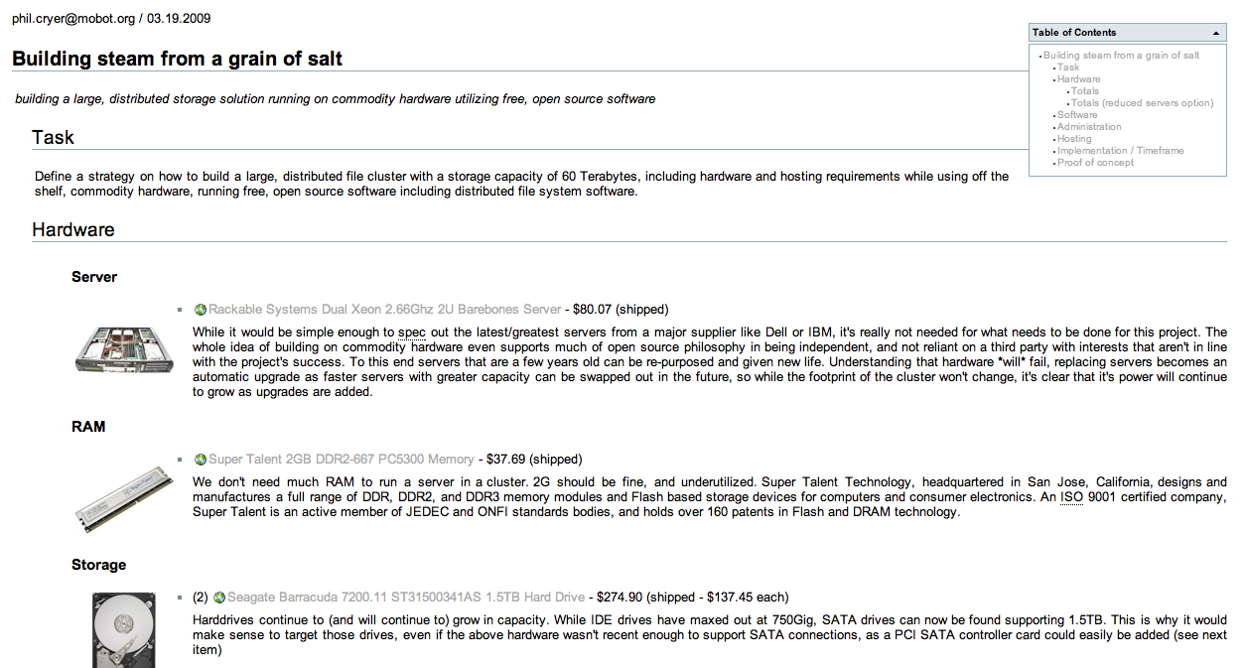
Notes:
I sketched out something that I felt would work, and specified all of the software and hardware components that would be needed to pull this off.

Slide 10
distributed filesystems
    write once, read anywhere
    replication, fault tolerance and redundancy
    error correction
    scalable horizontally
Notes:
With a clustered filesystem we could have all of these things that we needed, and didn’t have with the present architecture.

Slide 11



distributed filesystems
    many open source options available to try
    narrowed down to three to evaluate
Notes:
With a clustered filesystem we could have all of these things that we needed, and didn’t have with the present architecture.

Slide 12
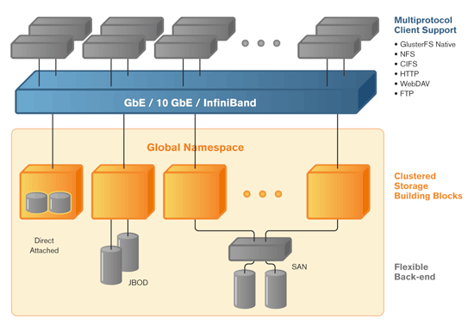
GlusterFS
Notes:
In the end I choose GlusterFS. What is GlusterFS, why was it a better solution to the others?

Slide 13
GlusterFS
    a clustered file-system capable of scaling to several petabytes
    open source software that runs on commodity hardware
    easy to install and manage (runs in users-pace)
    very flexible and customizable
    offers seamless expansion and updating
Notes:
it’s a clustered file-system capable of scaling to several petabytes, it’s open source software that will run on commodity hardware and is easy to install and manage, in no small part because it runs in user-space, so it’s not intrinsically tied in to the kernel (KISS, follows the Unix Philosophy). My take - it’s easy to run, is stable, fast and predictable. Once configured it seems to ‘just work’.

Slide 14
proof of concept
Notes:
From there I set out on the fun part; building a prototype. After piecing together a bunch of servers I had laying around, I came up with what would be the proof of concept.

Slide 15
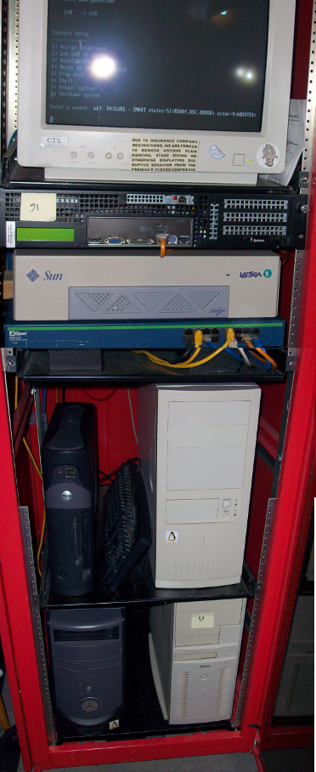
Notes:
So, what is this comprised of and what did it do?

Slide 16
proof of concept
    a six box cluster with servers running Debian/GNU Linux
    using GlusterFS as the distributed filesystem
    populated, and synced data with a remote cluster run by Anthony (data 616 <==> MBL)
    we simulated hardware failures
    ran map/reduce jobs (distributed computing)
    defined procedures, configurations and build scripts
Notes:
It’s a six box cluster with servers running Debian/GNU Linux using GlusterFS as the distributed filesystem. It was populated, and later synced, with a remote cluster running on virtual machines at the MBL in Woods Hole. With this we could simulate hardware failures, show the promise of using the system to do distributed processing, while defining procedures, configs and build scripts.

Slide 17
approved
    who could support the cluster?
    what hardware would we build the cluster with?
    where would the first cluster live?
    how would data come into/out of the cluster, how about syncing, serving, etc?
Notes:
Once our the idea approved, we set out to figure out who could support, what hardware would be needed, where the first cluster would live, as well as other specifics as to how data would come into the cluster, be synced out, served, etc.

Slide 18
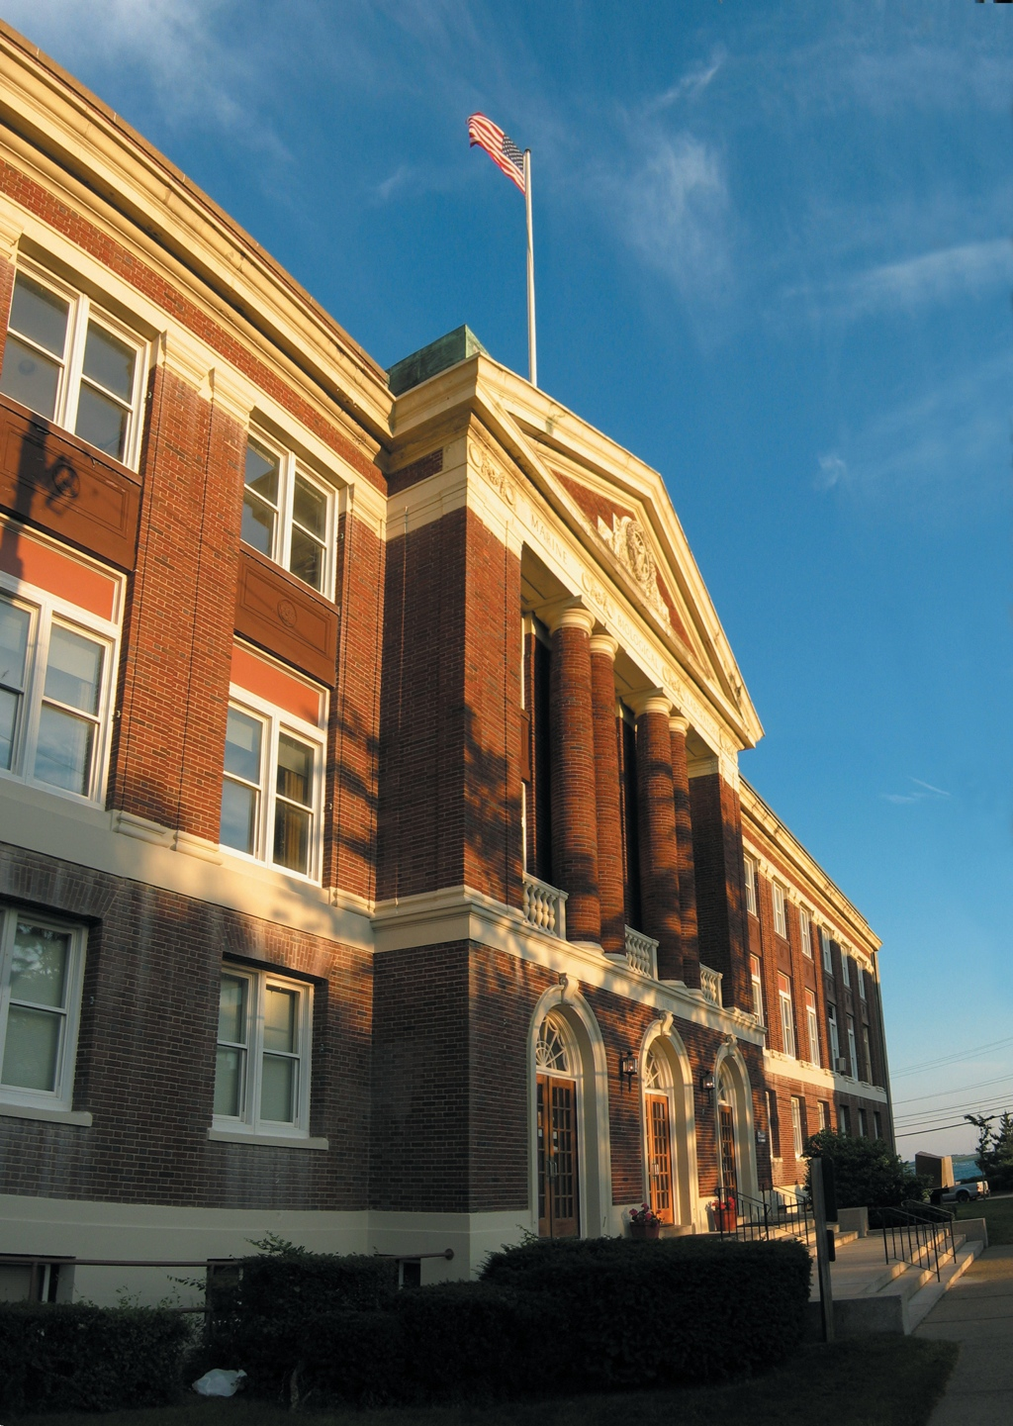
Notes:
In the end, MBL was decided upon.

Slide 19
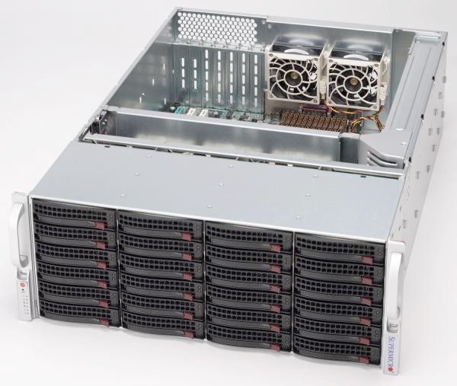
Notes:
We made specific decisions about the hardware (specifics later), and for running the cluster in MBL....

Slide 20
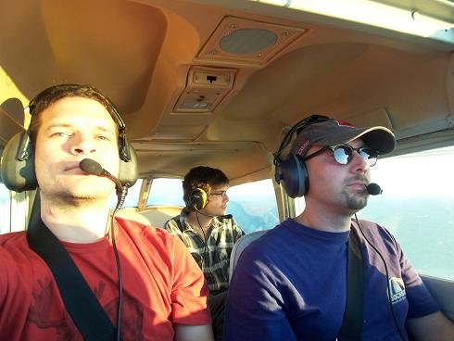
^ Anthony Goddard
Notes:
...and last but not least, a rockstar sysadmin!

Slide 21
how to populate
    we could request a server populated at IA shipped
    they could send us raw disks filled with our data
    we could ‘download’ the data
    transfer data through “the cloud”
Notes:
How to populate the cluster was/is a serious consideration. At one time IA was going to send us a box, then we thought maybe they could send us a bunch of raw drives. Other ideas were to download the data over a period of time, and another was that we would transfer the data through “the cloud”.

Slide 22
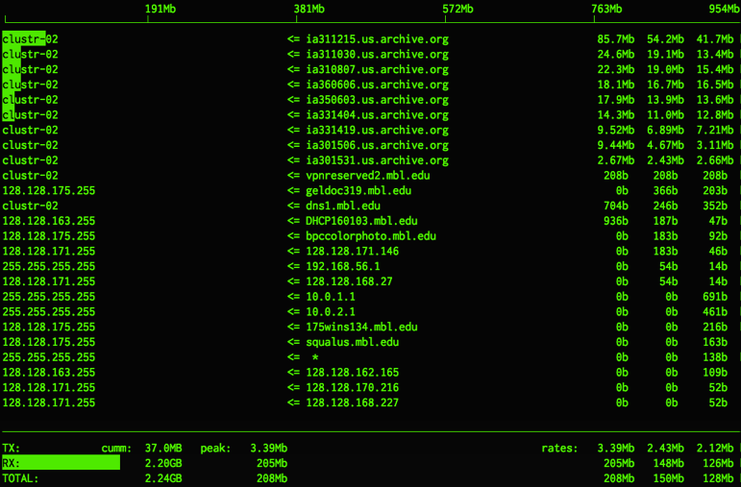
Notes:
Ultimately we choose to download everything. Using a BASH script and wget we kicked off 10 simultaneous downloads.

Slide 23
cluster status
    currently 20,114 books (few more days to go)
    22 TiB of disk space used
    shared across 2 GlusterFS nodes
    but it hasn’t all been so simple...
Notes:
So today we have almost populated the cluster with all of BHL’s data from IA.

Slide 24

Notes:
We’ve had a number of curious issues that we had to overcome.

Slide 25
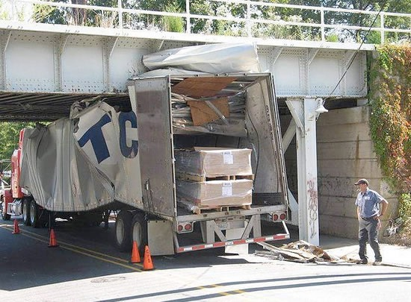
Notes:
First was ‘the fit’. While the vendor assured us all of the hardware would work together, in reality, the motherboard did not fit into the case we had selected. Online configuration - drop down, like Dell’s, would/could have prevented this (in the future...)

Slide 26

Notes:
Then we experienced various flakey-ness in regards to the SATA RAID card we choose. Late last night after updating the operating software without the SATA card in play we have overcome one of our blocking issues with this.

Slide 27
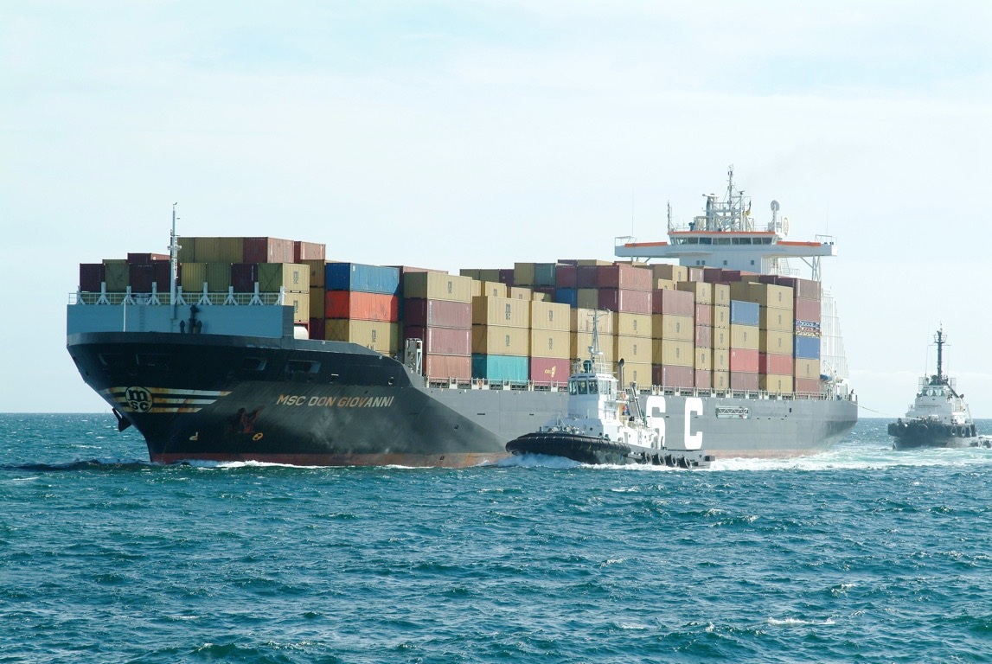
Notes:
...and lastly is shipping. Getting replacements for the original ill fitting parts took time, as we’re still waiting on some. Woods Hole is isolated as far as electronics, Ant needed some adapters that he tried to order from a regional supplier - they were backordered, so I went down the street in St. Louis and bought a bunch that I brought with me.

Slide 28
cluster status
    (6) 5U sized servers hosted at MBL
    each with 8 Gig RAM
    24 /1.5 TB drives in each server (RAID 5)
    over 100 TB of usable storage
    faster connection than ever before (delivery)
    ultimately the cluster will be split into 2 sets of 3, each in a different building, for further redundancy
Notes:
Cluster status (when complete)

Slide 29
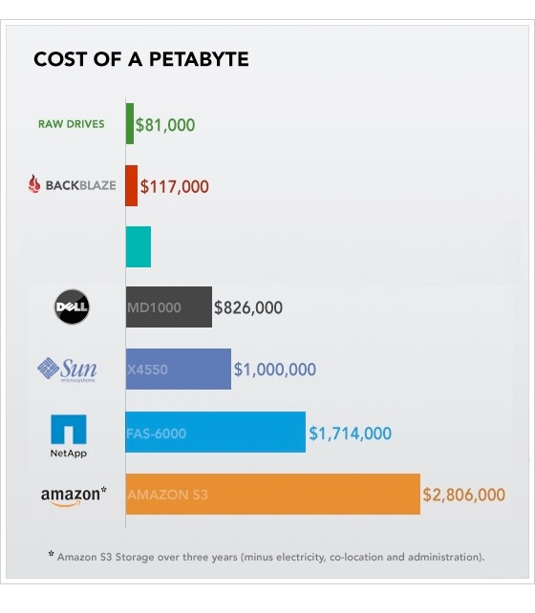
$246,000
Graph from Backblaze (http://www.backblaze.com)
Notes:
Here’s an overview of how much a petabyte could cost, projected out.

Slide 30
complex, or not
    while our example uses new, faster commodity hardware...
    it could run on any hardware that can run Linux
    chain old, outdated computers together
    build your own cluster for next to nothing (host it in your basement)
    can solve infrastructure funding issues, provides a working proof of concept before diving in
Notes:
Please, try this at home!

Slide 31
architecture
Notes:
More on the overall architecture

Slide 32
data syncing
    how would data be sync’d via the clusters
    working on “a Dropbox on steroids” (@chrisfreeland)
    I had an idea on how this would work, setup a test
    then started a thread on my blog about this - see http://bit.ly/pc-dropbox
    from this, more options mentioned, existing open source solutions like Lsyncd, rsync, Openduckbill
    next, testing between Mobot and the cluster

Slide 33

fedora-commons

Slide 34
fedora-commons
  Fedora-commons is open source digital repository software (not a Linux distribution)
  accounts for all additions and changes so it provides built-in version control
  provides disaster recover
  open standards to mesh with future file format
  provides open sharing services such as OAI-PMH

Slide 35
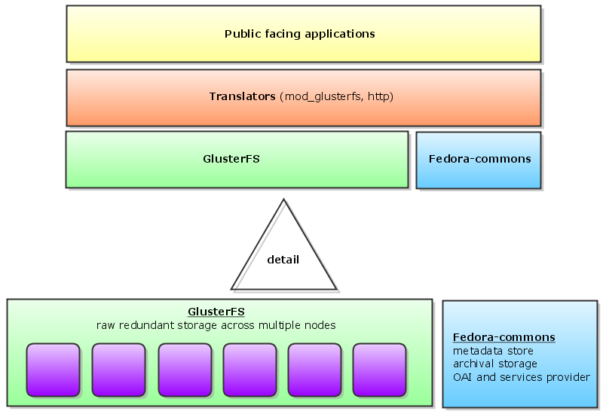
Notes:
An overview on how the cluster relates to the public facing apps, and to fedora-commons for archival activities.

Slide 36
other avenues

Slide 37

Duraspace

Slide 38
Duraspace
  BHL is participating in a pilot for Duraspace with the New York Public Library
  Duraspace would provide a link for publishers and cloud providers
  pilot to show the feasibility of hosting in “the cloud”
  testing the use of application servers (image server, taxonfinder, etc) running in “the cloud”
  pilot to show the feasibility of distributing data globally through “the cloud”

Slide 39
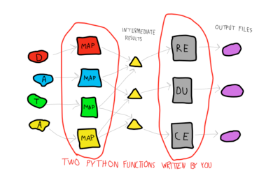
distributed computing

Slide 40
distributed computing
    map/reduce frameworks (Hadoop, Disco, others)
    Disco has a GlusterFS plugin
    make existing data more useful
    image and OCR re-processing, taxonfinder
    distributed web servers, geo-load balancing
    identifier resolution pools...?

Slide 41
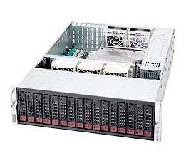
seed box(es)

Slide 42
seed box(es)
  reliable, easy to maintain hardware we can distribute
  would be a seed box, once on the network, adding other nodes are a matter of booting off the cd
  GlusterSP (storage platform) makes this easier (GUI)

Slide 43
sharing the code
    our code and configurations are all open source and hosted on Google Code - bhl-bits http://code.google.com/p/bhl-bits/
    our projects server shares detailed instructions on how we’ve built our cluster for others to use http://projects.biodiversitylibrary.org/
    we have a mailing list, bhl-tech, bhl-bits (announce)
    ask questions, get involved

Slide 44


  code http://code.google.com/p/bhl-bits
  email phil.cryer@mobot.org
    slides http://bit.ly/pc-slides
twitter @fak3r

