Slide 1
EAWG – July 15 - Web3

Slide 2
Web3 – What is it?
An idea for the "Next Version" of the web
Focuses on decentralization of the web via peer-to-peer networks, block chain technology, and token-based economics
Relatively new in popularity, picked up speed in 2021

Slide 3
How does a web3 application work?
Not fully vetted yet, but we have an idea
General idea is applications and data will be decentralized
The web and all its content will be hosted on peer-to-peer networks, like the Ethereum network
Data stores will be replaced by distributed networks and distributed file systems
There will no longer be backends, but instead "smart contracts"
Smart contracts are interfaces, hosted on peer-to-peer networks that allow web consumers to interact with the blockchain network

Slide 4
Smart Contracts on Ethereum (Hardhat and Solidity)
The Ethereum network has standardized interfaces for interacting on the blockchain, and they are hosted there
Written in a java-like language called "Solidity"
Toolchain called "Hardhat" lets developers test, create, and interact with smart contracts in our code bases
Can be extended to meet the needs of the application. Ethereum provides the structure for the contracts, but they can be extended to provide additional functionality
In my demo today we will extend "ERC721" for minting NFTs

Slide 5
NFTs – Context for Later
"Non-Fungible Token"
Unique digital asset, most popularly pieces of digital artwork, but can also be something like a domain name, digital document, or representative of a real physical object somewhere in the world
Often the assets belong to a collection, as in digital art
Many NFTs are often procedurally and randomly generated based off a set of attributes. Certain attributes are rarer than others, so NFTs become more valuable the more "unlikely" that their generation was

Slide 6
IPFS – Context for Later
"Interplanetary File System"
Decentralized File System in the cloud, similar to bit torrent
Most Files are too large to store efficiently on the block chain, so files get stored them "off chain" on IPFS
Handles addressability for us, all files in IPFS have a globally unique identifier that we can reference when minting an NFT

Slide 7
Metamask – Context for Later
Secure payment tool (browser plugin) that links up with a user's crypto wallets and several Ethereum based networks.
In today's demo, I will be using a fake wallet with ~10K Ether and have my smart contract deployed to a local development network, which Metamask is already connected to
In a production ready web3 app, everything would theoretically be deployed to the Ethereum main network

Slide 8
The Demo - Concept
Imagine UL has a fulfillment system where customers can request work be done to put the UL Mark on their product
They provide the details of the work, and the work is associated with their Account Id on a peer-to-peer network (in today's case, Ethereum)
When the work is complete, the proof of the work is detailed into a document, which is minted as an NFT
The NFT provides a guarantee of ownership by the client, and "proof" that their product has the UL Mark
The client then pays for the work that was done and retains ownership of that NFT

Slide 9
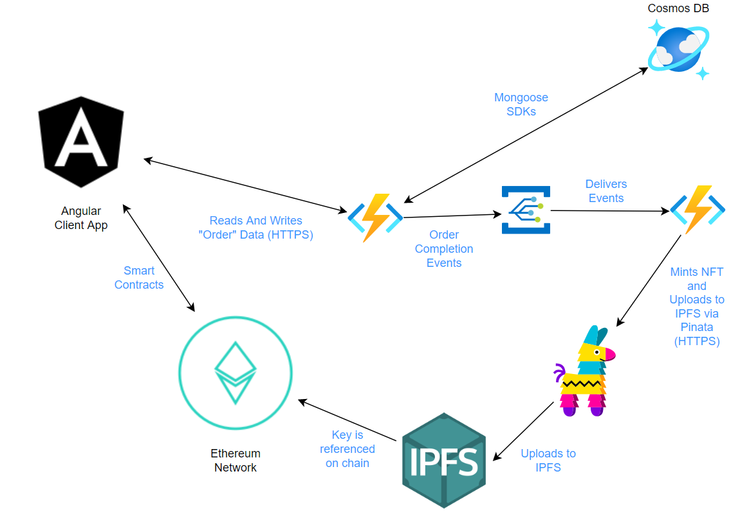
Architecture of the Demo

Slide 10
Demo

Slide 11
Thank you

