Slide 1


Slide 2
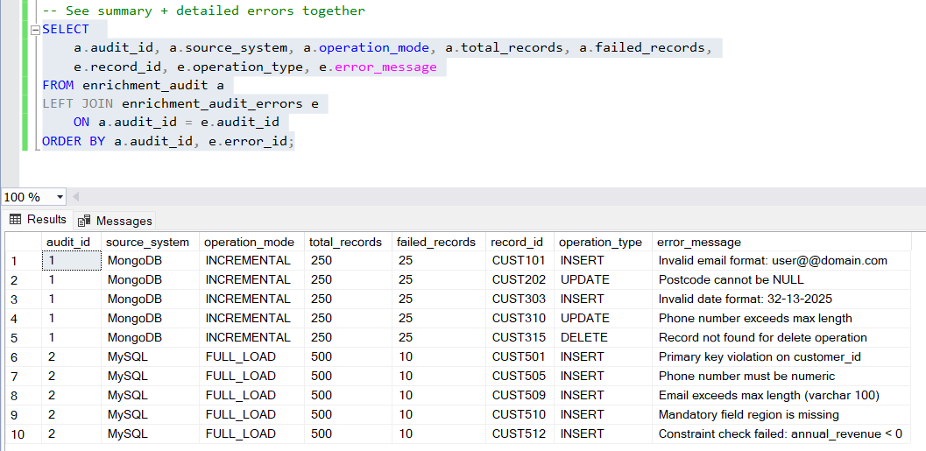
For power bi summary dashboard

