Slide 1
Thesis meeting
07. November 2017
General approach
Dataset generation
Technical questions
Road map

Slide 2
Approach
Navigation based on reference points (is what most other teams are doing)
We just want to know where we are in relation to the next gate and fly through it
  Camera Localization problem

Slide 3
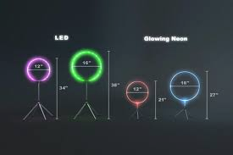
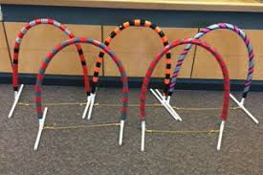
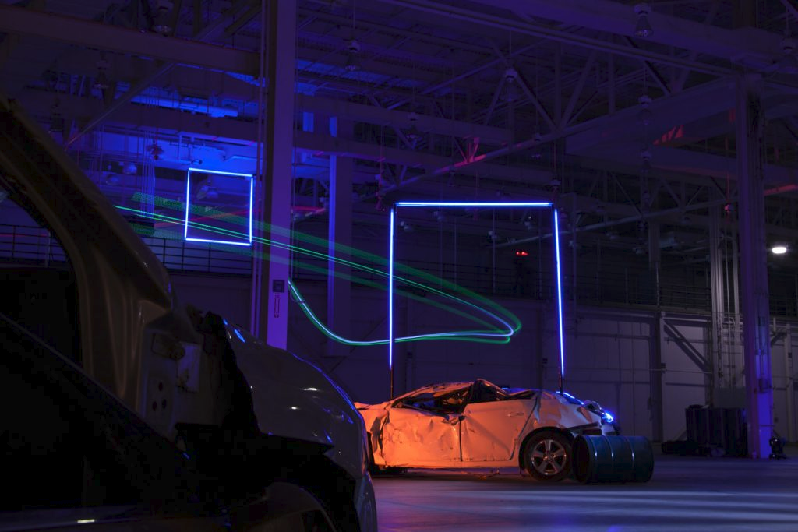
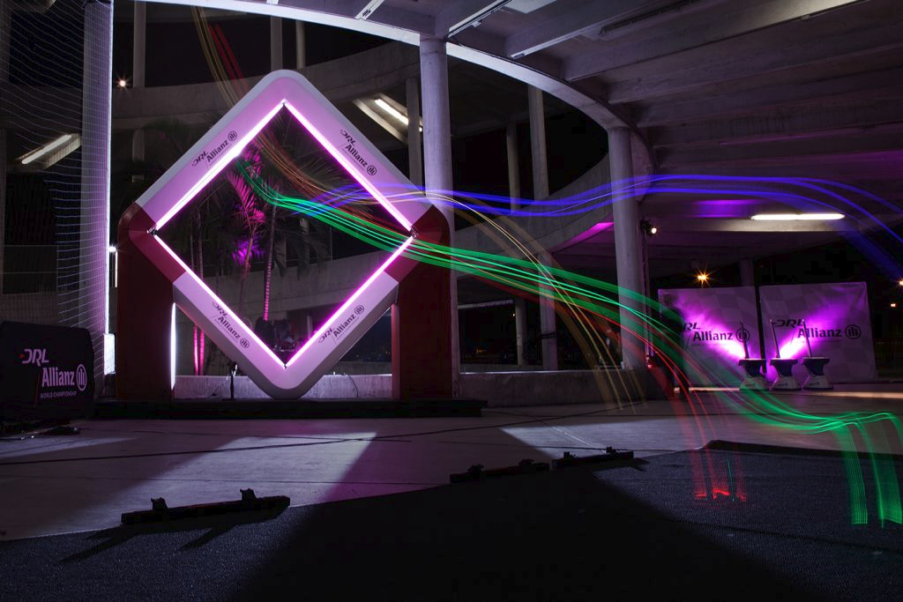
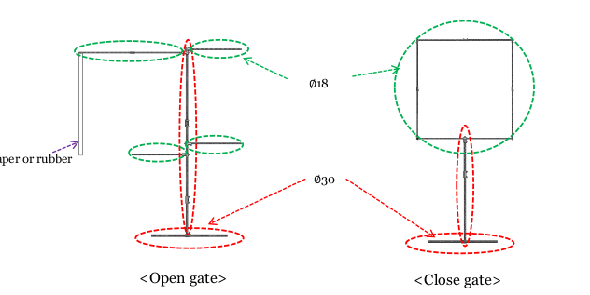
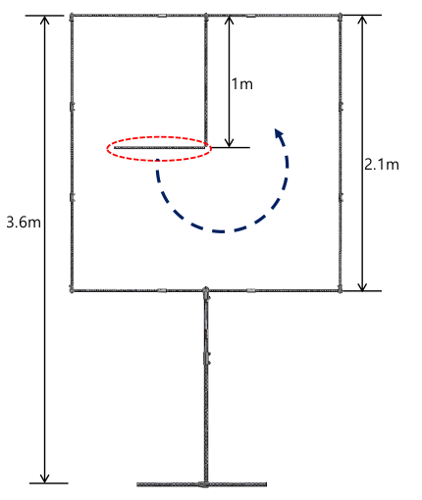
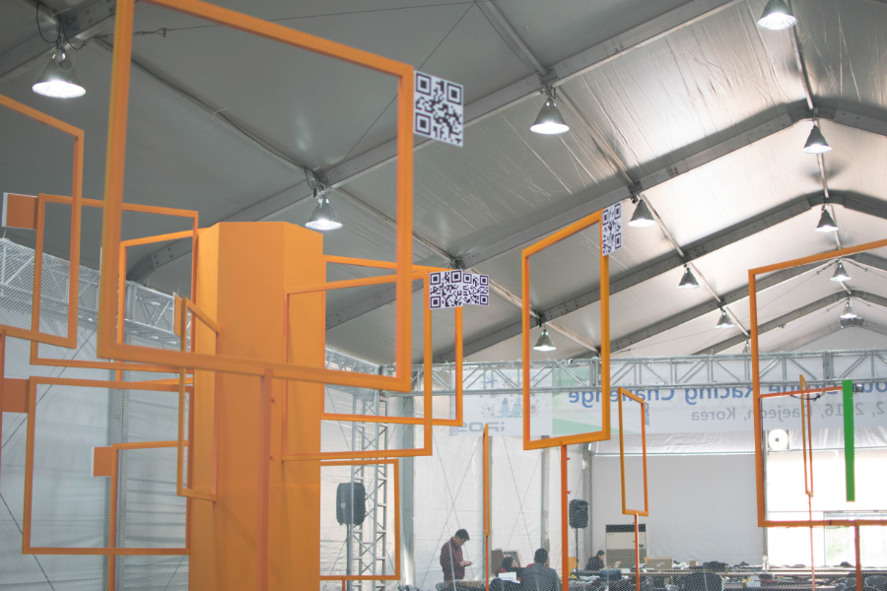
Shape examples

Slide 4
Robustness
Color Invariance
  Transformation to gray scale/binary image
Shape Robustness
  Generate datasets with different shapes:
  …

Slide 5
Possible Methods
Learn everything from the data
  Label every picture with relative 6d position
Recognize gate and do pose estimation based on predefined shapes (PnP)
  Label gate pixels
Look for closest hole in direction of next gate
  Label flyable area/ center of gate
Pseudo stereo vision using consecutive images

Slide 6
Dataset generation
Using the simulator
  Easy and quick
  Reality gap
Pasting gate images in real images
  Difficult for videos/ labeling of absolute position
Taking videos with another drone and label by hand
  Most realistic
  Takes a lot of time
  Easy to miss a lot of perspectives

Slide 7
Technical Questions
Whats the simulator software and how can I use it?
Documents about the drone (Soft- and Hardware)
Do we have a GPU/ floating point or vector operations?
Reports from last years algorithms etc
How does the control work?

Slide 8
Road Map
Date | Milestone
2017 November | Literature review
2017 December | Literature review, first dataset(s)
2018 January | (Official start) Evaluation of different models in python
2018 February | Evaluation of different models in python
2018 March | Implementation on drone
2018 April | Evaluation on drone in real conditions
2018 May | Refinement
2018 June | Refinement
2018 July | Final implementation/ evaluation
2018 August | Report, presentation etc.

