Slide 1
Network Analysis: TangStats
2022.07.01

Slide 2
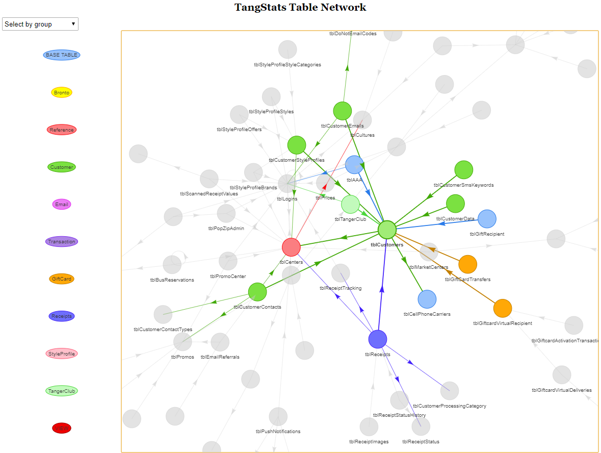
Overall Summary
Purpose: To characterize the table connections and usage with historical productionized reporting solutions (SSRS) in order to equip the team with intelligence around TangStats design as we aim to migrate/ design a new CDP solution for Tanger.
Overall Results:
We utilized a network analysis approach to look for linkages between tables.
Highly utilized and connected tables would be deemed a highly critical for performing deep dives on as those are already deemed as essential for business reporting.
It was surprising to see that even though there were many tables called for the production reports (over 500 tables), only 86 unique tables were used, which represents <1/3 of all possible tables.

Slide 3
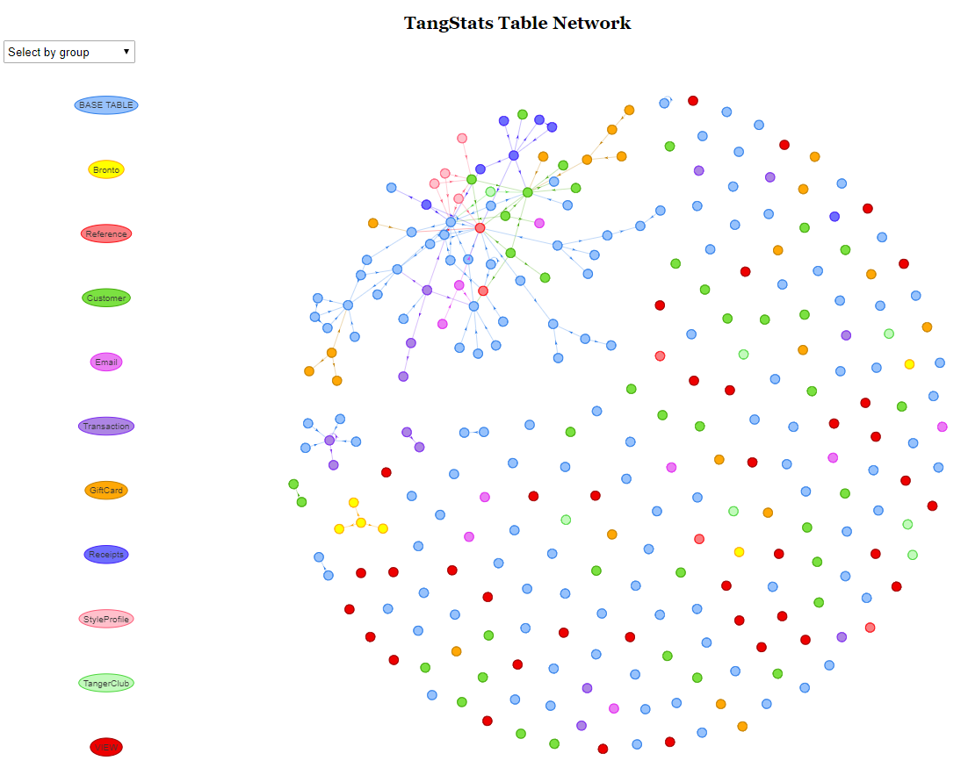
TangStats Table Connections
There are 271 unique tables + views within TangStats
92 (~1/3) have connections identified within the DB
There are some tables that exist in a cluster by themselves:
tblBronto
tblFC
tblRegisters
It was surprising to see that there were reference tables that weren’t linked (tblStates, tblCounties)
There are tables where the naming convention would indicate they are expired (eg tblEmailReferralsOLD)
Source: Pulse Survey, 2022.2.23

Slide 4
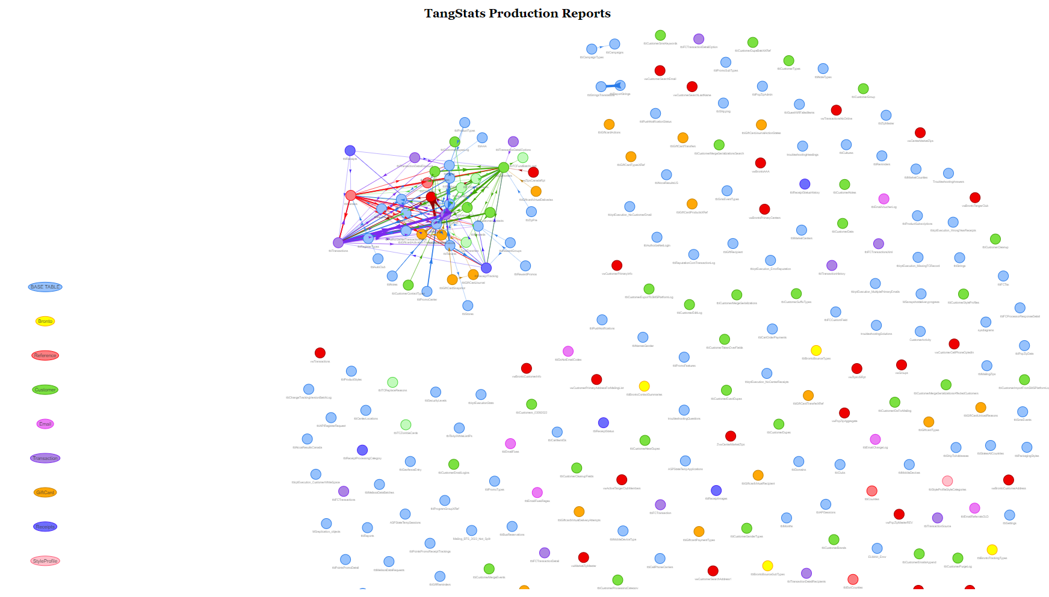
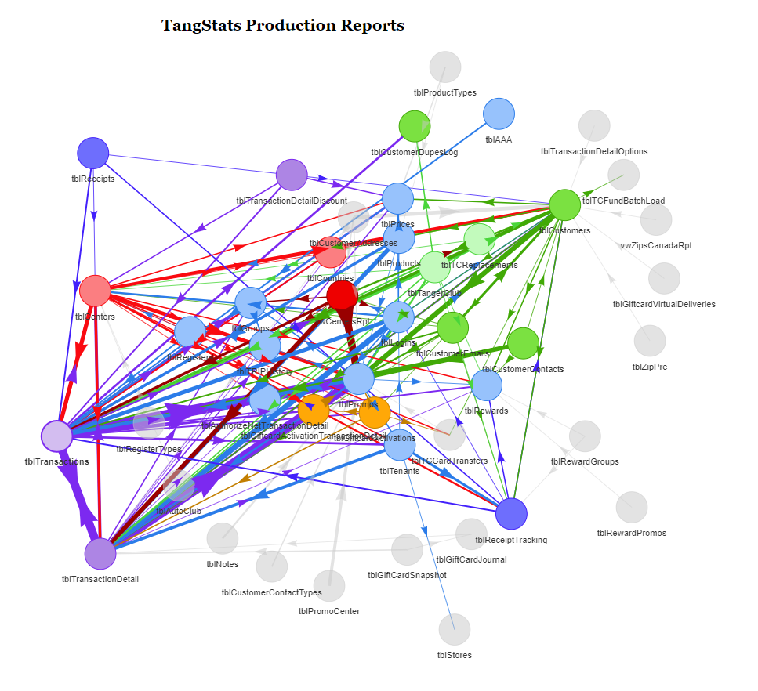
Productionized TangStats Reporting
There were a total of 592 tables called in various stored procedures within the production TangStats SSRS repo.
There were 86 unique tables called.
The average stored procedure links 5.8 tables together.
49 (18%) of the available TangStats tables are joined together.
Meaning that there are many tables that aren’t linked together
The top 5 linked tables are:
tblTransaction, tblCenters, tblCustomers, tblPromos, tblTransactionDetail
These tables would represent high criticality to ensure their information is captured
These highly linked tables were also the top 5 most frequently used tables in the stored procedures.
Source: Pulse Survey, 2022.2.23

Slide 5
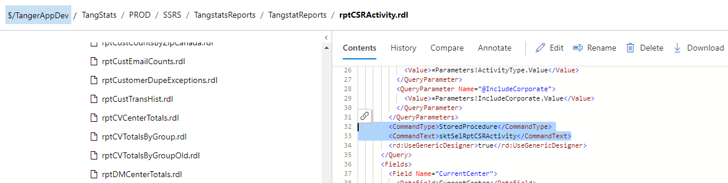
Methodology
Data Source: This analysis was developed by pulling results from two different sources:
We utilized the information schema to capture the linkage between tables as documented in SQL
SELECT * From INFORMATION_SCHEMA.TABLES ;
SELECT * From INFORMATION_SCHEMA.KEY_COLUMN_USAGE ;
The I&A team extracted table linkage from the production reports as documented in tfs.
Date Range: The data was extracted on 6/20/2022 and both the code base and tables are subject to changes.

