Slide 1
Building Analytics Capabilities
P. Walker

Slide 2


Goal: Deep root system, fostering sustainable growth
Outcomes: To provide actionable insights to leaders.
Process: To foster nimble and sustainable growth on pace with the need.
New root systems lead to stable analytics throughout the organization which feed each other
Challenge: Remaining robust with change
Answer leadership questions quickly with confidence while…
Disparate and often fractional data: Many different reports already exist
Avoiding..
Vendor lock-in: Leads to analyst lock-in
Analytics Ecosystem
Notes:
The data/ analytics team must work within the complex ecosystem of data within the organization.
It must be mutually beneficial, with data like the trees and the data team maybe more the fungi. According to Hidden Life of Trees, the fungi help to give nutrients to the trees, and also helps with the trees connect to each other/ communicate

Slide 3



New Questions/ What did we learn?
Customer Feedback/ Education
Questions
Actions
Data in the Wild
Data Warehouse/ Lake
Understand Customer Need
End User Buy-in
Deployment
Constantly new sources: tabular, spatial, text, networks, etc.
Quick iterations, flexible
Explainable
Scalable, Secure, trackable
SUCCESS
Many data types, sources
Auditable, Reproducible
Data Discovery
Iterative Data Cleaning/ Investigations
Dashboards
Data Organization/ Ingestion
Model Development
Reports/ Parameterized (User selections)
ACTIONS
Data Governance
Ad hoc reporting/ One-time analysis
Automated Alerting
TOOLS
To be able to partner with leaders, providing analytic solutions to address complex and growing needs, we need to:
Support a data foundation which continually grows and matures with the organization by gathering, centralizing and governing disparate and varied sources.
Utilize an analytics toolkit which easily and quickly can (1) ingest multiple data sources at varying degrees of cleanliness, (2) iterate upon analytics models to help customers refine questions, (3) deploy reproducible results to decision makers in an actionable format.
Participate in the process for capturing lessons learned, historical business knowledge to educated and align future analysts.
Analytics Spectrum: Driving from Questions to Action
Notes:
Power bi and tableau are from the trunk up
Audit .. Plan text version control

Slide 4
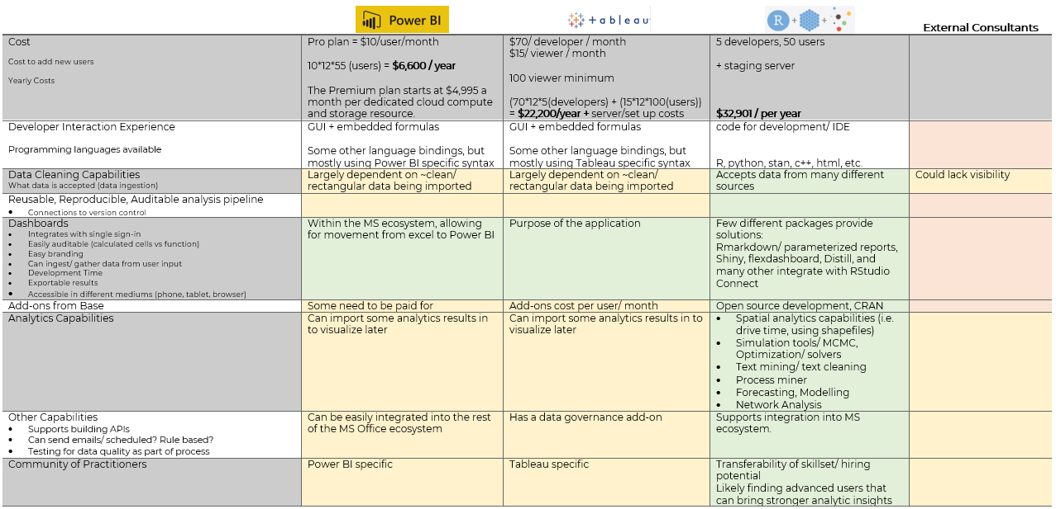
Analytics Toolset Comparison
Notes:
Opportunities for cross toolset usage

