Slide 1
Vision and Mission: Right action, right time
Vision: Through direct partnership, to nimbly provide right sized insight solutions at the right time, adapting to the shifting landscape of retail.
Mission: We empower all decision makers at Tanger with actionable insights at the right time.
We care about directly empowering Tanger employees.… part of that is understanding the customer experience and tenet experience.
Focus on finding and addressing the “right questions”.
Action oriented
Partnerships. Advising people to make good* decisions >> “Trusted Advisors”
> Demonstrated value through sustained success
> Shifting the process so we don’t go back to the old ways
> Scaling the right things… designing to scale.
Insights and Analytics: Who are we?

Slide 2
Though the team will continue to grow, we envision a future state where these six themes represent the body of work for Insights and Analytics:
Generating Reports
Automated + Dashboards
Towards centralized source of information
Alert end users when process “out of control” and needs to be addressed (not clutter with having to check all the time)
Studies
Address to questions of tomorrow
Helping Sales team make deals.
Dive into the challenges of yesterday
Interface with business
Maintain consistent message
Disseminate information, educate
Maintenance
Data Governance
Maintain and improve team knowledge gaps
Stress test internally to improve customer experience
Monthly Trainings
Similar to communication with business but to help increase overall knowledge
Internal Team Communication
Generate Reports/ Dashboards
- KPI, alerting, SPC
Studies
Understanding consumer preferences
Capturing impact of digital transformation
Direct interface with business
Intake
Prioritization
Newsletter/Blog
Maintenance
Data discovery
Knowledge base
Documentation
Phase out stale solutions
Internal Training
Partner with IT
Monthly Trainings
Internal Team Communication
A Typical Week: Envision 2023

Slide 3
Foundations
System
Outcome
Technical
> Data Governance
> Data Lineage
> Open data ingestion process
> Version control
Branding
> Insights templates
> Consistent Messaging/ Internal visibility
Reproducible & Reusable Analysis
> Testing/Validation
> Clear Objectives
> Problem Statement
> Assumptions Listed
> Recommendations
Intake Process
(include prioritization)
> Study
> Report
> Dashboard
Demonstrated value through sustained success
Earned trust
Democratized data
Self service/ Empowered end user
> Knowledge Base
> Newsletter
Agile to shifting business landscape
… adapting to experiential
Insights and Analytics: Future Steady State

Slide 4
Set up internal comm. standards
In development
Internal Processes Implemented
Viz In progress
New Data Ingestion
New Data Ingestion
Continued expansion of our understanding of the expansive data landscape.
Mapped Data Landscape
Data discovery
Data discovery
Data dictionary
Data dictionary
Mapped Data Landscape
Revisit with New Tech Implementation
External comm. standards
Establish analytics standards
Implement intake process
Paths to Steady State

Slide 5
What are the tools/ items are requires in each of the 6 blocks of work?
(a) Goal: Quickly gather what our customers are looking for.
(b) Triage work/ combine projects where necessary
… start a new project folder in IA drive
… criticality / redirect asks if necessary
(c) Intake // Output: Intake brief
(d)
(e)
(f)
Formalize Scope:
Communicating timelines, setting up readout time
What should the end result look like?
External
Internal
(a) Customer request
(Intake tool)
(b) Prioritize request
Initial version of scoping brief
(c) Formalize scope of work
(project brief)
Iterate with feedback
(d) Solution developed
Pre-reads shared/ insight accessible
Solution leads to great new questions
(e) Read out to customer
(f) Develop lessons learned.
Add to knowledge base
Archived work
Insights and Analytics: Solution Process

Slide 6
External
Internal
(a) Customer request
(Intake tool)
(b) Prioritize request
(c) Formalize scope of work
Iterate with feedback
What are the tools/ items are requires in each of the 6 blocks of work?
Formalize Scope:
Communicating timelines, setting up readout time
What should the end result look like?
(d) Solution developed
Pre-reads shared/ insight accessible
Solution leads to great new question
(e) Read out to customer
(f) Develop lessons learned.
Add to knowledge base
Archived work
Naming conventions for work stored. searchable
Insights and Analytics: Solution Process

Slide 7
Tracks of reimplementation vs Tracks of what has enterprise value now.
Anna… goals are in 4 buckets for this year…
Enhance capability of the people (remove side reports).. Support develop of end users // self serve, know where to go when, trusted asset
Improve insights capability… into critical insights platform/ visualize …. // self serve and
Refine data management capabilities (data gov)
Develop customer centric insights. // what are the new ways we are going to evaluate our current customers and how do we find new customers
“trusted advisor”… even to get there is going to be a large lift
“what is the return now” … need to be able to address this now
Simplify the insights landscape… and cut off everyone else sql backend access… but we have to be ready to catch all of the asks…
... Need to also spin up a more formalized intake work
… automate and visualize

Slide 8
Review of AKQA “Executive Status”
Starts with the 4 personas…
We don’t have our data characterized like this… can we say we are reaching these types of people….
Foundational analysis? << establish baseline… measure brands/centers who perform well in those different segments… are there other segments we should be capturing?
In strategy (pg 6) “model provides upmarket and emerging brands a way to reach new audiences”

Slide 9
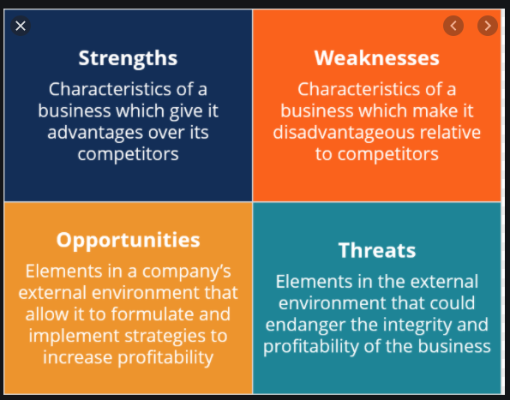
Strengths
Weaknesses
Unique combination of external (many different industries) and internal perspectives + not married to the “Tanger Way”
Strong process driven background
Not situated within a single business unit
Babbage
Varied degree of visibility to current state (reporting, data, actions)
Weak connections to some of our potential partners + partner self confidence in data skills (TRUST)
Poor connections to IT/ Data Governance
Inconsistency of leadership directions
Widespread dissatisfaction with current way
New leaders/ culture of change
Necessity of entire industry/ COVID impacts (market is changing)
Data not available or useful
Not moving quick enough / Not enough resources to perform the work
Outcomes if not successful: Irrelevance, not trusted
Currently accepted business knowledge no longer applicable
Opportunities
Threats
Notes:
What is the value of the Tanger product to end consumers?
Good brands, easy to find, convenient locations
Is our member data valuable to our retailers? Is it valuable to us?
What would it mean for Tanger to be a data company?
It looks like Simon is just bigger than us, not necessarily more innovative…
What industries should Tanger be looking to emulate?

Slide 10
Priorities
Establish trust
Take them/BU on the journey (Bottom up)
Partner with receptive BU + newsletter to highlight to rest of org (Socialize)
Top leaders model behavior we want to keep (no emails) (Top down)
What do we need to in place to enforce?
Foundation is laid
Applications/ data
Data Gov
How do we train out bad behavior?
Someone with authority ensuring hard stop
Phase in something that is actually better
Is there things we can do without IT? // Could we co-opt all of those current resources?

Slide 11



Tanger as a data company by 2023
Data as most valued asset
….low quality research manifests as an environment of knowledge cacophony, where teams only read and trust research that they themselves created
https://medium.com/airbnb-engineering/how-airbnb-democratizes-data-science-with-data-university-3eccc71e073a
https://medium.com/airbnb-engineering/scaling-knowledge-at-airbnb-875d73eff091
For Netflix, the brand’s data philosophy encompasses 3 key tenets:
Data should be accessible, easy to discover, and easy to process for everyone.
The longer you take to find the data, the less valuable it becomes.
Whether your dataset is large or small, being able to visualize it makes it easier to explain.
https://www.wired.com/insights/2014/03/big-data-lessons-netflix/
https://www.delphix.com/blog/what-is-a-data-company
https://algorithms-tour.stitchfix.com/
https://tdwi.org/articles/2018/09/26/ppm-all-five-characteristics-data-driven-company.aspx?m=1
…that being data-driven is not the same as being metrics-driven. The majority of companies are metrics-driven; they have key performance indicators defined and they track them

Slide 12
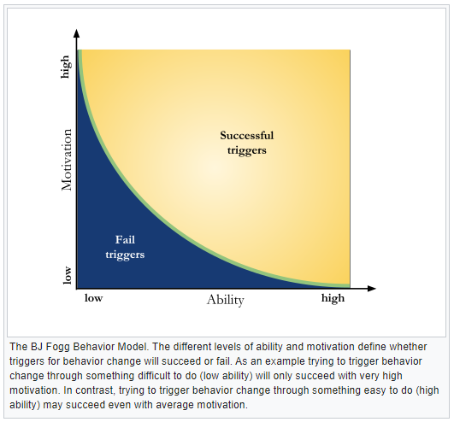
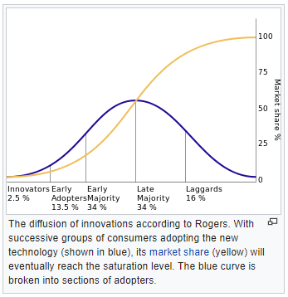

Slide 13
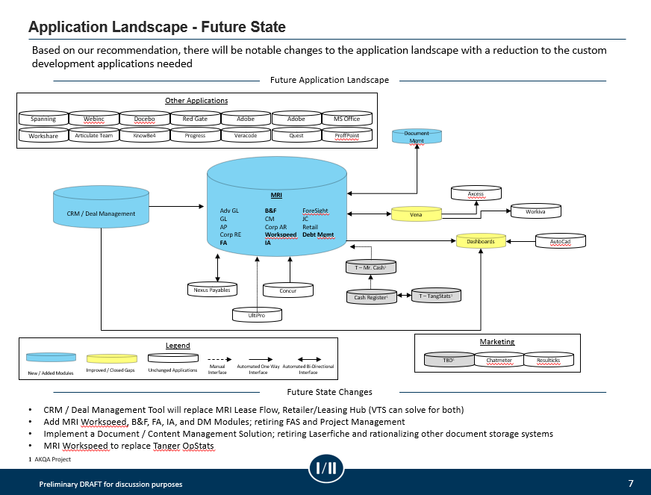

Slide 14
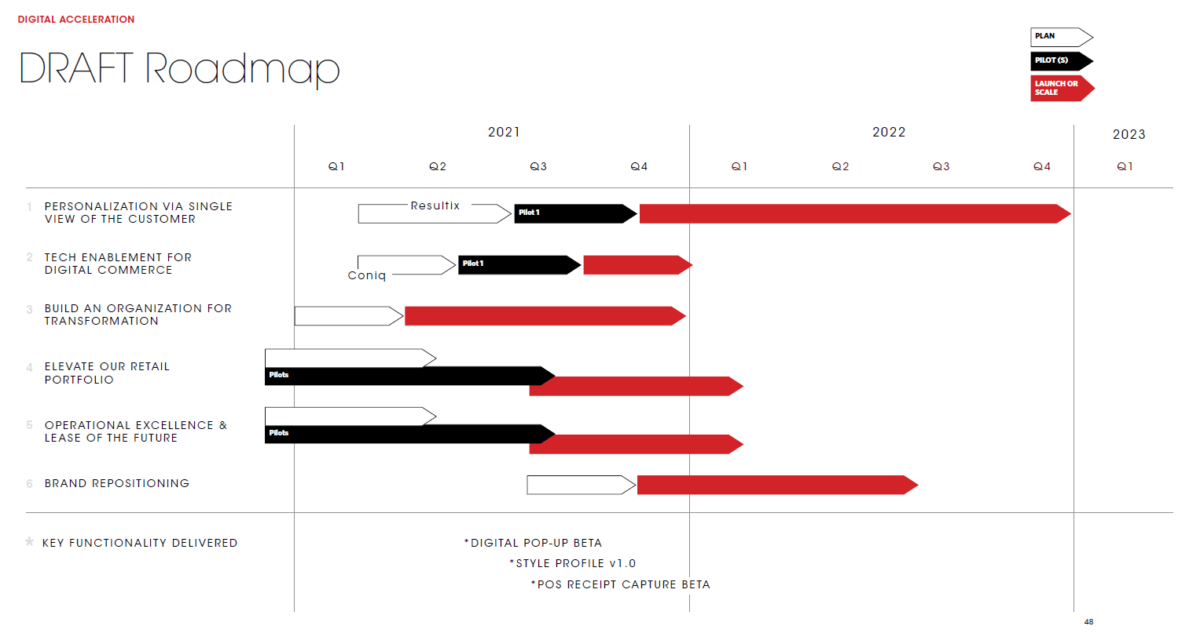

Slide 15
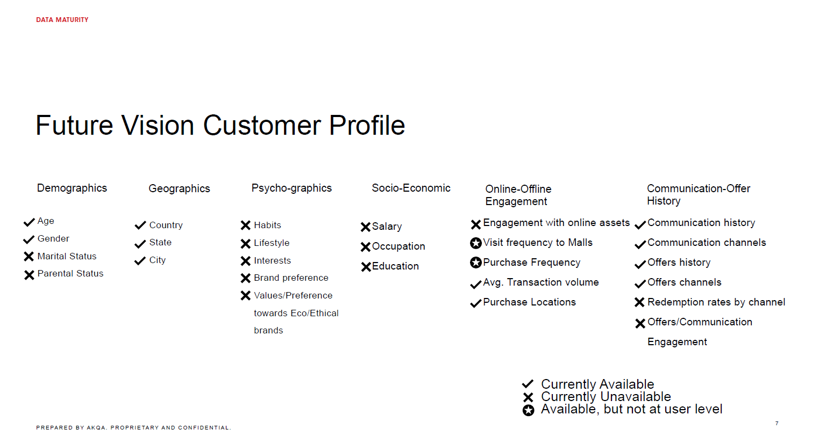

Slide 16
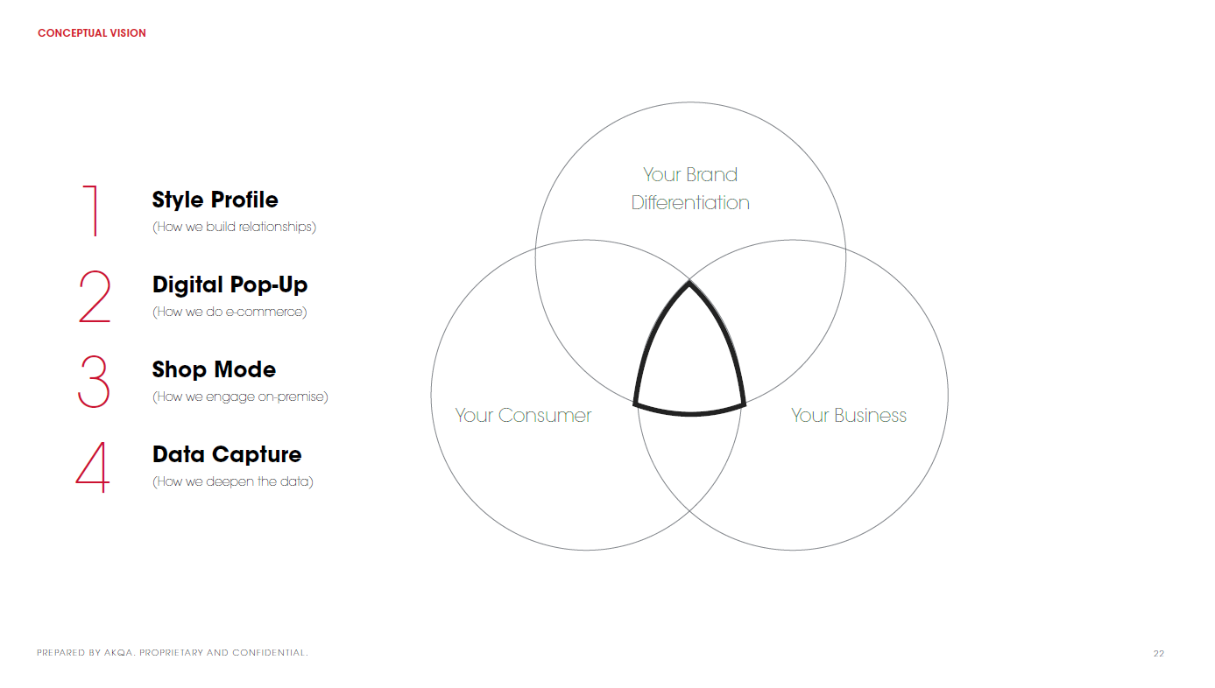

Slide 17
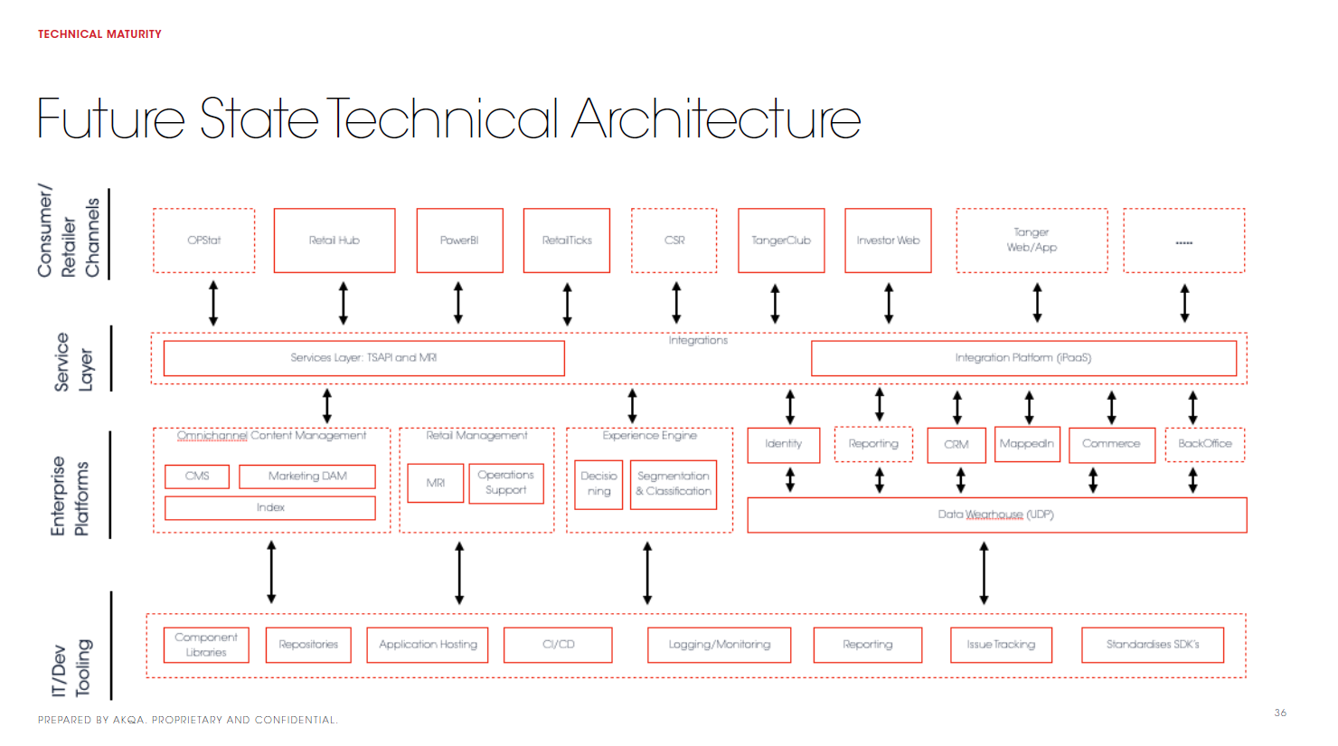

Slide 18
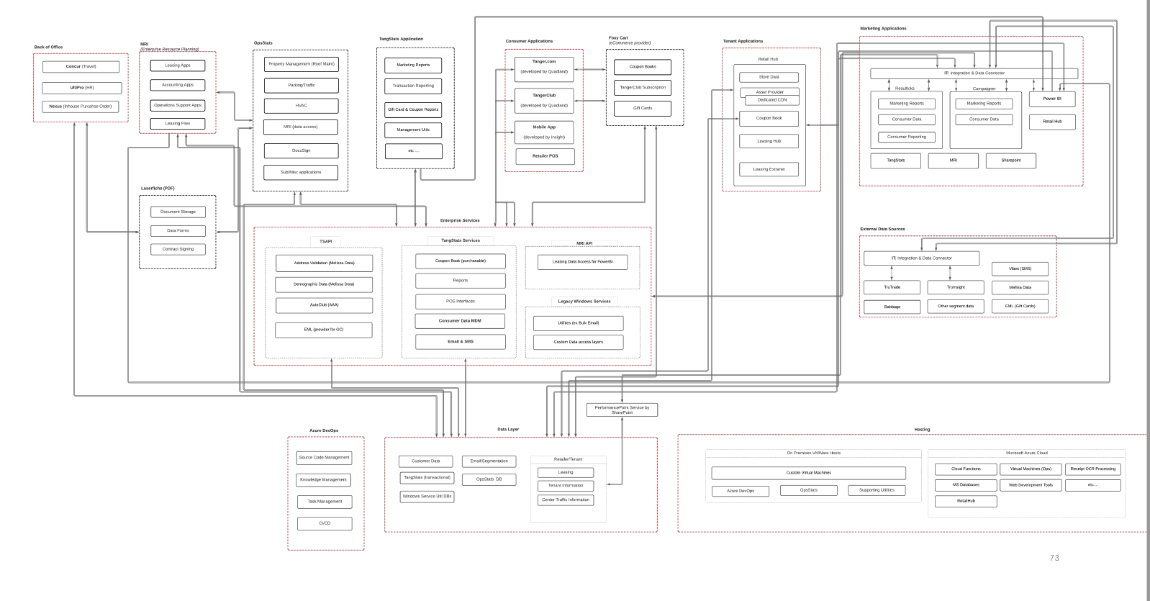

Slide 19
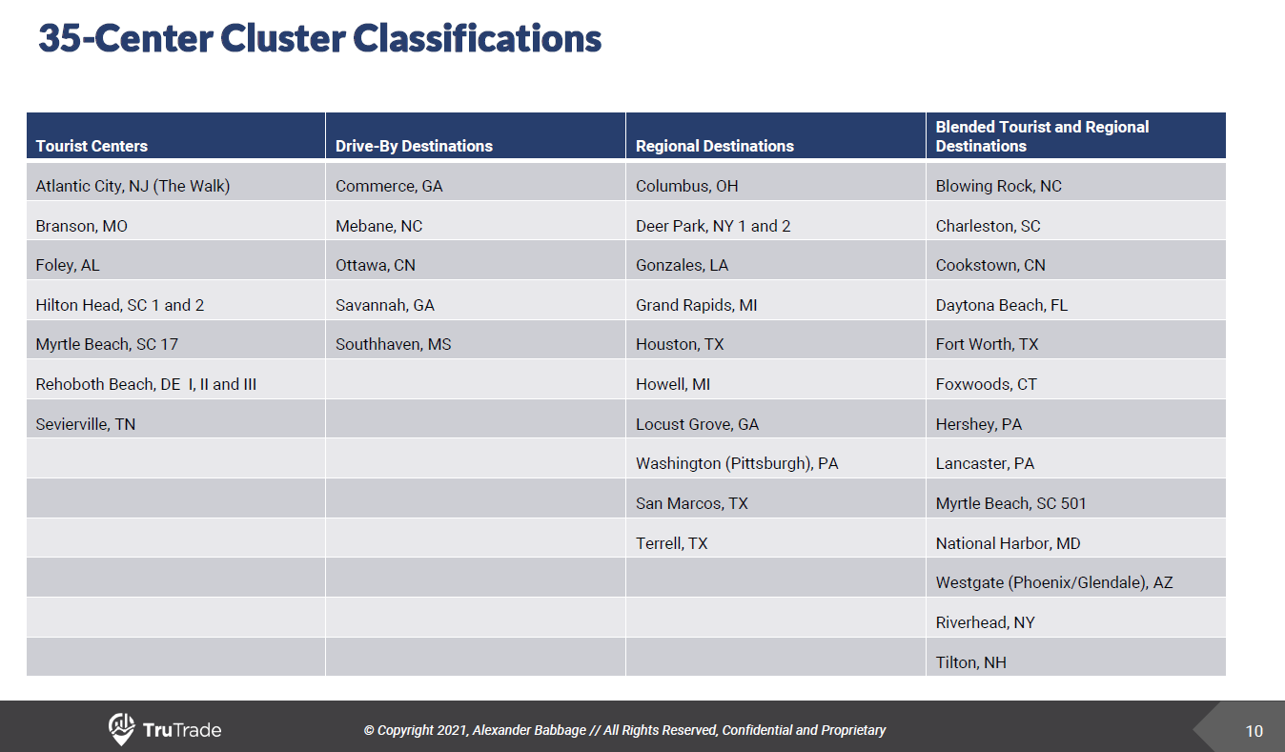
Lookup tables to build…
Writing to db for I&A usage

Slide 20
I&A Team touchpoint. Share lessons learned + roadblocks.
Start of week stand up with functional leaders. Reporting out activities to be completed… following an agile-ish approach?
Monthly analytics training with select end users. How to use system, determining effective statistical tests, etc
A process metric/ KPI is flagged as out of standard >> Investigate, alert affected party for read out. Determine next steps and document in ___
The data for a long term study is now available. Perform analysis with
Kicking off a new study.
End of every other week… Automated email with past 2 weeks highlights to organization.
Data science lunch and learns… Model development, model assessments
Revisit outputs. What can be phased out
A Typical Week: Envision 2023

Slide 21
Sustainable Success
Streamline institutional knowledge // expose gaps
How do we as a team not get caught off guard
From our customer’s needs
By our own team members
What is the culture we want in our own team?
Curious, self driven, clear, unbiased

Slide 22
Advanced Analytics
What would make a data scientist want to join Tanger?
Competing against companies with well supported IT
Tanger not a brand known for advanced analytics // nor are REITs in general…

Slide 23
Team Values
Trust
Comfortable with uncertainty
Sustainable success
Creative insights. Bridging multiple disciplines

Slide 24
Vision and Mission: customer focused/ service mentality
Vision: To drive the best experience for both tenets and customers by arming our Tanger employees with the most pertinent and actionable information.
Mission: We are trusted partners in the discovery of answers for our tenets and customers.
We care about…
Craig: “Maybe we can’t get you that… and how can we help”
partnerships

Slide 25
Vision and Mission: Open Insights for Everyone
Vision: To remove to friction of Tanger employees for getting to the insights they need.
Mission: We provide the tools (studies, reports, applications etc) to allow anyone to make informed, data driven decisions.
We care about…
Neutral
Easy to access
Self service

Slide 26
Vision and Mission: Advanced Analytics
Vision: To be the best in class analytics group for retail.
Mission:
We care about….

