Slide 1

Module 6
*********
Data
Loading
Workforce Information Database Training
Last update November 2006

Slide 2
Module 6
Data Loading
What are the common data loading problems relevant to
the Workforce Information Database?

Slide 3
Module 6
Data Loading
Data Loading Guide
1. Assure the received data load has all the fields or can be aggregated to create the necessary fields to fit the table in the Workforce Information Database structure.
2. Assure the fields are in the correct format as the Workforce Information Database (DB) structure.
3. Assure the geographies of the data load are consistent with the Workforce Information DB geog table.

Slide 4
Module 6
Data Loading
Data Loading Guide
4. Assure data load contains all geographies that will be represented in the retrieval software.
Load the data load via a data loader to ensure data integrity.
6. If errors occur from the load attempt, correct those erroneous records and reload them via data loader.

Slide 5
Module 6
Data Loading
Data Loading Guide
continued...
7. Document data load on the data tracking log.
8. Test retrieval software/system to assure the recently loaded data load is accessible and reasonable or review data in the table for validity and integrity.
*************************
ALWAYS load to a test server/database before production!

Slide 6
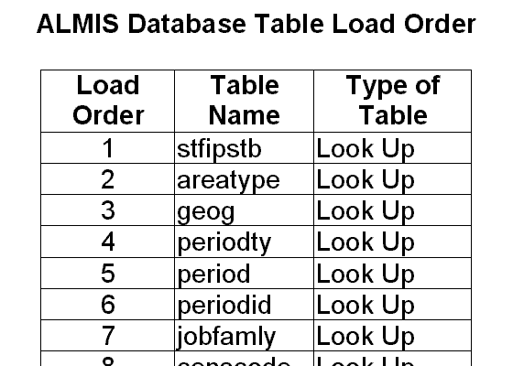
Module 6
Data Loading
Workforce Info DB
Load Order
(Refer to
Handout)

Slide 7
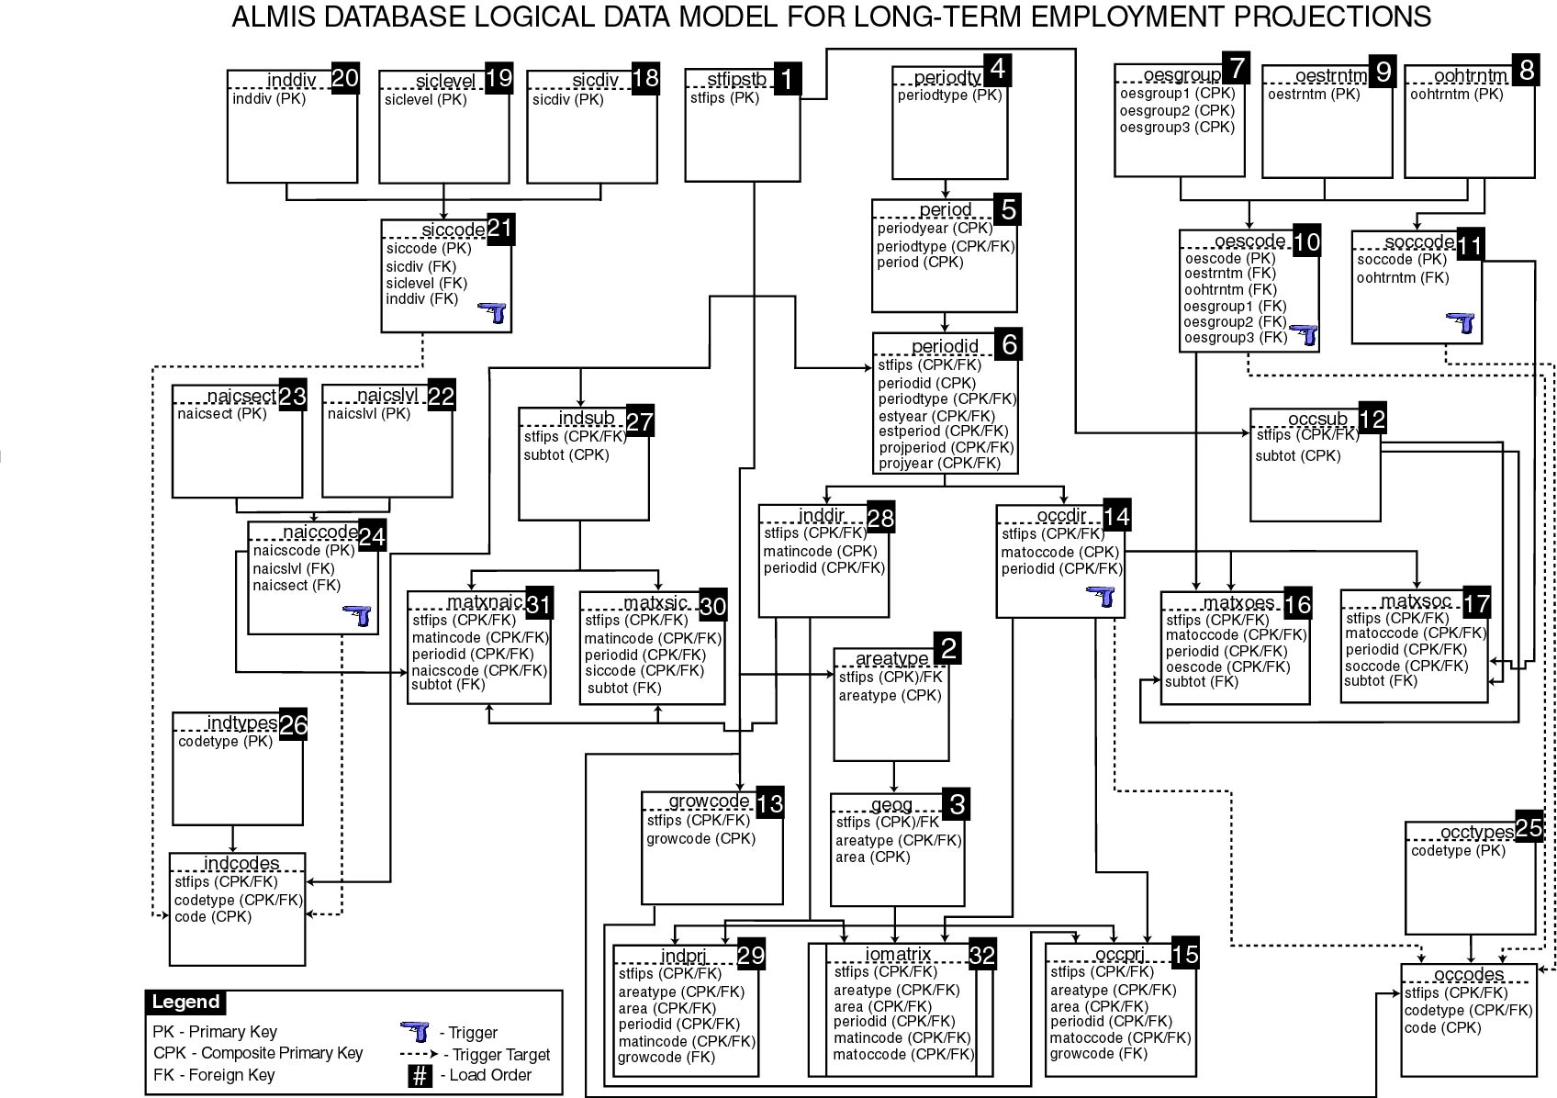
Module 6
Data Loading
WORKFORCE INFORMATION DATABASE LOGICAL DATA MODEL FOR LONG-TERM EMPLOYMENT PROJECTIONS

