Slide 1


Data Collection
And NCSC Services

Slide 2
Objectives
Identify sources of various types of content
Target your efforts – do what’s important
Identify core tables
Identify useful Internet resources

Slide 3

Geek Census
How much of a geek are you today?
The circus side show is the source of the word geek: “a performer who engaged in bizarre acts, such as biting the head off a live chicken.”
Notes:
This is good background info for those of us who have been placed at the front of the room
As for me, I’m either a ‘3’ or as much a geek as I need to be.
We could have used “nerd” but that’s not as interesting. Coined by Dr. Seus in ????

Slide 4
Agenda
1. NCSC Info & the ALMIS Database
2. Planning your time
3. Internet Resources
4. Licensing Files

Slide 5
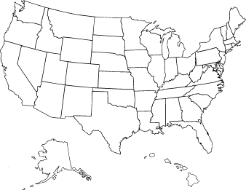
Where We Are
NCSC
Notes:
I’d like to get one of the objectives out of the way right at the start.
First things first – you’ll find us in Des Moines, IA

Slide 6
Who We Are
  National Service Center for
    Classifications
    Crosswalks
    Related Data & Resources
  Funded by the ETA through the ALMIS Resource Center
  Operated by the State of Iowa since 1983

Slide 7
What We Do
  Specialize in occupational and training program classification resources and their relationships
  Microcomputer products
  Major delivery mechanism is internet:
    www.xwalkcenter.org
    ftp.xwalkcenter.org

Slide 8
ALMIS Database Support
  Visual FoxPro and Access databases
  Standard/prototype crosswalk & lookup tables
  National data files (projections, CES, LAUS, QCEW, etc.)
  Technical assistance dealing with classifications, crosswalks, data issues, file translations, etc.
  National database manager for licensing information used in America’s Career InfoNet
Return to
Agenda

Slide 9

ALMIS Puzzle
ONLY word in the English language that begins and ends with same three letters
_ _ _ ergro _ _ _
u
n
d
u
n
d
Notes:
There might be a prize here for somebody.
Of course, if you want to spend your evening looking for a second word that meets those conditions, feel free. There will be no prize if you find one.

Slide 10
Core Lookup Tables
  ADDRESTY
  ANNSLFLG
  AREATYPE
  BENMARK
  CESCODE
  CREDITCD
  EMPSZFLG
  EMPSZRNG
  GEOCODE
  GEOG
  GROWCODE
  INCOMTYP
  INCSOURCE
  INDDIR
  INDSUB
  INDTYPES
  LEVELTYP
  LICNUMTY
  LOCSTAT
  OCCDIR
  OCCSUB
  OCCTYPES
  OWNERSHP
  PERIOD
  PERIODID
  PERIODTY
  POPSOURC
  PRPBSTAT
  RATETYPE
  STATTYPE
  STFIPSTB
  URLTOPIC
  WEBFLAG
National/prototype files available from the NCSC FTP Server

Slide 11
Core Data & Crosswalk Tables
  MATXNAIC
  MATXSOC
  LICXOCC
  CES
  EMPDB
  INCOME
  INDPRJ
  INDUSTRY
  IOMATRIX
  LABFORCE
  LICAUTH
  LICENSE
  OCCPRJ
  OESWAGE
  POPULATN
National/prototype files available from the NCSC FTP Server
National and state data available from the NCSC FTP Server

Slide 12
Best Sources
NCSC, others
You, NCSC, ?
You
You
Within your domain (OES, CES, etc.)
Within your state (Economic Development, Education, etc.)
Federal agencies
Other

Slide 13
NCSC Data Files
State Data Files
  POPULATN
    U.S., State, County
    1900-2005 (U.S., state)
    1970-2005 (county)
  BEA INCOME (INCOME table)
    U.S., States: 1929-2005
    MSAs, Counties: 1969-2004
  Census Income (INCOME table)
    U.S., States: through 2004
  COMMUTE – Commuting patterns from 2000 census
  CENLABOR
    U.S., State, County (1990)
    U.S., State, MSA, County or County Group (2000)
National Data Files
  National employment projections, 2004-2014
  INDUSTRY (ES-202/QCEW)
  OESWAGE
  CES (monthly updates)
  LABFORCE (monthly updates)
  CPI (monthly updates)
Return to
Agenda

Slide 14
Internet Resources
ALMIS Resource Center Home Page
NCSC ALMIS Database Page
NCSC ALMIS Database Files Page
NCSC ALMIS Database Non-standard tables
Return to
Agenda

Slide 15
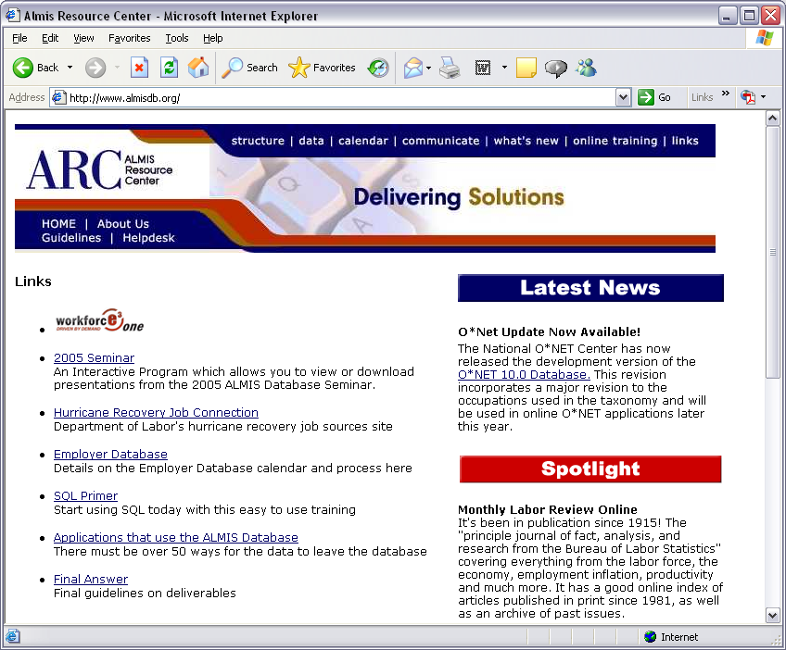
ARC Home Page
http://www.almisdb.org
Back

Slide 16
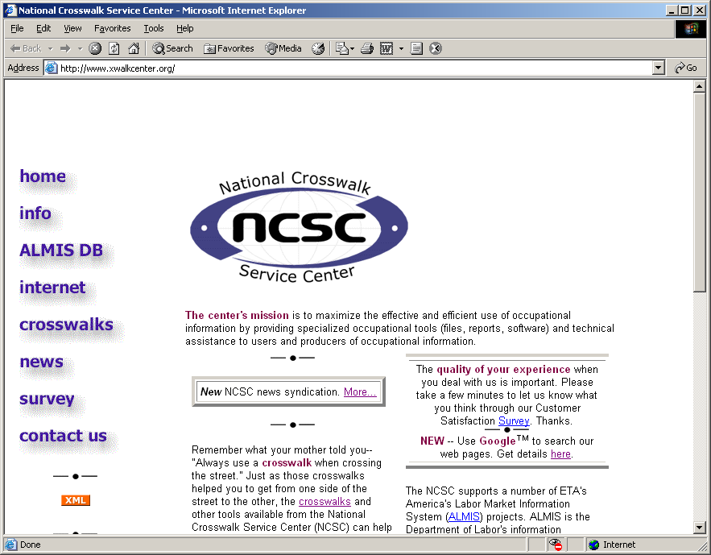
NCSC Home Page
  Links to NCSC Internet resources, news items
  Main access to ALMIS Databases is from ALMIS Resource Center’s page
http://www.xwalkcenter.org

Slide 17
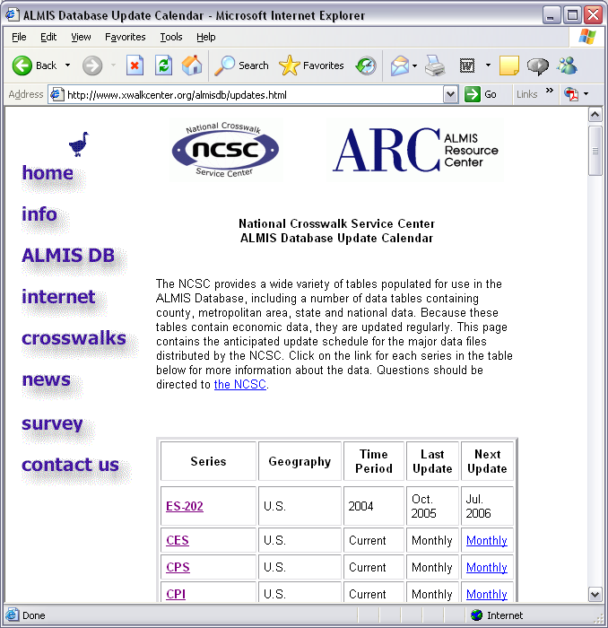

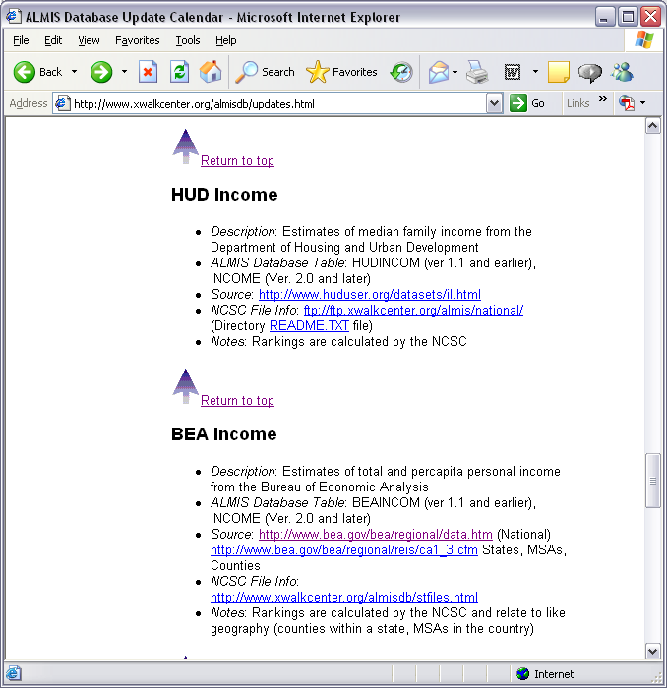


ALMIS Database Update Calendar
Lists national, state and local data available from the NCSC
Provides dates of last update and next anticipated update
Includes NCSC file location and URL of source page on the Internet
http://www.xwalkcenter.org/almisdb/updates.html

Slide 18
Let’s Work
Let’s look at county population estimates
Go to http://www.census.gov/popest/counties/
“download entire data set” link
Return to Internet
Resources

Slide 19
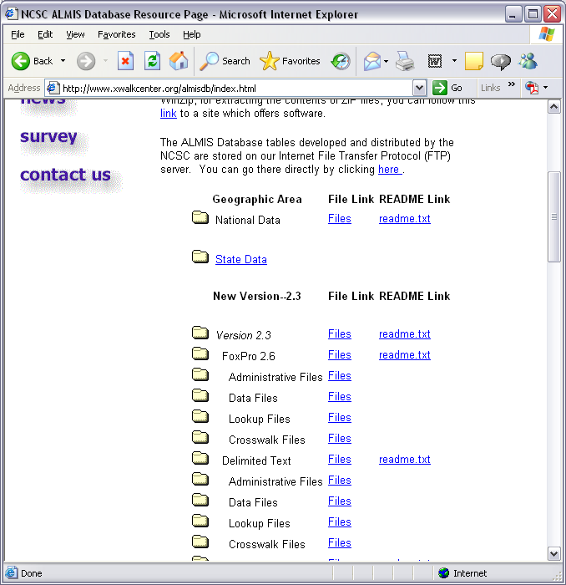
NCSC ALMIS Database Files Page
  Links to national and state data directories
  Standard, prototype lookup, crosswalk, data and administrative file structures are organized by Database Version
http://www.xwalkcenter.org/almisdb/index.html

Slide 20
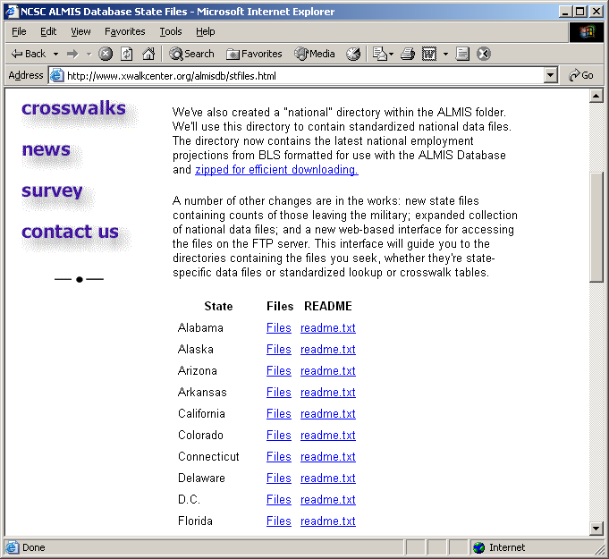
NCSC ALMIS State Data Files Page
Links to state’s directory on ftp.xwalkcenter.org and to readme.txt file
http://www.xwalkcenter.org/almisdb/stfiles.html

Slide 21
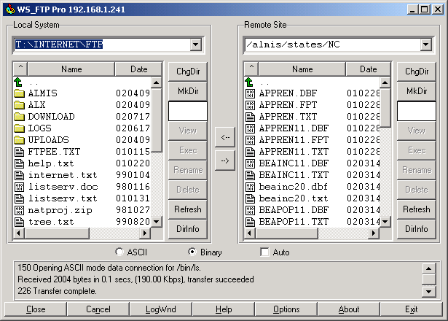
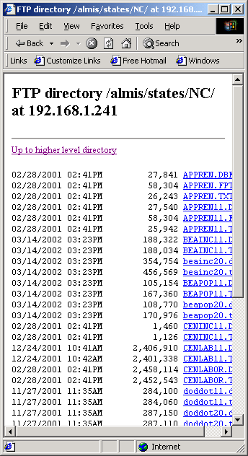
Views of FTP state folder

Slide 22
NCSC ALMIS FTP Directories
├───national
├───nonstd
├───states
│ ├───AK
│ ├───AL
│ ├───…
│ └───WY
├───VER10
├───VER11
│ ├───FOX26
│ │ ├───DATA
│ │ ├───LOOKUP
│ │ └───XWALK
│ ├───TXT
│ │ ├───DATA
│ │ ├───LOOKUP
│ │ └───XWALK
│ └───VISFOX
├───VER20
│ ├───FOX26
│ │ ├───ADMIN
│ │ ├───DATA
│ │ ├───LOOKUP
│ │ └───XWALK
│ ├───TXT
│ │ ├───ADMIN
│ │ ├───DATA
│ │ ├───LOOKUP
│ │ └───XWALK
│ └───VISFOX
├───ver21
│ ├───fox26
│ │ ├───admin
│ │ ├───data
│ │ ├───lookup
│ │ └───xwalk
│ ├───txt
│ │ ├───admin
│ │ ├───data
│ │ ├───lookup
│ │ └───xwalk
│ └───visfox
├───ver22
│ ├───fox26
│ │ ├───admin
│ │ ├───data
│ │ ├───lookup
│ │ └───xwalk
│ ├───txt
│ │ ├───admin
│ │ ├───data
│ │ ├───lookup
│ │ └───xwalk
│ └───visfox
└───ver23
├───access
├───fox26
│ ├───admin
│ ├───data
│ ├───lookup
│ └───xwalk
├───txt
│ ├───admin
│ ├───data
│ ├───lookup
│ └───xwalk
└───vfp

Slide 23
FTP Troubleshooting
  If you’re using Internet Explorer, look for the “Enable folder view for FTP sites” (Tools/Internet Options) on the “Advanced” tab. Change the setting.
  Try this address: http://webdata.xwalkcenter.org/ftp
  Try connecting through the IP address (ftp://165.206.254.241)
  Contact the NCSC at 515-242-5034
Return to Internet
Resources

Slide 24
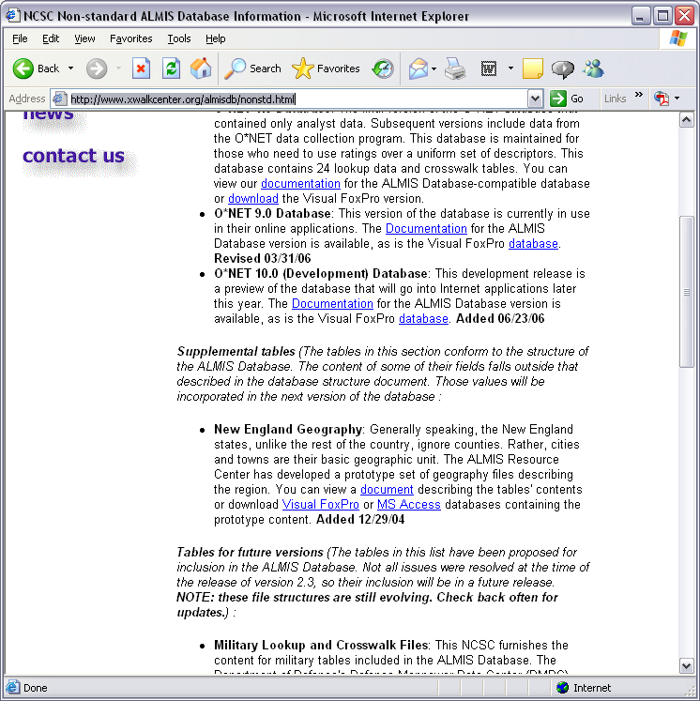
NCSC ALMIS Nonstandard Tables Page
Links to:
  External databases (designed to be used with the ALMIS Database)
  Supplemental files – go beyond content of structure document
  Tables for future versions
http://www.xwalkcenter.org/almisdb/nonstd.html
Bonus Slide

Slide 25
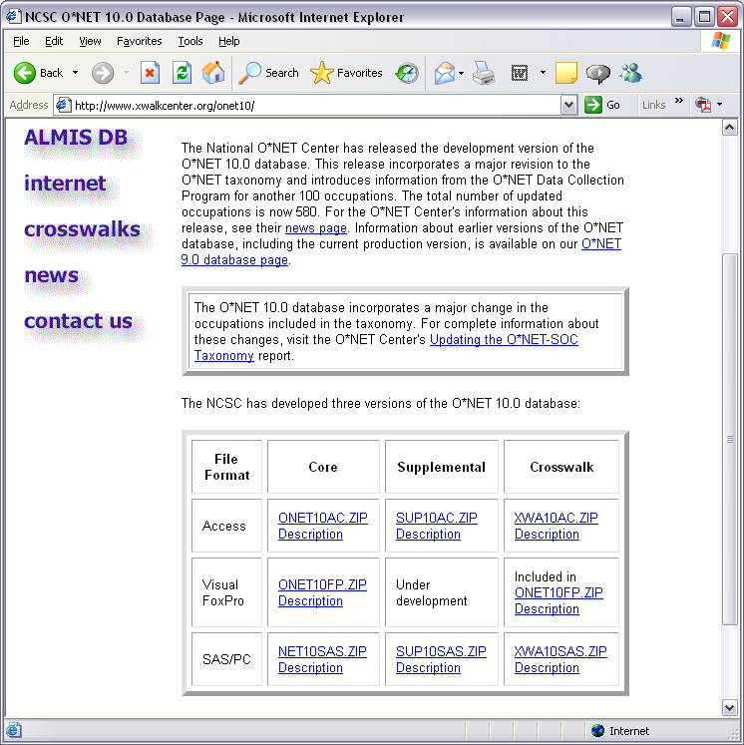
NCSC O*NET Version 10.0 Files
  MS Access, Visual FoxPro and SAS/PC versions
  Visual FoxPro version designed to work with the ALMIS Database
  Version 10.0 contains major revision in occupations used – now in development release
Bonus Slide
Return to Internet
Resources
http://www.xwalkcenter.org/onet10/

Slide 26
Perspective
All is perspective.
To a worm, digging in the ground is more relaxing than going fishing.
Clyde Abel

Slide 27

Licensing Tables
Licensing files – process for ACINET
  States send licensing tables (LICENSE, LICAUTH, LICHIST) to the NCSC (LMI Grant requires updates once every two years)
  The NCSC checks for internal consistency and compatibility with ACINet application
  The NCSC and the state work out solutions to any problems identified.
  Quarterly updates are sent to ACINet

Slide 28
NCSC Licensing Services
Version Conversion – ACINet uses structure based on Version 2.3 of the ALMIS Database
Licensing-occupation crosswalk enhancement
Testing

Slide 29
Licensing Tests
NCSC Licensing Testing
  Primary key tests
  Each agency relates to at least one license
  Each license relates to an agency
  Each license relates to at least one valid O*NET occupation
  Each LICHIST record relates to a license

Slide 30
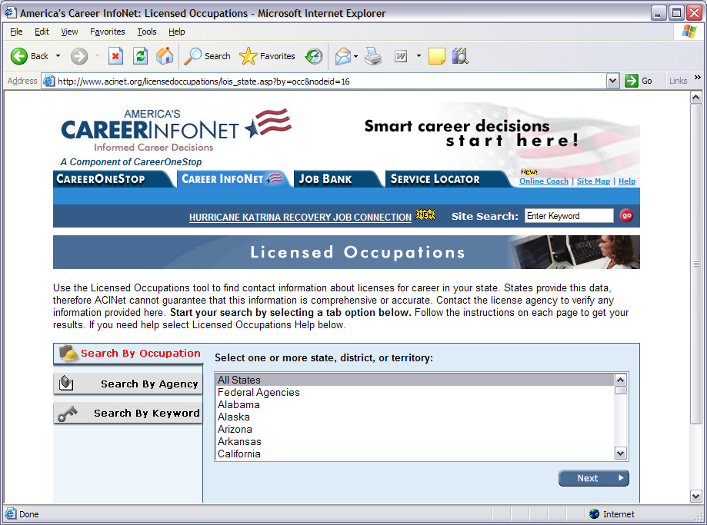
ACINet Licensing Application
http://www.acinet.org/licensedoccupations/lois_state.asp?by=occ&nodeid=16

Slide 31
Contact Us
  Mail:
    National Crosswalk Service Center
    Department of Education
    Grimes State Office Building
    Des Moines IA 50319
  Telephone:
    515-242-5034
  E-mail:
    ncsc@iowa.gov
  Home Page:
    http://www.xwalkcenter.org

Slide 32
Data Collection
And NCSC Services

