Slide 1
Wyomingatwork.com
Version 12.1

Slide 2
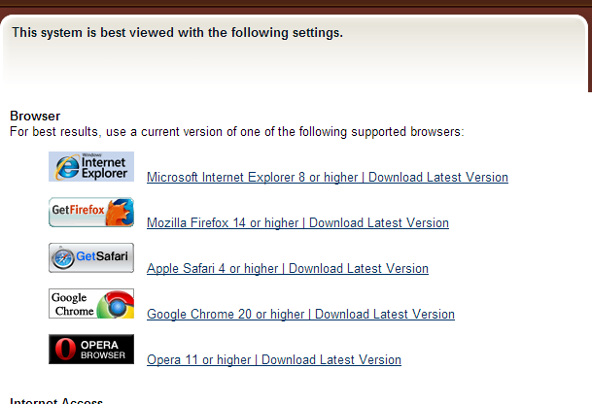
Wyomingatwork.com can now be used with a variety of browsers!

Slide 3
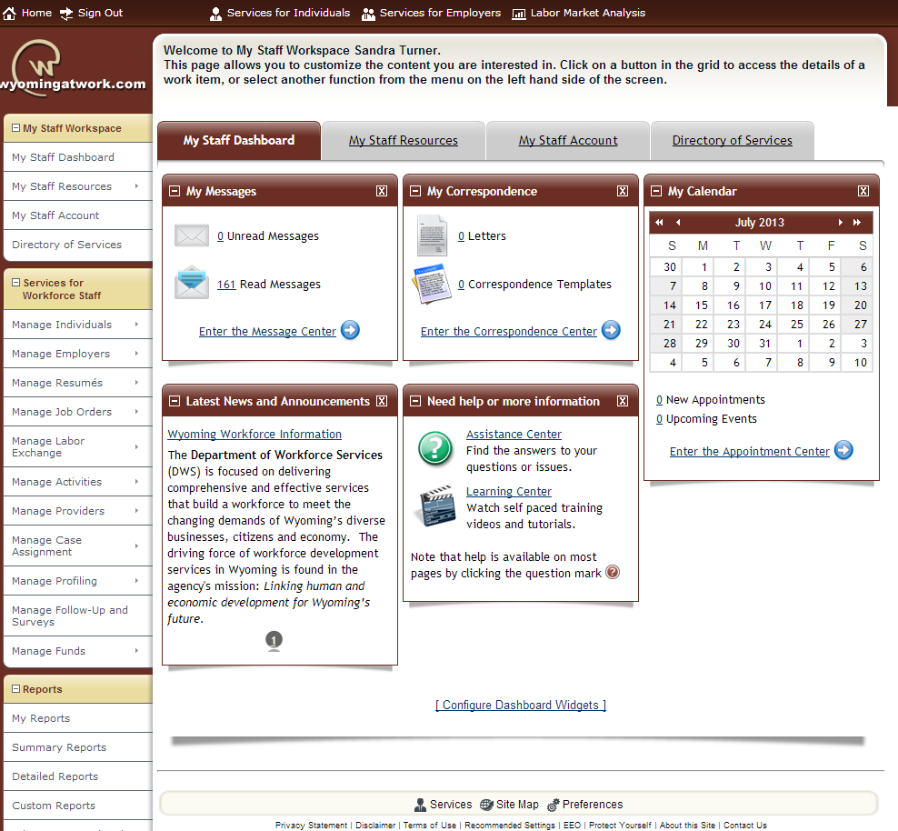
Staff: Upon logging in the first time to Version 12.1 your dashboard will look similar to this until you configure it how you want it to look. To configure the dashboard widgets, just click on the “Configure Dashboard Widgets”

Slide 4
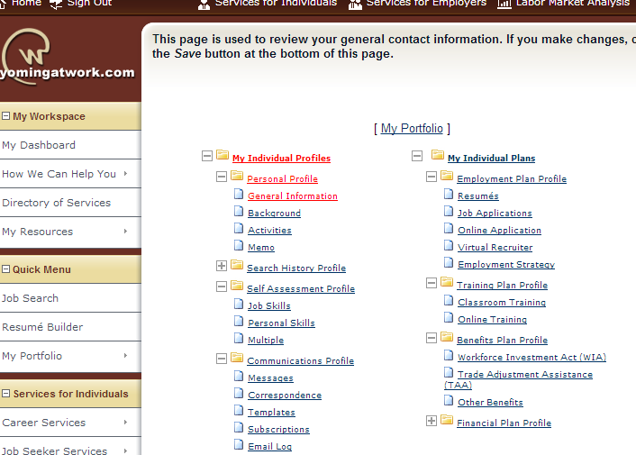
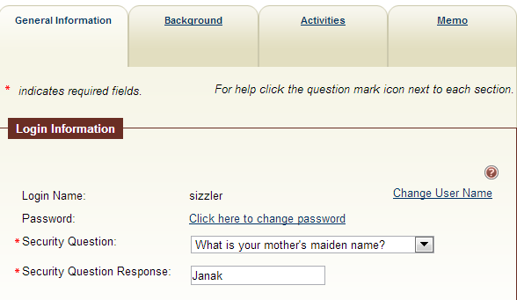
Staff now have the ability to change usernames for job seekers and employers

Slide 5
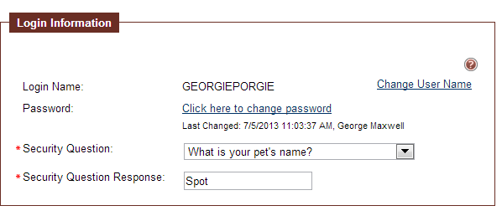
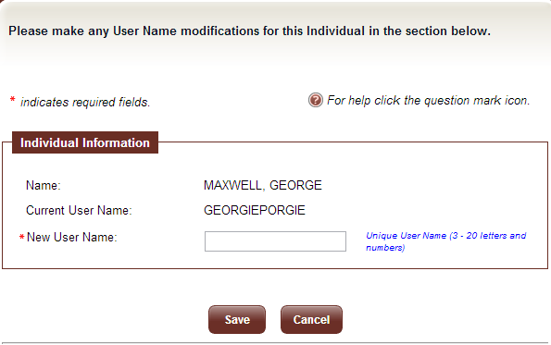

Slide 6
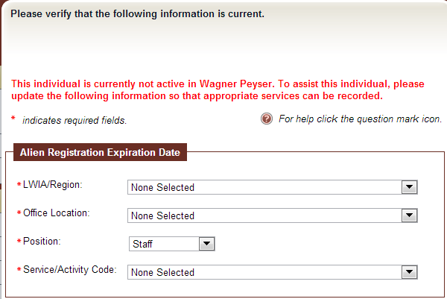
New Wagner Peyser Re-Registration Screen: The new screen is designed to capture more information.
When staff go to select the activity that they will be re-enrolling the individual into, WP will ONLY display services that are “Reportable” based upon WP Reporting service categories. This will insure the first activity is a reportable service.

Slide 7
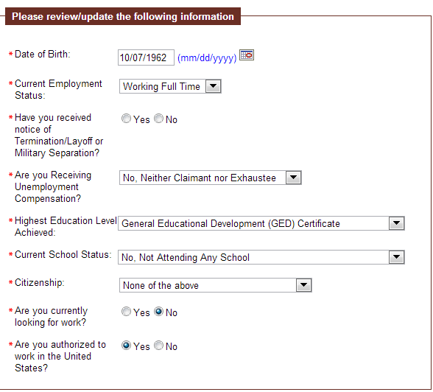
This has been added with no default answer. This was added to better capture Dislocated Worker Information for the 9002 Reports. When Yes is selected the Date of separation prompt will appear and the date must be entered.

Slide 8
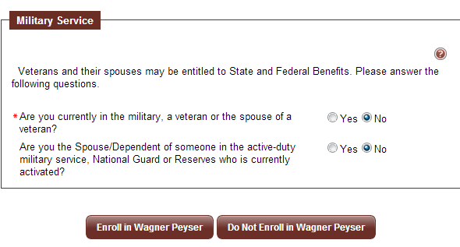
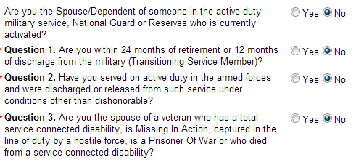
Military Service has also been added to this page. The military service will now work just like the individual registration. All prompts are new to the re-registration into Wagner Peyser. This will insure that the system is attaching the correct military service information to the WP participation record.
When answered yes the additional questions will be displayed

Slide 9
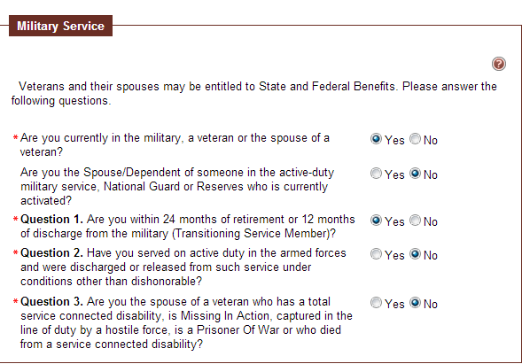
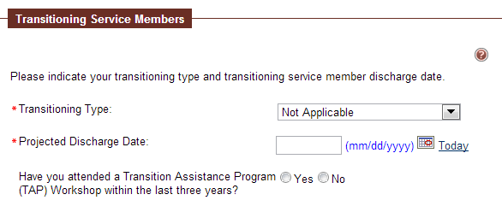
When Question “ Are you within 24 months of retirement or 12 months of discharge from the military (Transitioning Service Member)?” is answered yes the screen will change and present the Transitioning Service Member Questions
New question added

Slide 10
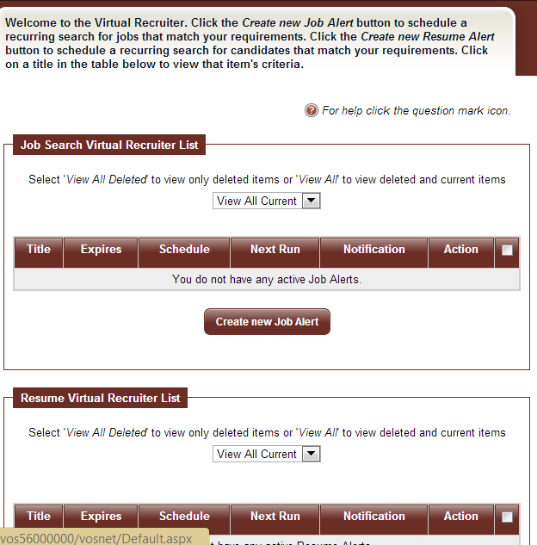
My Virtual Recruiter has been added to My Staff Resources. Staff can set these up to watch for jobs for clients or for Candidates for job openings.

Slide 11
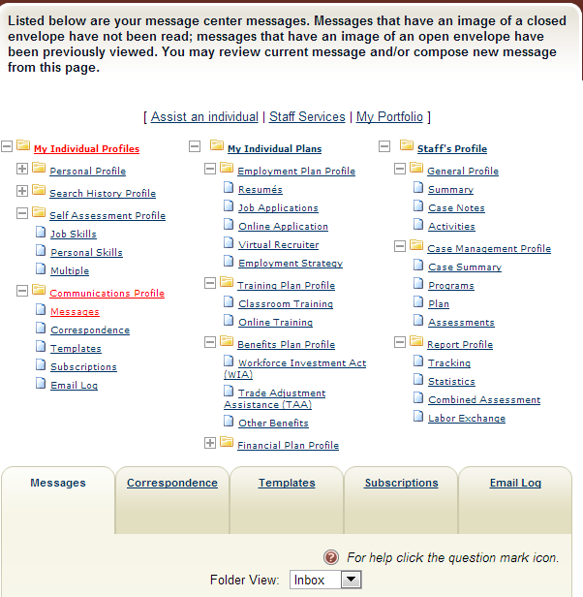
When assisting an individual, staff can review activities that have taken place with the individual.

Slide 12
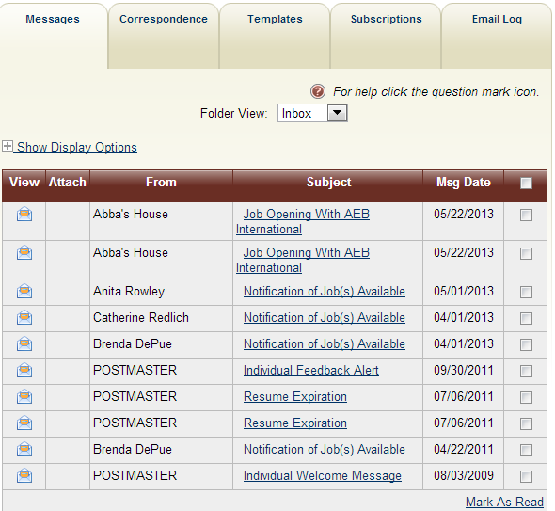
All messages sent using Wyomingatwork can be seen here. This would include staff, system generated and employers approved for self service.

Slide 13
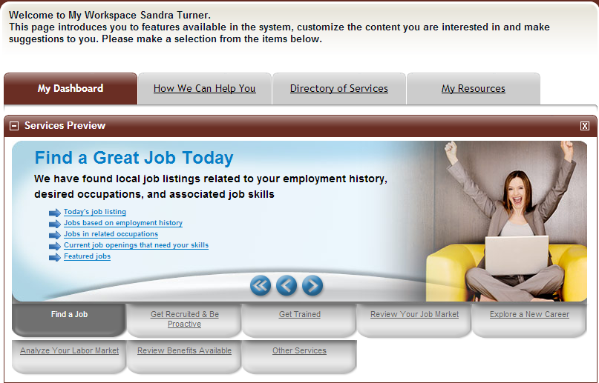

Upon logging on to their account, this is what the Job Seeker will see.

Slide 14

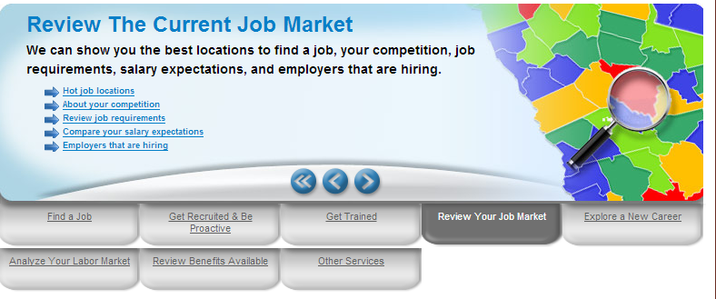

Slide 15
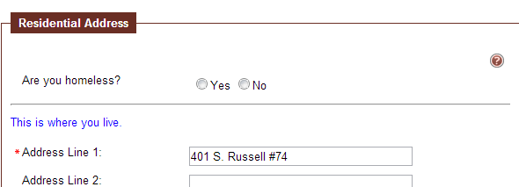
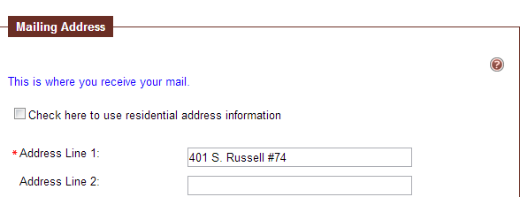
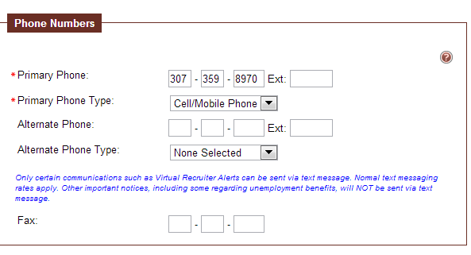
General Information Tab:
Some text has been added to explain things a bit better.

Slide 16
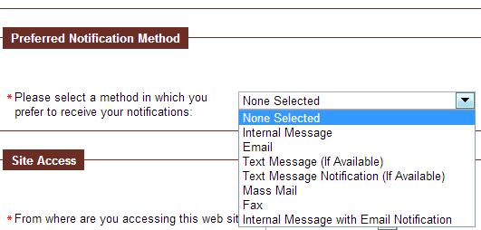
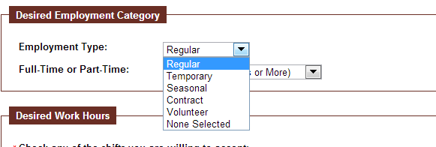
Preferred method of contact added.
Background Wizard: Volunteer added to employment type.

Slide 17
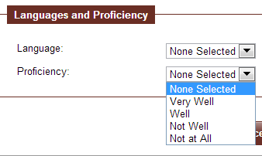
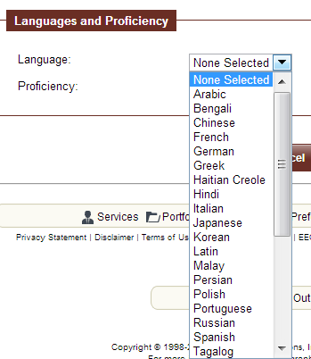
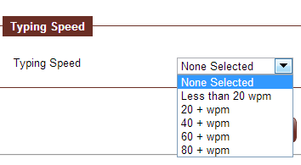
Background Wizard: Language and proficiency have been added. Drop downs include list of Languages and proficiency options
Typing Speed drop down included on Background.

Slide 18
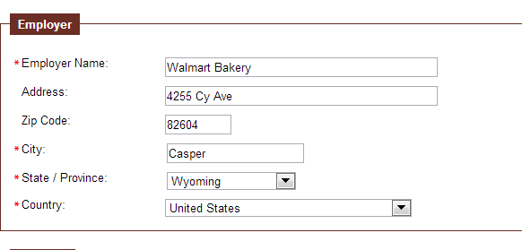
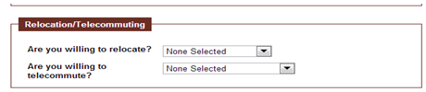
When entering employment history, a list automatically pops up that includes Employer address’ to prefill . It will not prefill out of state employers however.
New question regarding telecommuting or relocating.
Notes:
Pull print with drop downs for both of these . Also cannot skip this page. May need to enter an OPC question?

Slide 19
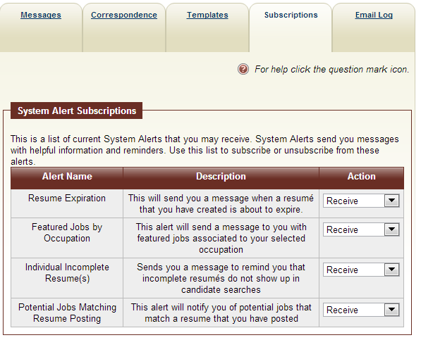
Another cool feature with Version 12.1 is system alerts for job seekers. All of these alerts will default to ‘Receive’ .

Slide 20
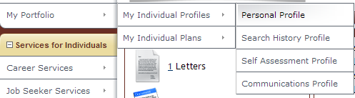
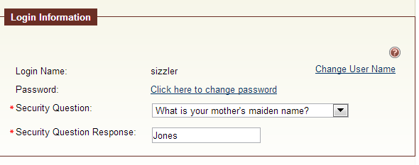
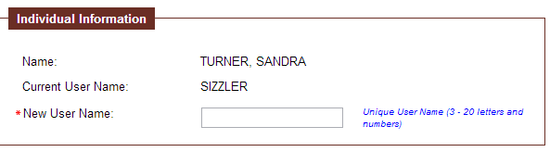
Job seekers can change their own username

Slide 21
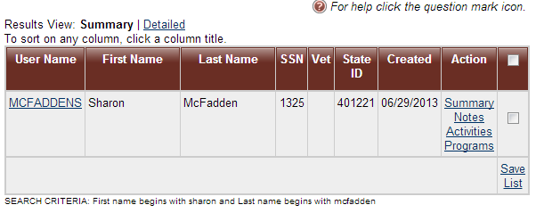
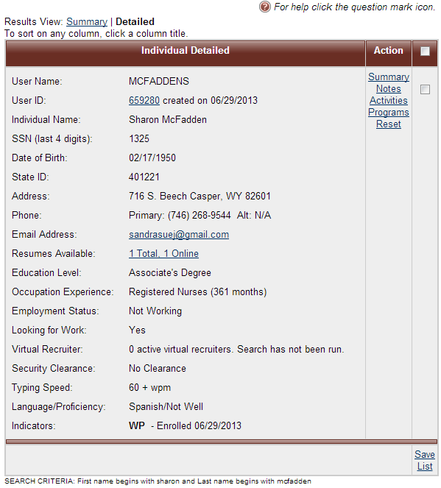
When looking up a client the first screen to display is the Results View screen: If you have selected Summary View, you see this very basic information.
However, as you know, when you select Detailed view you see more detailed information.
Virtual Recruiter, Typing speed and Language/proficiency have been added in Version 12.1
instead you select the Detailed view you see this screen

Slide 22
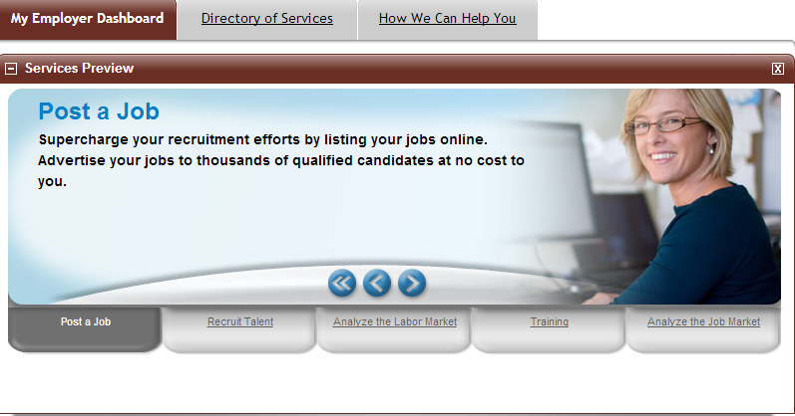
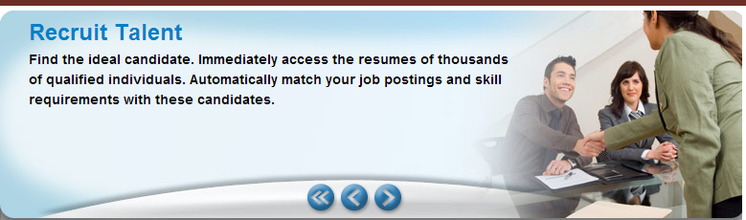
Upon logging on to their account, this is what the Employer will see

Slide 23
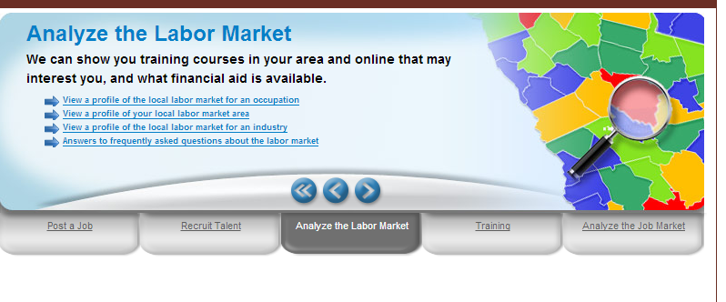
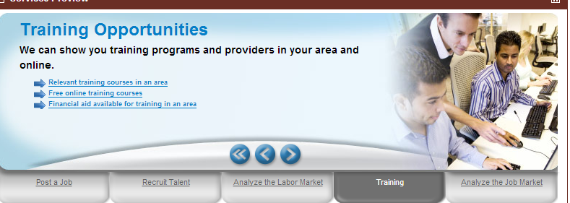

Slide 24
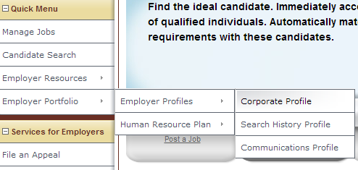
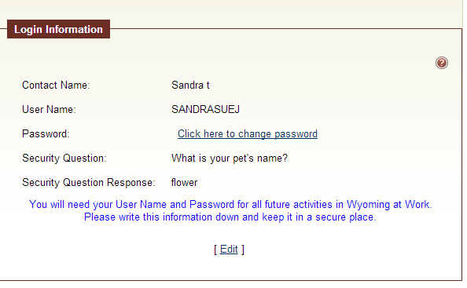
Employers can also change their username
Employer Portfolio, Employer Profiles
Corporate Profile
Click on Edit

Slide 25
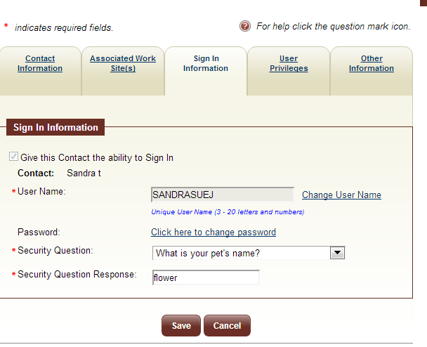

Slide 26
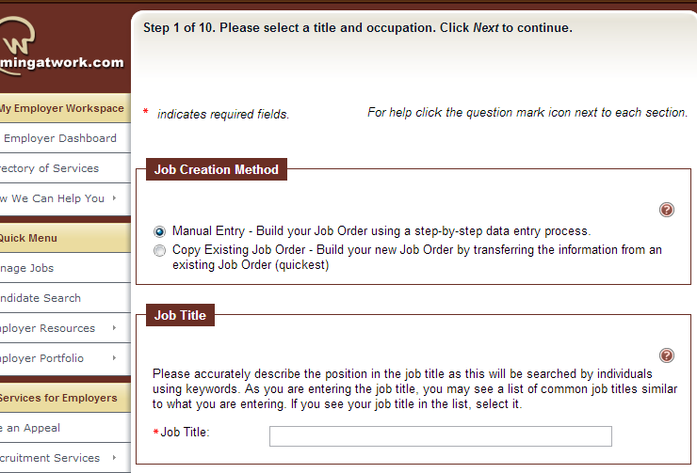
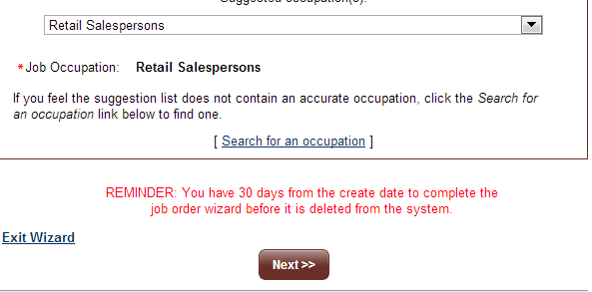
Job order entry has been modified to 10 steps instead of 17 steps.
Incomplete job orders are deleted after 30 days.

Slide 27
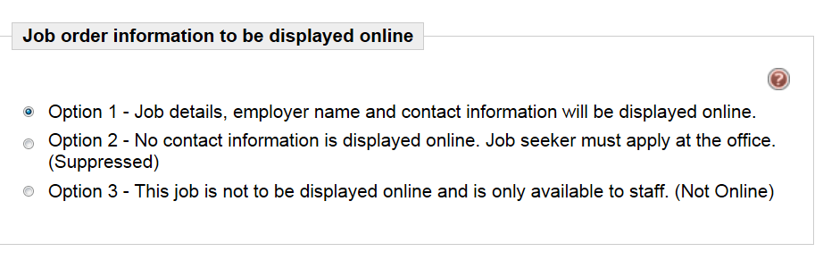
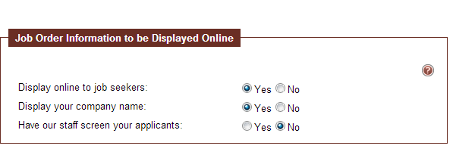
Current display for online choices.
Version 12.1 display for online choices. As you can see this is changed to Yes, No options.
When marked ‘NO” this is what we used to call suppressed job order
If YES is marked here an additional question appears

Slide 28
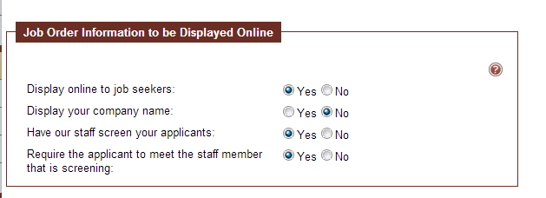
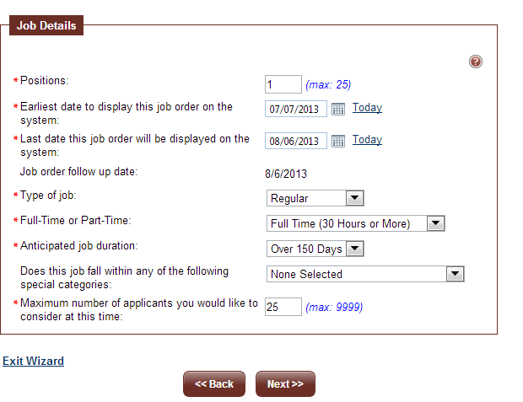

Slide 29
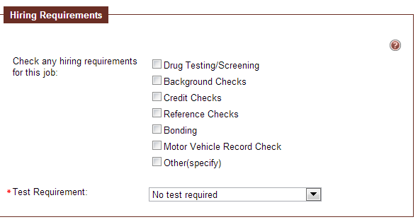
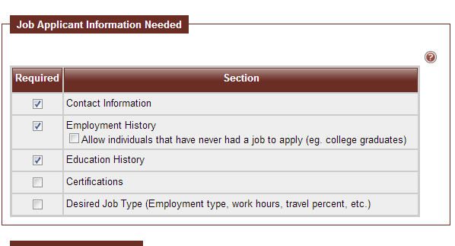
Additional Requirements added to list
Job Application Information Needed – New check box to ‘Allow Individuals that have never had a job to apply

Slide 30
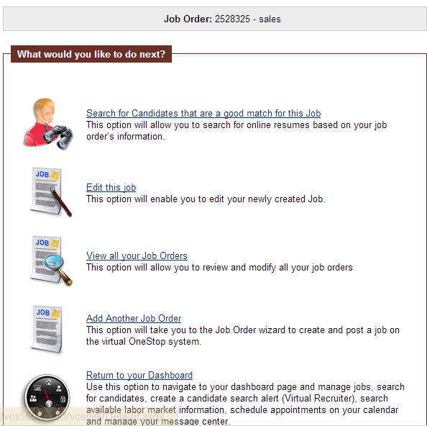
In version 11 of W@W when selecting “Finish” on a Job Order Entry, you return to a view of the job order just input, with a selection at the bottom to ‘Return to Job Order List.’ In Version 12.1 you will get this screen and will need to select
“View all your Job Orders” to see the employers Job Order List.

Slide 31
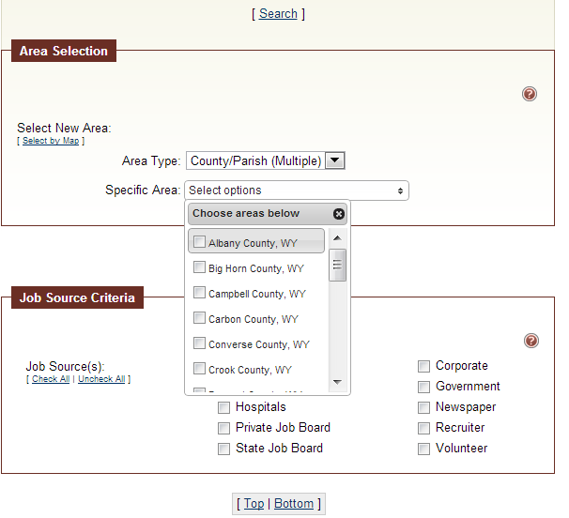
Job seekers and staff can conduct a job search using multiple counties when using the Advanced Search

Slide 32

There is now the ability to create a template to enter job orders. It is very similar to creating a job order

Slide 33


Slide 34

If you select Create job from template you will return to this screen. Just click on Edit this job and make any necessary changes.

Slide 35

When searching for preferred job orders only, the seeker will see a new column called Skills Matched. When staff are managing an individual and conducting a preferred job order search only, staff will see a new column called Skills Matched. When managing an individual and conducting a job search for preferred and spidered job orders, the Skills Matched column will not appear.

Slide 36


The Application Eligibility Tab for WIA is easier to read.
Version 11
Version 12.1

Slide 37

More Changes in Version 12.1
Job Seekers can now download existing resumes or use the Copy and Paste format.

