Slide 1
Data
Structures
and
Algorithms
Chapter 10

Slide 2
Maps
•
Map is a data structure to efficiently store and
values based on search keys.
Map stores (key, value) pairs.
Each (key, value) pair is called an entry.
Keys are unique.
Maps are also known as associative arrays.
retrieve
•
•
•
•
•
Applications:
–
–
–
–
(movie title, movie information)
(part number, part information)
(reservation number, reservation information) (student id, student information)

Slide 3
Maps
Map ADT
size( ): Returns the number of entries in M.
isEmpty( ): Returns true if M is empty. Returns false, otherwise.
get(k): Returns the value v associated with the key k, if such entry exists. Returns null, otherwise.
put(k, v): If there is no entry in M with a key equal to k, then adds the entry (k, v) to M and returns null. Otherwise, replaces the existing value associated with the key k with v and returns the old value.
•
•
•
•

Slide 4
Maps
Map ADT
remove(k): Removes from M the entry with the key k and returns its value. If there is not entry in M with the key k, returns null.
keySet( ): Returns an iterable collection containing all keys in M.
values( ): Returns an iterable collection containing all values in M. If multiple keys map to the same value, then the value appears multiple times in the returned collection.
entrySet( ): Returns an iterable collection containing all
(key, value) entries in M.
•
•
•
•

Slide 5
Maps
Map
ADT
•
Map interface
1
2
3
4
5
6
7
8
9
10
public interface Map<K,V>
int size();
boolean isEmpty();
V get(K key);
V put(K key, V value);
V remove(K key);
Iterable<K> keySet();
Iterable<V> values();
{
Iterable<Entry<K,V>> entrySet();
}
•
Note: java.util.Map interface
provides
more extensive
set of operations than those defined above.

Slide 6
Maps
Map ADT
Simple application example: Word Frequency
•
–
Counts frequency of each word in a text.
–
–
–
–
–
Create an empty map.
In the map, an entry is (word, frequency) pair.
Read one word at a time.
If the word is not in the map, insert it and set frequency
= 1
If the word is already in the map, increment the frequency of the
word.
•
WordCount.java code.

Slide 7
Maps
Hash Tables
Hash table is an efficient implementation
•
of a map.
•
•
Consider a map that stores n entries.
Assume keys are integers in the
values are characters, usually N
We can design a lookup table of
range [0, N – 1] and
≥ n.
length N as follows,
•
where keys are used as indexes:
0
1
2
3
4
5
6
7
8
9
10
D
Z
C
Q
Lookup table’s capacity N = 11
Currently there are 4 entries: (1,D), (3,Z), (6,C), and (7,Q)

Slide 8
Maps
Hash Tables
•
Issues:
– The domain of keys may be much larger than the actual number of elements to be stored in the table, i.e., N >> n. This is a waste of space.
– Keys may not be integers. Then, they cannot be used as indexes in the table.
•
Solution:
– Use a hash function that maps keys to integers in the range [0, N – 1], distributing keys relatively evenly.
– N doesn’t have to be very large (could be smaller).

Slide 9
Maps
Hash Tables
Ideally a hash function distributes keys evenly across the table.
•
•
In practice, some keys are mapped to the
same location.
•
One solution: each slot in the table keeps
a bucket which
called bucket
stores a collection of
array.
entries. This
table is
0
1
2
3
4
5
6
7
8
9
10
(1,X)
(12,M)
(4,K)
(8,Y)
(19,A) (41,G)
(10,E)
(54,H)

Slide 10
Maps
Hash Function
•
Two step process:
Arbitrary
Objects
•
Hash code maps keys of
arbitrary object type to integers. The resulting integer is also called hash code.
Hash
code
. . . . ‐2, ‐1, 0, 1, 2, . . . .
Compression
function
•
Compression function maps
the hash code to integers in the range [0, N – 1]
0, 1, 2, . . ., N ‐ 1

Slide 11
Maps
Hash Code
Treat bit representation of base types as integers
•
•
Polynomial
objects
Cyclic-shift
hash code: used for strings or variable-length
•
hash code: a variant of polynomial hash code
•
Java has a
default hashCode( ) function defined in the
Object class, which returns a 32-bit integer of int type.
When designing a hashCode() for a user-defined class, make sure: If x.equals(y), x.hashCode( ) = y.hashCode( )
•

Slide 12
Maps
Compression Function
When two keys are mapped to the same hash table index, it is called collision.
A good compression function must distribute hash codes (of keys) relatively uniformly across the hash table to minimize collisions.
Will discuss two compression functions (compression functions are often called just hash functions):
– division method
– MAD (multiply-add-and-divide) method
•
•
•

Slide 13
Maps
Compression Function
Division method: i mod N,
where i is an integer (such as a hash code)
hash table size.
•
and N is the
•
MAD method: [(ai + b) mod p] mod N,
where N is hash table size, p is a prime number larger than N, and a and b are integers in [0, p – 1], a > 0.
private int hashValue(K key) {
return (int) ((Math.abs(key.hashCode( )*scale + shift)
% prime) % capacity);
}

Slide 14
Maps
Compression Function
•
MAD method is better (in terms of well distributing
across the has table), but division method is more efficient.
keys

Slide 15










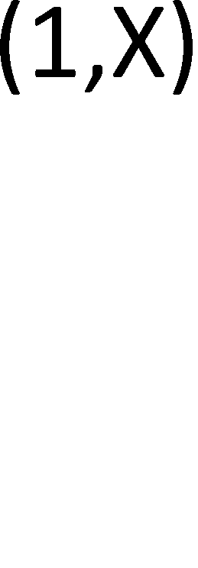
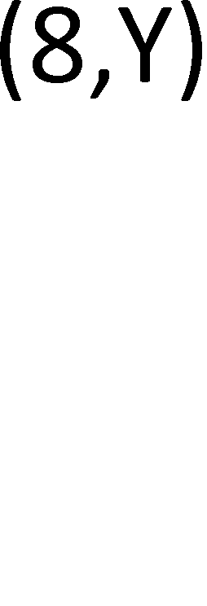
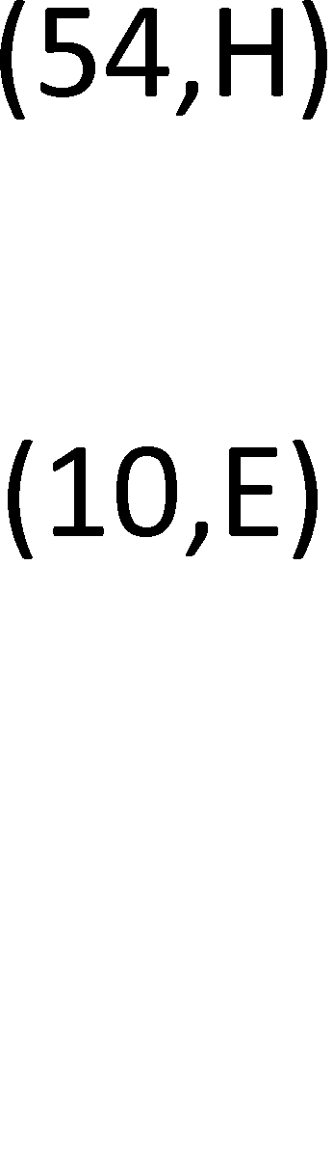
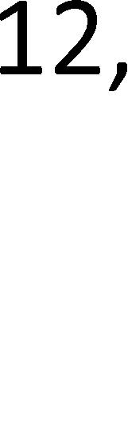

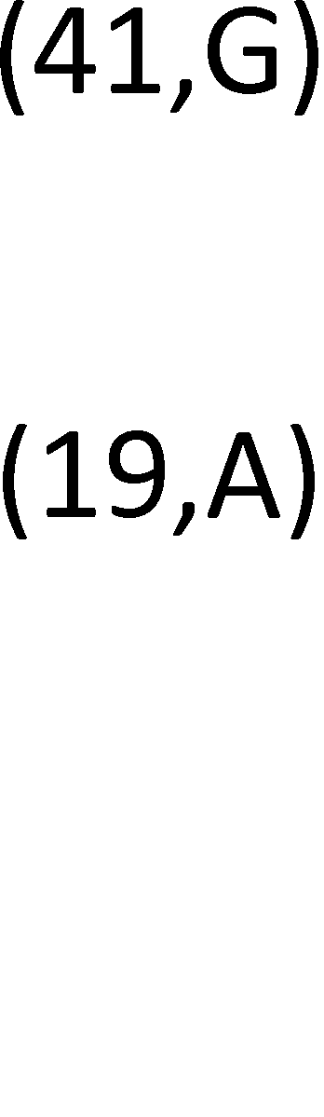
Maps
Collision Handling
When two keys are mapped to the same slot in the hash table, it is called collision.
Will discuss two collision resolution approaches:
chaining and open addressing.
•
•
•
Chaining: Each slot in the table keeps an unsorted list
and all keys that are mapped to the same slot are kept in the list.

Slide 16
Maps
Chaining Method
Advantage: Easy to implement
Drawback:
– Additional storage
•
•
– In the worst case, all keys are
which increases running time.
Running time
stored
in the same list,
•
–
–
–
Load factor λ = n / N, which is
expected size of a list.
Map operations run in
O( ⎡^{n / N} ⎤)
or O(λ)
If keys are well distributed, O(λ) = O(1) and running
time is O(1).
In the worst case, O(n).
–

Slide 17
Maps
Open Addressing
All entries are stored in a hash table itself.
No additional data structure and no additional storage space is needed.
When adding a new key causes a collision, an
•
•
•
alternative
element is
Will briefly
location in the table is found and the new
stored in that location.
discuss three open addressing techniques –
•
linear probing, quadratic probing, and double hashing.

Slide 18
Maps
Linear Probing
Assume A is the array of a hash table. Inserting an entry (k, v).
•
•
–
Hash function h is applied to key k, i.e., j ←
mapped to j.
h(k). We say k is
–
–
If A[j] is empty, then the entry is stored there, i.e., A[j] ← (k, v).
If that slot is occupied, the next bucket A[j+1] is probed to see whether it is available.
If it is empty, the entry is stored there. Otherwise, the next bucket, A[j+2], is probed, and so on, until an empty slot is found or all slots have been probed.
The sequence of slots probed , called probe sequence, is determined by A[(j+i) mod N], for i = 0, 1, 2, . . ., N – 1.
i is called probe number.
–
–
–

Slide 19















Maps
Linear Probing
Illustration: N = 10, h = k mod N, keys are added in the following order: 4, 12, 14, 24.
•

Slide 20
Maps
Linear Probing
Searching an entry with key = k.
•
–
–
A key k is mapped to the array index j, i.e., j ← h(k).
If A[j] is empty, then conclude the entry is not in the hash table.
If that slot is occupied and it has the entry with k, then the entry is found.
If the slot is occupied and the key of the entry in the slot is not k, the next bucket, A[j+2], is probed, and so on, until the entry is found or all slots have been probed.
–
–

Slide 21
Maps
Linear Probing
Deleting an entry:
•
–
–
–
–
Assume initially all slots are empty.
Assume we want to remove an entry
in A[j].
We cannot simply remove the entry in A[j].
Assume
the current table is:
0
1
2
3
4
5
6
7
8
9
12
4
14
24
–
And, we
delete an entry with key = 14.

Slide 22
Maps
Linear Probing
•
After deleting entry with
key = 14
0
1
2
3
4
5
6
7
8
9
12
4
24
•
Search entry with key =
24
24 is mapped to A[4]; occupied; A[5] is probed; empty; conclude
entry with key = 24 is not in the table => this is wrong.
search 24
1
0
2
3
4
5
6
7
8
9
12
4
24

Slide 23
Maps
Linear Probing
Solution: Put a “special object” or a “defucnt” object the slot from which an entry is deleted.
•
in
•
For example, place ϕ in the slot when an
removed.
After removing entry with key = 14
entry is
•
0
1
2
3
4
5
6
7
8
9
12
4
φ
24
•
•
When inserting, the slot with ϕ is considered empty.
When searching and entry with key = k, the slot with considered having an entry with a key ≠ k.
ϕ
is

Slide 24
Maps
Linear Probing
Linear probing tends to create primary clustering.
A cluster is a contiguous occupied slots.
Once a cluster is formed, it tends to grow, which is called
primary clustering.
•
•
•

Slide 25
Maps
Quadratic Probing
Uses a quadratic function to determine the next slot to probe.
Example: Probe sequence is determined by
A[(h(k) + f(i)) mod N], for i = 0, 1, 2, . . ., N – 1,
•
•
where f(i) =
i²
•
Assume that we are inserting a key 24 and it is
to A[4], and that it is occupied. Then, the probe sequence is:
mapped
A[(4
A[(4
A[(4
. . . .
+ 1²)
+ 2²)
+ 3²)
mod
mod mod
10]
10]
10]
=
=
=
A[5],
A[8],
A[3],

Slide 26
Maps
Quadratic Probing
Quadratic hashing does not have primary clustering.
But, it still has clustering problem, which is called
secondary clustering.
•
•
•
There are quadratic probing methods that use different
quadratic functions.

Slide 27
Maps
Double Hashing
Does not cause serious clustering problem.
Uses two hash functions.
Probe sequence is determined by
A[(h(k) + iꞏ h’(k)) mod N], for i = 0, 1, 2, . . .,
•
•
•
N – 1
•
One common secondary hash function h’ is:
h’(k) = q – (k mod q), for some prime number q < N, N is prime
Another common h’ is:
h’(k) = 1 + (k mod N’), where N’ is slightly smaller than
N, N is prime
•

Slide 28
Maps
Double Hashing
•
Example (of the second
h(k) = k mod 13
h’(k) = 1 + (k mod 11)
h’)
0
1
2
3
4
5
6
7
8
9
10
11
12
79
h(k, i) = (h(k) + i*h’(k)) mod
N
69
–
–
–
–
Inserting k = 14, h(k) = 1,
h(14) = 1, occupied
i = 1: 1 + 4 = 5, occupied
h’(k)
=
4
98
59
i = 2: 1 + 8 = 9, empty, store
14 here
14
37

Slide 29
Maps
Load Factor and
Load factor is defined as λ = n /
A larger value of λ means there
collisions.
So, a smaller λ is better.
Efficiency
N
is higher probability
•
•
of
•
•
•
With chaining method, λ could be greater than 1.
With open addressing, λ ≤ 1.
•
Performance of chaining method:
– A theoretical analysis shows that the average number of entries that need to be probed for a successful
search is approximately
1 +
^{λ} .
2

Slide 30
Maps
Load Factor and Efficiency
Performance of chaining method (continued):
•
–
Let C be the average number of entries
that
need
to
be
probed
for
a
successful
search.
λ
C
0.5
1.25
0.7
1.35
1.0
1.5
2.0
2
–
Java uses chaining method and
default.
λ is set to
0.75 or less by

Slide 31
Maps
Load Factor and Efficiency
Performance of double hashing:
– The average number of slots that need to be probed
•
for a successful search is approximately
¹ ln ¹
λ 1 − λ
– Let C be the average number of slots that need to be
probed for a successful search.
λ
C
0.3
1.19
0.5
1.39
0.7
1.72
0.9
2.56

Slide 32
References
M.T. Goodrich, R. Tamassia, and M.H. Goldwasser, “Data Structures and Algorithms in Java,” Sixth Edition, Wiley, 2014.
•

