Slide 1
Data
Structures
and
Algorithms
Chapter 9

Slide 2
Priority
Queues
•
•
Each element in a queue is associated with a key.
When an element is removed, an element with a minimal
(or maximal) key is removed.
Usually keys are numbers.
Objects can be used as keys as far as there is a total ordering among those objects.
•
•

Slide 3
Priority
Queues
ADT
insert(k, v): Create an entry with key k and value v in the priority queue.
min( ): Returns (but does not remove) an entry (k, v) with the minimum key. Returns null if the priority queue is empty.
removeMin( ): Removes and returns an entry (k, v) with the minimum key. Returns null if the priority queue is empty.
size( ): Returns the number of entries in the priority queue.
isEmpty( ): Returns true if the priority queue is empty. Returns false, otherwise.
•
•
•
•
•

Slide 4
Priority
Queues
ADT
•
Illustration
Method
Return Value
Priority Queue Contents
insert(17, A)
{(17, A)}
insert(4, P)
{(4, P) , (17, A)}
insert(15, X)
{(4, P) , (15, X), (17, A)}
size( )
3
{(4, P) , (15, X), (17, A)}
isEmpty( )
false
{(4, P) , (15, X), (17, A)}
min( )
(4, P)
{(4, P) , (15, X), (17, A)}
removeMin( )
(4, P)
{(15, X), (17, A)}
removeMin( )
(15, X)
{(17, A)}
removeMin( )
(17, A)
{ }
removeMin( )
null
{ }
size( )
0
{ }
isEmpty( )
true
{ }

Slide 5
Priority
Queues
Implementation
An element in a priority queue has key and
Entry interface is used to store a key-value
•
•
value.
pair.
1
2
3
4
public interface Entry<K,V> {
K getKey();
V getValue();
}

Slide 6
Priority
Queues
Implementation
PriorityQueue interface
•
1
2
3
4
public interface PriorityQueue<K,V>
int size();
boolean isEmpty();
{
Entry<K,V> insert(K key, V value) throws
IllegalArgumentException;
Entry<K,V> min();
Entry<K,V> removeMin();
5
6
7
}

Slide 7
Priority
Queues
Implementation
Keys must have total ordering.
Total ordering means there is a linear ordering keys.
•
•
among all
•
Total ordering of a comparison rule, ≤, satisfies the
following properties:
–
–
Comparability property: k1 ≤ k2 or k2 ≤ k1.
Antisymmetric property: If k₁ ≤ k₂ and k₂ ≤ k₁, then k₁
= k2.
Transitive property: If k₁ ≤ k₂ and k₂ ≤ k₃, then k₁ ≤ k₃.
–
•
•
If keys have total ordering, minimal key is well defined
key_{min} is a key such that: key_{min} ≤ k, for all k

Slide 8
Priority
Queues
Implementation
Two ways to compare objects in Java
– compareTo and compare
compareTo is defined in java.util.Comparable
•
•
•
interface.
A class must override and implement the compareTo
method.
•
Ordering defined in the compareTo method is
natural ordering.
Usage: a.compareTo(b) returns
called
•
–
–
–
a negative number, if a < b
zero, if a = b
a positive number, if a > b
•
Many Java classes implemented Comparable interface.

Slide 9
Priority
Queues
Implementation
compare is defined in java.util.Comparator interface.
Use this to compare not by natural ordering
Need to write a separate customized comparator
Example: To compare strings by length (natural ordering is lexicograhic ordering).
First, write a customized comparator method
•
•
•
•
•
1
2
3
4
5
6
7
public class StringLengthComparator implements Comparator<String> {
public
int compare(String a, String b){
if (a.length() < b.length()) return -1;
else if (a.length() == b.length()) return 0;
else return 1;
}
}

Slide 10
Priority
Queues
Implementation
Then, use it as follows:
•
8
9
10
11
12
13
14
15
16
17
27
28
public class ComparatorTest {
public static void main(String[] args) {
StringLengthComparator c = new StringLengthComparator();
String s1 = "tiger";
String s2 = "sugar";
String s3 = "coffee";
String s4 = "cat";
System.out.println("Compare s1 and s2: " + c.compare(s1, s2)); // 0
System.out.println("Compare s1 and s3: " + c.compare(s1, s3)); // -1
System.out.println("Compare s1 and s4: " + c.compare(s1, s4)); // 1
}
}

Slide 11
Priority
Queues
AbstractPriorityQueue Base Class
Provides common features for different concrete implementations.
An entry in a queue is implemented as PQEntry:
•
•
1
2
3
4
5
6
7
8
9
10
11
12
protected static class PQEntry<K,V>
private K k; // key
private V v; // value
public PQEntry(K key, V value) {
k = key;
v = value;
}
public K getKey() { return k; } public V getValue() { return v; } protected void setKey(K key) { k =
implements
Entry<K,V>
{
key; }
protected void setValue(V value) { v = value; }
}

Slide 12
Priority
Queues
Implementing Using a Heap
Implementation with an unsorted list
Implementation with a sorted list
•
•
•
We will focus on implementation with heap.
•
Heap is a binary tree with the following properties:
– Heap-order property: In a heap T, for every position p, except
the
root, the key stored at p is greater than or equal to the key stored
at p’s parent. (minimum-oriented heap)
– Complete binary tree property: A heap is a complete binary tree.

Slide 13
Priority
Queues
Implementing Using a Heap
Complete binary tree
•
–
Levels 0, 1, . . ., h – 1 of T have the maximal number
of nodes (in other words, level i has
2^{i}
nodes, where 0
≤ i
≤ h – 1), and
–
Nodes at level
h
are
in
the leftmost
possible
positions
at
that
level.
(a)
(b)
yes
no

Slide 14
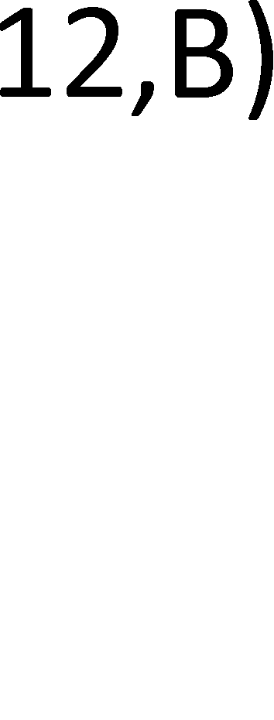
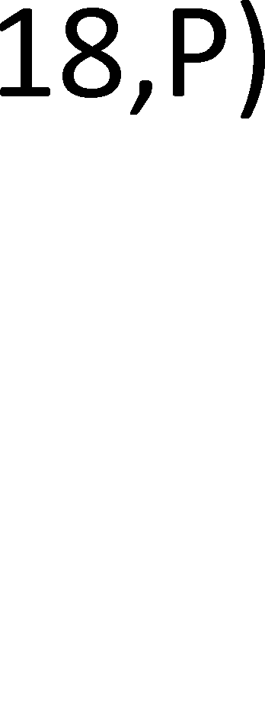
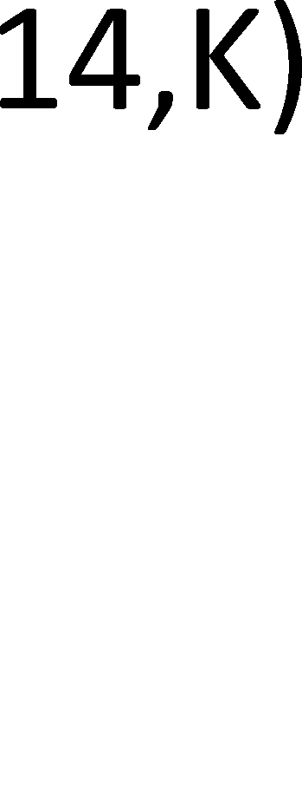
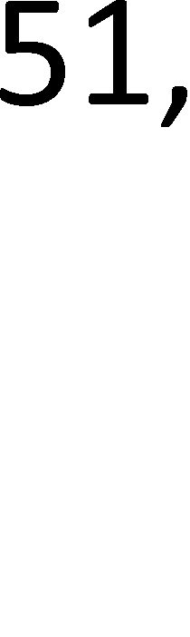

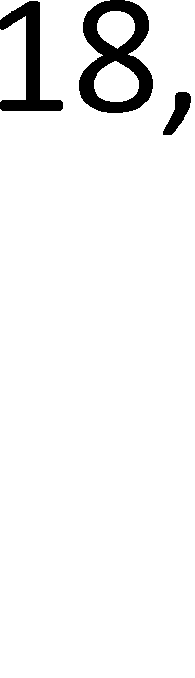



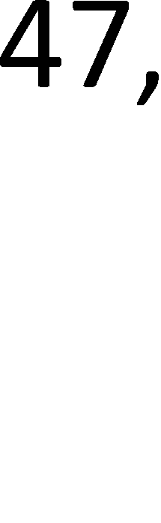

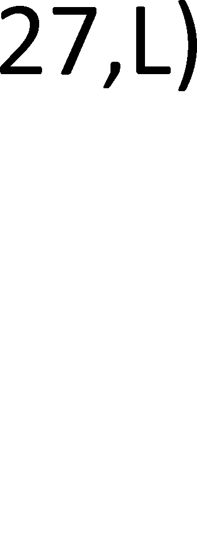
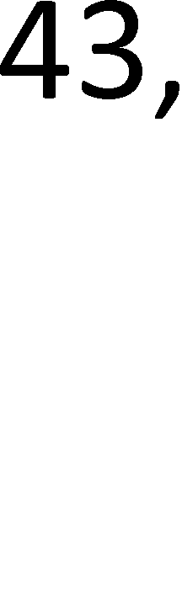



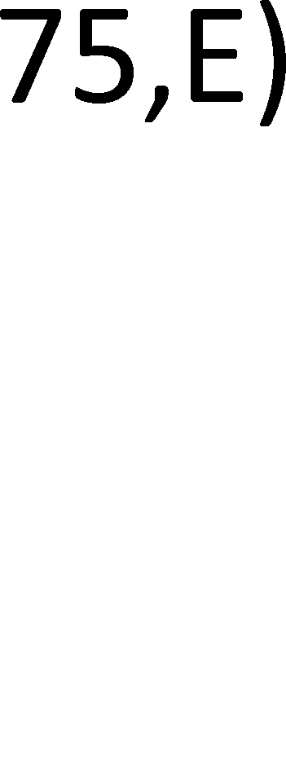
Priority
Queues
Implementing Using a Heap
•
Priority
queue
implemented
using
a heap
example:
•
Height of a heap with n entries is
^{h =} ⎣^{log n}⎦

Slide 15
Priority
Queues
Implementing Using a Heap
•
Adding an
– Step 1:
– Step 2:
entry to a heap
Add new entry at the “end” of the heap
Reorganize the heap (because adding new
entry may violate the heap-order property)
•
Reorganization is done by up-heap bubbling.

Slide 16
Priority
Implementing
Illustration
Queues
Using a Heap
•
New entry (5,U) is added to the
end of the heap.
Since 5 < 61, (5,U) is swapped
with its parent (61,V).
(12,B)
(18,P)
(14,K)
(24,D)
(18,A)
(61,V)
(47,H)
(27,L)
(43,G)
(36,O)
(51,M)
(75,E)
(5,U)

Slide 17
Priority
Implementing
Illustration
Queues
Using
a
Heap
•
Since 5 < 14, (5,U) is swapped
with its parent (14,K).
(18,P)
(12,B)
(14,K)
(24,D)
(18,A)
(5,U)
(47,H)
(27,L)
(43,G)
(36,O)
(51,M)
(75,E)
(61,V)

Slide 18
Priority
Queues
Implementing Using
Illustration
a
Heap
•
Since 5 < 12, (5,U) is swapped
with its parent (12,B).
(18,P)
(12,B)
(5,U)
(24,D)
(18,A)
(14,K)
(47,H)
(27,L)
(43,G)
(36,O)
(51,M)
(75,E)
(61,V)

Slide 19
Priority
Implementing
Illustration
Queues
Using
a
Heap
•
We reached the root. So, stop.
This is the final heap.
(5,U)
(18,P)
(12,B)
(24,D)
(18,A)
(14,K)
(47,H)
(27,L)
(43,G)
(36,O)
(51,M)
(75,E)
(61,V)

Slide 20
Priority
Queues
Implementing Using a Heap
Removing the entry with minimal key
– Step1: Remove the root
– Step 2: Last node is move up to the root and
down-heap bubbling.
•
perform
•
Down-heap bubbling is opposite of up-heap bubbling.

Slide 21
Priority
Queues
Implementing Using a Heap
Illustration
Th e la st entry (75,E) is moved up to
•
Root entry (12,B) is removed.
(12,B)
be the new root.
(18,P)
(32,K)
(24,D)
(18,A)
(61,V)
(47,H)
(27,L)
(43,G)
(36,O)
(51,M)
(75,E)
Left chil d has smal ler key. So, (18,P) is
swapped with (75,E)
(75,E)
(18,P)
(32,K)
(24,D)
(18,A)
61,V
(47,H)
(27,L)
(43,G)
(36,O)
(51,M)

Slide 22
Priority
Implementing
Illustration
Queues
Using a
Heap
•
Rig ht child has s ma ller key. So, (18,A)
is s wapped w ith (75,E)
(18,P)
(75,E)
(32,K)
(24,D)
(18,A)
(61,V)
(47,H)
(27,L)
(43,G)
(36,O)
(51,M)
Left chil d has smal ler key. So, (36,O)
is s wapped w ith (75,E)
(18,A)
(18,P)
(32,K)
(24,D)
(75,E)
(61,V)
(47,H)
(27,L)
(43,G)
(36,O)
(51,M)

Slide 23
Priority
Queues
Implementing Using
Illustration
a
Heap
•
(18,P)
Th is is the final hea p.
(18,A)
(32,K)
(24,D)
(36,O)
(61,V)
(47,H)
(27,L)
(43,G)
(75,E)
(51,M)

Slide 24
Priority
Queues
Array-Based Heap
The level number of a position p, f(p), is defined follow:
•
as
–
–
–
If
If
If
p
p p
is
is is
the
the the
root, f(p) = 0
left child of position q, f(p) = 2*f(q) + 1 right child of position q, f(p) = 2*f(q) + 2
•
The level number is used as the index in an array where
the entry with position p is stored.

Slide 25
Priority
Queues
Array-Based Heap
Then, the entry at position p is stored in
•
A[f(p)].
•
•
•
•
Index
Index Index Index
of
of of of
the root node is 0.
left child of p = 2*f(p) + 1 right child of p = 2*f(p) + 2
parent of p =
⎣^{( f ( p)} − ^{1) / 2}⎦

Slide 26
Priority
Queues
Array-Based
Heap
•
Example
0
(12,B)
1
(18,P)
2
(14,K)
3
(24,D)
4
(18,A)
5
6
(47,H)
(61,V)
7
(27,L)
8
(43,G)
9
(36,O)
10
(51,M)
11
(75,E)
(12,B)
(18,P)
(14,K)
(24,D)
(18,A)
(61,V)
(47,H)
(27,L)
(43,G)
(36,O)
(51,M)
(75,E)
0
1
2
3
4
5
6
7
8
9
10
11

Slide 27
Priority
Queues
Array-Based Heap
HeapPriorityQueue class implements a priority using a heap.
A heap is implemented using ArrayList.
•
queue
•
•
Will briefly discuss upheap, downheap, insert, and
removeMin methods.
•
HeapPriorityQueue.java code

Slide 28
Priority
Queues
Analysis of Heap-Based
insertion:
– upheap method takes O(log n)
– So, insertion takes O(log n)
removeMin:
– downheap method takes O(log n)
– So, removeMin takes O(log n)
Priority
Queue
•
•
Method
Running Time
size, isEmpty
O(1)
min
O(1)
insert
O(log n)
removeMin
O(log n)

Slide 29
Priority
Queues
Bottom-up Heap Construction
Given n elements, we can build a heap with n
successive insertions => takes O(n log n) time.
•
•
O(n) time algorithm
– Begin at the parent of the last node, move backward to the root.
– At each node, perform down-heap bubbling.

Slide 30
Priority
Queues
Bottom-up
Illustration
Heap
Construction
•
14
5
8
25
9
11
17
16
15
4
12
6
7
23
20
0
1
2
3
4
5
6
7
8
9
10
11
12
13
14
0
14
1
2
5
8
3
4
5
6
25
9
11
17
7
8
9
10
12
11
12
13
23
14
20
16
15
4
6
7

Slide 31
Priority
Queues
Bottom-up Heap Construction
Java implementation
•
1
2
3
4
5
6
public HeapPriorityQueue(K[ ] keys, V[ ] values) {
super();
for (int j=0; j < Math.min(keys.length, values.length); j++)
heap.add(new PQEntry<>(keys[j], values[j]));
heapify();
}
7
8
9
10
11
protected void heapify() {
int startIndex = parent(size()-1); // start at PARENT of last
entry
for (int j=startIndex; j >= 0; j--)
downheap(j);
}
// loop until processing the root

Slide 32
Priority
Queues
Java’s Priority Queue
java.util.PriorityQueue
An entry is a single element.
Some operations in Java’s PriorityQueue
•
•
•
–
–
add(E e): Inserts the specified element e to the
priority queue.
isEmpty( ): Returns true if the priority queue contains no
element.
peek( ): Retrieves, but does not remove, a minimal element from the priority queue.
remove( ): Removes a minimal element from the priority queue. size( ): Returns the number of elements in the priority queue.
–
–
–

Slide 33
Priority
Queues
Heap-Sort
Uses array-based heap data structure.
In-place sorting: no additional storage is used.
Uses a maximum-oriented heap.
maximum-oriented heap: In a heap T, for every
•
•
•
•
position
p, except the root, the key stored at p is smaller than or
equal to the key stored at p’s parent.
Sorting steps:
•
1.
2.
Given n elements are inserted into a maximum-oriented heap.
Repeat the following until only one node is left in the heap:
Root is swapped with the last node, heap size is decremented,
perform down-heap bubbling.

Slide 34
Priority
Sorting with
Illustration
Queues
Priority
Queue
•
The maximum‐oriented heap after the first step.
The root node and the last node is swapped. Heap size is decremented.
25
25
14
11
9
5
8
14
11
9
5
8
Down‐heap bubbling is applied on the
root.
8
8
14
11
9
5
25
14
11
9
5
25

Slide 35
Priority
Sorting with
Illustration
Queues
Priority
Queue
•
The root node is swapped with the last
node. Heap size is decremented.
14
14
9
11
8
5
25
9
11
8
5
25
Down‐heap bubbling is applied on the
root.
5
5
9
11
8
14
25
9
11
8
14
25

Slide 36
Priority
Queues
Sorting with Priority
Illustration
Queue
•
The root node is swapped with the last
node. Heap size is decremented.
11
11
9
5
8
14
25
9
5
8
14
25
Down‐heap bubbling is applied on the
root.
8
8
9
5
11
14
25
9
5
11
14
25

Slide 37
Priority
Queues
Sorting
Illustration
with
Priority
Queue
•
The root node is swapped with the last
node. Heap size is decremented.
9
9
8
5
11
14
25
8
5
11
14
25
Down‐heap bubbling is applied on the
root.
5
5
8
9
11
14
25
8
9
11
14
25

Slide 38
Priority
Queues
Sorting
Illustration
with
Priority
Queue
•
The root node is swapped with the last
node. Heap size is decremented.
8
8
5
9
11
14
25
5
9
11
14
25
At this time the array is sorted.
5
5
8
9
11
14
25
8
9
11
14
25

Slide 39
Priority
Queues
Adaptable Priority Queue
•
•
•
Can
Can
Can
remove
replace replace
arbitrary entry (not just the root).
the key of an entry. the value of an entry.
•
Uses location-aware entities to find an entry in
queue efficiently.
a priority
•
Location-aware entry keeps one more field, current index
of the entry in an array-based heap.

Slide 40
Priority
Queues
Adaptable Priority
of removeMin
Queue
•
Illustration
(5,K,0)
(14,R,1)
(8,D,2)
(29,S,3)
(15,B,4)
(13,E,5)
5
deleted
14
moved up
8
29
15
13
(13,E,0)
(14,R,1)
(8,D,2)
(29,S,3)
(15,B,4)
down‐heap bubble
13
14
8
29
15

Slide 41
Priority
Queues
Adaptable Priority
Queue
•
Illustration
of
removeMin
(8,D,0)
(14,R,1)
(13,E,2)
(29,S,3)
(15,B,4)
8
14
13
29
15

Slide 42
Priority
Queues
HeapAdaptablePriorityQueue
Extends HeapPriorityQueue class. An entry in the queue
Class
•
•
1
2
3
4
5
6
7
8
9
protected static class AdaptablePQEntry<K,V> extends PQEntry<K,V>
{
private int index;
// entry's current index within the heap
public AdaptablePQEntry(K key, V value, int j) {
super(key, value);
index = j;
// this sets the key and value
// this sets the new field
}
public int getIndex() { return index; }
public void setIndex(int j) { index = j; }
}

Slide 43
Priority
Queues
HeapAdaptablePriorityQueue Class
HeapAdaptablePriorityQueue.java code.
•

Slide 44
References
M.T. Goodrich, R. Tamassia, and M.H. Goldwasser, “Data Structures and Algorithms in Java,” Sixth Edition, Wiley, 2014.
•

