Slide 1
CSCI 3280
Introduction to Multimedia Systems
Tutorial 1 - ASCII Art
(updated Jan 27, 2016)

Slide 2
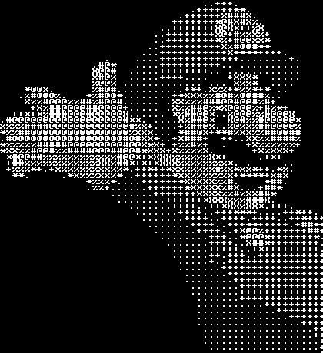
Tone-based ASCII Art

Slide 3
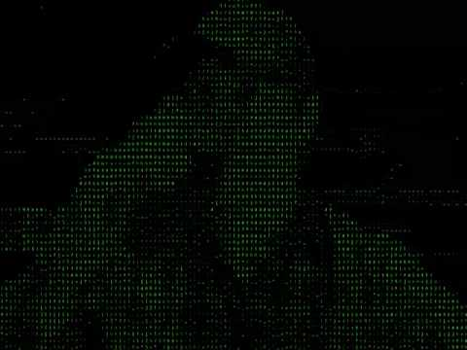
Tone-based ASCII Art Video

Slide 4
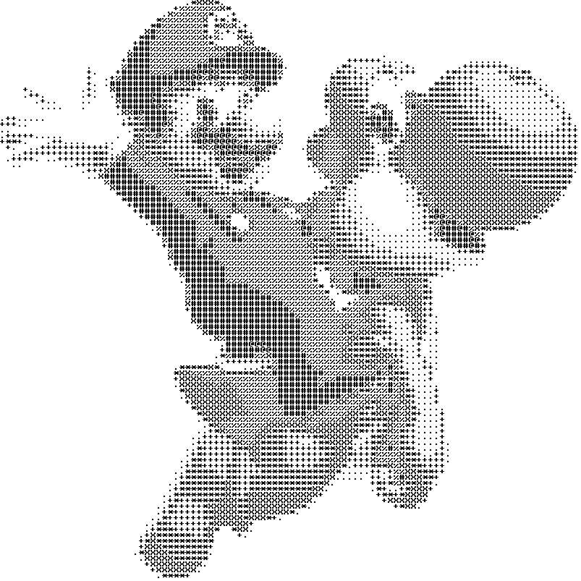
Tone-based ASCII Art on paper

Slide 5
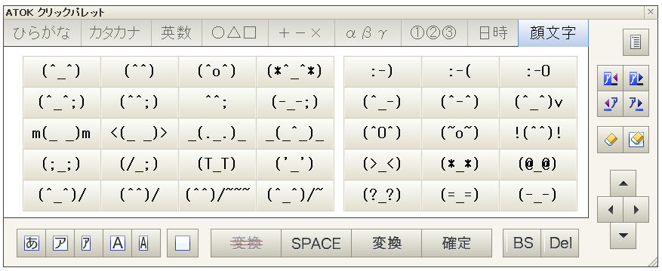
Structure-based ASCII Art

Slide 6
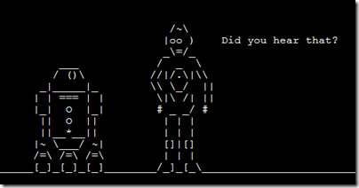
Structure-based ASCII Art

Slide 7
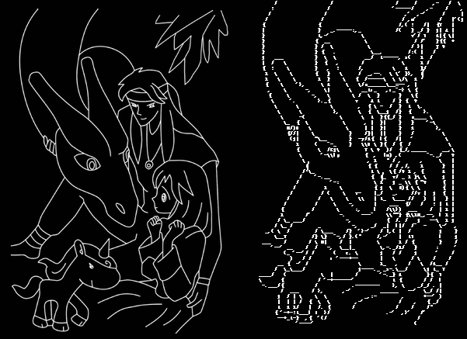
Structure-based ASCII Art
http://www.cse.cuhk.edu.hk/~ttwong/papers/asciiart/asciiart.html

Slide 8
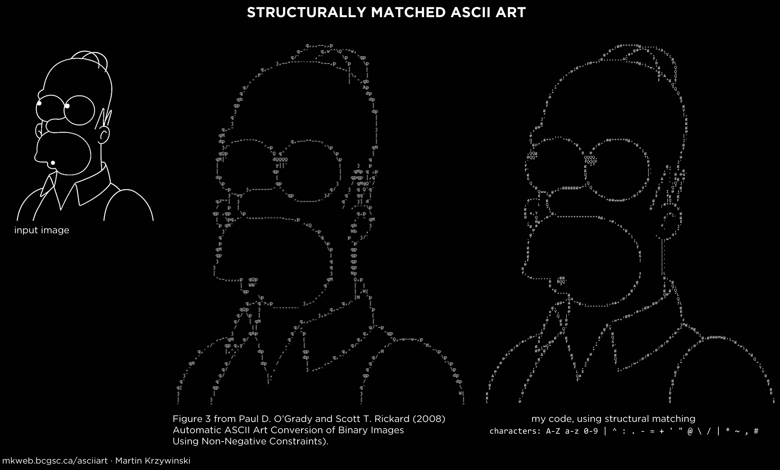
Structure-based ASCII Art
http://mkweb.bcgsc.ca/asciiart

Slide 9

Proportional-spaced ASCII Art
http://mkweb.bcgsc.ca/asciiart

Slide 10
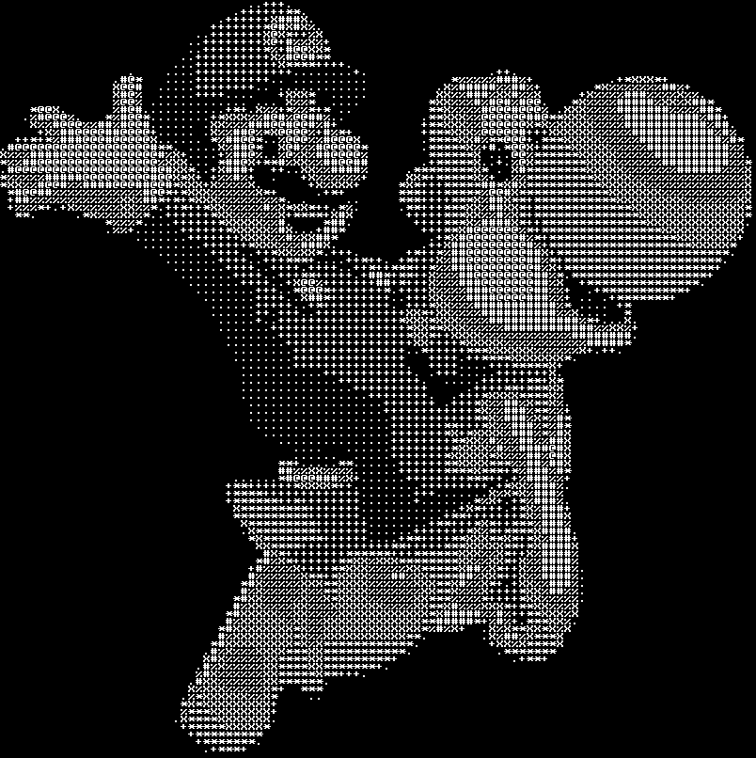

Asg. 1 part 1 - Inverse ASCII Art

Slide 11
Asg. 1 part 1 - Inverse ASCII Art
int main( int argc, char** argv)
{
char shades[MAX_SHADES] = {' ', '.', '+', '*', 'X', '%', '#', '@'};
int w, h;
// Open ASCII Art file ( command line: argv[1] )
//
FILE *fin = fopen( argv[1], "r" );
fscanf( fin, "%d %d", &w, &h );
// Create a Bitmap object accordingly
Bitmap myBmp(w, h);
// Bitmap.setColor(x,y,R,G,B) sets color of pixel at (x,y)
// Use fgetc() to read text char from .txt file
//
// Your code goes here ...
// Save Bitmap file ( command line: argv[2] )
myBmp.save( argv[2] );
fclose(fin);
return 0;
}

Slide 12

Asg. 1 part 2 - ASCII Art Generation
ASCII art

Slide 13
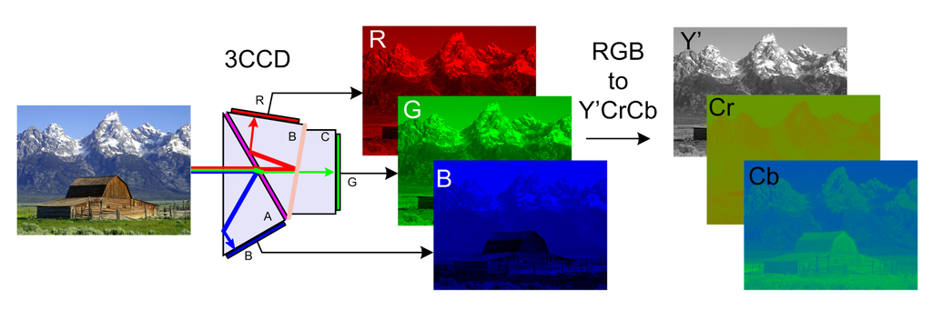
Obtain Luma (Brightness) from RGB
Based on CCIR. 601
Y’ = 0.299 * R + 0.587 * G + 0.114 * B
Y’ is a component of a color-space
named Y’CbCr where Cb = B - Y, Cr = R - Y
http://en.wikipedia.org/wiki/YCbCr

Slide 14

Quantization

Slide 15
The Rest is Simple
Please READ
Assignment 01 Document
(available on both CSE course page and eLearn)
Due Date : Feb 16, 2016 (23:59)

Slide 16
Heard of ….
MPEG-2, AVCHD, H264?
YUV? 4:2:2? 4:4:4?
10-bit, 8-bit video
http://en.wikipedia.org/wiki/YCbCr

