Slide 1
CSCI 3280
Introduction to Multimedia Systems
Tutorial 2
Bitmap file format
and
Basic image resampling
( updated Feb 2, 2016 )

Slide 2
Bitmap internals
R
G
a given bitmap
B

Slide 3
Bitmap File Format Header
Items | Example
image size | 100, 100
color channel bit-depth | 8 (unsigned char)
row order | top -> bottom
column order | left -> right
pixel format | BGR, RGB or RGBA
color table | varies
data offset (bytes) | 200
compression | RLE, ZIP
R
G
B
Example BMP intro : http://www.fileformat.info/format/bmp/egff.htm

Slide 4

Basic Image Resampling

Slide 5

Basic Image Resampling
To summarize information of N pixels into 1

Slide 6

Basic Image Resampling
To summarize information of N pixels into 1

Slide 7
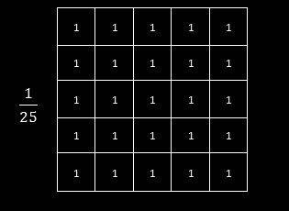

Basic Image Resampling
Box Filter
To summarize information of N pixels into 1
Kernel diagrams from OpenCV tutorial

Slide 8
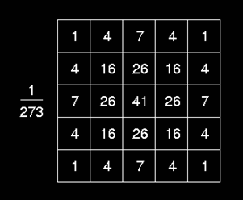
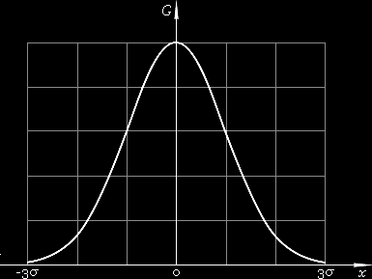
Basic Image Resampling
Gaussian Filter
To summarize information of N pixels into 1
Kernel diagrams from OpenCV tutorial

Slide 9
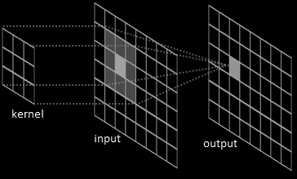
Image Filtering
Gaussian Kernel
Image from OpenCV tutorial and River Trail Documentation

Slide 10
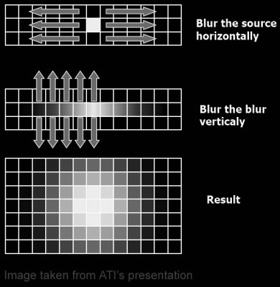
Implementations
Separable into 1 Horizontal and 1 vertical pass
Image from ATI presentation

Slide 11
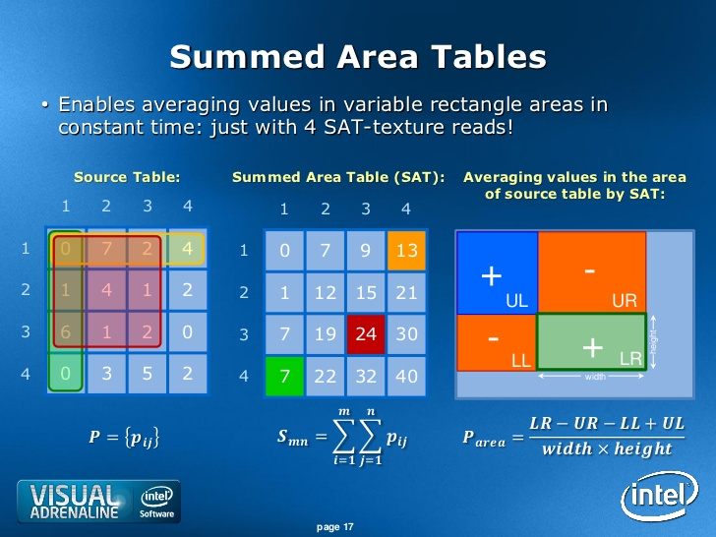
Implementations
Fastest variable-size Box Filtering
Image from Intel presentation

Slide 12
Useful resources
Graphics Gems III
Ch. 2 General Filtered Image Rescaling
by Dale Schumacher
http://tog.acm.org/resources/GraphicsGems/gemsiii/filter.c
Summed Area Table (Integral image)
http://www.shaderwrangler.com/publications/sat/SAT_EG2005.pdf
Stack Blur (Fast Triangular Blur)
http://www.quasimondo.com/StackBlurForCanvas/StackBlurDemo.html

