Slide 1
Analysis Of Spotify Audio Features For Classification of Song Genre
By: Philip Franco

Slide 2
Overview
Dataset
Principal Component Analysis
Factor Analysis
Cluster Analysis
Discriminate Analysis
Neural Network
Notes:
These are the topics I will be going over!

Slide 3
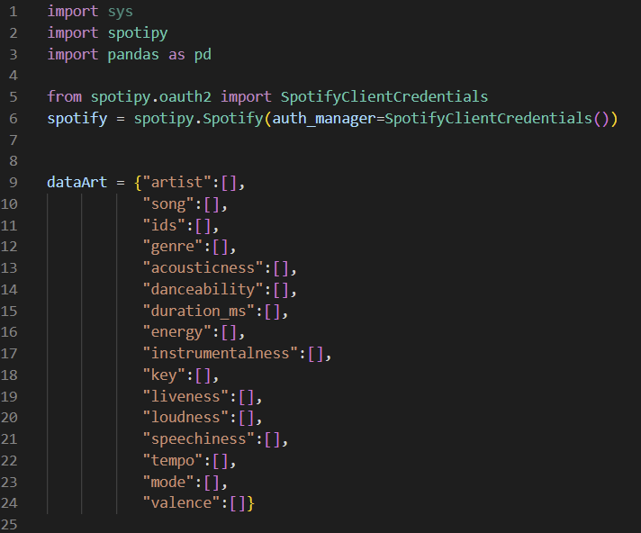
Dataset
Generated the Dataset using Spotipy
Spotify API for Python
Grabbed 250 songs
Rock
EDM
Country
Rap
Classical
Notes:
Rock: The Killers Mr. Brightside
Rap: Post Malone Cooped Up (with Roddy Ricch)
Country: Rascal Flatts Life is a Highway
Classical: Ludwig van Beethoven Piano Sonata No. 20 In G Major, Op. 49, No. 2: 2. Tempo di Menuetto
EDM: Avicii The Nights

Slide 4
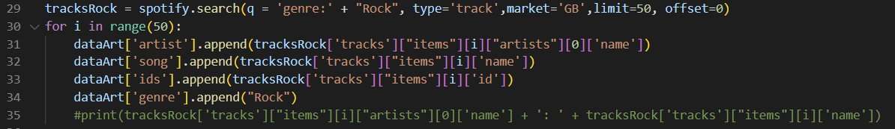
Code
Notes:
This is the code that I wrote to obtain the rock songs. Line 29 grabs the data, and then I place the information I care about into a pandas dataframe. I did this for all genres of music that I care about.

Slide 5
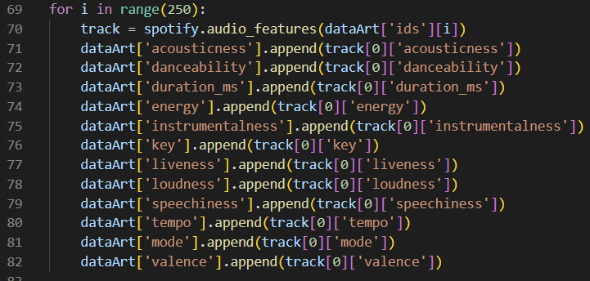
Code
Notes:
Once my dataframe had all the artists and songs, I used spotifies audio features function to grab data for each of the songs. I then saved it into a dataframe and exported it as a csv.

Slide 6
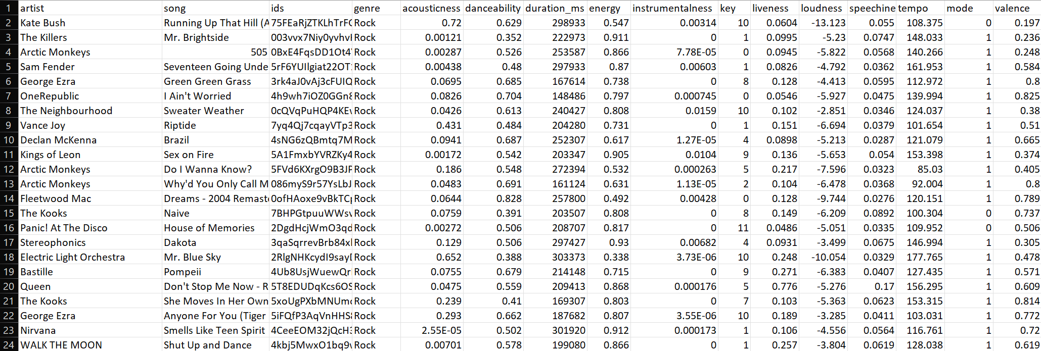
Final Dataset
Notes:
This is the first 24 songs in the generated dataset.

Slide 7
Dataset Definitions
12 Columns of data
Acousticness – Measures how acoustic a song is from a scale of 0-1.
Danceability – Takes tempo, rhythm stability, and beat strength into account to determine how suitable a track is for dancing. The scale is 0-1.
Duration_ms – The length of the song in milliseconds.
Energy – Songs that are high in energy have a fast tempo, are loud, and have good dynamic range. The scale is 0-1.
Instrumentalness – Predicts if there are no vocals in a song. Scale is 0-1, where values above 0.5 are intended to represent instrumental tracks.
Key – The key the track is in, and the scale maps to the pitch being used from -1-11. If no key was detected, -1 was used.
Liveness – Predicts if the track was played in front of an audience in the recording. Scale is 0-1 where 0.8 describes a high likelihood that there was an audience.
Loudness – This is measured in decibels.
Mode – Indicates modality of the track, or whether is in major, 1, or minor, 0.
Speechiness – Detects if there are spoken words in a song, where the higher values would be a speech only recording such as a podcast. Most songs with music and speech will fall between 0.3 and 0.6, and songs with no lyrics will fall below 0.3.
Tempo – This is an estimate of beats per minute of a song.
Valence - Predicts the sentiment of the song.
Notes:
These are the audio features that spotify has to offer. They have their own algorithms they use to determine the values given on each song for each audio feature. Most of them are self explanatory, so I will only go over a few of them. Instrumentalness, speechiness, valence

Slide 8
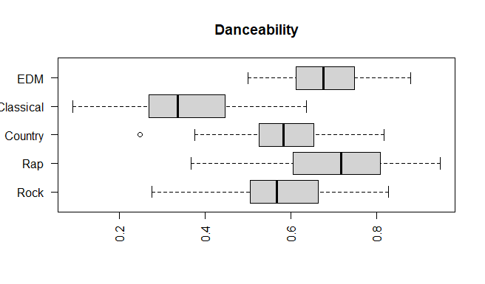
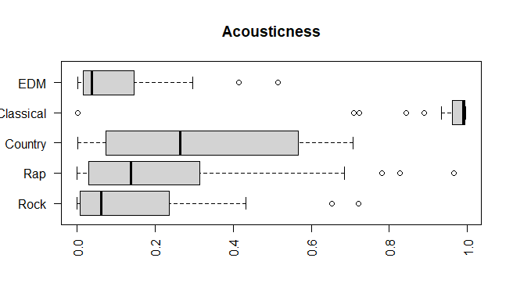
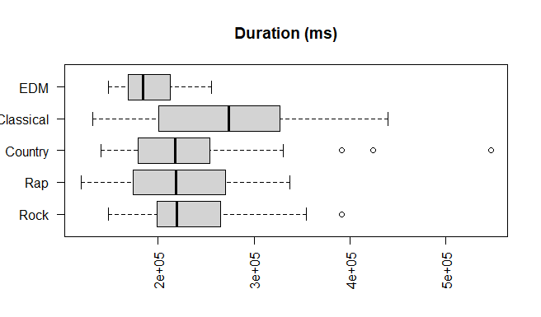
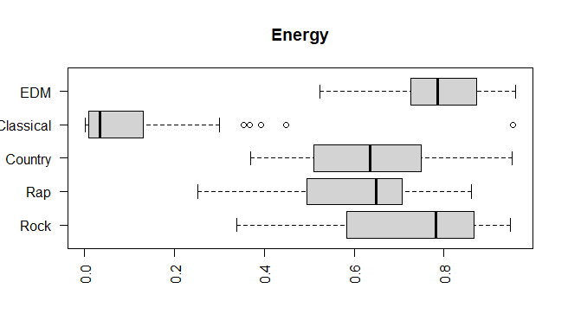
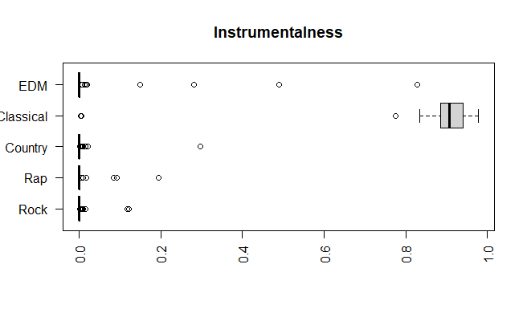
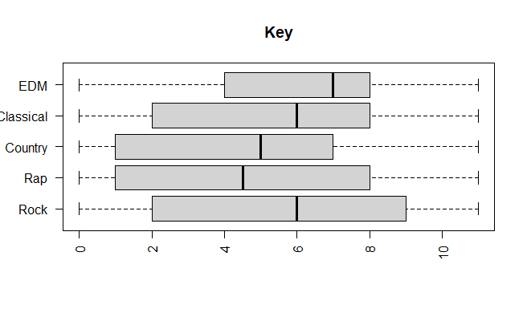
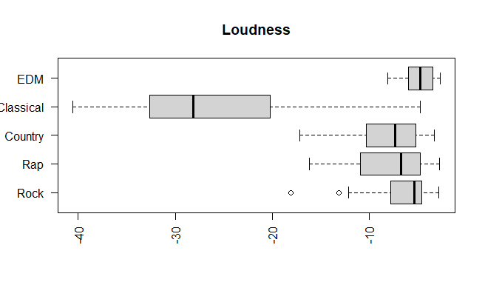
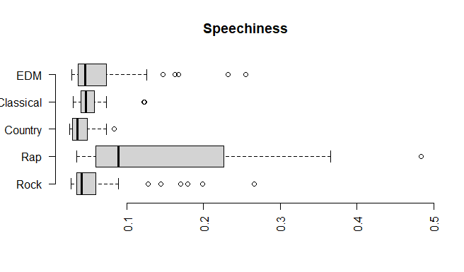
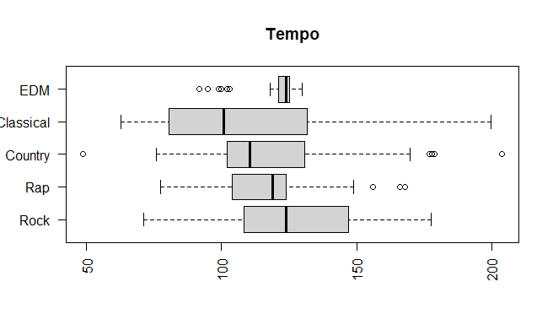
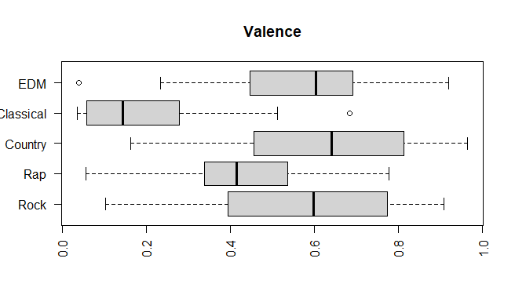
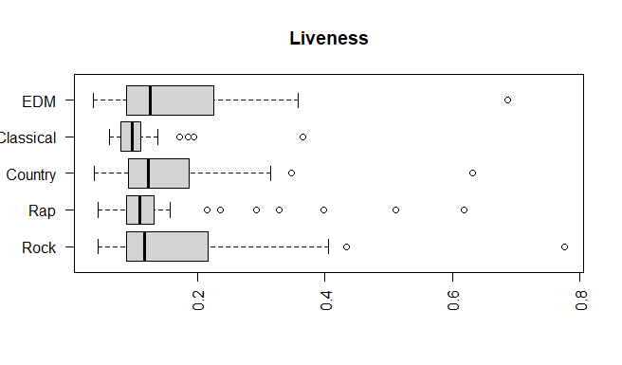
Dataset Box Plots
Notes:
It is good to look at the data. I did not plot mode, because those values are only 0 or 1. Collectively looking at these plots, it becomes apparent that Classical music is the odd one out. It has low danceability, energy, and valence, but has high instrumentalness and acousticness. Other things to note is that rap music has high speechiness. EDM has high values per song for loudness. Rock and country are very similar.

Slide 9
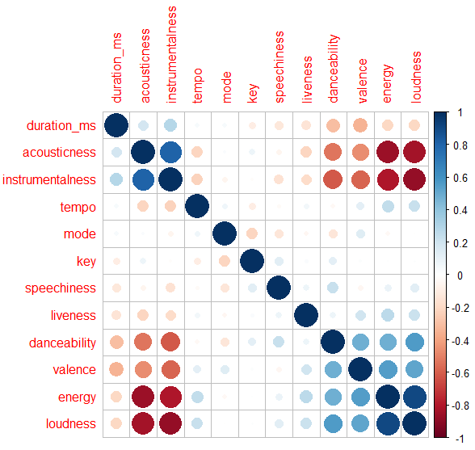
Dataset Correlation Plot
Notes:
Looking at the data, you can see the energy and loudness have a high positive correlation with each other, while having negative correlation with acousticness and instrumentalness. Acousticness and Instrumentalness also have negative correlation with danceability and valence while having a positive correlation with each other.

Slide 10
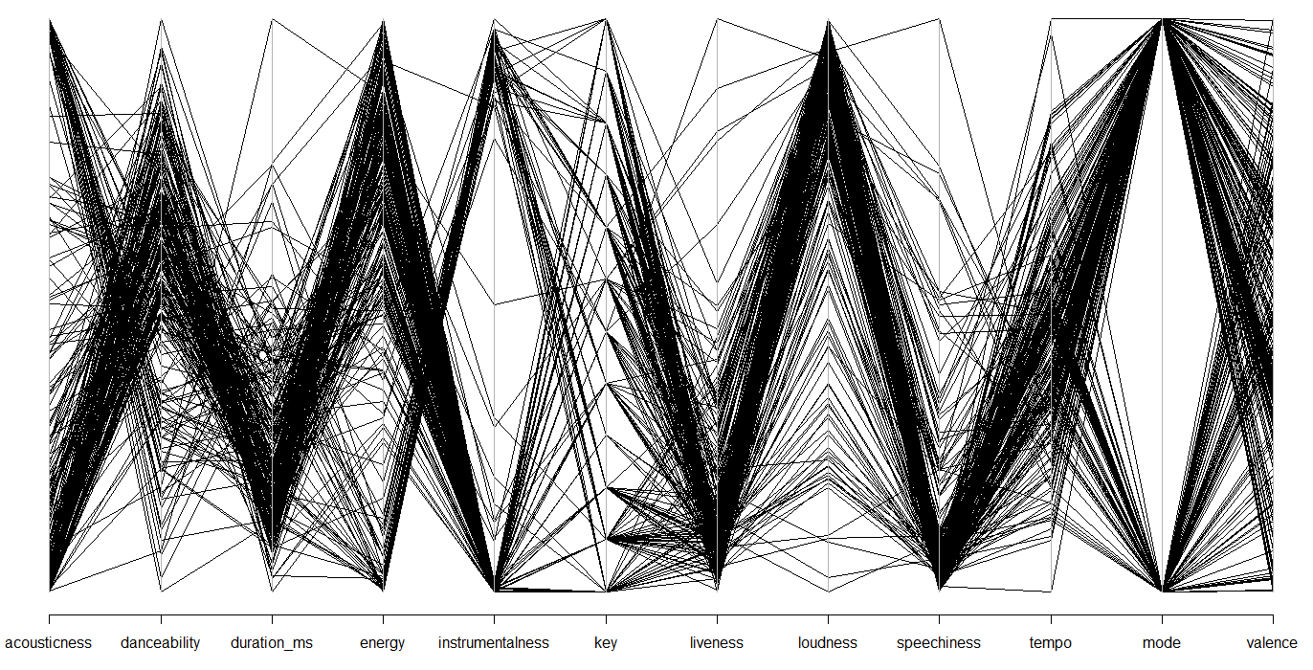
Dataset Chord Plot
Notes:
Here is the Chord plot for the data set. Some trends we can see is that there is a large variance in the intrumentalness feature due to classical music. In this data set, most songs seem to have high energy and loudness, but low danceablility and liveness. The key, mode, and valence appear to be evenly distributed.

Slide 11
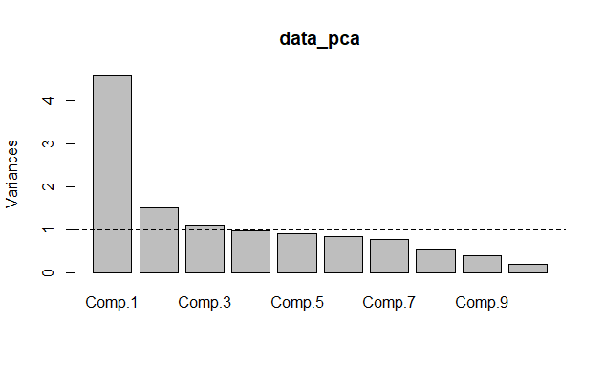
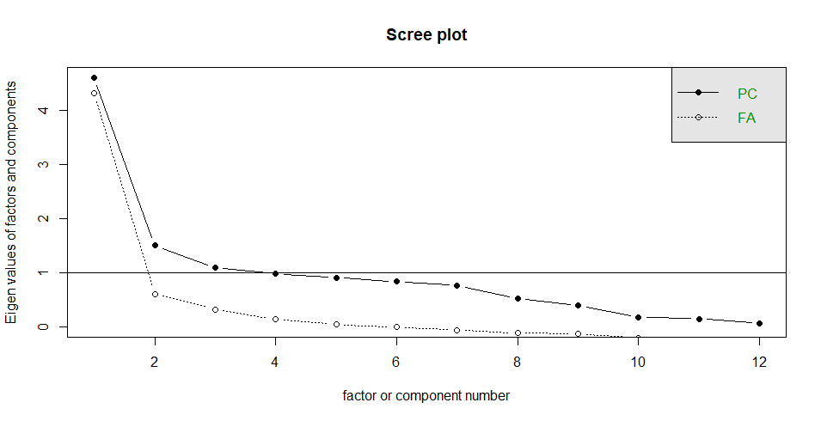
Principal Component Analysis
Notes:
When performing Principal Component Analysis, there are only 3 components with a standard deviation about 1. In the scree plot, you can kind of see an elbow appear at 3 Principal components, and another one again at 8.

Slide 12
Principal Component Analysis
 | Comp.1 | Comp.2 | Comp.3 | Comp.4 | Comp.5 | Comp.6 | Comp.7
Standard Deviation | 2.145 | 1.2247 | 1.0472 | 0.9908 | 0.9519 | 0.9157 | 0.8768
Proportion of Variance | 0.3836 | 0.1250 | 0.0913 | 0.08180 | 0.07551 | 0.06988 | 0.06407
Cumulative Proportion | 0.3836 | 0.5086 | 0.6000 | 0.6818 | 0.7573 | 0.8272 | 0.8913
Notes:
At Prinicpal Component 6, the cumulative proportion is 82!

Slide 13
Principal Component Analysis
 | Acou | Danc | Dur | Ener | Instr | Key | Live | Loud | Spch | Tem | Mod | Val
CP1 | 0.41 | -.235 | 0.17 | -.426 | 0.43 |  | -.139 | -.432 |  | -.114 |  | -.323
CP2 | 0.11 | 0.27 | -.284 |  |  | 0.51 |  |  | 0.43 | -.363 | -.487
CP3 | 0.14 | 0.14 | -.53 | -.152 |  |  |  | -.134 | -.253 | -.453 | 0.45 | 0.39
Notes:
In the above table you can see the first three components that cover approximately 60% of the data. Component 1 appears to represent the Classical genre, because the Acousticness is higher, the Energy is lower, and the Valence is lower. Component 2 appears to be influenced by songs that have high Speechiness. Component 3 appears to look at songs that are shorter and have a lower tempo.

Slide 14
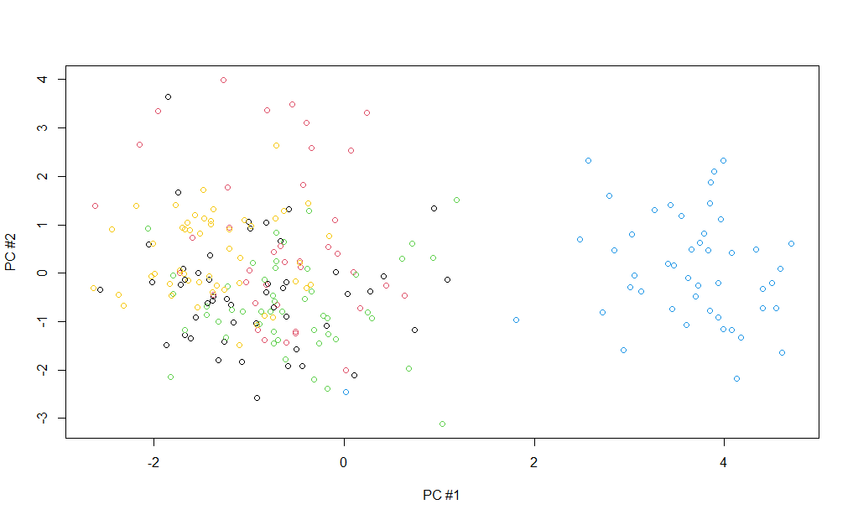
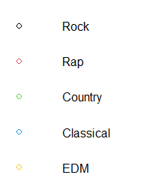
Principal Component Analysis
Notes:
When plotting the first and second component, you can see how the Classical Genre is off towards the right of the plot. Rap music appears to be more focused towards the top left of the graph. EDM is focused on the middle left of the graph. The Rock and Country genres are blended towards the left/bottom of the graph.

Slide 15
Factor Analysis
 | K=4 | K=5 | K=6 | K=7
P-Value | 0.02042 | 0.30594 | 0.83735 | NA
TLI | 0.97 | 0.994 | 1.020 | 1.024
RMSE | 0.052 | 0.024 | 0 | 0
 | Acou | Danc | Dur | Ener | Instr | Key | Live | Loud | Spch | Tem | Mod | Val
FA1 | -.846 | 0.35 | -.108 | 0.97 | -.722 |  | 0.25 | 0.86 |  | 0.27 |  | 0.38
FA2 | -.212 | 0.54 | -.390 | .23 | -.425 | 0.11 | 0.10 | 0.29 |  |  |  | 0.88
FA3 |  | 0.3 | -.128 |  |  | 0.33 |  |  | 0.33 | -.262 | -.491 | -.194
FA4 |  | 0.3 |  |  | -.44 |  |  | 0.28 | 0.27 |  |  | -.16
FA5 | 0.47 | -.26 |  |  | 0.13 | 0.11
Notes:
Factor Analysis is a model that looks at the measurements of the latent variables. When testing different values for K, we check the P-values. At K=5, the P-Value is first greater than 0.05 meaning the probability that the null hypothesis is true. The TLI value is greater than 0.95, and the RMSE value is lower than 0.05. K=5 is the best fit for this set of data, which makes a lot of sense when considering there are 5 categories for the dataset. Below is a table showing the 5 factors, with a data cut off of 0.25 to remove negligible values.
Factor 1 shows a very low acousticness, but a high amount of energy and loudness. This seems to be pulling out songs that are in the EDM genre. Factor 2 looks at songs that have high valence and danceability so songs that are positive and up-beat. I am not sure what Factors 3 and 4 represent. Factor 5 has high acousticness, so it could represent songs of the classical genre.

Slide 16
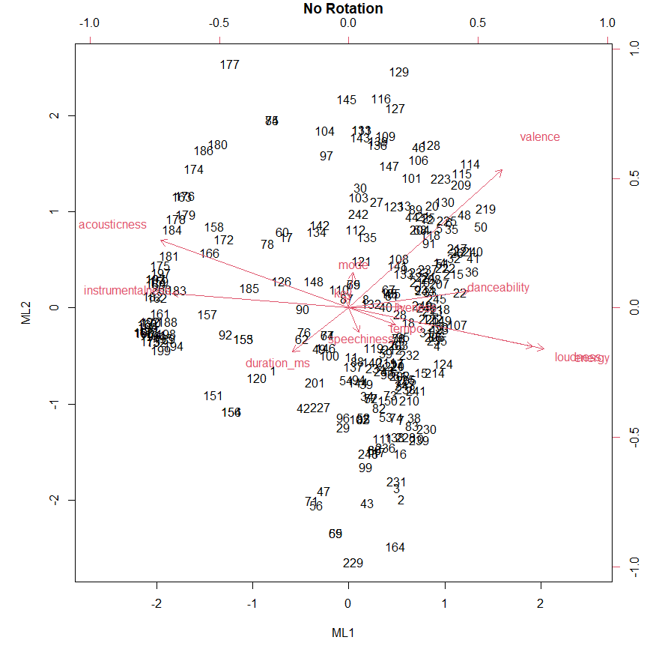
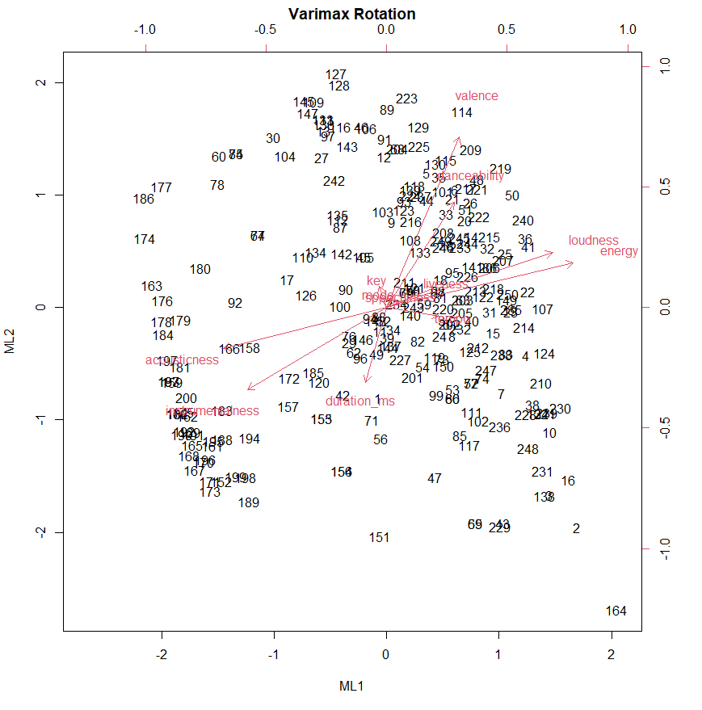
Factor Analysis
Notes:
A varimax rotation was used for this data set, and by using this type of rotation the variance was increased in the data. Looking at the charts below, the loudness and energy are right on top of the same axis before the rotation. After the rotation, they are adjusted along with many of the other variables.

Slide 17
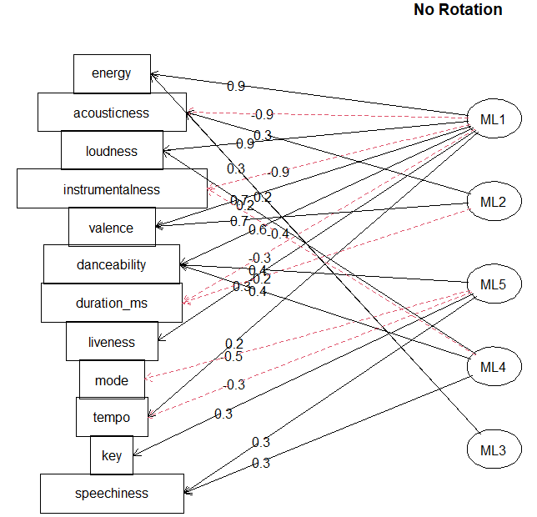
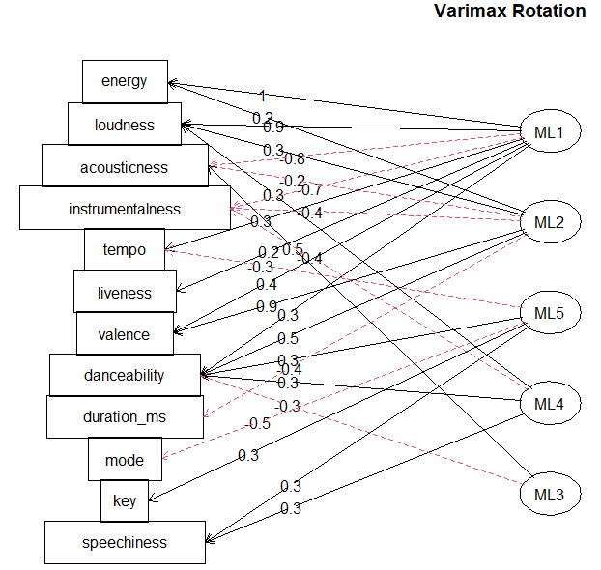
Factor Analysis
Notes:
The graphs below show how the loadings changed form each variable when comparing the factor analysis using varimax rotation and not using varimax rotation. The rotation was a success by drastrically increasing the variance in the dataset when providing factor analysis.

Slide 18
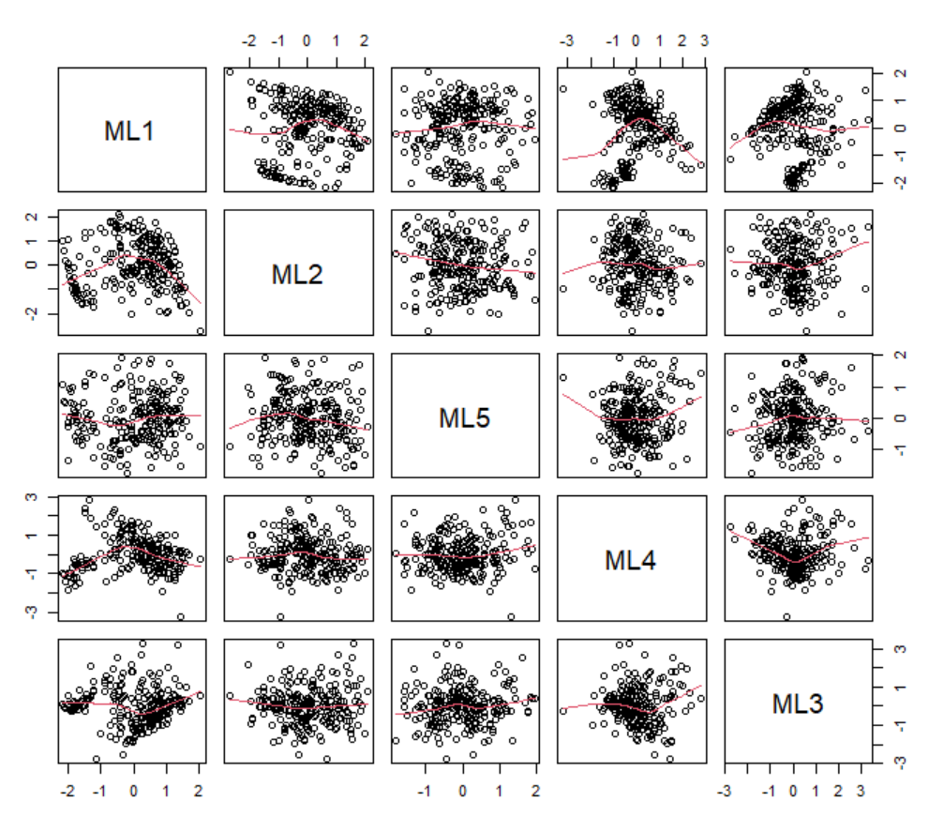
Factor Analysis
Notes:
This pairs plot can show the relationship between each component of the factor analysis.

Slide 19
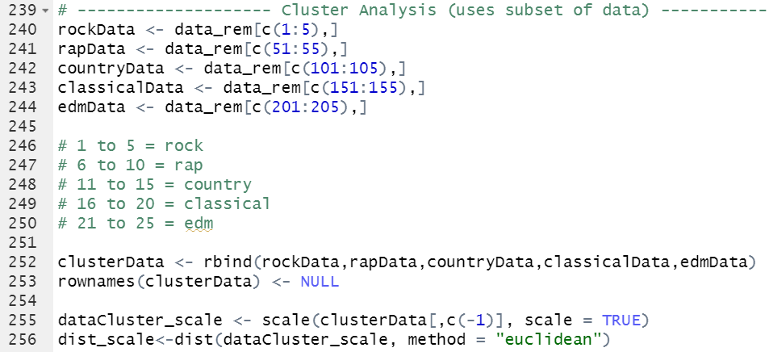
Cluster Analysis
Notes:
Cluster analysis used a subset of data due to the size of the initial dataset. This helps make the plots legible. This did not change the outcome of the analysis.

Slide 20
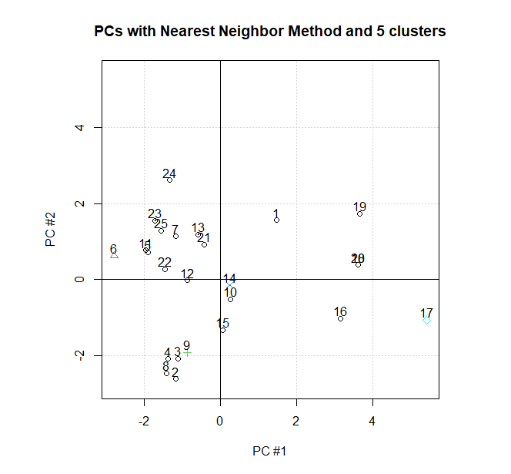
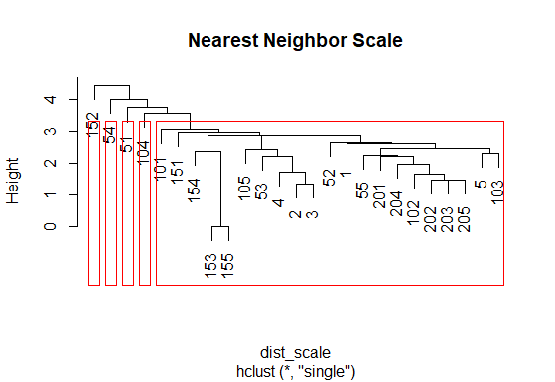
Cluster Analysis
Notes:
Nearest Neighbor performed poorly..

Slide 21
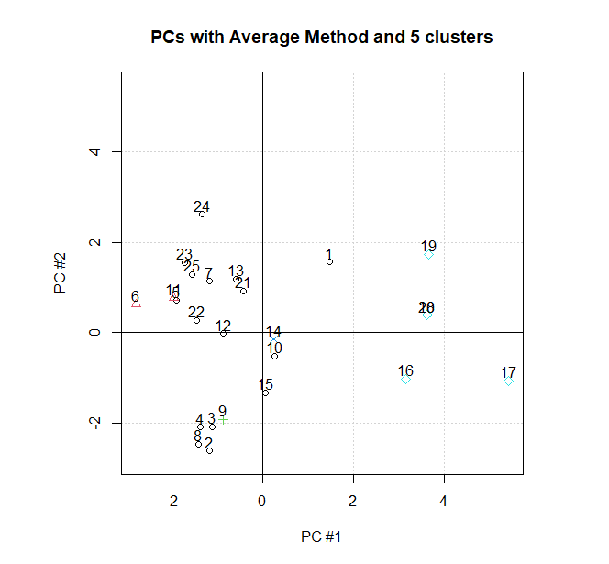
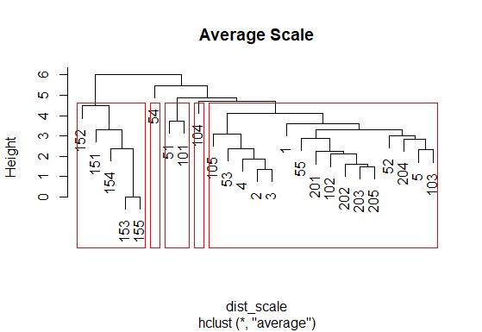
Cluster Analysis
Notes:
Average scale performed alright, able to at least separate the classical music from the group.

Slide 22
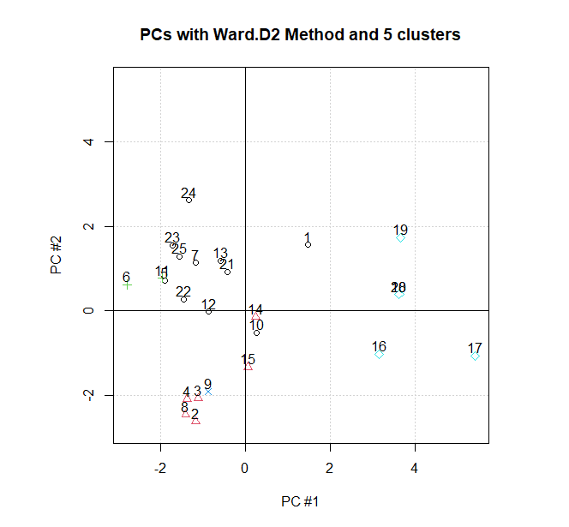
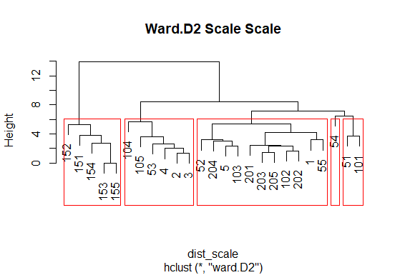
Cluster Analysis
Notes:
Ward D2 performed better than average scale, also being able to separate the classical music from the group.

Slide 23

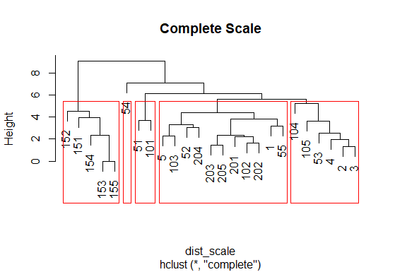
Cluster Analysis
Notes:
Complete scale performed the same as ward 2d

Slide 24
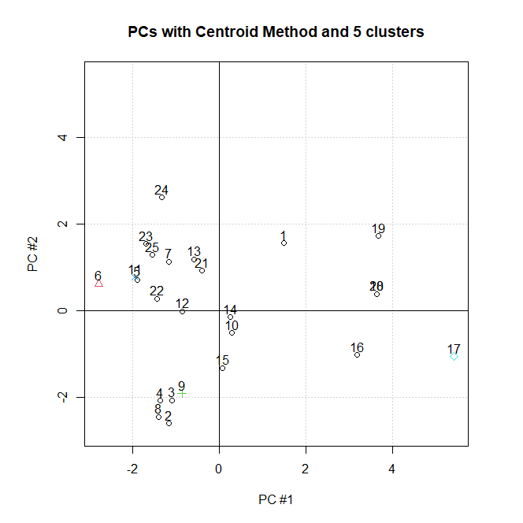
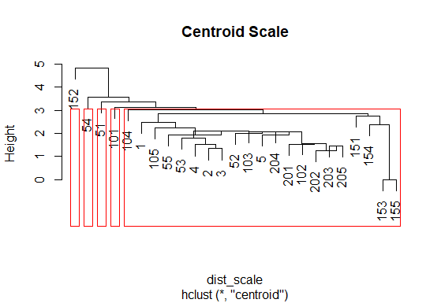
Cluster Analysis
Notes:
Centroid scaler performed poorly.

Slide 25
Linear Discriminate Analysis
 | Classical | Country | EDM | Rap | Rock
Classical | 48 | 1 | 0 | 0 | 1
Country | 0 | 32 | 5 | 1 | 12
EDM | 1 | 2 | 31 | 9 | 7
Rap | 0 | 7 | 7 | 31 | 5
Rock | 0 | 14 | 9 | 3 | 24
 | Classical | Country | EDM | Rap | Rock
Classical | 96% | 2% | 0% | 0% | 2%
Country | 0% | 64% | 10% | 2% | 24%
EDM | 2% | 4% | 62% | 18% | 14%
Rap | 0% | 14% | 14% | 62% | 10%
Rock | 0% | 28% | 18% | 6% | 48%
Overall: 66.4 %
Notes:
Linear Discriminate Analysis shows that we can classify a song correctly 66% of the time. Classical music was the easiest to classify, giving a 96% success rate. Rock was the most difficult to classify due to rock songs being similar to not only country songs, but similar to EDM and rap. Although country songs are classified properly the 2nd highest of all genres, they still get confused for Rock about a quarter of the time.

Slide 26
Quadratic Discriminate Analysis
 | Classical | Country | EDM | Rap | Rock
Classical | 48 | 1 | 0 | 0 | 1
Country | 1 | 31 | 1 | 3 | 14
EDM | 1 | 1 | 28 | 7 | 13
Rap | 0 | 3 | 7 | 29 | 11
Rock | 0 | 17 | 6 | 5 | 22
 | Classical | Country | EDM | Rap | Rock
Classical | 96% | 2% | 0% | 0% | 2%
Country | 2% | 62% | 2% | 6% | 28%
EDM | 2% | 2% | 56% | 14% | 26%
Rap | 0% | 6% | 14% | 58% | 22%
Rock | 0% | 34% | 12% | 10% | 44%
Overall: 63.2 %
Notes:
The quadratic discriminate analysis performed worse than the linear discriminate analysis, only being successful 63.2% of the time. The results were very similar to linear discriminate analysis, where Classical music was the easiest genre to classify and rock was the worst

Slide 27
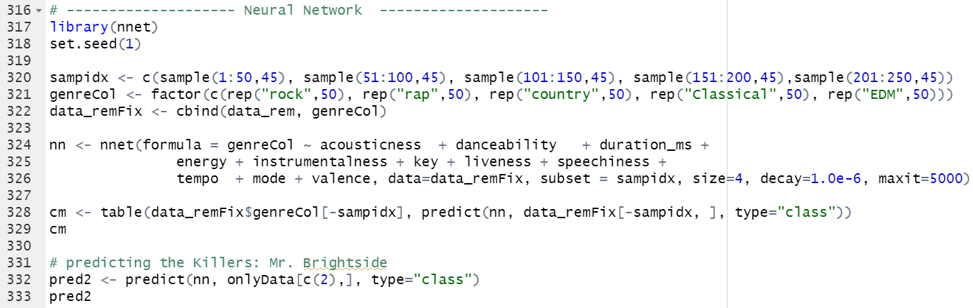
Neural Network
Notes:
I attempted to use a neural network to classify the data, but was unsuccessful. I tried a few sizes, decay, and max iteration values to try to get it to produce good results. None of the results were consistent, and all appeared to be random when looking at the confusion matrix. I took 45 songs from each genre to train the neural net, and then used 5 songs from each genre to test. This was overall unsuccessful

Slide 28
Conclusion
Dataset
Principal Component Analysis
Factor Analysis
Cluster Analysis
Discriminate Analysis
Neural Network
Notes:
Overall I was successful in analyzing this data set to learn more about it and R. I scraped my own data using the spotipy API and performed a handful of multivariate statistics analysis methods. It was interesting going into the analytics knowing there were 5 categories for the data, and then seeing each type of analysis try to find the 5 categories. Factor Analysis was the most convincing that there were 5 different categories in the data set. The Discriminate Analysis further confirmed that the songs could successfully be classified based off the audio features more frequently than not.

