Slide 1
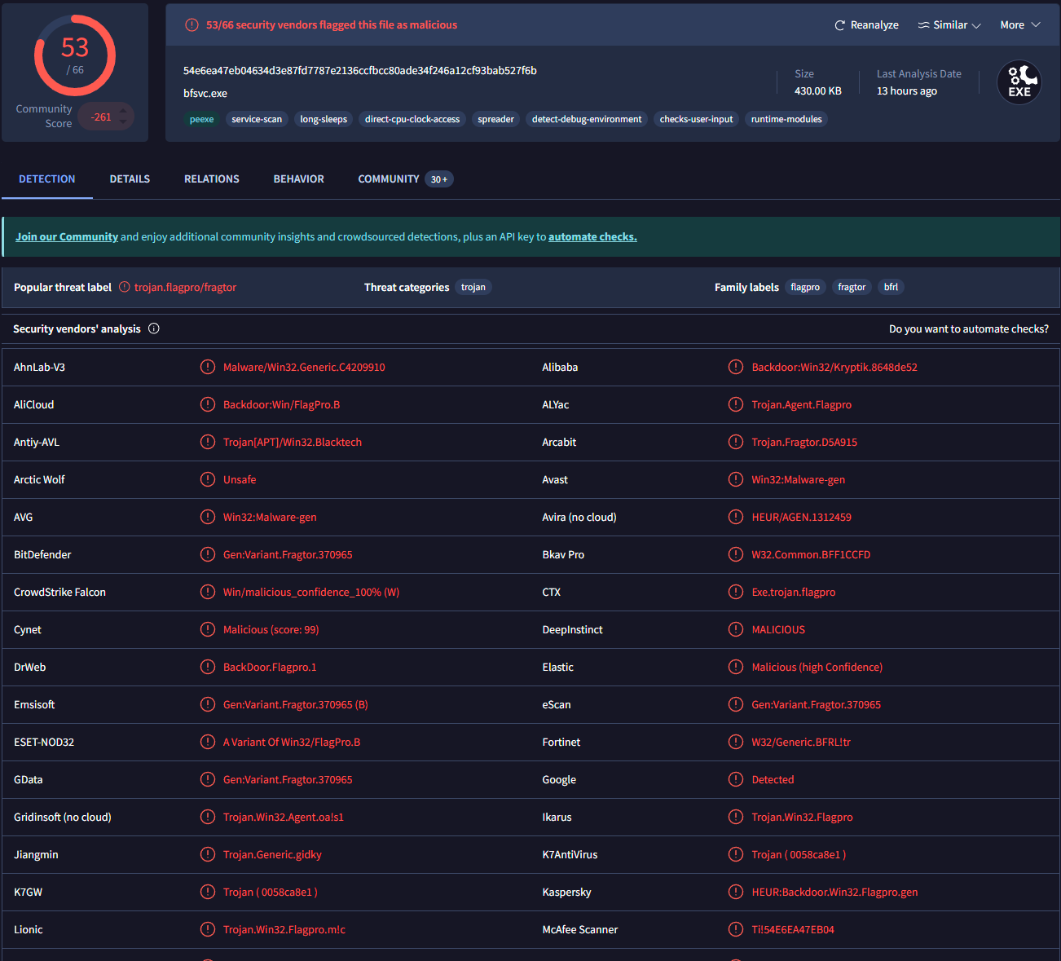
Has this file been identified as malicious? Explain why or why not.
Yes!
Multiple security vendors have flagged this as malicious:

Slide 2
TTPs
Tools
Win32 Flag Pro – Command and Control
Network/host artifacts
Domain names
IP addresses
See next slide
Hash values
8f35a9e70dbec8f1904991773f394cd4f9a07f5e

Slide 3
IP Addresses
104.115.151.81
104.117.234.151
104.125.90.151
104.86.229.106
104.86.245.126
108.160.170.33
108.177.11.94
108.177.112.104
108.177.119.100
108.177.119.101

Slide 4
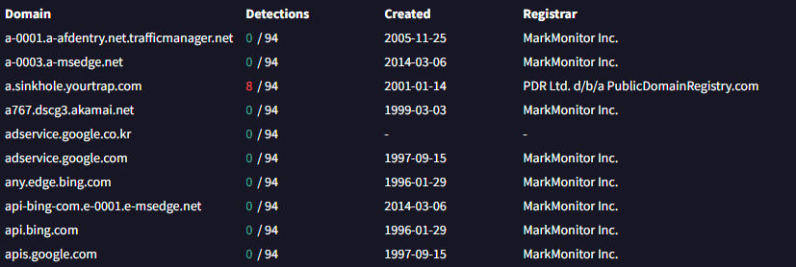
Domain Names

Slide 5
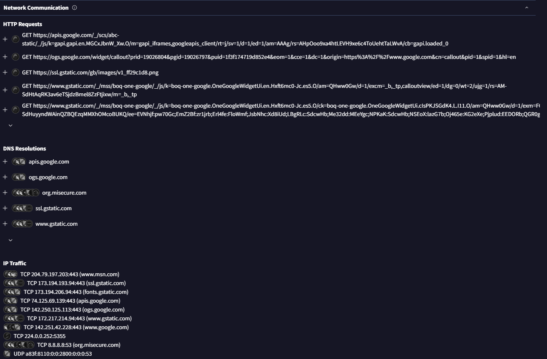
Network/Host Artifacts

Slide 6
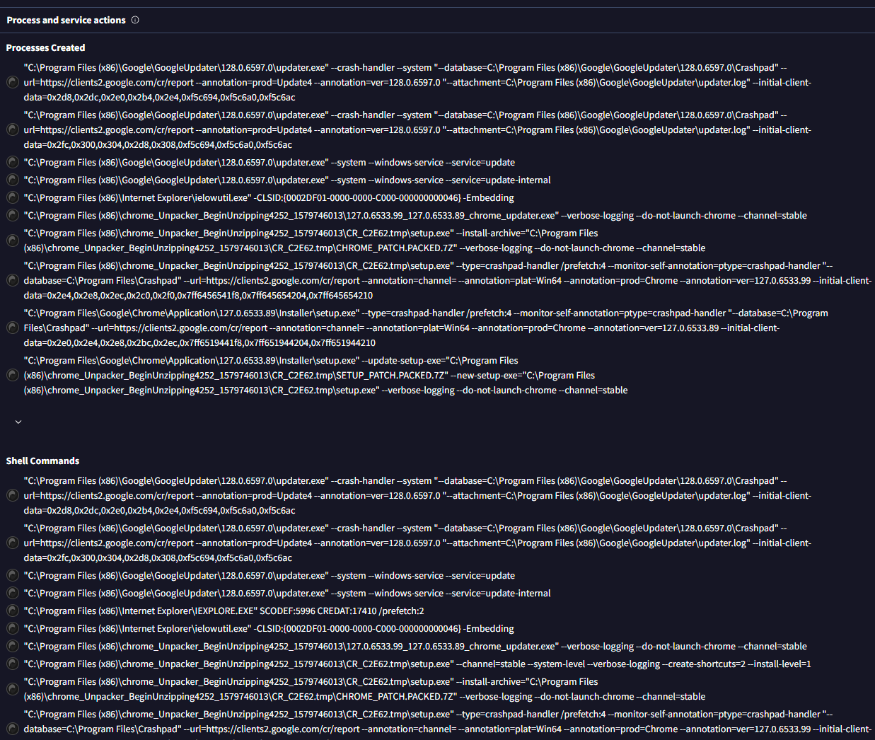

Slide 7
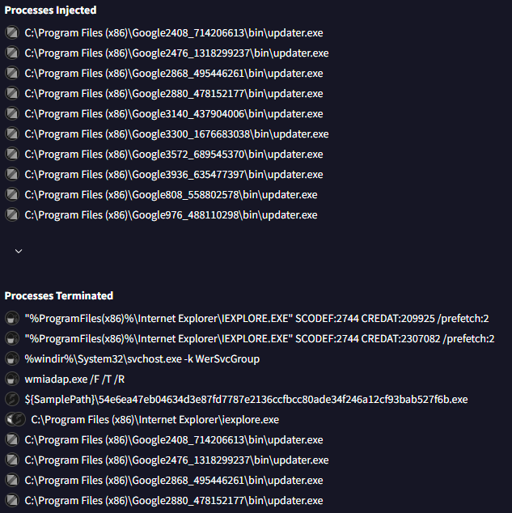

Slide 8
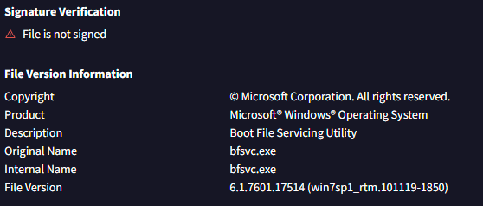
Tools Used

Slide 9
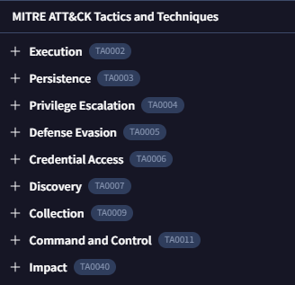
TTPs

