Slide 1
How to Request Host Certificate
호스트 인증서 신청 방법
2007.10.01
2017.05.25(Update)

Slide 2
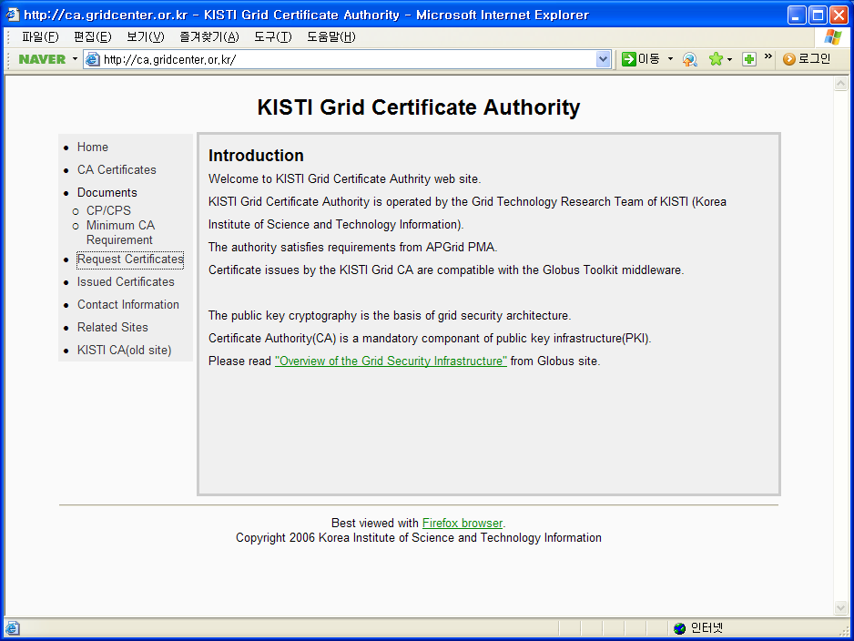
Visit ca.gridcenter.or.kr

Slide 3
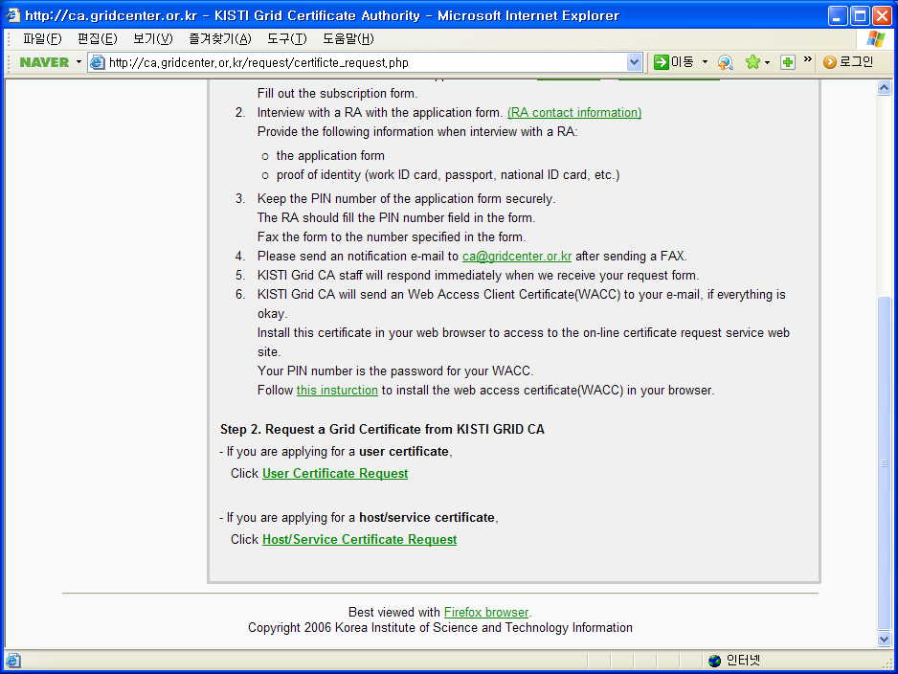

Slide 4
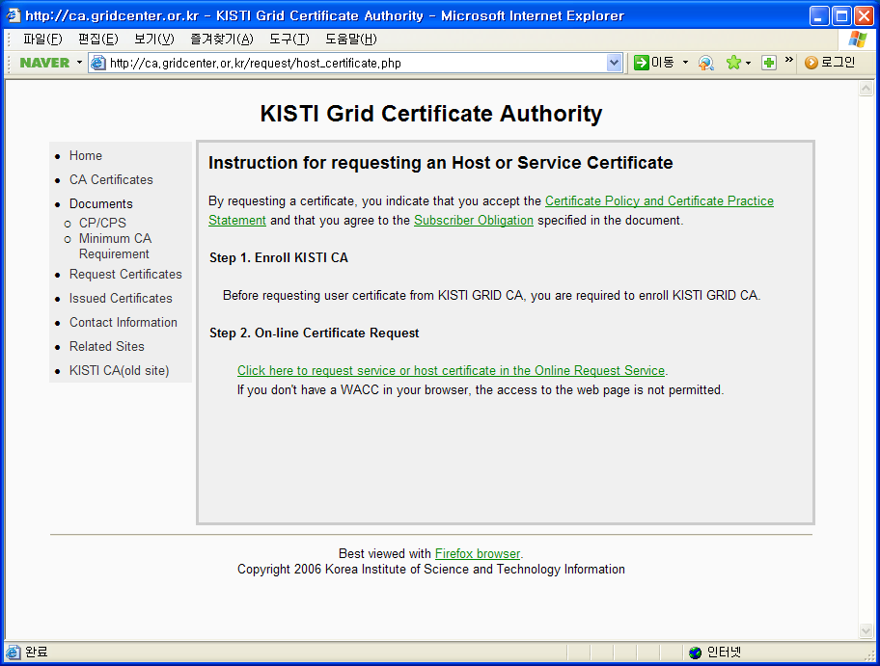

Slide 5
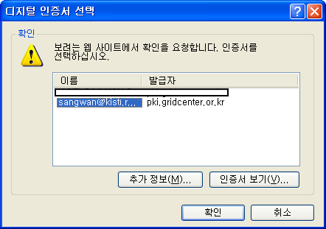
Connect to “Online Request Service” using your WACC certificate.

Slide 6
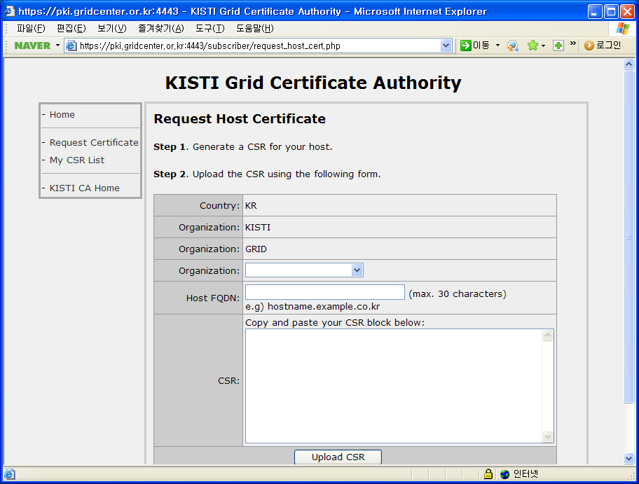
Select Your Organization
and input the FQDN of
the host for which you want
to get a certificate.
This CSR input textarea.

Slide 7
OpenSSL version >= 0.9.7
How to generate CSR with OpenSSL
Using RSA 2048-bit and
do not encrypt the key using DES.
openssl req \
-new -sha256 -newkey rsa:2048 -nodes \
-keyout hostkey.pem \
-out hostcert_request.pem \
-subj "/C=KR/O=KISTI/O=ORGANIZATION/CN=host\/grid.example.com"
This is common for every certificate issued by KISTI CA
Replace this your own organization and hostname.
If you use globus software, for host certificate ‘host/’ is prefied in the CN.
If successful, the hostkey.pem and hostcert_request.pem files are generated.

Slide 8
How to generate CSR with OpenSSL
EX) a user in KISTI request a host certificate with the name ‘test.kisti.re.kr’
Run like this,
openssl req \
-new -sha256 -newkey rsa:2048 -nodes \
-keyout hostkey.pem \
-out hostcert_request.pem \
-subj "/C=KR/O=KISTI/O=KISTI/CN=host\/test.kisti.re.kr"

Slide 9
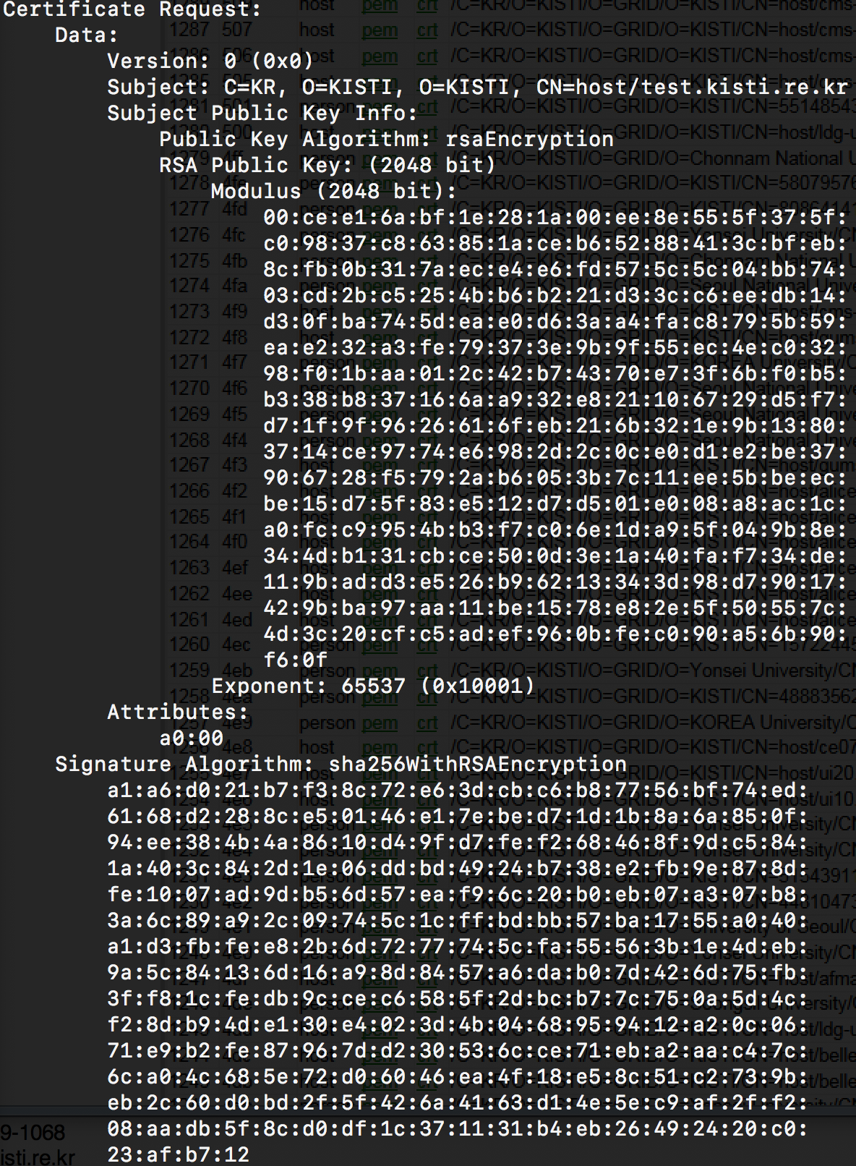
Check the generated CSR.
openssl req -in hostcert_request.pem -text -noout
Check the subject of the CSR
Check the RSA key size.

Slide 10
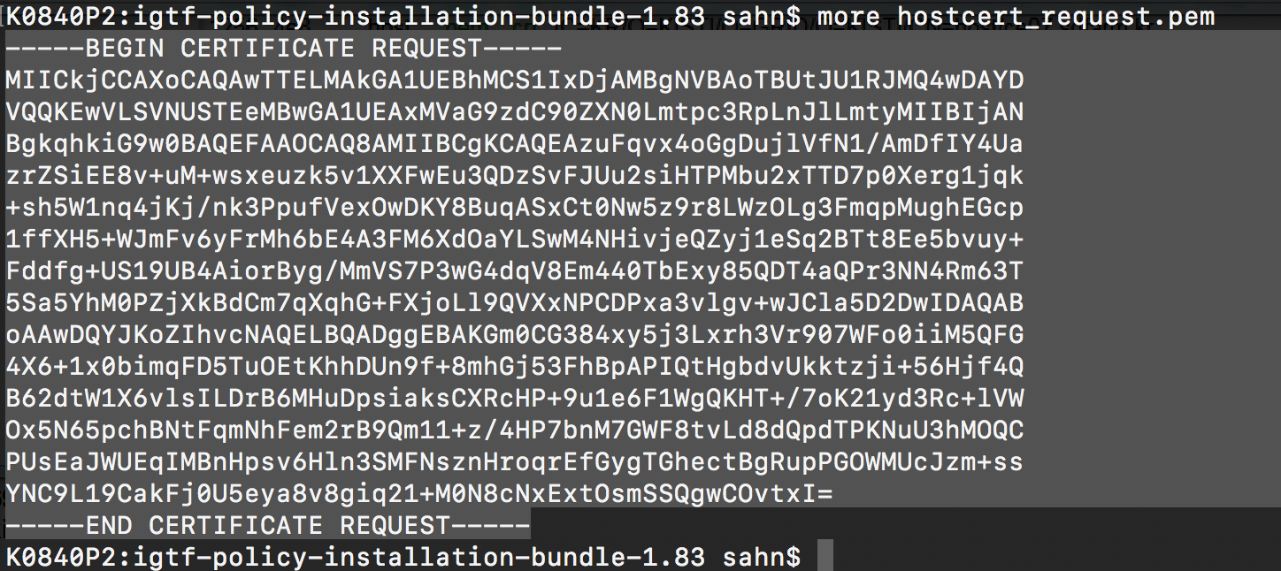
If the CSR have no problem,
You can input the CSR text block in the previous step.
Copy the content of the hostcert_request.pem file.

Slide 11
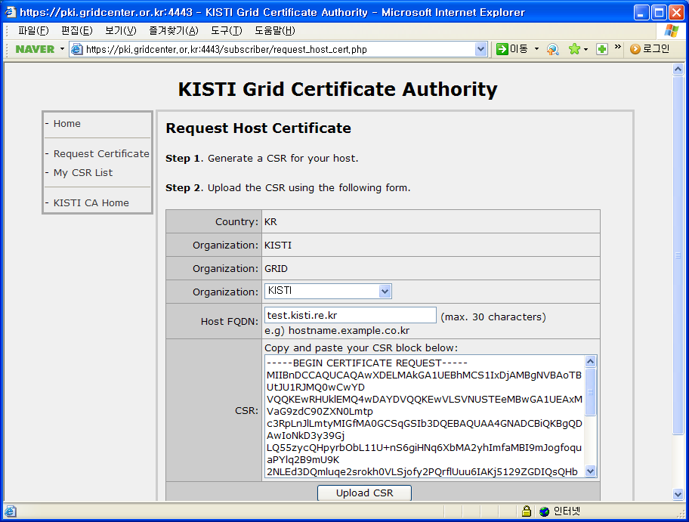
Select Organization
and input the Host FQDN.
If the information in the
request form is not
correct, the issuance
of the certificate can be
rejected.
Paste the copied CSR text block.
Finally, press the Upload button.

Slide 12
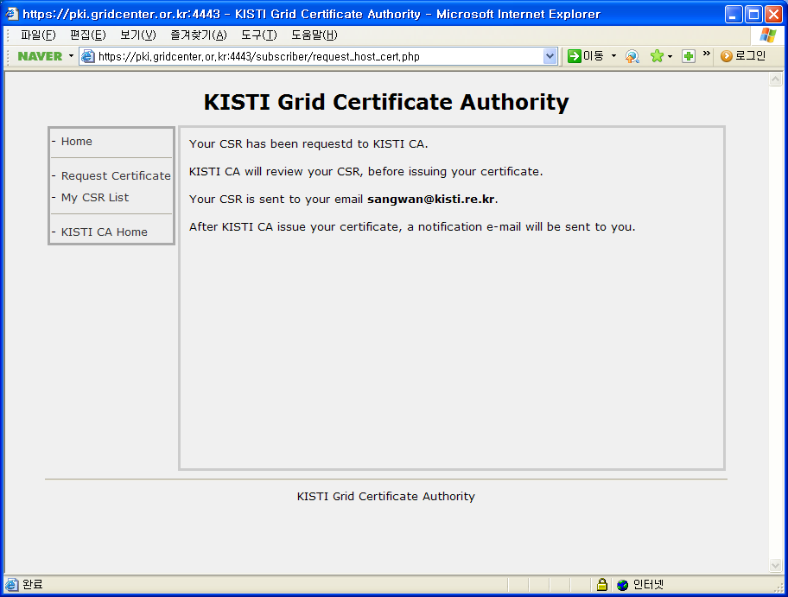
CSR information has been stored and the page show
that an email message has been sent.

Slide 13
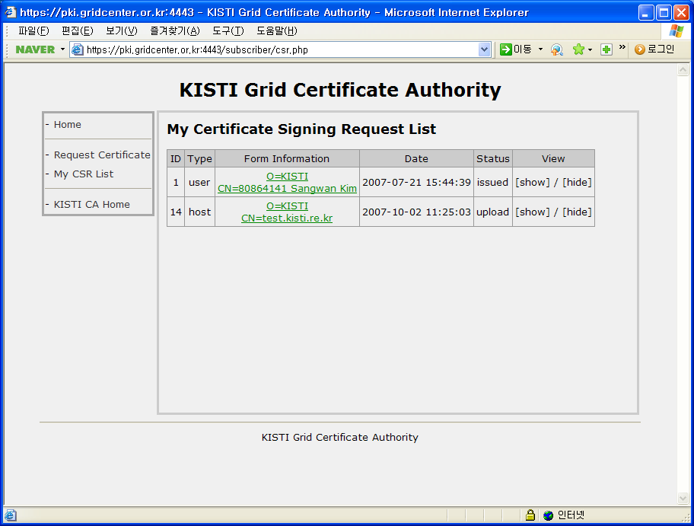
Request CSR information is shown in the left size menu
‘ My CSR List’

Slide 14
After finishing CSR upload process,
for notification, please send an email to kisti-grid-ca@kisti.re.kr
containing the following message.
To KISTI CA manager,
I have uploaded my host certificate request,
please sign the CSR.
FROM: Your Name

