Slide 1
How to Request User Certificate
사용자 인증서 신청 방법
2007.10.01

Slide 2
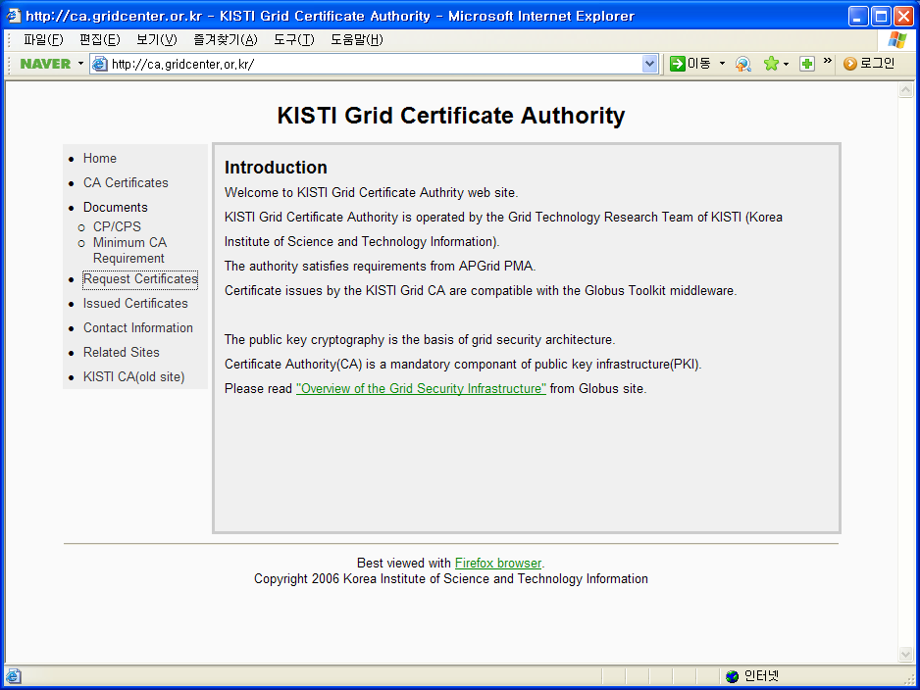

Slide 3
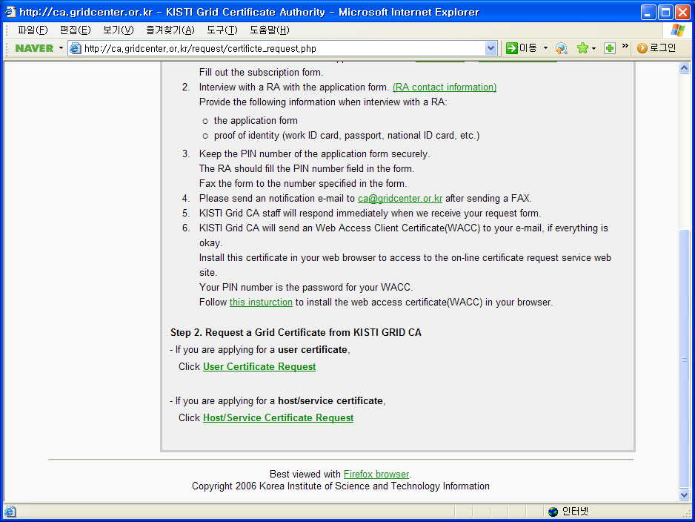

Slide 4
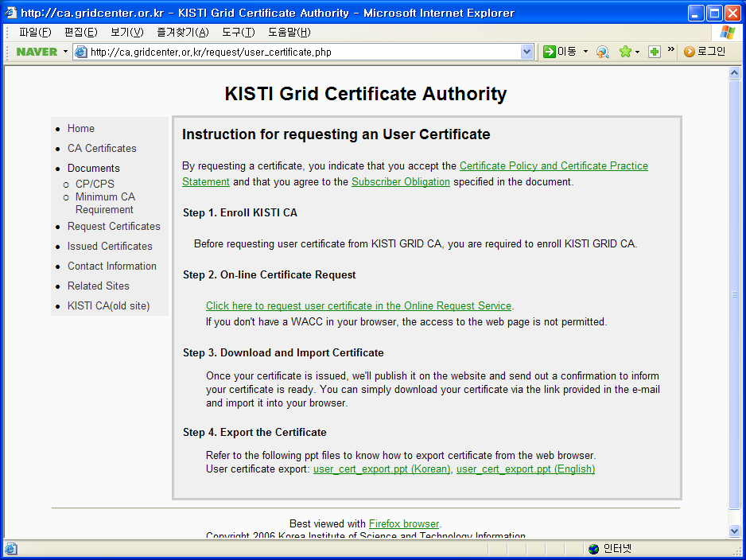

Slide 5
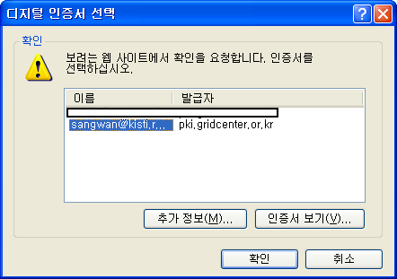

Slide 6
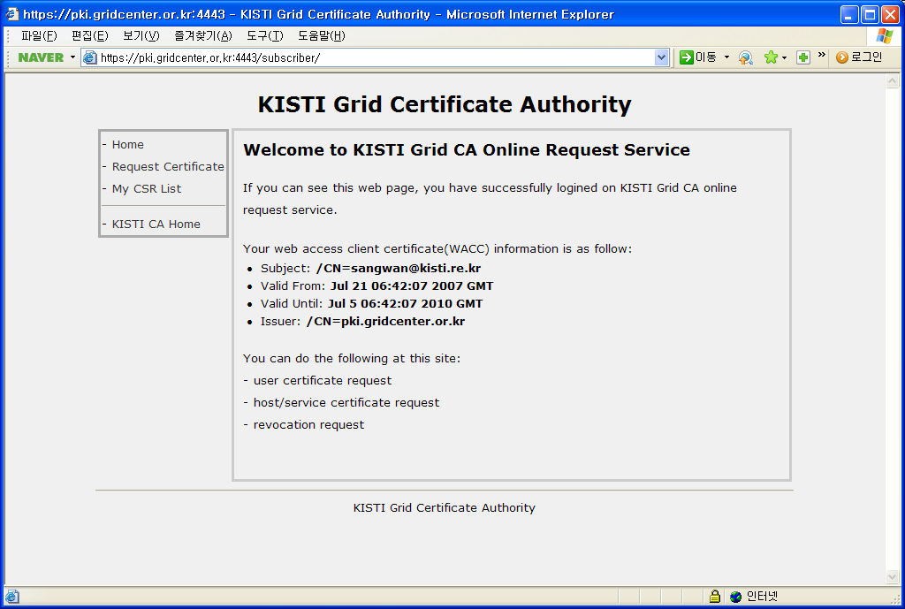

Slide 7
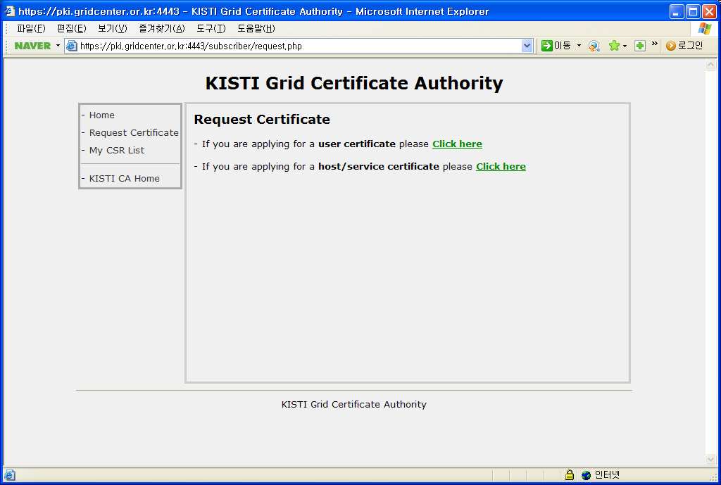

Slide 8
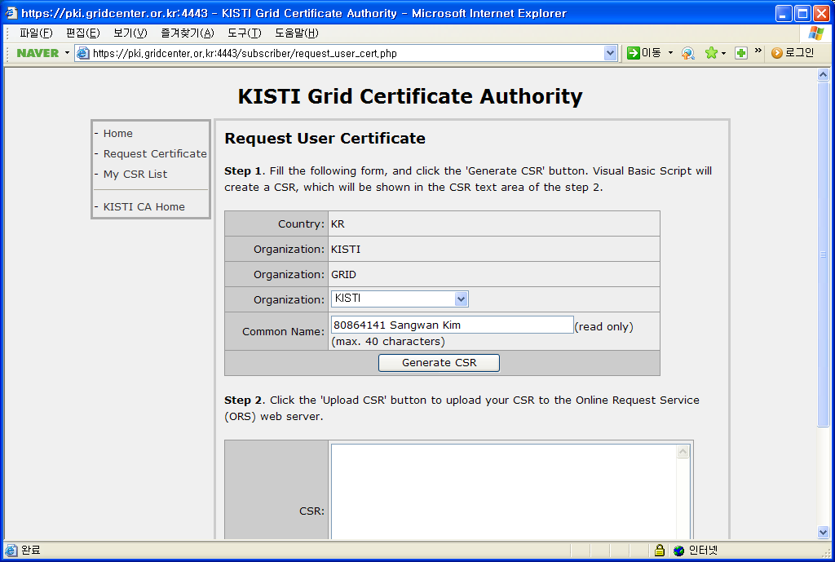

Slide 9
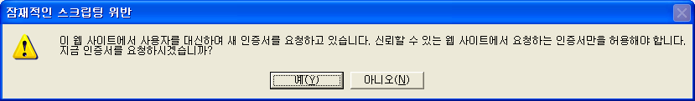
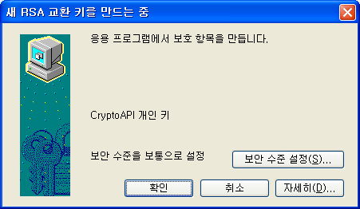
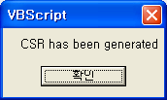
OK
OK
OK

Slide 10
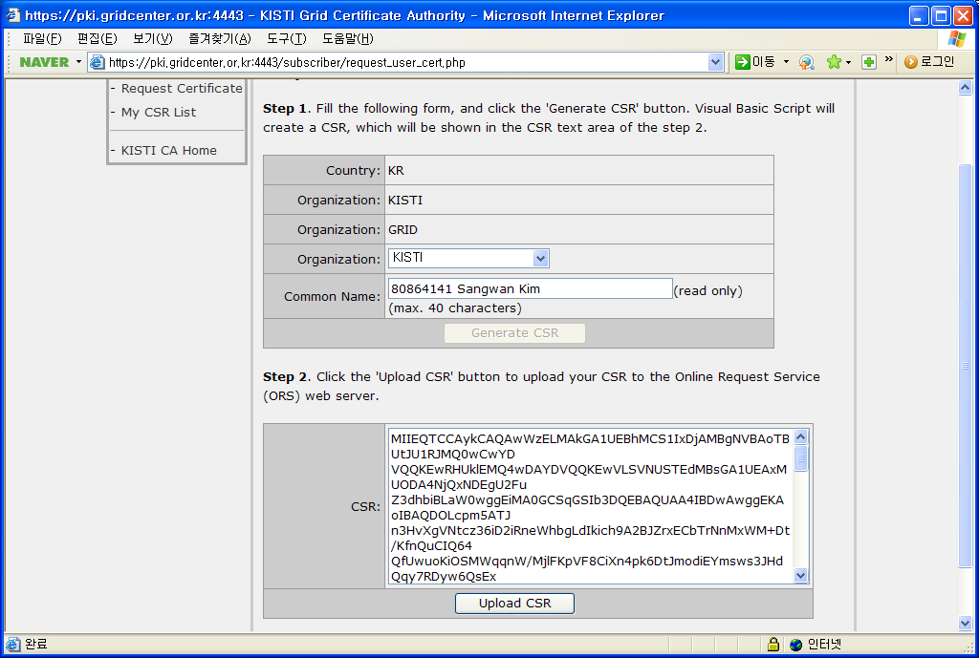

Slide 11
After finishing CSR upload process,
for notification, please send an email to ca@gridcenter.or.kr
containing the following message.
To KISTI CA manager,
I have uploaded my user certificate request,
please sign the CSR.
FROM: Your Name

