Slide 1
KISTI Grid Certificate Authority
Installing Web Access Client Certificate
Notification !
WACC certificate is a client certificate for your web browser
to access to the online certificate request web site provided
by KISTI GRID CA.
WACC certifcate itself is not a GRID certificate of KISTI GRID CA.

Slide 2
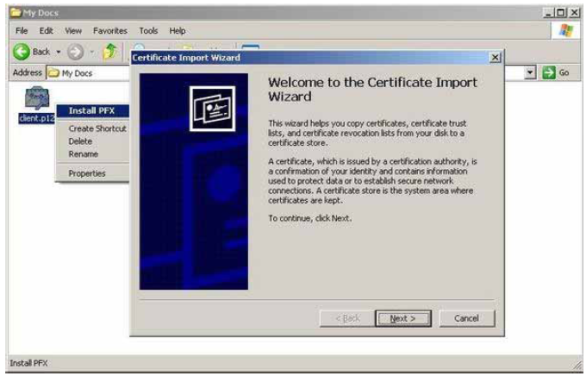
Double-click the client.p12 to install it.

Slide 3
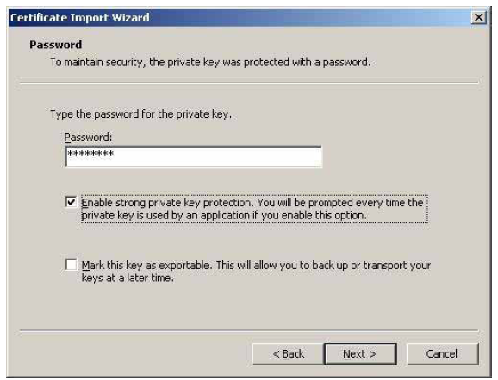
Input your PIN number as the password.
You wrote down the PIN number in the application form.
You don’t need to check the ‘Enable strong private key protection...’
check box.

