Slide 1
Exporting User Certificate from Internet Explorer

Slide 2

Down your user certificate from the KISTI GRID CA web site.
Rename the extention of your certificate file(.pem) to .crt.
You should use the same web browser used for the user certificate
Application process because your private is stored in the web browser.

Slide 3
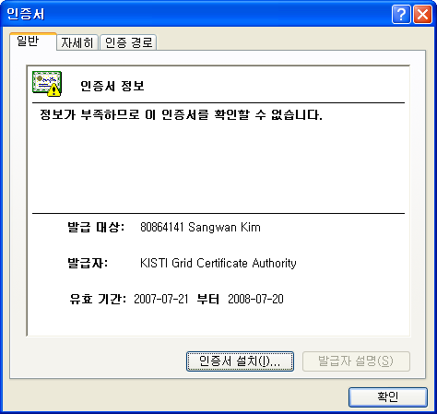
Open the certificate file to install the certificate in the browser.
Install Certificate

Slide 4
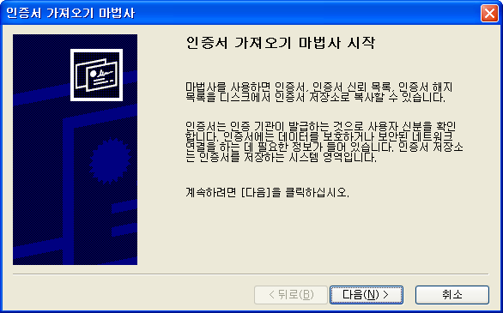
Starting Wizard
Next

Slide 5
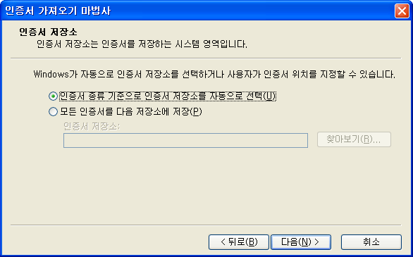
Next

Slide 6
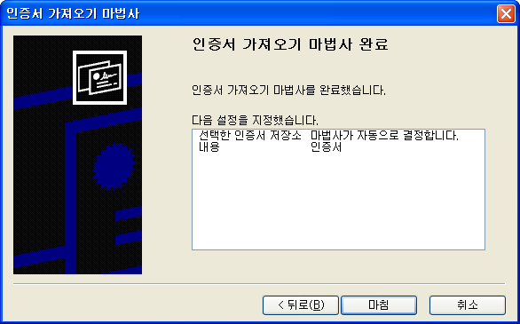
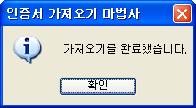
Finish
Importing certificate has
been finished.

Slide 7
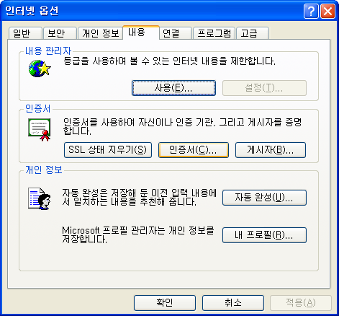
Open Tools -> Internet Options -> Contents in the Internet Explorer.
Click ‘Certificate’
Certificate

Slide 8
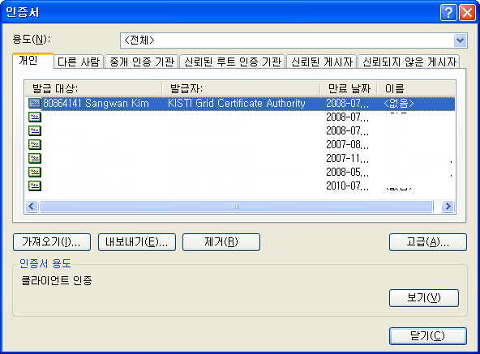
Check if the imported certificate is shown in the list.
Click ‘Export’
Export

Slide 9

Starting Wizard
Next

Slide 10
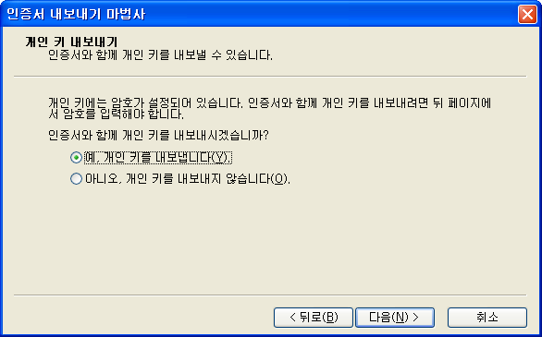
Select ‘Yes, Export with the private key’
Next

Slide 11
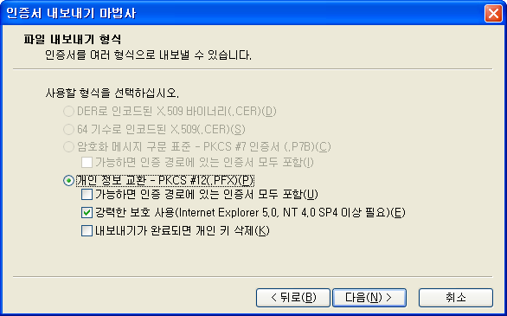
PKCS #12 file format
Next

Slide 12
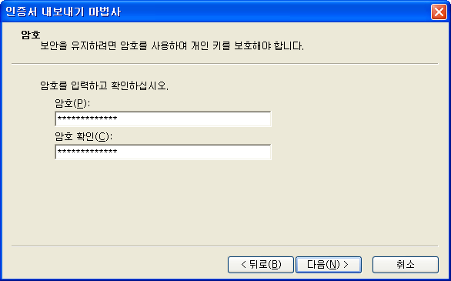
Input your passphrase.
We recommend that you use a pass phrase more than 12 characters
for security.
Next

Slide 13
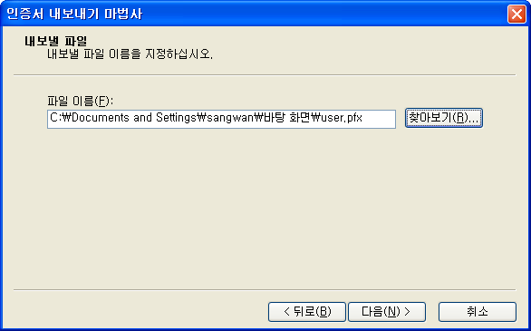
Choose the export file path.
Next

Slide 14
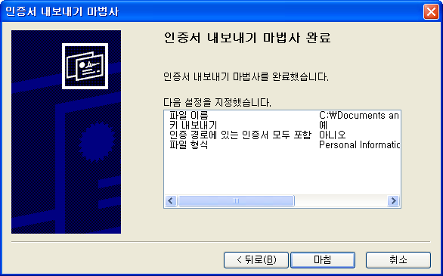
Finish

Slide 15
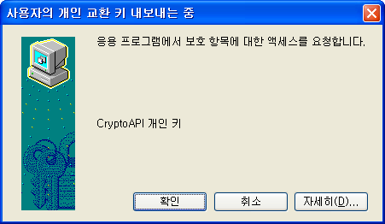
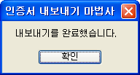
OK
Certificate Export
has been done

Slide 16

Now, you get the your certificate file(.pfx) which contains
both of your certificate and your private key in it.

Slide 17
You can extract the certificate or private key from the pfx file
using openssl command.
$ openssl pkcs12 -in user.pfx -clcerts -nokeys -out usercert.pem
Enter Import Password: <.pfx file pass phrase>
MAC verified OK
$ openssl pkcs12 -in user.pfx -nocerts -out userkey.pem
Enter Import Password: <.pfx file pass phrase>
MAC verified OK
Enter PEM pass phrase: <userkey.pem pass phrase>
Verifying - Enter PEM pass phrase: <userkey.pem pass phrase >
For Globus Toolkit, you can copy usercert.pem and userkey.pem
in ~/.globus directory.

