Slide 1


GPT2 Chatbot
Try it: @neural_chat_bot

Slide 2

Plan
About model (Anton, Misha)
  What is GPT-2
  What is used for
  SOTA? Why so interesting?
Retrieval (Ivan F + Pasha)
  about DSSM, triplet loss
  graphs, metrics

Slide 3
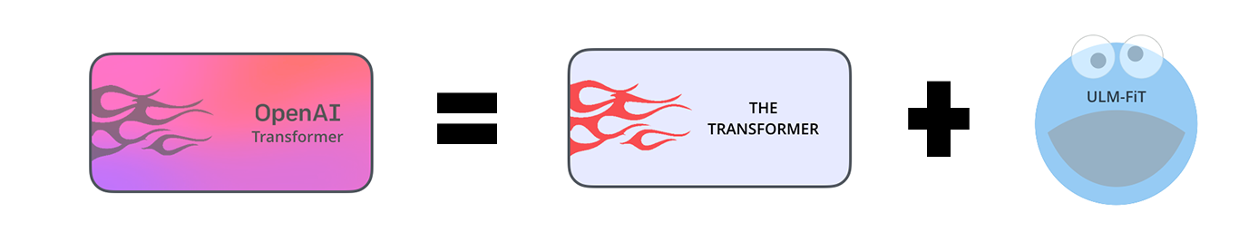
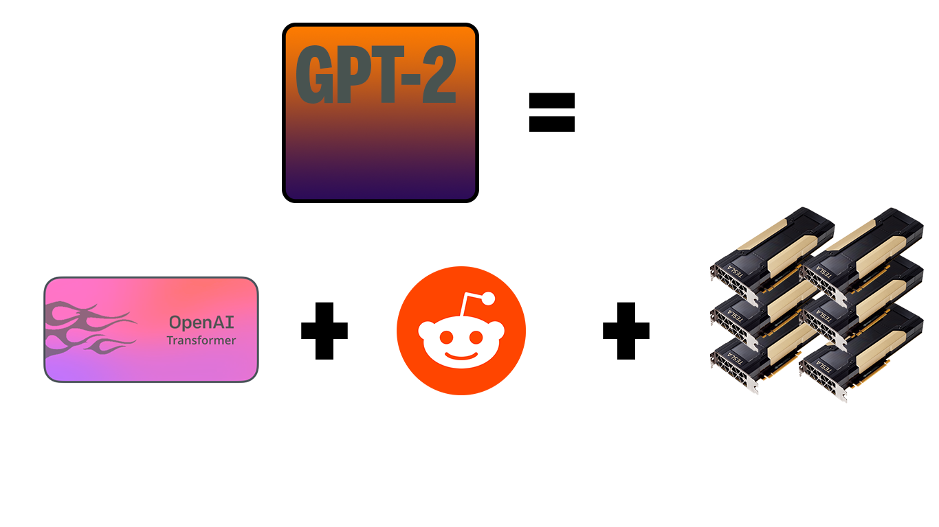
GPT-2
Generative
Pretrained
Transformer
40GB of Internet text
1.5 billion of parameters
8 million web pages
GPT-1
2018
10x
data
params
2019
GPT-2
GPT-1
[1] Alec Radford Jeffrey Wu, Language Models are Unsupervised Multitask Learners

Slide 4
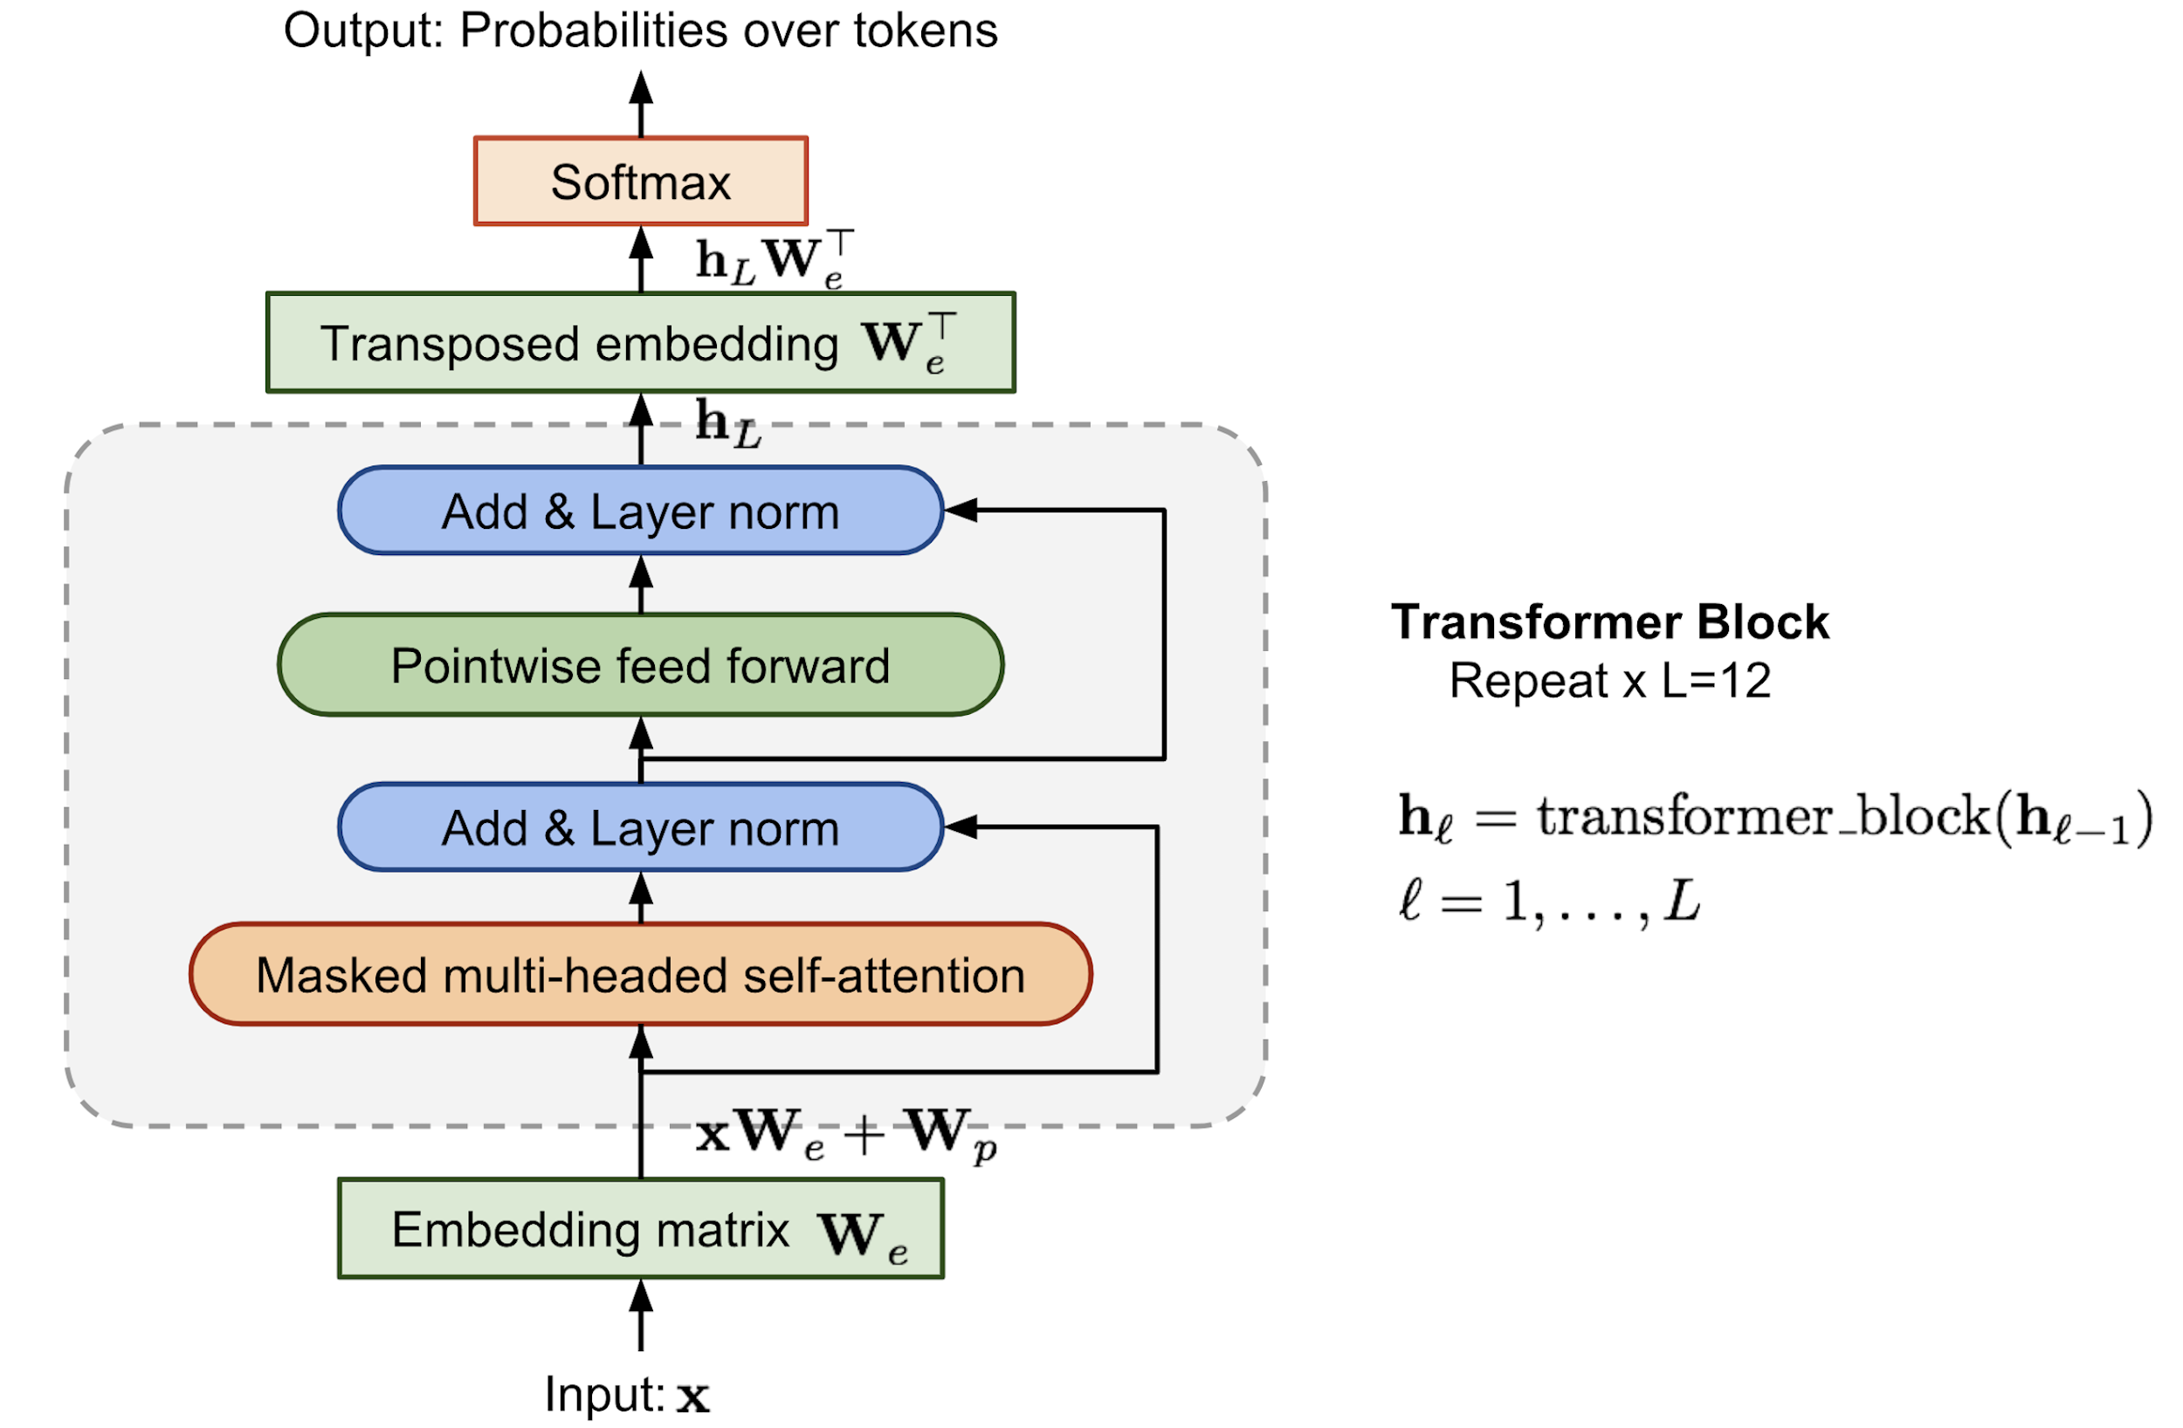
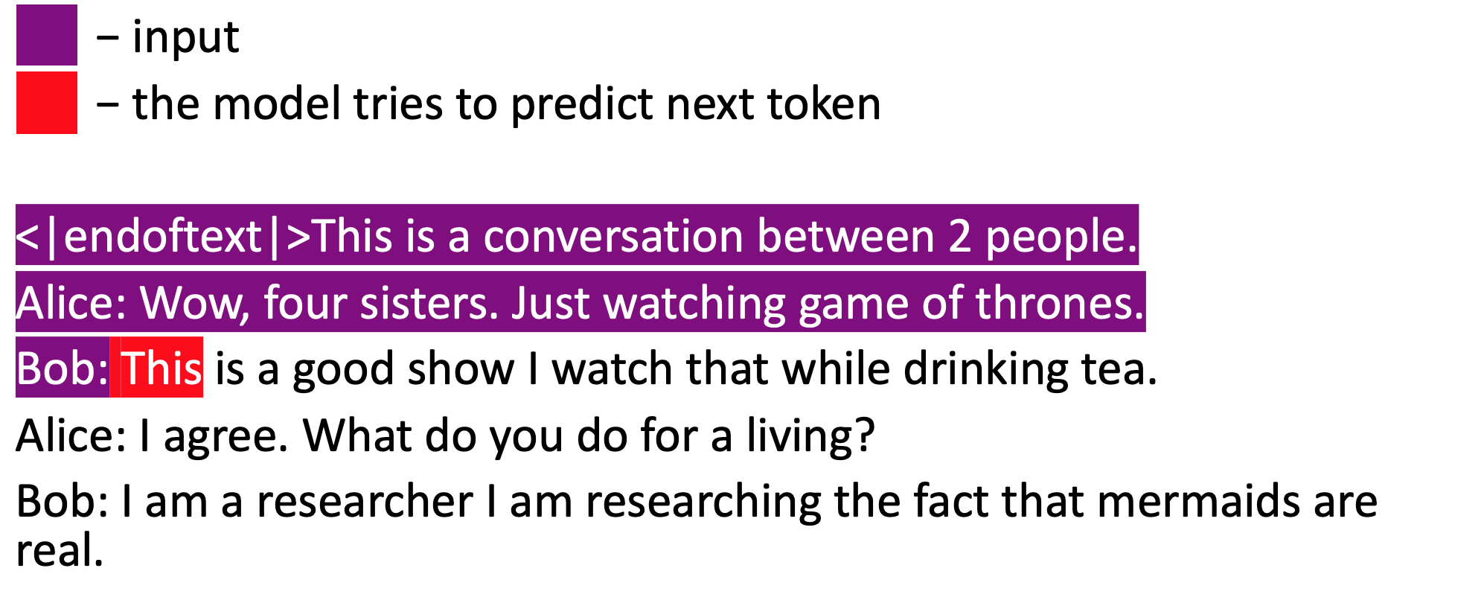
GPT-2

Slide 5

Why is it interesting?
Fresh & SOTA model (Feb 2019)
2 approaches:
Generative | Pros | Wide variety of replies Large context
 | Cons | Can generate weird and offensive answers
Retrieval | Pros | All replies are meaningful
 | Cons | Limited variety of replies Short context

Slide 6
Neural generative chatbot

Slide 7

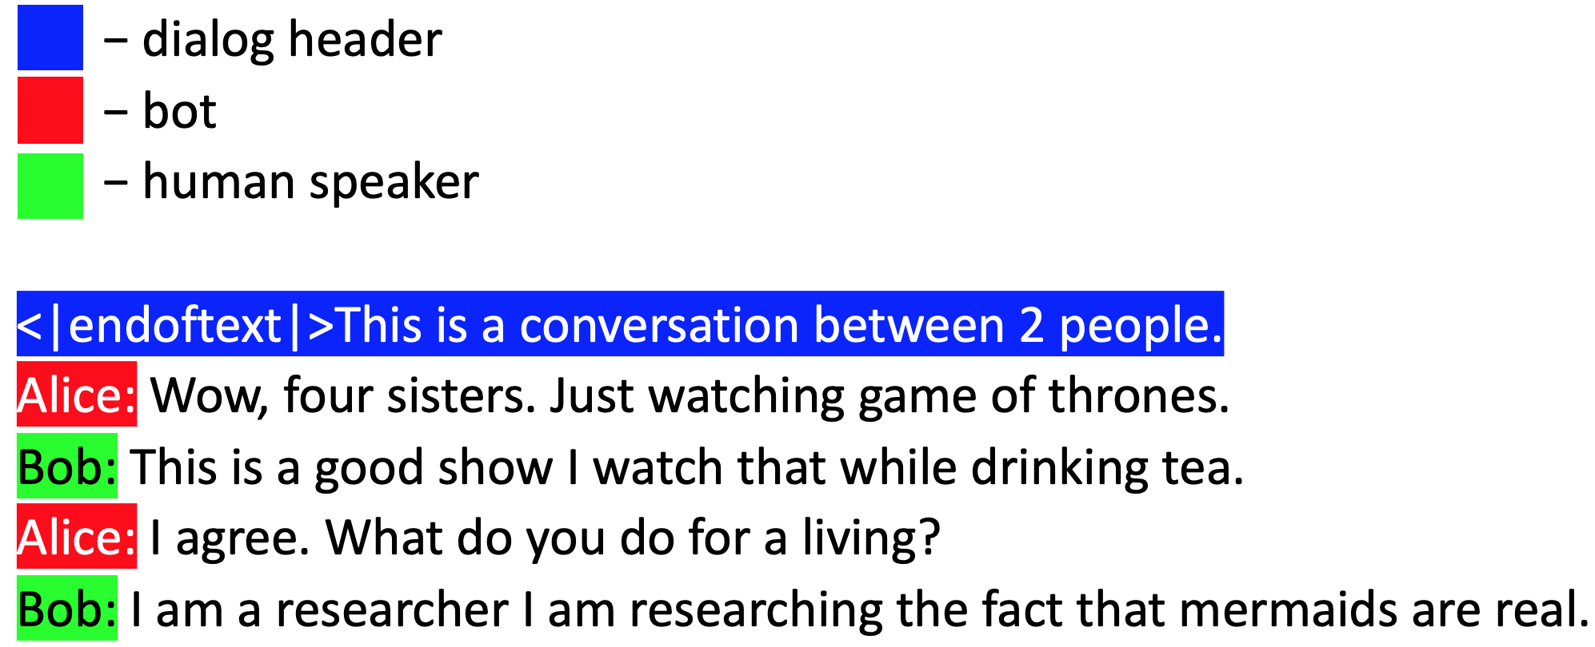
Dialog format as text

Slide 8

Data pre-processing
Simple punctuation checker
Word filtering
Training
GPT-2 117M
Longest train time ≈ 35 hrs on 8 Nvidia GTX 1080 Ti on Pardus cluster
Model trained on 5 datasets

Slide 9
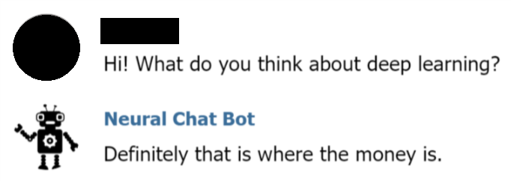
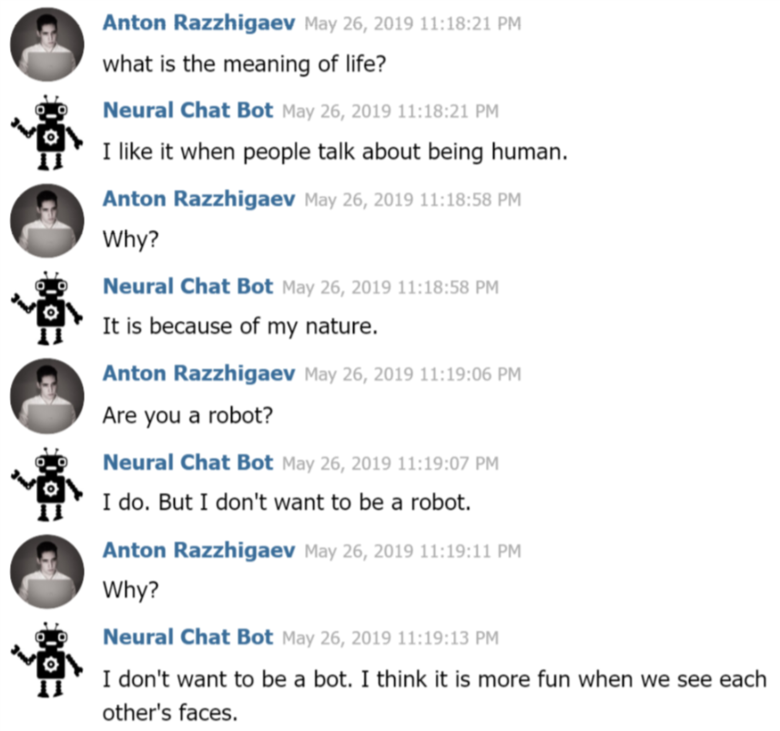
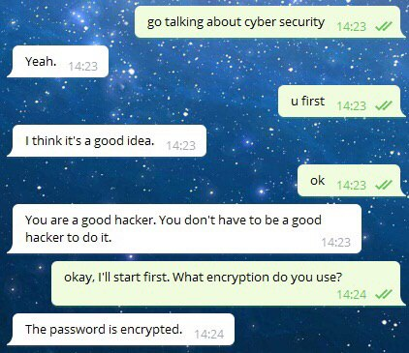
Dialog examples
Try it: @neural_chat_bot

Slide 10
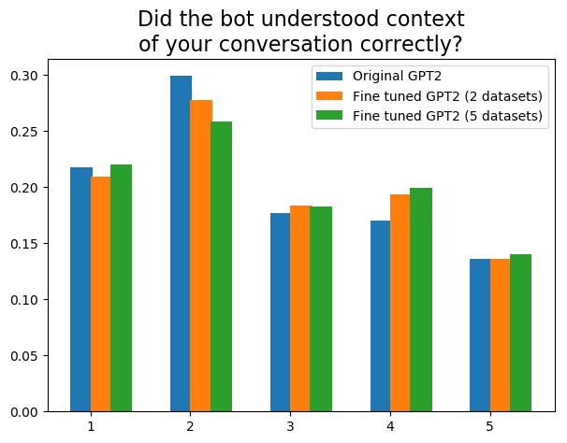
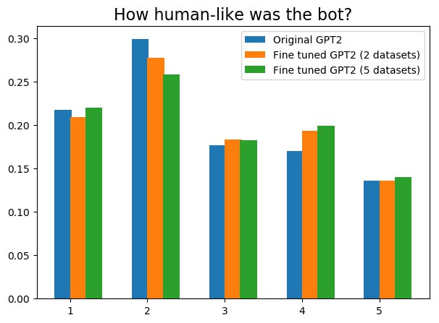
Human evaluation. Rating from 1 to 5.
Green is better but just slightly
8

Slide 11
Retrieval based chatbot

Slide 12
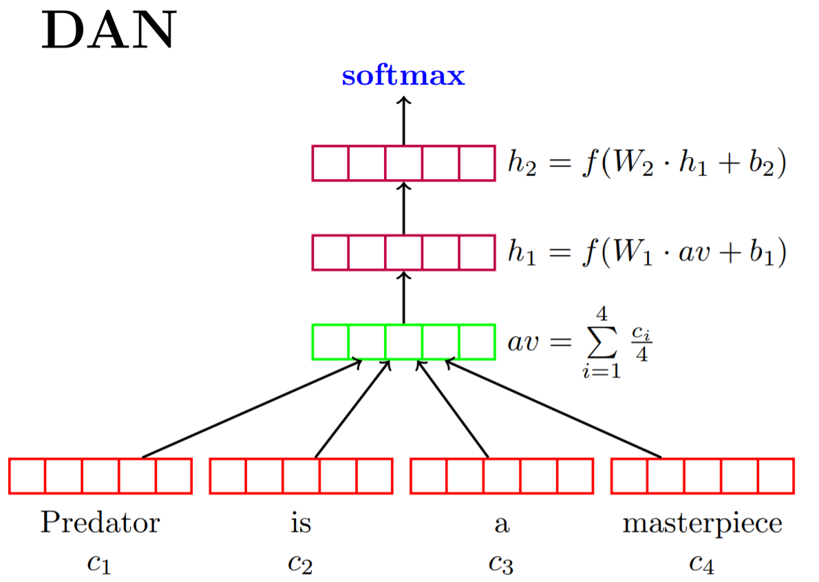
Retrieval-based chatbot
Retrieval-based chatbot chooses a response to a given context among pre-stored answers
We compare two models:
GPT-2

Slide 13
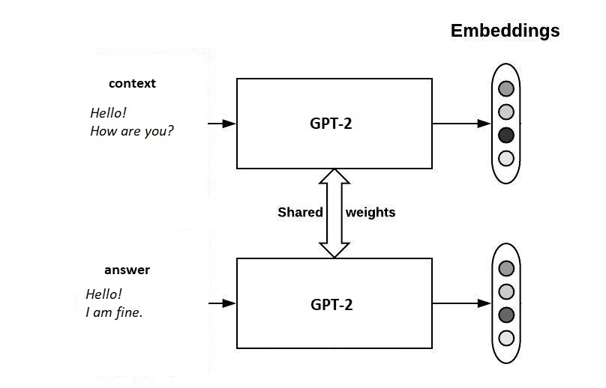
Retrieval-based chatbot
Model converts texts into hidden representations (embeddings)
Pretrained GPT/GPT-2 outputs vectors of dimension 768
Output vectors are aggregated using mean-pooling

Slide 14
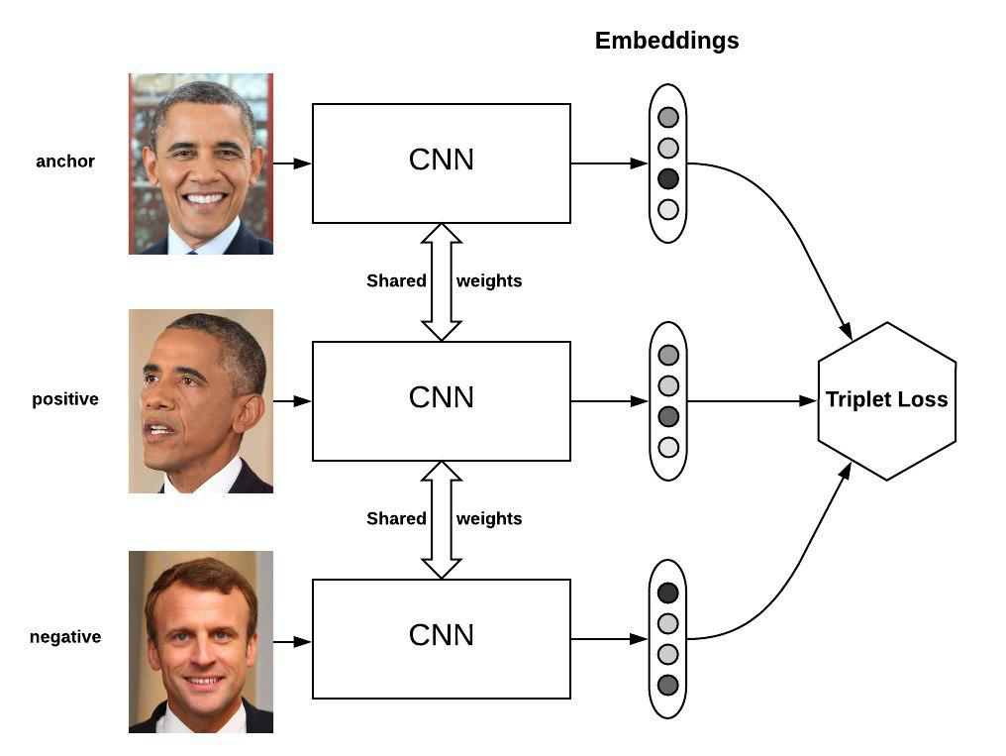
Retrieval-based chatbot: Training
Triplet Loss
f(.) - trained model
A - anchor input
P - positive input
N - negative input
Prediction
kNN (k=1) using approximate kNN
(context)
(positive answer)
(negative answer)

Slide 15
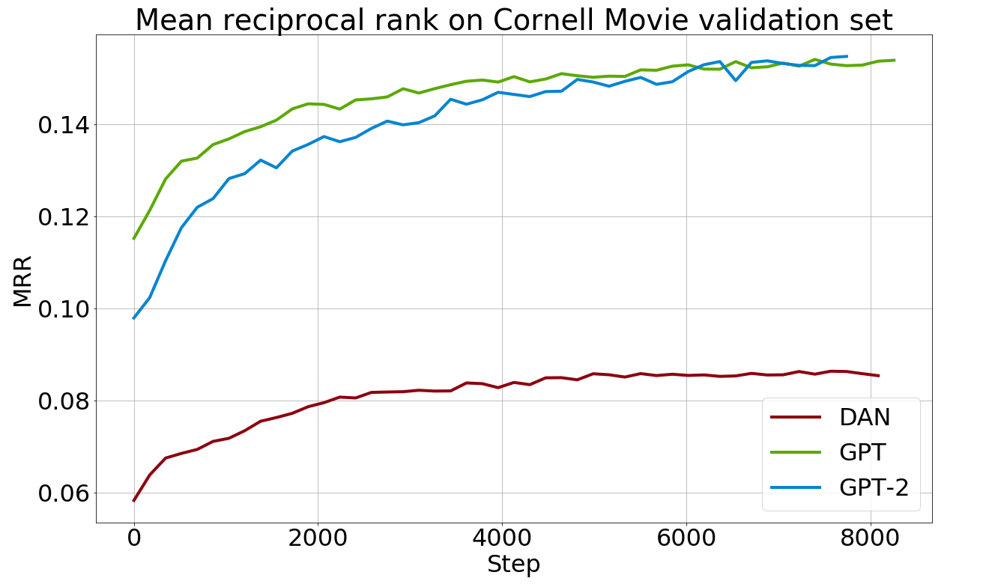
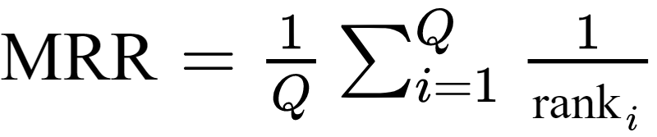
Metrics
Q - corpus size
rank_{i} - position of the relevant answer
Models | Cornell Movie
GPT fine-tuned | 0.159
GPT original | 0.043
GPT-2 fine-tuned | 0.103
GPT-2 original | 0.01
DAN | 0.08
50 epochs, batch_size = 128, margin = 0.3, adam, lr =0.003

Slide 16
Conclusions
Conditioning and dialog datasets allow GPT-2 to work as a chatbot via language modeling
Telegram bot is launched (and is very funny)
It’s difficult to evaluate chatbots
Generative approach works subjectively better
Retrieval based approach is faster and doesn’t generate offensive answers

Slide 17
Try it: @neural_chat_bot

Slide 18
References
Alec Radford Jeffrey Wu, Language Models are Unsupervised Multitask Learners
Jacob Devlin et al, BERT: Pre-training of Deep Bidirectional Transformers for Language Understanding
Ashish Vaswani et al, Attention Is All You Need
Yoav Goldberg, Neural Network Methods for Natural Language Processing
Braden Hancock et al, Learning from Dialogue after Deployment: Feed Yourself, Chatbot!
Vladimir Vlasov et al, Few-Shot Generalization Across Dialogue Tasks

Slide 19
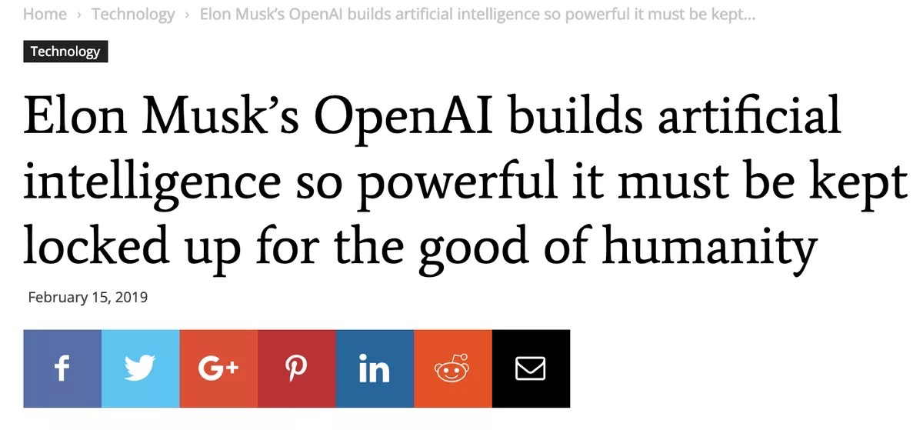

Slide 20
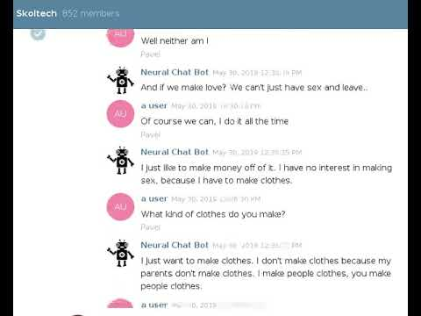
Popularity in Skoltech chat

