Slide 1
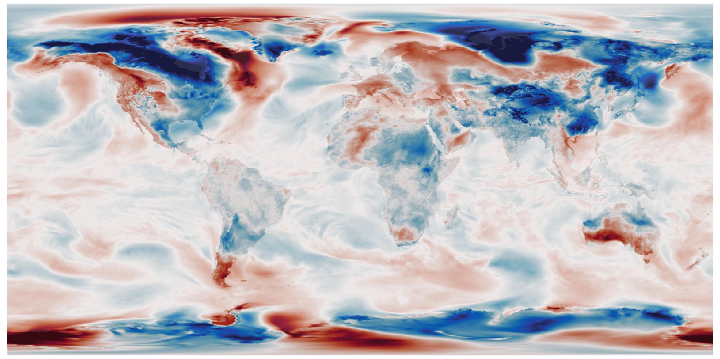
Encoder:
Convolutional Neural Network
E(weather field) = (m₁,m₂,…,m_{n},s₁,s₂,…,s_{n})
Learn Encoder and Generator
That make the two fields the same:
G(R(E(field))) ≈ field
Make distribution of x_{i} ≈ N(0,1)
Reparameterization:
Make sample from means and standard deviations
(x₁,x₂,…,x_{n}) = N(m₁,m₂,…,m_{n},s₁,s₂,…,s_{n})
Generator:
Convolutional Neural Network
weather field = G(x₁,x₂,…,x_{n})

