Slide 1
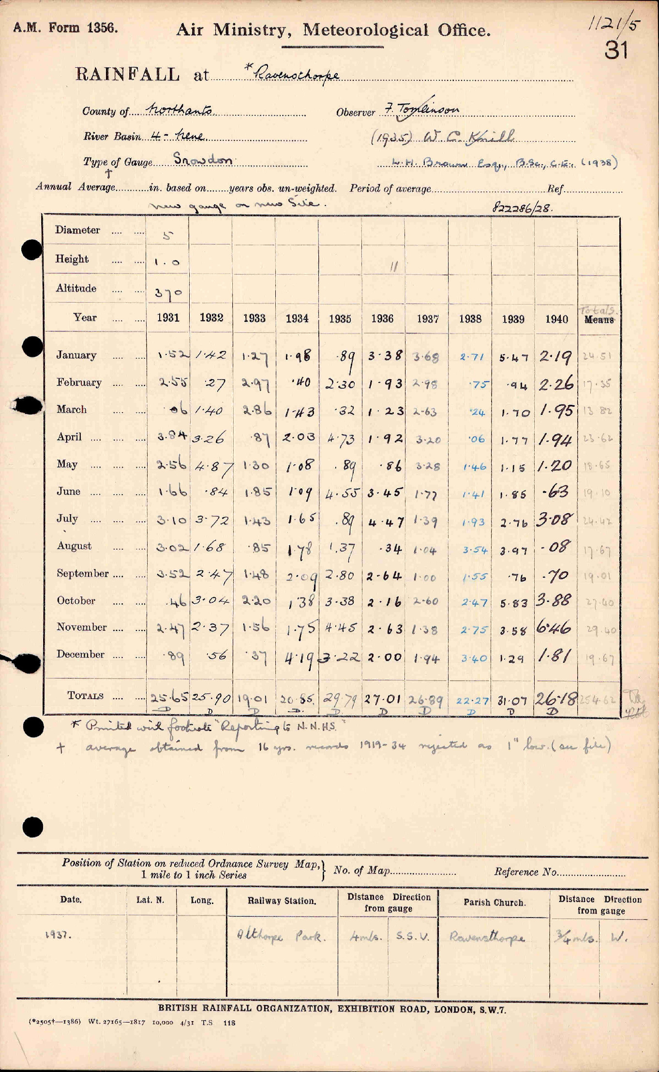
1931,1932,1933,1934,1935,1936,1937,1938,1929,1940
1.52,1.42,1.27,1.98, .89,3.38,3.68,2.71,5.47,2.19
2.55, .27,2.97, .40,2.30,1.93,2.98, .75, .94,2.26
.06,1.40,2.86,1.43, .32,1.23,2.63, .24,1.70,1.95
3.94,3.26, .87,2.03,4.73,1.92,3.20, .06,1.77,1.94
2.56,4.87,1.30,1.08, .89, .86,3.28,1.46,1.15,1.20
1.66, .84,1.85,1.09,4.55,3.43,1.77,1.41,1.86, .63
3.10,3.72,1.43,1.65, .89,4.47,1.39,1.93,2.76,3.08
3.02,1.68, .85,1.78,1.37, .34,1.04,3.54,3.97, .08
3.52,2.47,1.48,2.09,2.80,2.64,1.00,1.55, .76, .70
.46,3.04,2.20,1.38,3.38,2.16,2.60,2.47,5.83,3.88
2.47,2.37,1.56,1.75,4.45,2.63,1.38,2.75,2.58,6.46
.89, .56, .57,4.19,3.22,2.00,1.94,3.40,1.29,1.81

