Slide 1
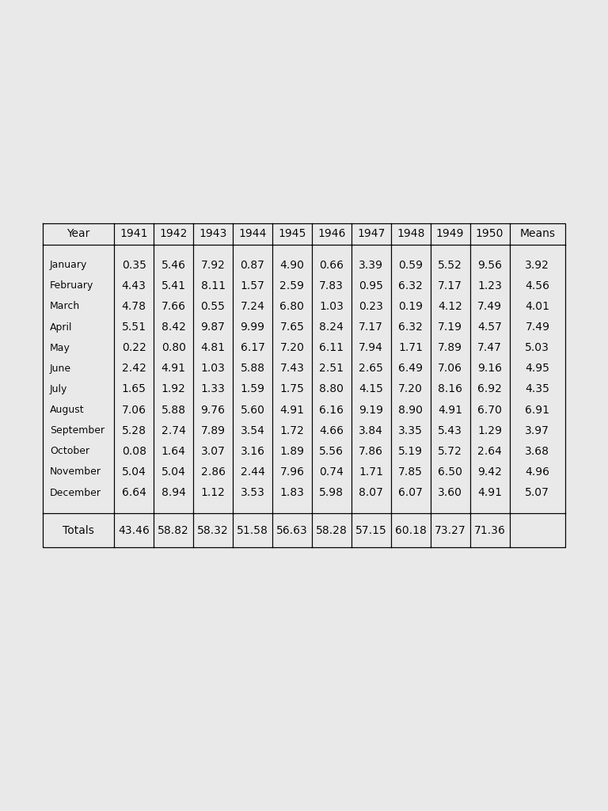
Convolution
Dropout
Convolution
Dropout
Convolution
Dropout
Convolution
Images
Dropout
Convolution
Dropout
Convolution
[[ 0.0,0.0,0.9,0.1, …],
[ 0.2,0.2,0.3,0.0, …],
…
[1.0,0.0,0.0,0.0,…]]
Dense
Softmax
Digit probabilities

