Slide 1

IE 7374 Project Creation of Centralized Tourist-Hotel Database FOR INDIA
Prepared by: PHILIP MATHEW

Slide 2
Problem Definition
Approximately 10 million tourists visit India every year and check into various hotels.
As per Govt. regulations all the hotels have to fill a C-form which contains tourists details and then it is sent to immigration authorities and the local police. Each hotel has to do the same process when that tourist visit their hotel.
This results in data duplication and loss of important man hours of the hotel

Slide 3
Our Solution
We have created a relational database model.
It will eliminate data duplication and will save approx. 50% valuable man hour of the hotel staff.
The C-form will be filled only once at the first hotel where the tourist check-ins and it will be subsequently updated by the tourist’s primary key which is the passport number in the database.
Also this database will be shared with the local database, so they can monitor if there is any untoward situation.

Slide 4
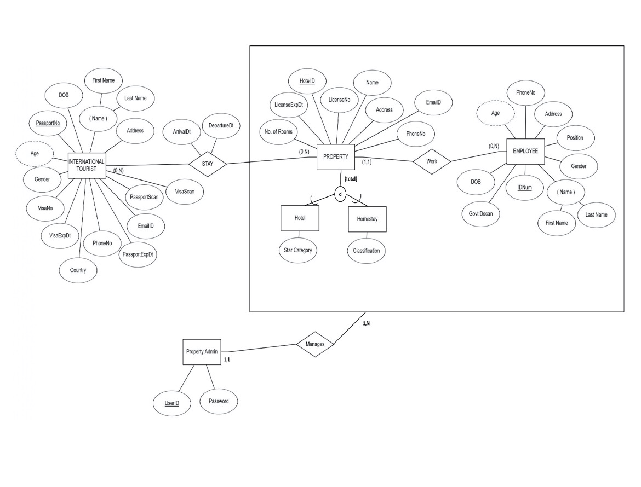
EER Diagram

Slide 5
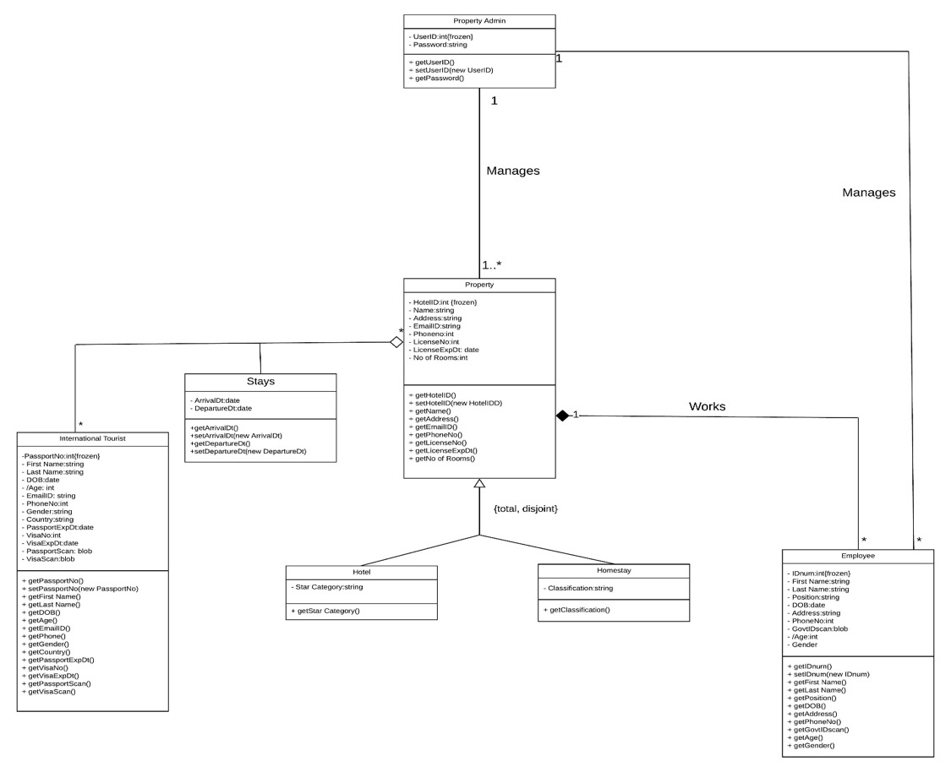
UML Diagram

Slide 6
Relational Model

Slide 7
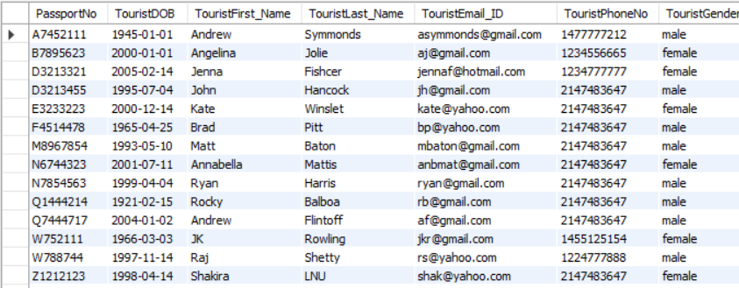
Implementation on MySQL
We have created a new schema which on MYSQL.
The tables are: International Tourists, Property, Employees, Hotel, Homestay
The table International Tourists is shown below as a sample:

Slide 8
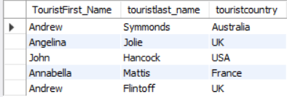
MYSQL Queries
Query1: Find the name and countries of tourists who have stayed at ‘Taj Mahal’
select a.TouristFirst_Name, a.touristlast_name, a.touristcountry
from international_tourists as a, stay as b, property as c
where b.staypassportNo = a.PassportNo and b.staypropertyid = c.propertyid
and c.propertyname = 'Taj Mahal'

Slide 9
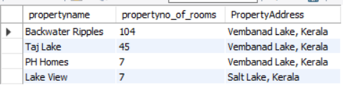
Query2: Find Property Name, No. of rooms, property address and property type whose property location is near a lake
select propertyname,
propertyno_of_rooms,PropertyAddress
from property where PropertyAddress like '%Lake%'
order by propertyno_of_rooms desc

Slide 10

Query3: Find Property Name, No. of rooms, star category of properties with highest 3 no. of rooms
select a.propertyname,
a.propertyno_of_rooms, b.star_category
from property as a, hotel as b
where a.propertyID = b.HTPropertyID
order by a.propertyno_of_rooms desc
limit 3

Slide 11
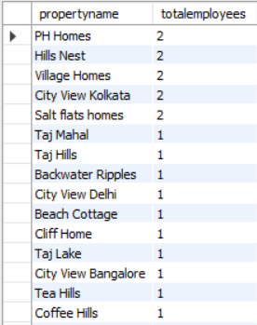
Query4: Find property name and total number of employees working in the respective property that are present in the database
select a.propertyname, count(b.employeeID) as totalemployees from property as a, employee as b
where a.PropertyID = b.Employeework_hotelid
group by a.PropertyID
order by totalemployees desc

Slide 12

Query5: Find tourist names, duration of stay and property names of the top 3 longest stay duration of tourists in the properties
select a.touristFirst_Name, a.touristLast_name, datediff(b.stayingto,b.stayingfrom) as duration_days, c.propertyname from international_tourists as a, stay as b, property as c
where a.passportno = b.staypassportno and b.StayPropertyID = c.propertyID
order by duration_days desc
limit 3

Slide 13
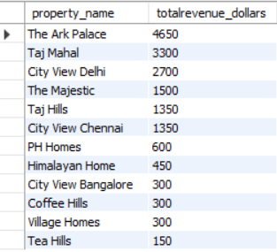
Query6: Find property name and total revenue the properties receive as income in dollars (assuming $150 per day for a tourist to stay in a property)
With staydetails as (select Datediff(b.stayingto, b.stayingfrom) as duration, b.staypropertyID as stay_prop, c.propertyname as property_name
from international_tourists as a, stay as b, property as c
where a.passportno = b.staypassportNo and b.StayPropertyID = c.propertyID)
select property_name, sum(duration)*150 as totalrevenue_dollars
from staydetails
group by stay_prop
order by totalrevenue_dollars desc

Slide 14

Query7: Find property name, license expiry date whose license is expiring in the next 1 year
select propertyname, propertylicenseexpdt
from property
where propertylicenseexpdt <= date_add(curdate(), interval 1 year)

Slide 15
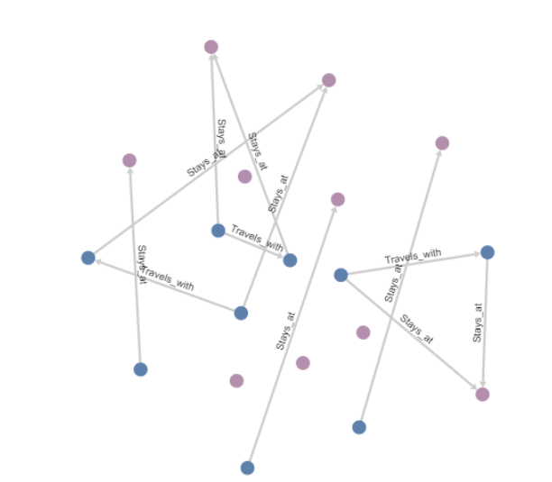
NOSQL Implementation
We have created 2 tables and 2 relations on Cypher NEO4J system on PDMB playground. The graphical database is shown

Slide 16
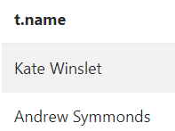
NOSQL Queries
Query1: Find tourists’ name who have stayed at hotel Taj Mahal
MATCH(t:International_Tourists)-[e]-(p:Property)
WHERE p.propname='Taj Mahal'
RETURN t.name;

Slide 17
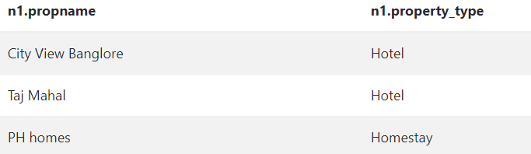
Query2: Find property name and type where an international tourist travelled along with a friend.
MATCH (n1:Property)-[e1]-(b:International_Tourists),(n2:International_Tourists)
Where (b)-[:Travels_with]-(n2)
RETURN DISTINCT n1.propname, n1.property_type;

Slide 18
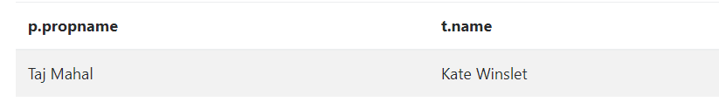
Query3: Find international tourist names and property name where tourists stayed in property with greater than 40 rooms.
MATCH(t:International_Tourists)-[e]-(p:Property)
WHERE p.no_of_rooms>40 and t.touristcountry='USA'
RETURN t.name,p.propname;

Slide 19
Data Retrieval using python
The database is accessed using Python and visualization of analyzed data is shown below. The connection of MySQL to Python is done using mysql.connector, followed by cursor.excecute to run and fetchall from query, followed by converting the list into a dataframe using pandas library and using matplotlib to plot the graphs for the analytics.

Slide 20
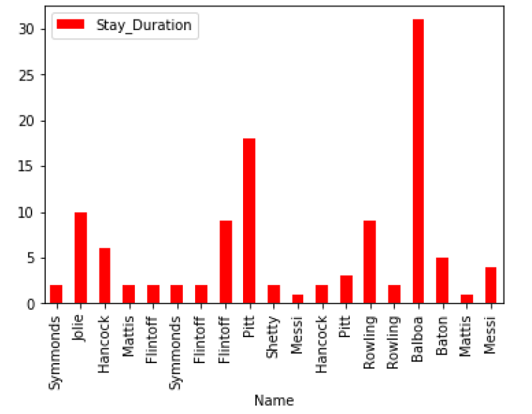
Graph1: Duration of Tourists’ Stay
sql_Query = "select a.touristLast_name, datediff(b.stayingto,b.stayingfr
om) as duration_days from international_tourists as a, stay as b, proper
ty as c WHERE a.passportno = b.staypassportno AND b.StayPropertyID = c.p
ropertyID"
cursor = project.cursor()
cursor.execute(sql_Query)
records = cursor.fetchall()
print(records)
dataplot.plot(kind='bar',x='Name',y='Stay_Duration',color='red')
plt.show()

Slide 21
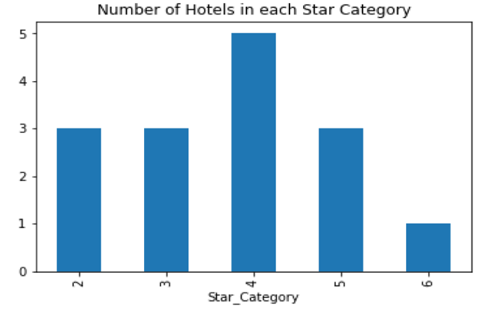
Graph2: No. of Hotels in Each Star Category
sql_Query2 = "select a.propertyname, b.star_category from property as a,
hotel as b where a.PropertyID = b.HTPropertyID "cursor = project.cursor()
cursor.execute(sql_Query2)
hotel_star = cursor.fetchall()
print(hotel_star)
dataplot1.groupby('Star_Category')['Hotel_Name'].nunique().plot(kind='ba
r')
plt.title('Number of Hotels in each Star Category')
plt.show()

Slide 22
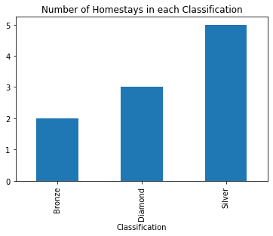
Graph3: Number of Homestays in Each Classification
sql_Query3 = "select a.propertyname, b.classification from property as
a, homestay as b where a.PropertyID = b.HSPropertyID "
cursor = project.cursor()
cursor.execute(sql_Query3)
HS_Class = cursor.fetchall()
print(HS_Class)
dataplot2 = pd.DataFrame(HS_Class, columns = ['Homestay_Name' , 'Classif
ication'])
print (dataplot2)

Slide 23
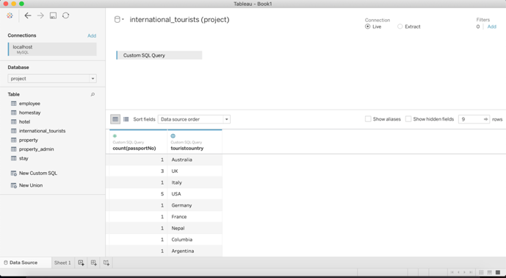
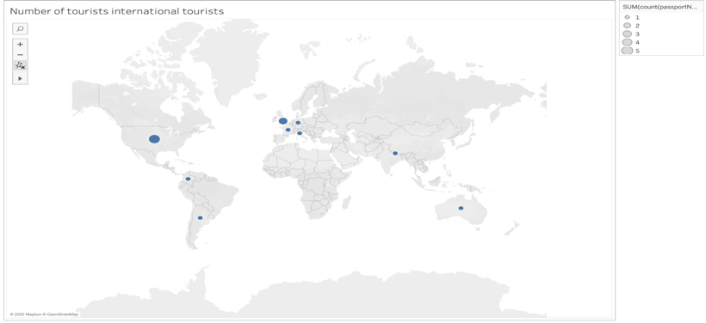
Interface with TableaU
The database was also linked to Tableau for geo-mapping of international tourists by running custom SQL Query on Database via Tableau

Slide 24
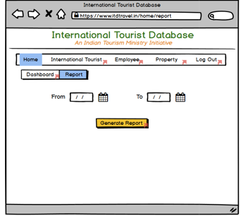
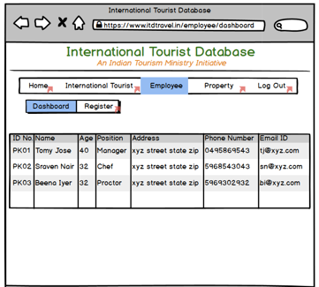
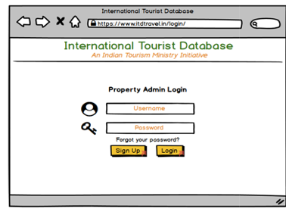
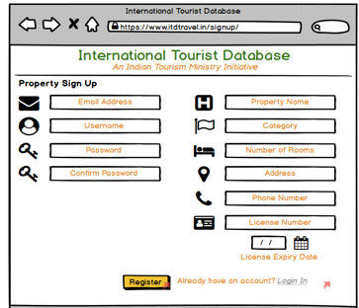
Graphical User Interface
A Graphical User (UX) Interface for the front-end of the database was created using Balsamiq Wireframes

Slide 25
Summary
The International Tourist database designed on MySQL is an industry ready relational database that can be implemented in the Indian tourism industry after adding Data Governance.
It will result in annual cost savings of $4.5M and improve the tourist data input process time by 50% and provides great analytics capabilities, a small part of which is shown in this report utilizing Python and Tableau.

