Slide 1


MrsGren MEMORY GAME by P Barnes

Slide 2
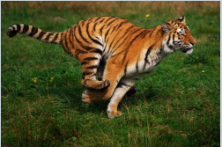

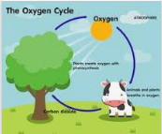
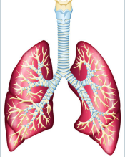
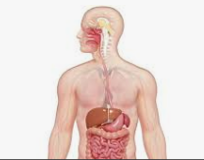
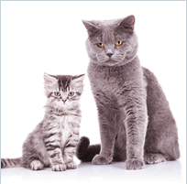
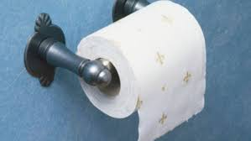
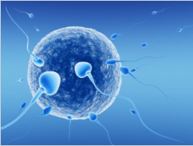
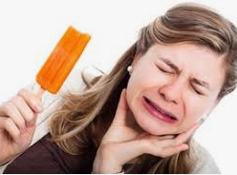
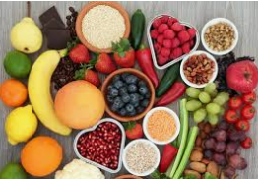
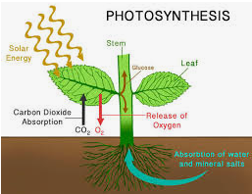
Growth
Sensitivity
1D
1A
1B
1C
Photo-
Synthesis
1E
Repro
duction
2B
2C
Movement
2A
2D
2E
Digestion
3A
3B
3C
Respiration
3D
3E
4A
Oxygen Cycle
4C
4D
Nutrition
4E
4B
Excretion

