Slide 1
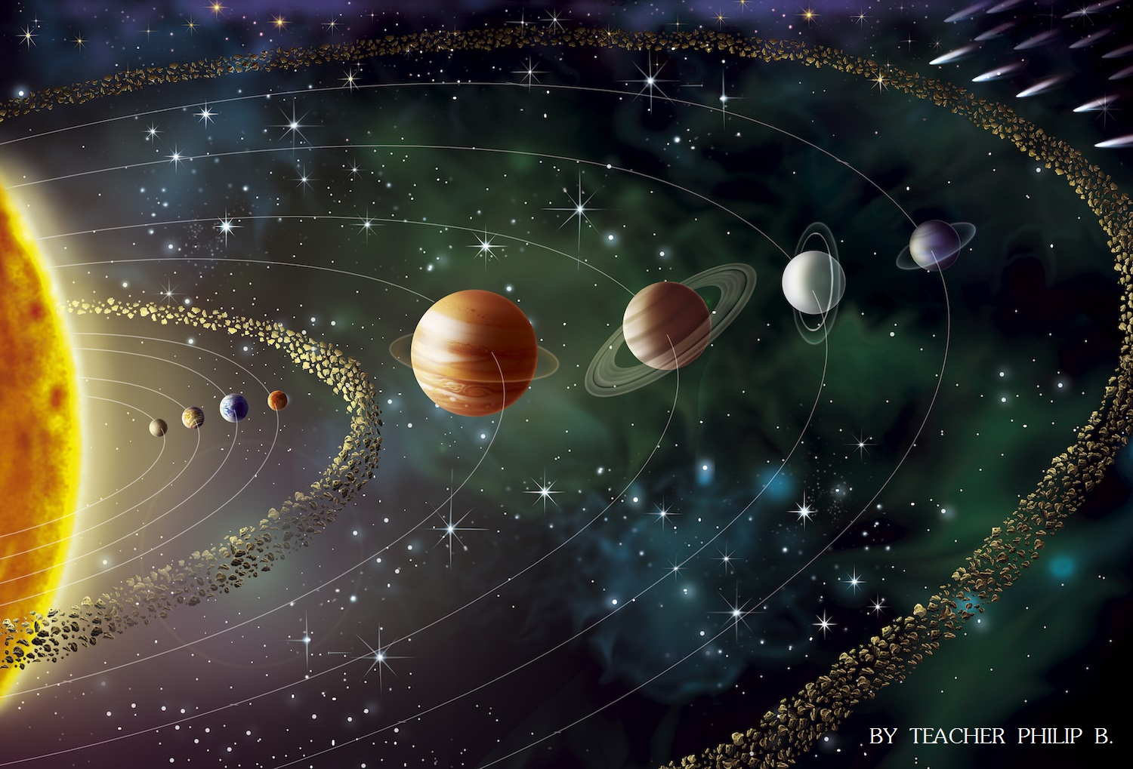
Memory Game
10 Common Elements in the Universe

Slide 2











1A
1B
Iron
1C
1D
Nitrogen
1E
Magnesium
2A
2B
Silicon
2C
2D
Helium
2E
3A
3B
Neon
3C
Hydrogen
3D
3E
Carbon
4A
4B
4C
4D
Sulfur
Oxygen
4E

