Slide 1
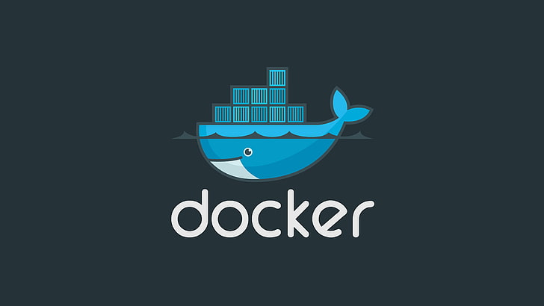

Slide 2
Docker
Docker is a set of platform as a service products that use OS-level virtualization to deliver software in packages called containers.

Slide 3
Why docker was born ?

Slide 4
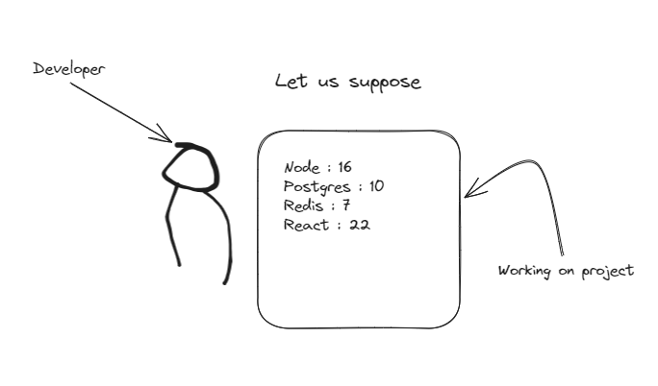

Slide 5
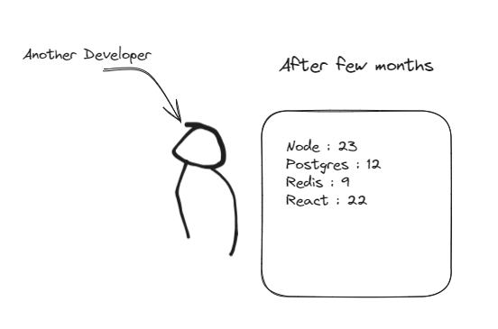

Slide 6
In this case the project might not work or run or any other problem may arise

Slide 7
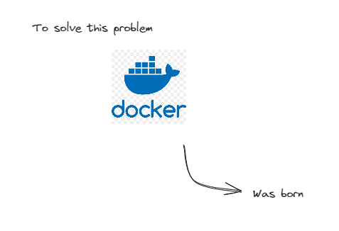

Slide 8
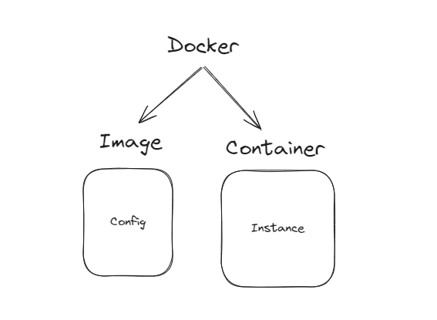

Slide 9
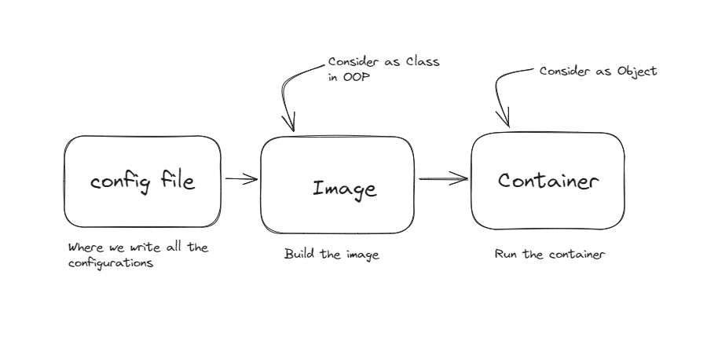

Slide 10
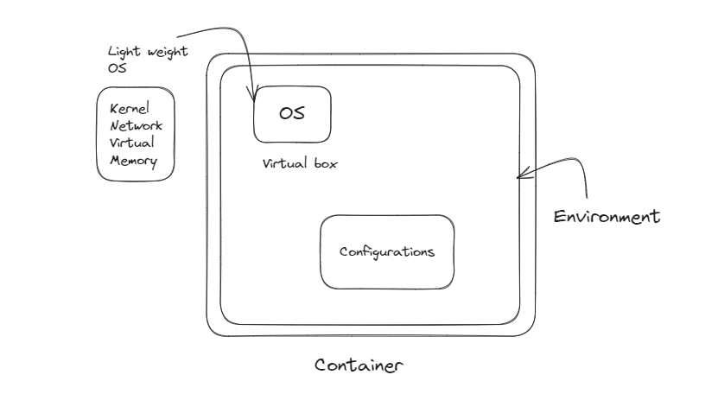

Slide 11
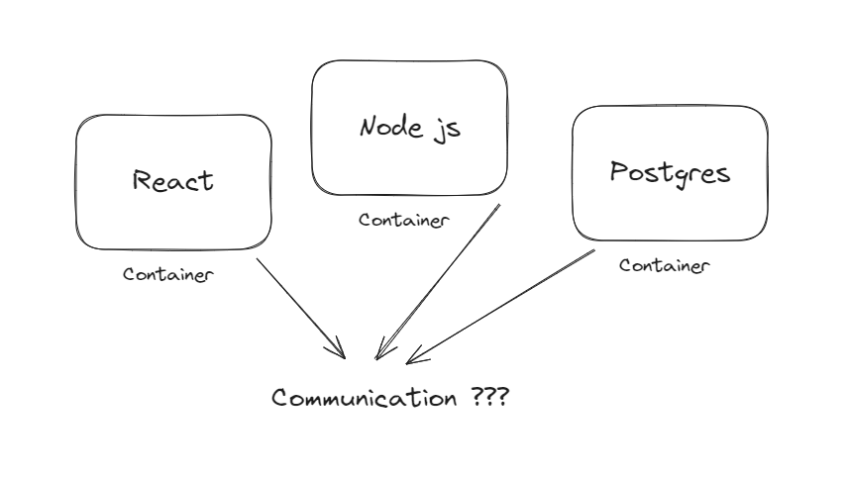

Slide 12
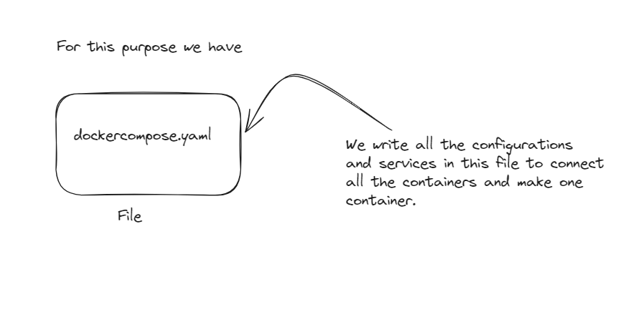

Slide 13
Docker Volume ??

Slide 14
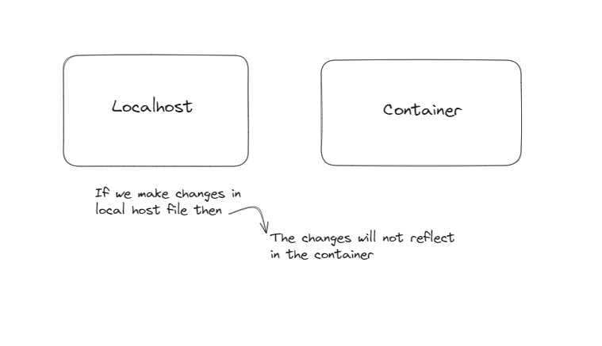

Slide 15
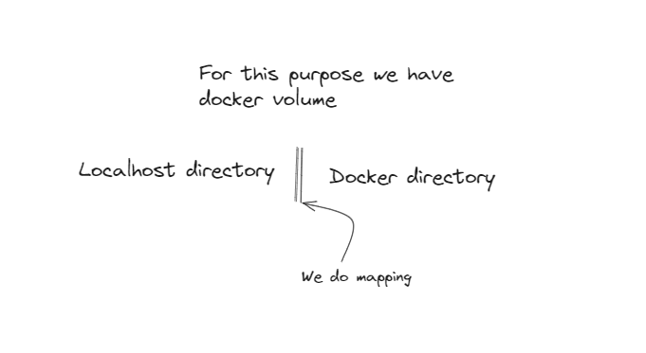

Slide 16

Any Queries ???

