Slide 1
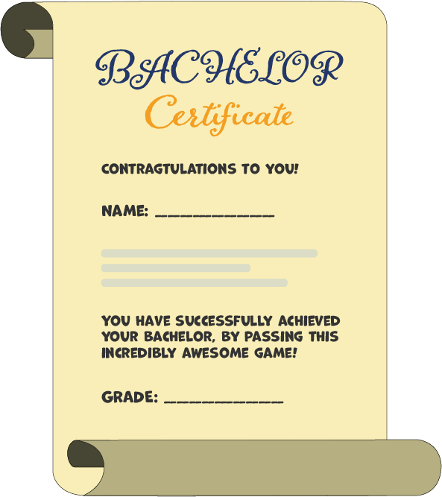
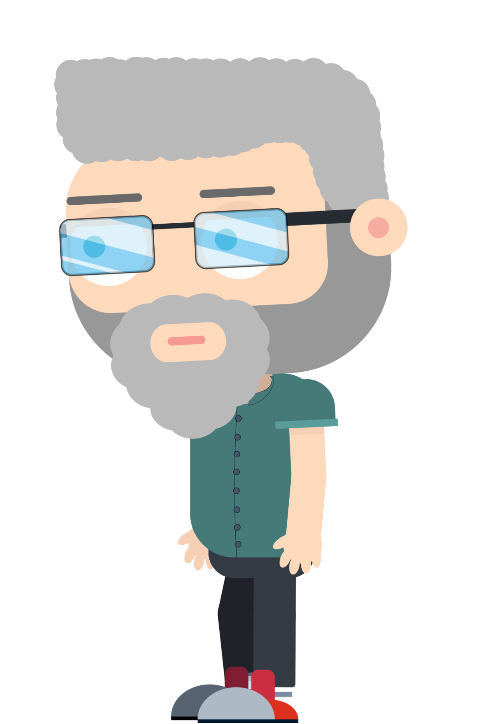
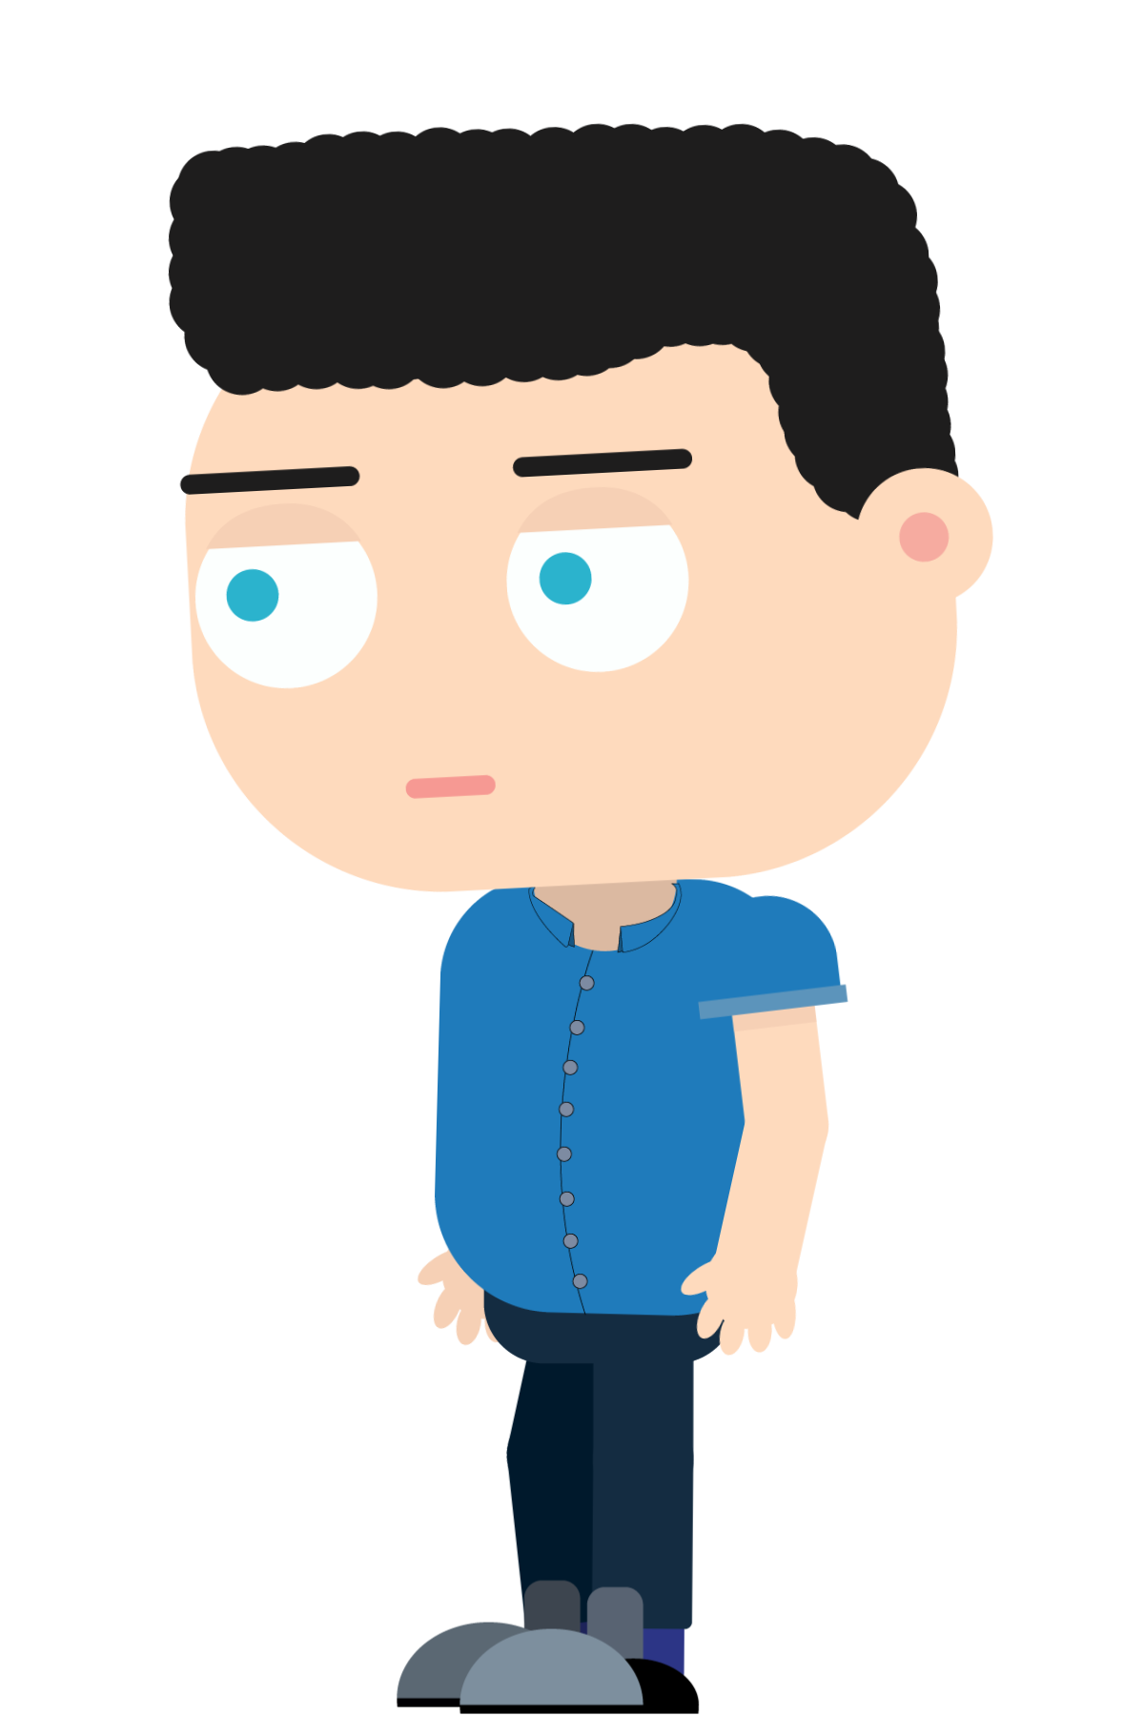
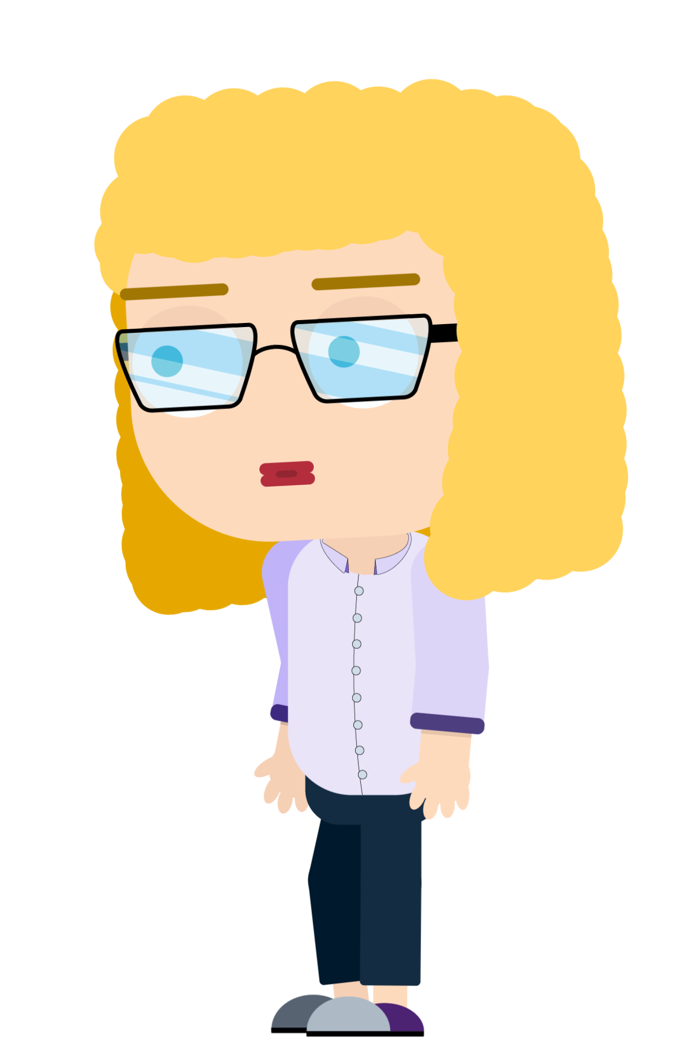
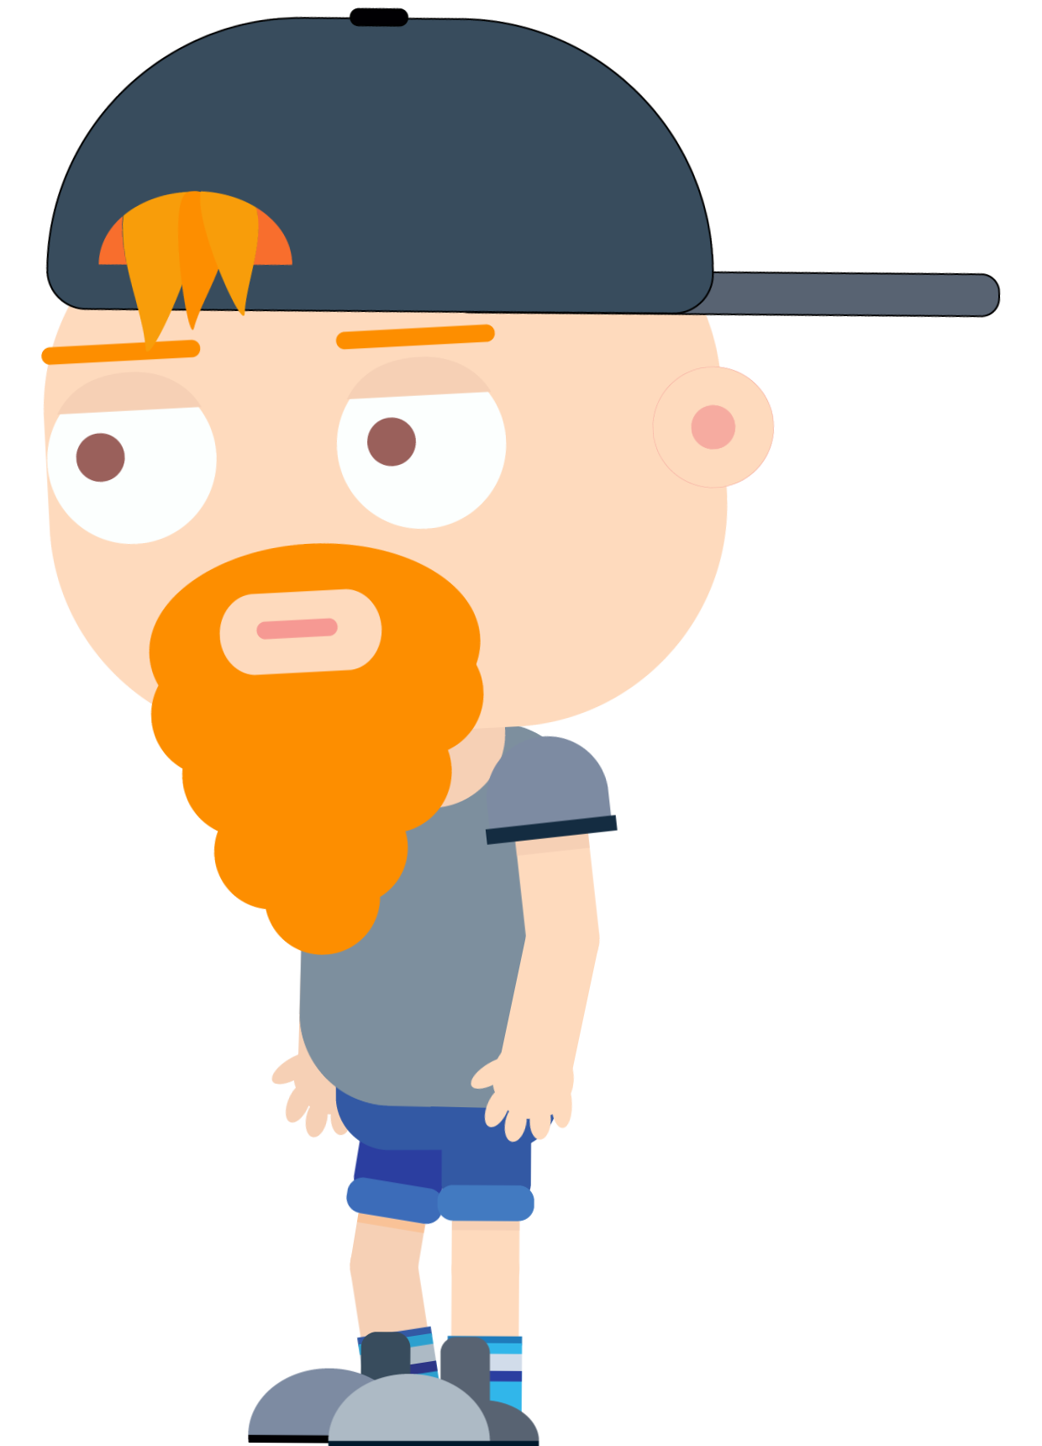
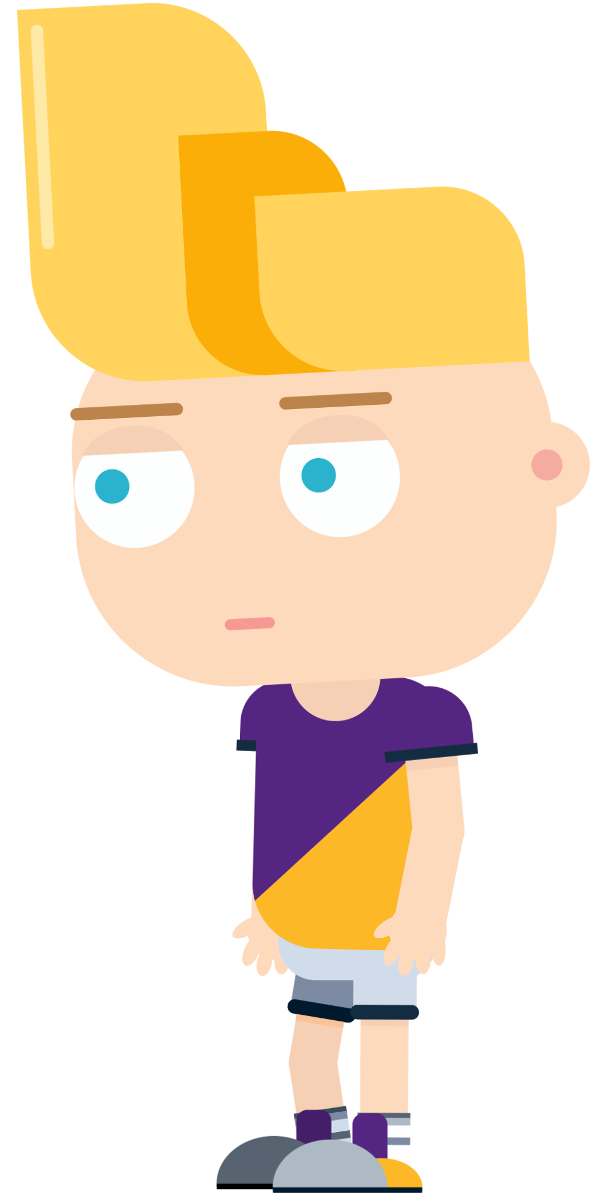
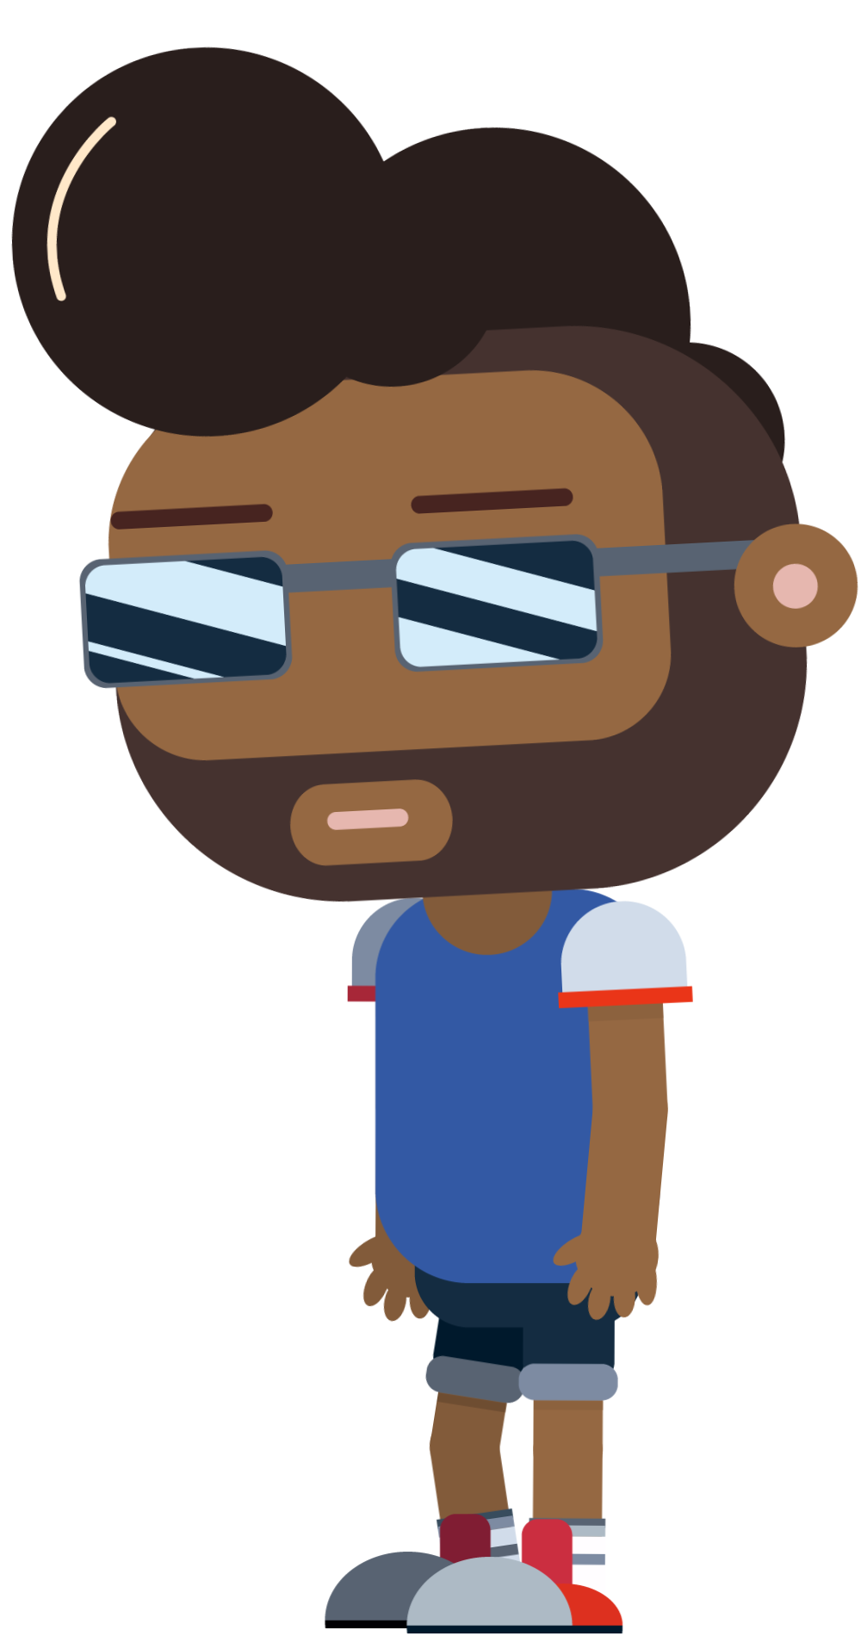
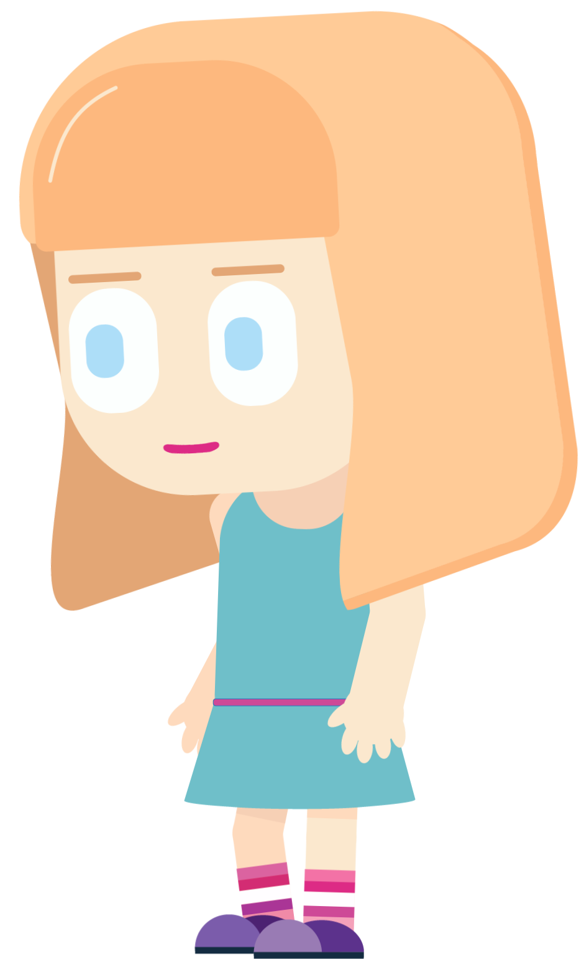
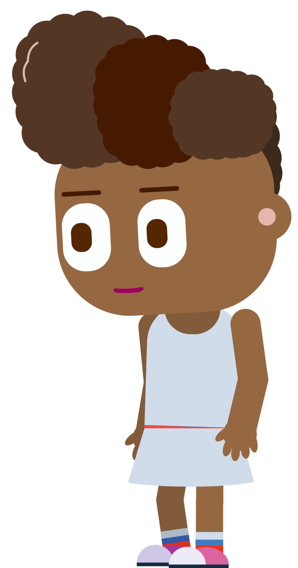
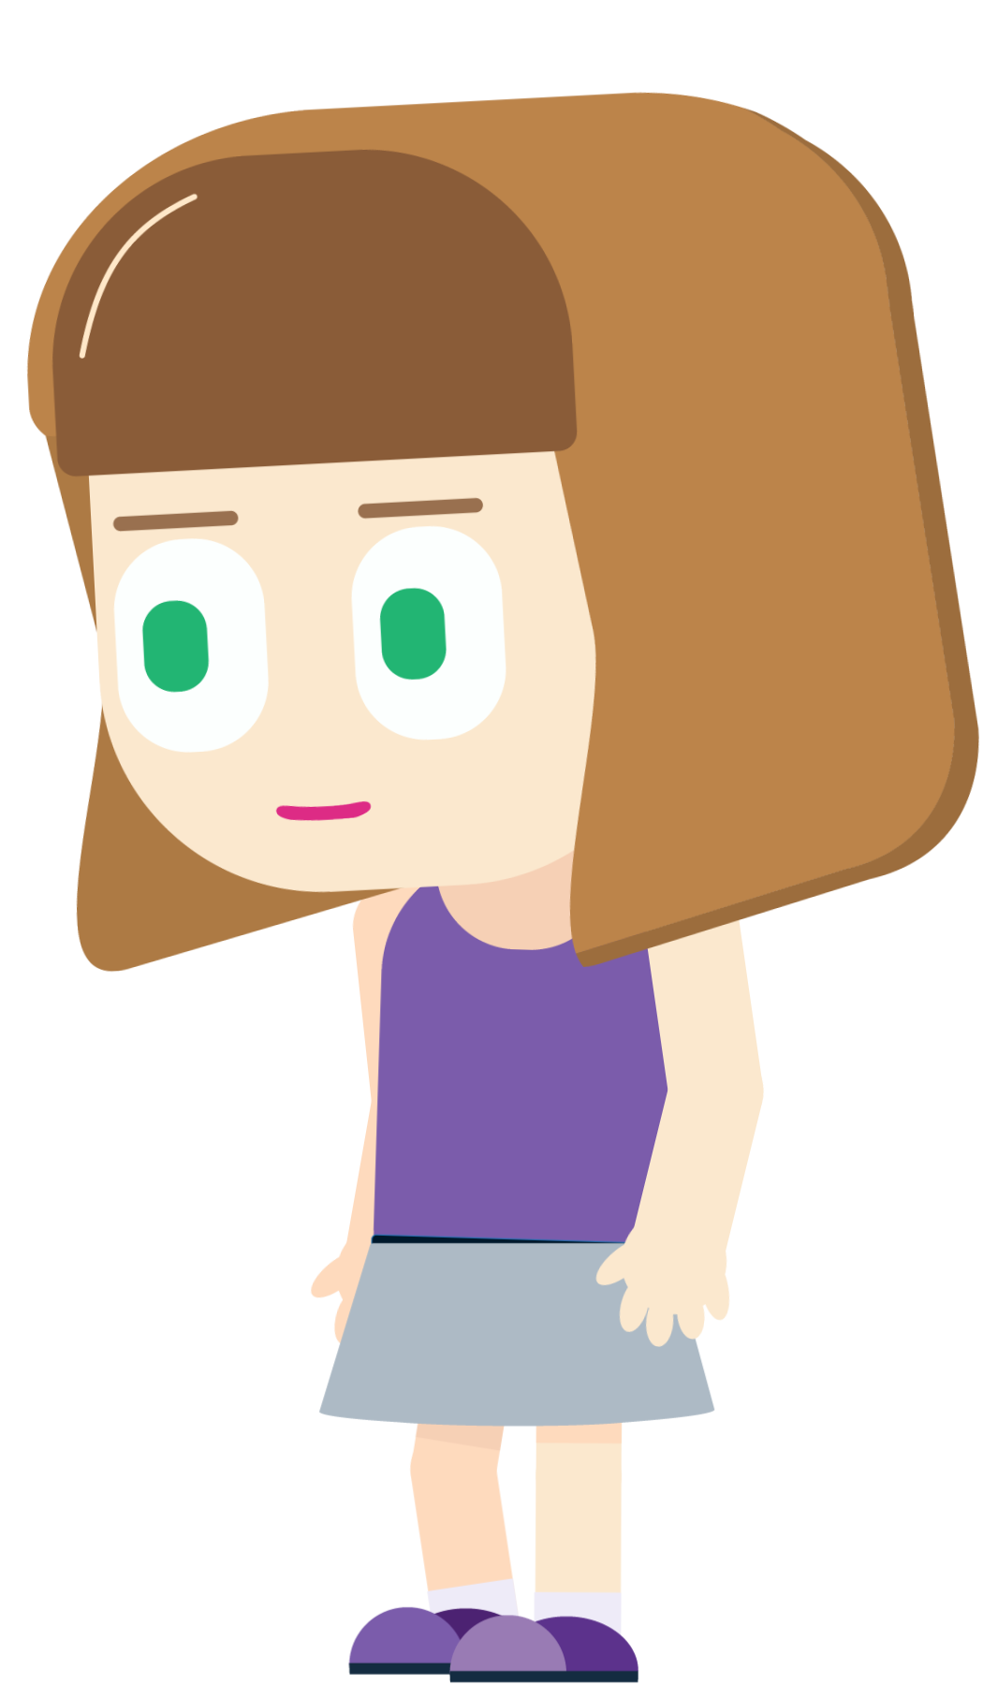
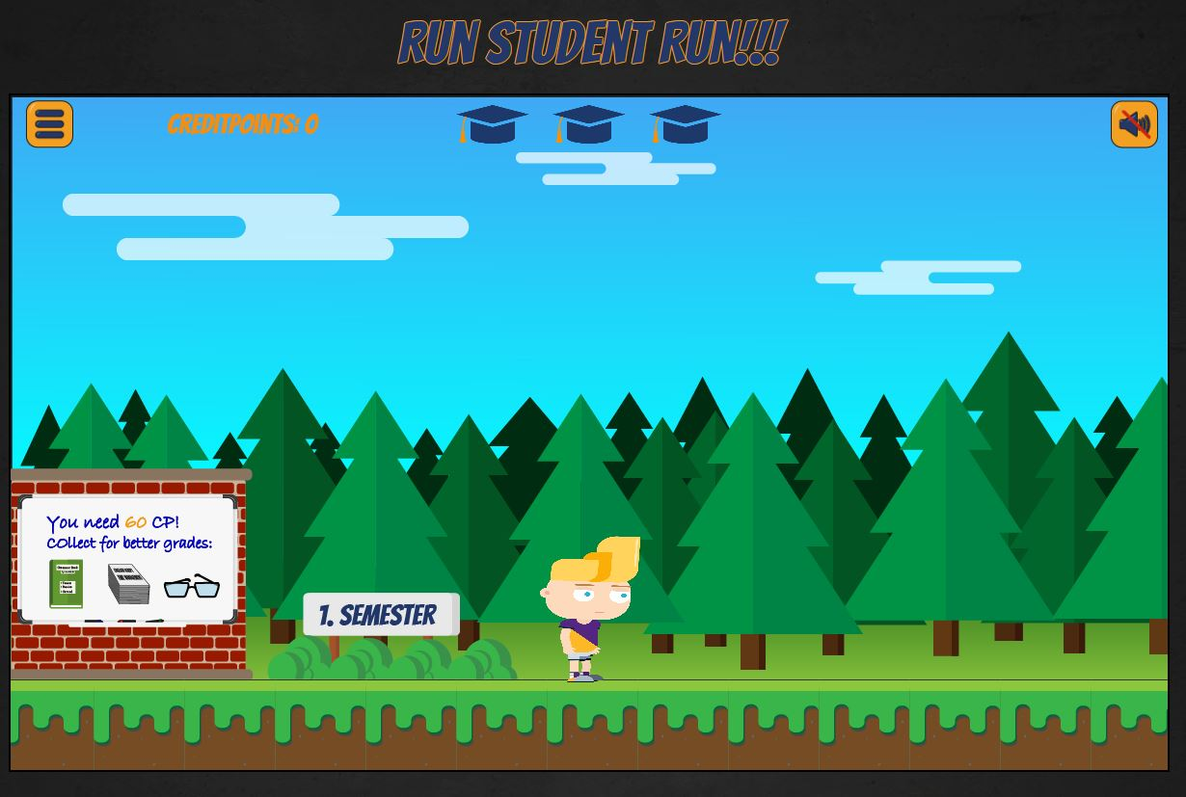
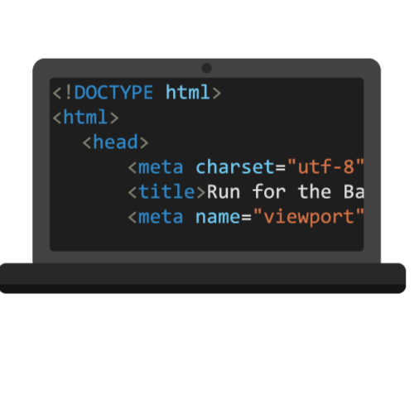

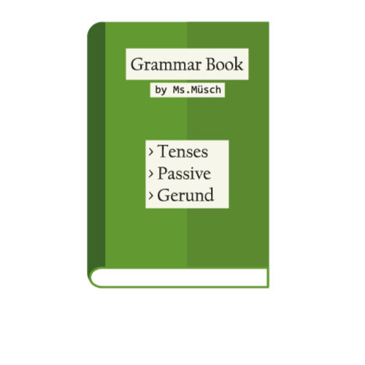


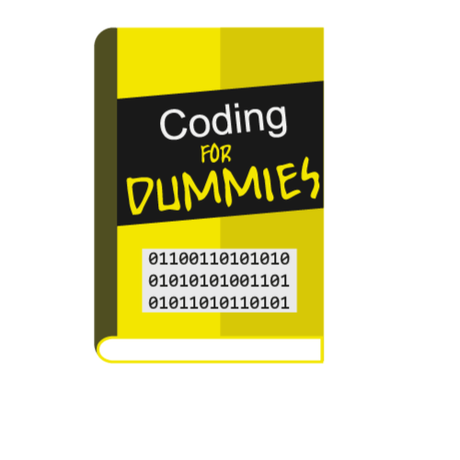
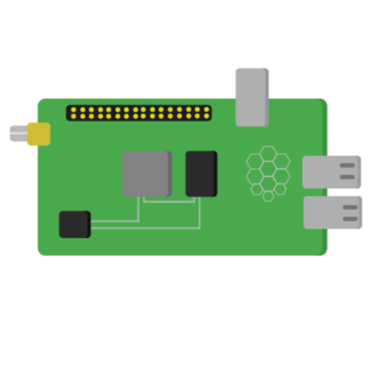


Run for the bachelor pitchslide
1. Level: City Run
2. Level: Jungle Run
3. Level: Space Run
4. Bachelor Degree achieved
GAME CONTENT
2. LEVEL: JUNGLE RUN
3. Level: Space run
NPC
Male student
Female student
Bäumle
-Courth
Brändle
Müsch
Boy1
Boy2
Boy3
Girl1
Girl2
Girl3
Characters
Obstacles
Canvas-built
3 Levels
Collectables
Explore not only the planet earth but also other planets!
Assets of the game
Tropical adventure
Different professor
Objects
Calculated CP
Select your favorite character
Lives
Adjusted obstacles
& collectables
Advanced
challenges
Performance-based grade
Who runs the best?
All assets designed by ourselves
Game music & sounds produced by us
100% SELFMADE
Different levels
Based on every student’ s life
Game introduction
The player is at the beginning of his “Bachelor Run” and he/she has to overcome the obstacles and find the collectables to reach the end and thus to absolve the Bachelor Degree.
Level goal
The goal in each level is to gain 60 CP. At the end of each level, the professor is waiting to congratulate the student for his accomplishments.
Level instruction
The student has 3 lives in total. If he/she looses all 3 lives, the game will restart. At the beginning of each level, collectables for a better grade are shown on the board.

